Slide 1
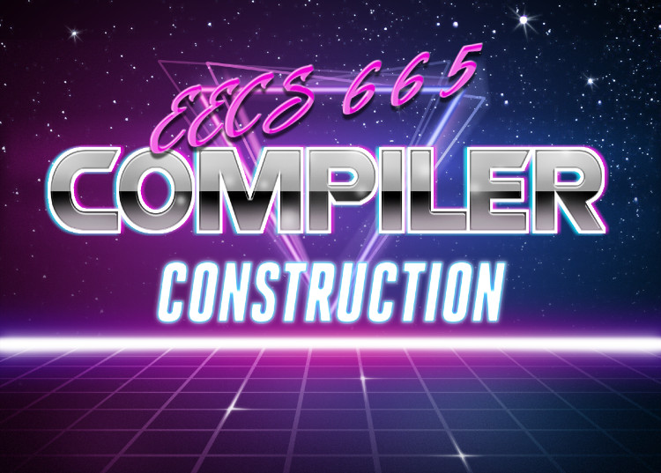
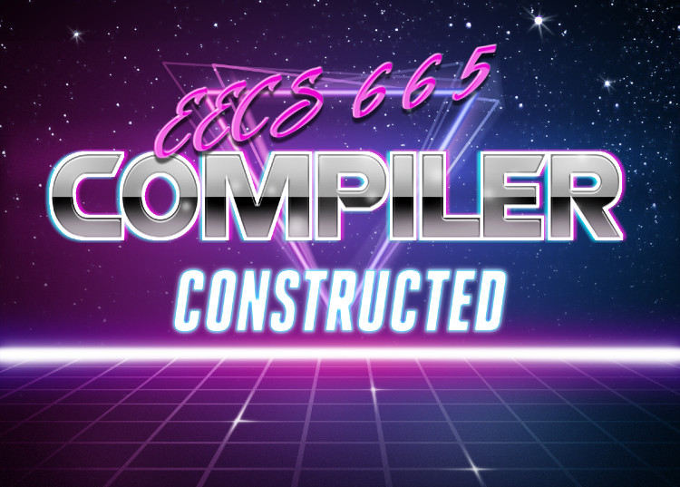
Beyond Compilers

Slide 2
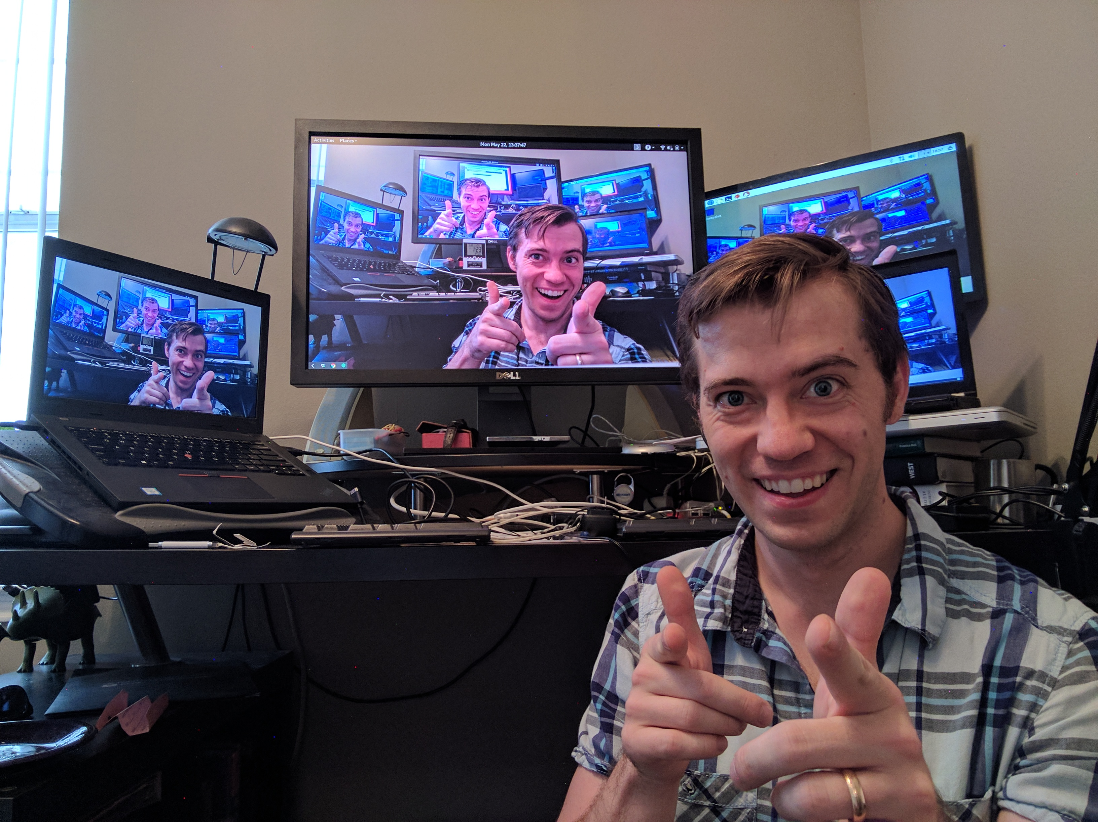
This Time
Lecture Outline
Beyond Compilers
Using compiler techniques for other stuff
Next Steps
Final Words
What next for EECS 665
Logistical wrap-up
Just Drew Talkin’

Slide 3

Compiler Techniques Outside Compilers
Beyond Compilation
Why Compilers Matters (maybe?)
i.e. why Drew is qualified to teach compilers
ac
Build a compiler
Anything else
???

Slide 4
This Lecture
Beyond Compilation
Lexical Analysis
Compiler Techniques
Lexing
Parsing
Syntax-Directed Translation
Semantic Analysis
IRs
Architecture
Utilities
RE
Compiler
Front end
Syntactic Analysis
Semantic Analysis
Middle end
IR
Codegen
IR Optimization
Back end
Final Codegen
Final Code
Optimization

Slide 5
Compiler Techniques Outside Compilers
Beyond Compilation
Lexical Analysis
Front end
Syntactic Analysis
Semantic Analysis
Middle end
IR
Codegen
IR Optimization
Back end
Final Codegen
Final Code
Optimization

Slide 6
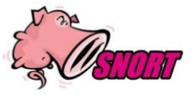
Signature Matching
Beyond Compilers
Regular-expression based matching of network traffic
Rather than producing tokens, produces actions
alert tcp $EXTERNAL_NET any -> $HTTP_SERVERS $HTTP_PORTS (msg:"WEB-IIS cmd.exe access"; flow:to_server, established; content:"cmd.exe"; nocase; classtype:web-application-attack; sid:1002; rev:5;)

Slide 7
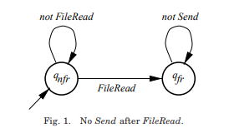
Policy Automata
Beyond Compilers
Enforce stateful policies on system call sequences
Expressible via finite state automaton

Slide 8
Compiler Techniques Outside Compilers
Beyond Compilation
Lexical Analysis
Front end
Syntactic Analysis
Semantic Analysis
Middle end
IR
Codegen
IR Optimization
Back end
Final Codegen
Final Code
Optimization

Slide 9
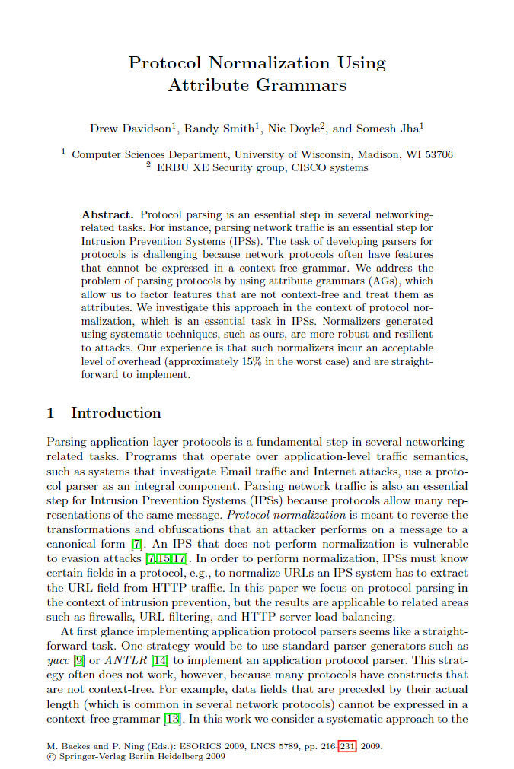
Protocol Normalization Using AGs
Beyond Compilation
Uses SDT to rewrite grammar to a canonical form
Actually uses BISON!
More PoC than production-ready code

Slide 10
Clang-Format
Beyond Compilation
Code (re)formatter
Ensures that all code in a project is of a consistent style

Slide 11
Compiler Techniques Outside Compilers
Beyond Compilation
Lexical Analysis
Front end
Syntactic Analysis
Semantic Analysis
Middle end
IR
Codegen
IR Optimization
Back end
Final Codegen
Final Code
Optimization

Slide 12
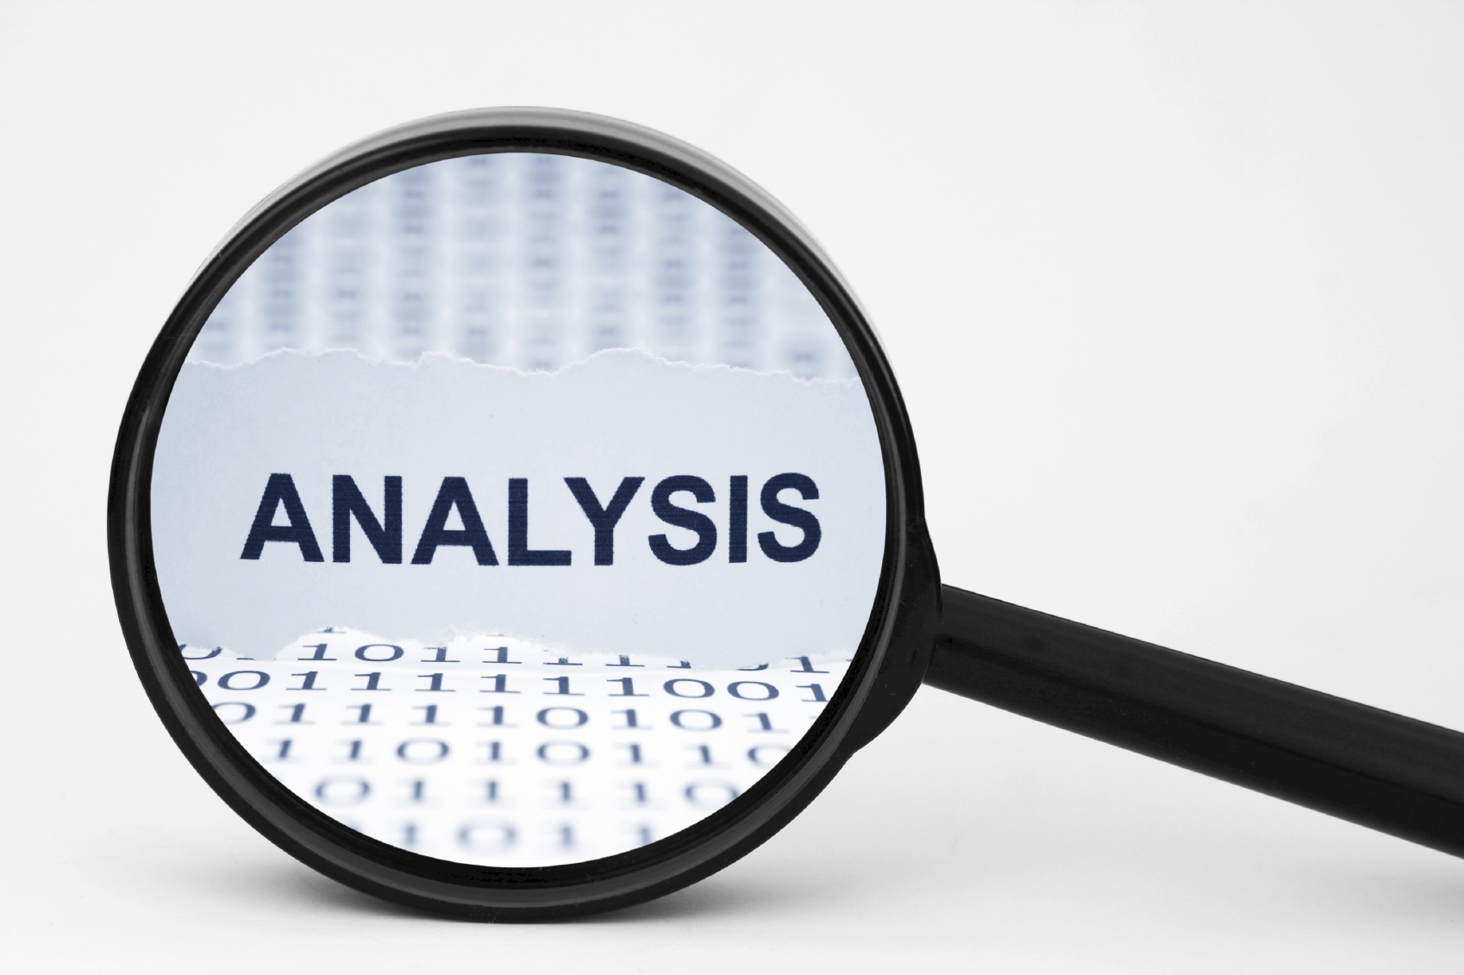
Static Analysis
Beyond Compilation
We did a bit already:
Typechecking
Data flow
We focused on faithfully translating program
But what about when the program is garbage?

Slide 13
Information Leakage
Beyond Compilation
We’d like to know if a program can leak secret/private data
It would be good to know that before running the program
Use static analysis!
  Can data that comes from a sensitive source reach an untrusted sink?

Slide 14
Static Instrumentation
Beyond Compilation
Add “reporting” to executables
Test suite line coverage: Is every line of the program exercised by the test suite?
Taint tracking: determine if user input is ever touching protected memory

Slide 15
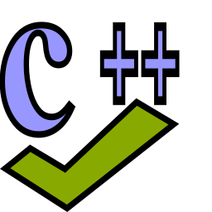
Static Analysis: cppcheck
Beyond Compilation
Tool for common CPP errors
Check for semantic errors / likely logic issues
Sorta like a standalone version of the warning phase of the compiler

Slide 16
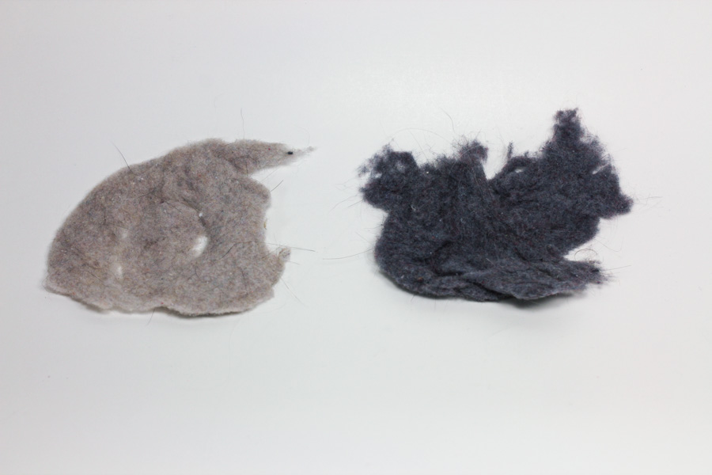
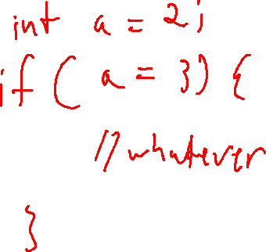
Linters
Beyond Compilation
Check source code for likely bugs
  cpplint
  pylint / flake8
  bandit
Dryer Lint (a different kind of lint)

Slide 17
Compiler Techniques Outside Compilers
Beyond Compilation
Lexical Analysis
Front end
Syntactic Analysis
Semantic Analysis
Middle end
IR
Codegen
IR Optimization
Back end
Final Codegen
Final Code
Optimization

Slide 18
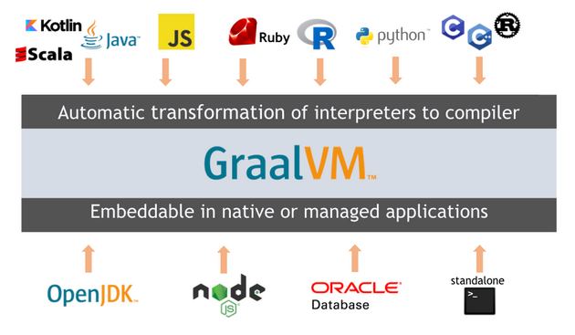
“Old School” Virtual Machines
Beyond Compilation
Abstract hardware architecture
Compile once, run anywhere

Slide 19
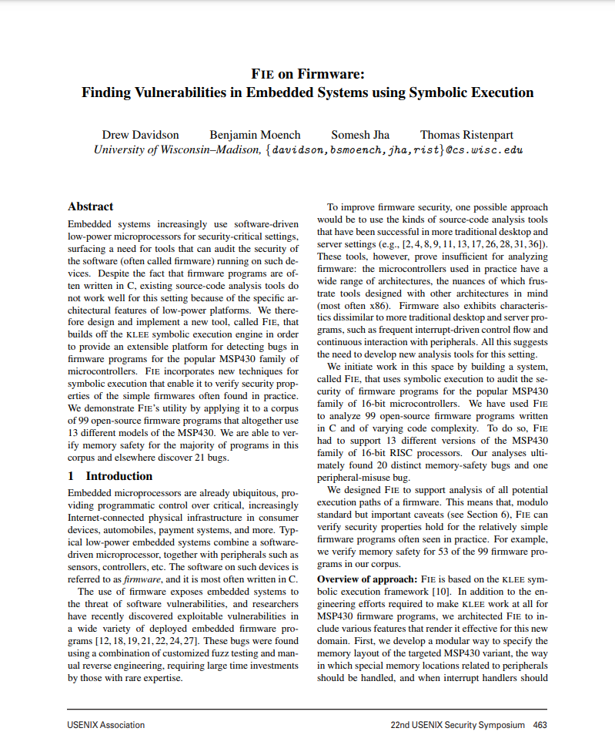
FiE on Firmware!
Beyond Compilation
Analyze behaviors of 100s of related IoT programs

Slide 20
Compiler Techniques Outside Compilers
Beyond Compilation
Lexical Analysis
Front end
Syntactic Analysis
Semantic Analysis
Middle end
IR
Codegen
IR Optimization
Back end
Final Codegen
Final Code
Optimization

Slide 21
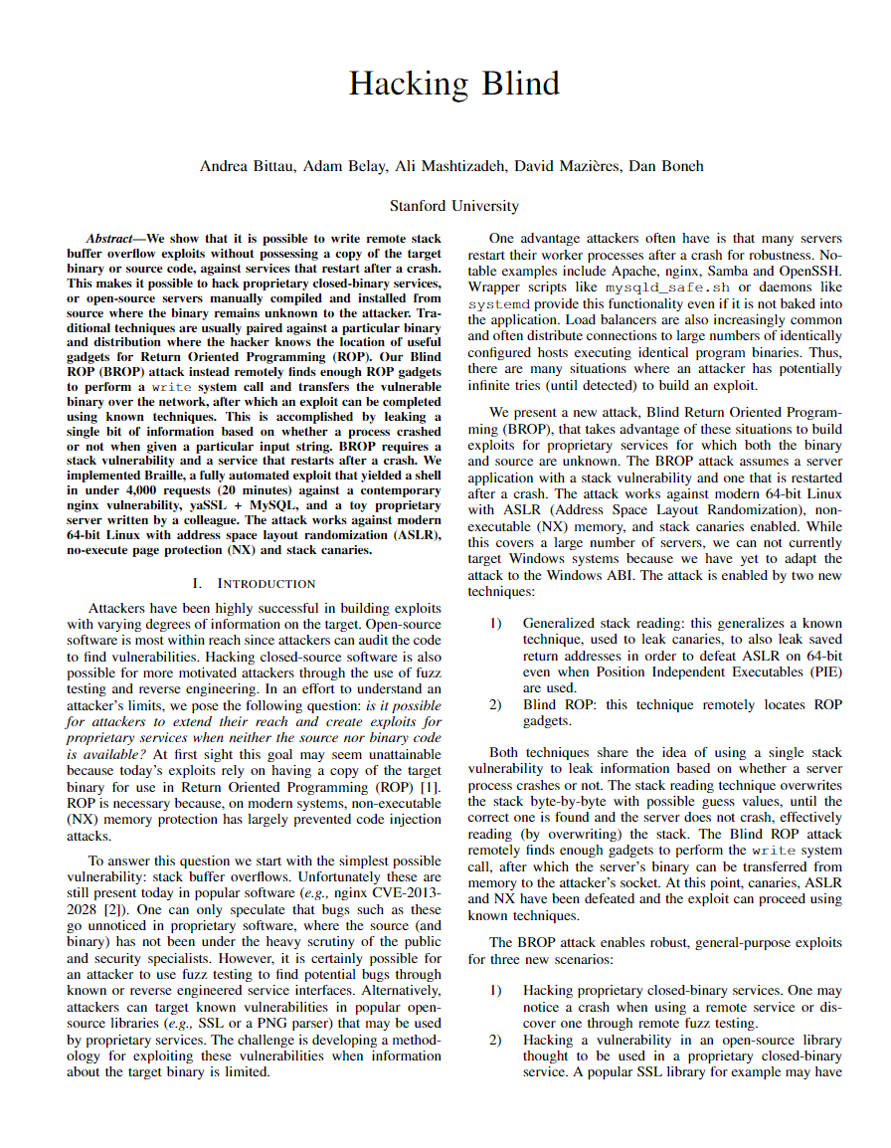
Assembly Code: Low Level Security
Beyond Compilation
Buffer overflows
ROP
  Blind ROP

Slide 22
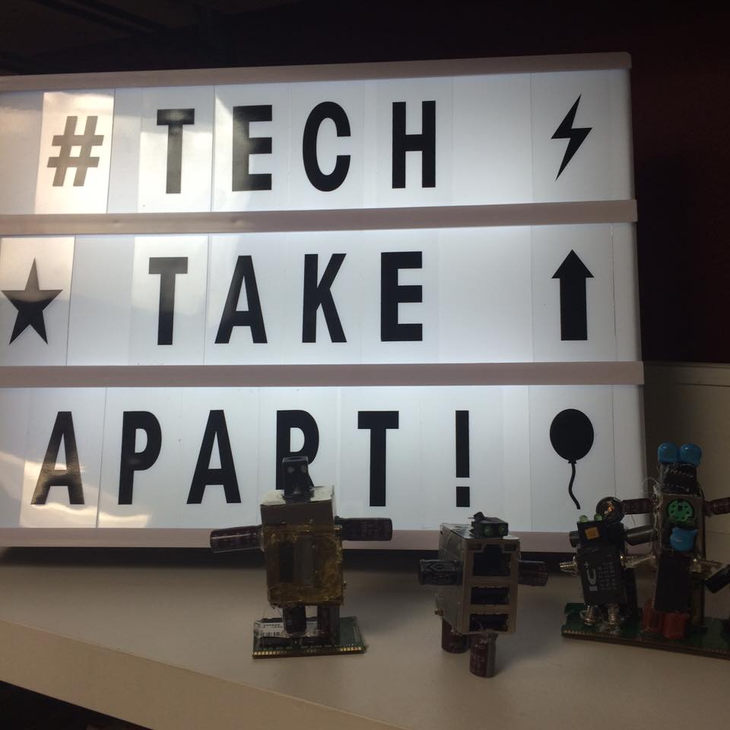
Decompilation
Beyond Compilation
Run the compiler toolchain in reverse
Binary to assembly
  (disassembler)
Assembly to source
  (decompiler)

Slide 23
Decompilation
Beyond Compilation
Run the compiler toolchain in reverse
Binary to assembly
  (disassembler)
Assembly to source
  (decompiler)
Popular tools
(Commercial)
(Free)
IDA Pro
Ghidra
Hex Rays

Slide 24
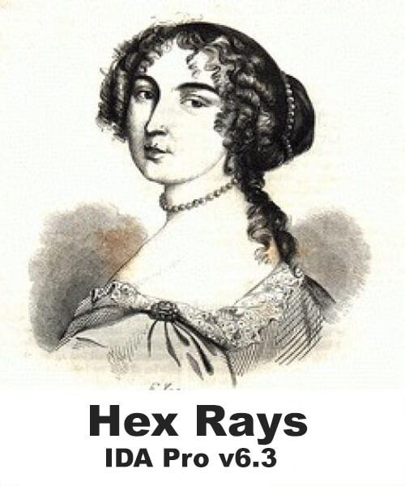

Reverse Engineering Tools
Beyond Compilation
IDA Pro
Long considered the best and tool by default
Builds CFG from binary
Ghidra
Developed by the NSA
Released (open source) April 4, 2019

Slide 25
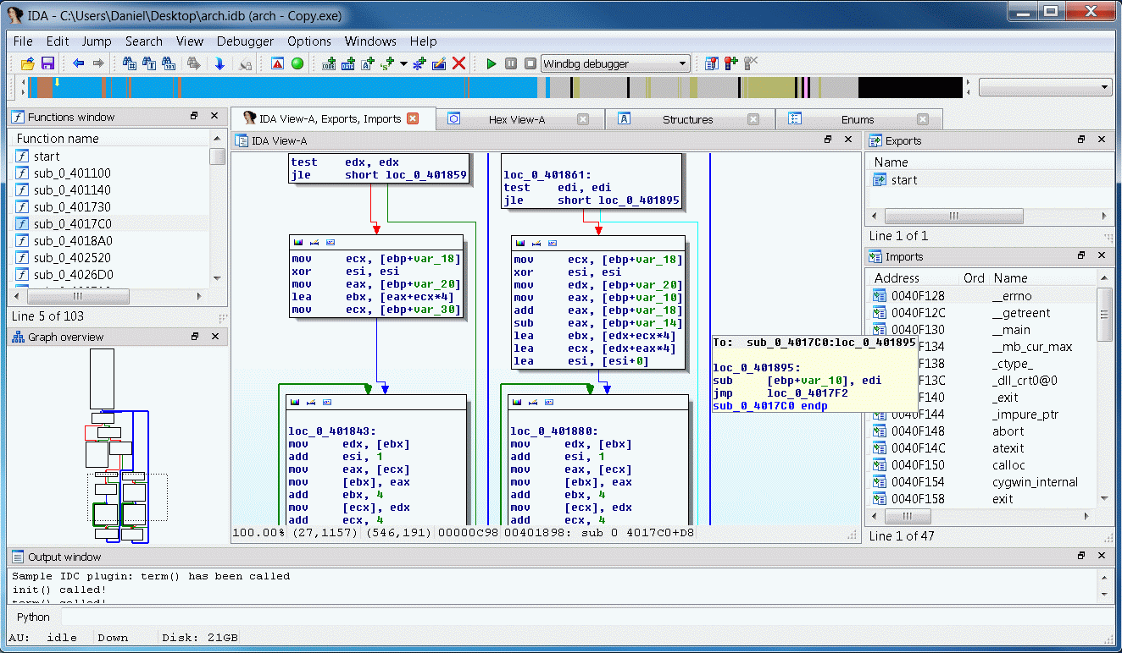
Reverse Engineering Tools
Beyond Compilation

Slide 26
Reverse Engineering Tools: Why?
Beyond Compilation
IP theft
(duh)
Ok, but what legit uses?
Malware analysis
Code “improvements”

Slide 27
Compiler Techniques Outside Compilers
Beyond Compilation
Lexical Analysis
Front end
Syntactic Analysis
Semantic Analysis
Middle end
IR
Codegen
IR Optimization
Back end
Final Codegen
Final Code
Optimization

Slide 28
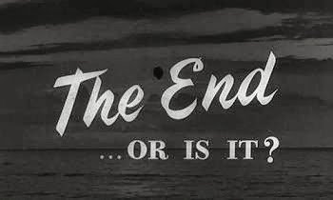

Slide 29

Where to go Next
Next Steps
Our compiler gives you a basic foundation:
There’s more to nearly every area of the course than what we covered
Hopefully this course serves as a framework for refinement

Slide 30

What We Didn’t Cover
Next Steps
Topics we glossed over:
Object oriented code
Many optimizations
Compiling non-imperative code
  Logic programming (e.g. datalog)
  Functional programming (Haskell et al)
We glossed over some topics

Slide 31

Is this Stuff Useful?
Next Steps
From what we’ve covered:
I bet you have could invent a programming language
I hope you have a deeper understanding of how programs work
I think you gained some tools in your toolbelt

Slide 32
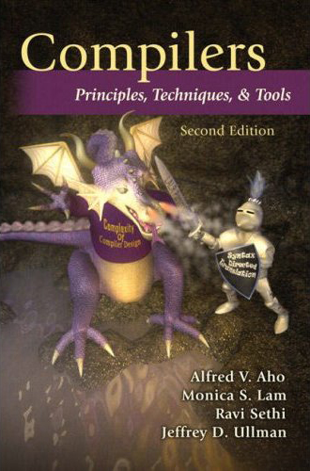
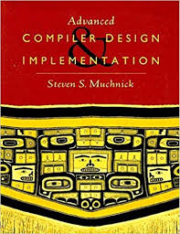
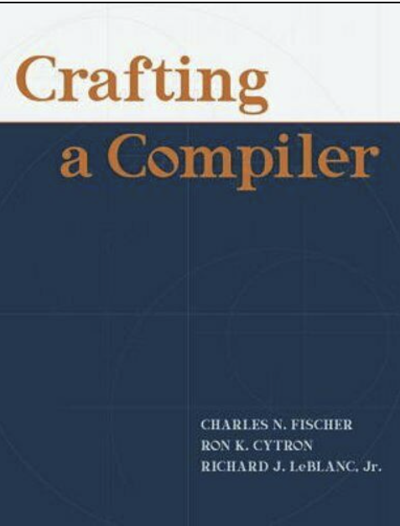
Continuing the Journey
Beyond Compilation: Next Steps
If you like compiler construction
Classic compilers texts
  Compilers: Principles, Techniques and Tools
    Aho, Lam, Sethi, and Ullman
  Advanced Compiler Design & Implementation
    Munchnick
  Crafting a Compiler
    Fischer and Cytron
Cutting Edge Developments
  SIGPLAN Proceedings
  LLVM Docs

Slide 33

Continuing the Journey
Beyond Compilation: Next Steps
If you like compiler construction
Classic compilers texts
  Compilers: Principles, Techniques and Tools
    Aho, Lam, Sethi, and Ullman
  Advanced Compiler Design & Implementation
    Munchnick
  Crafting a Compiler
    Fischer and Cytron
Cutting Edge Developments
  SIGPLAN Proceedings
  LLVM Docs
If you dislike compiler construction
Sorry ☹

Slide 34










Maybe the real Compilation…
was the friends we made along the way
Regular
Languages
Lexical
Analysis
Context-Free
Grammars
Syntactic
Analysis
Syntax-Directed
Translation
Semantic
Analysis
Intermediate
Representations
Hardware
Architecture
Machine
Code
Optimization /
Program Analysis

Slide 35

Unfinished Business
My Final Words
Grades:
Project Grades forthcoming
Curve:
Projects may be individually curved
Minimal curve will be out in time for the final

Slide 36

Official Course Evaluations
My Final Words
Your chance for a performance review
I review these every semester
The department chair reviews these every semester
Please do them!
There are 2 surveys
  University
  Department

Slide 37
Unofficial Course Evaluations
My Final Words
https://compilers.cool/final-survey
Things you should know:
Still completely anonymous
I won’t look at the responses until after grades are assigned
Less about absolutes than improvement:
Don’t worry about my feelings
Just for me (though I might pull quotes for future semesters)

Slide 38
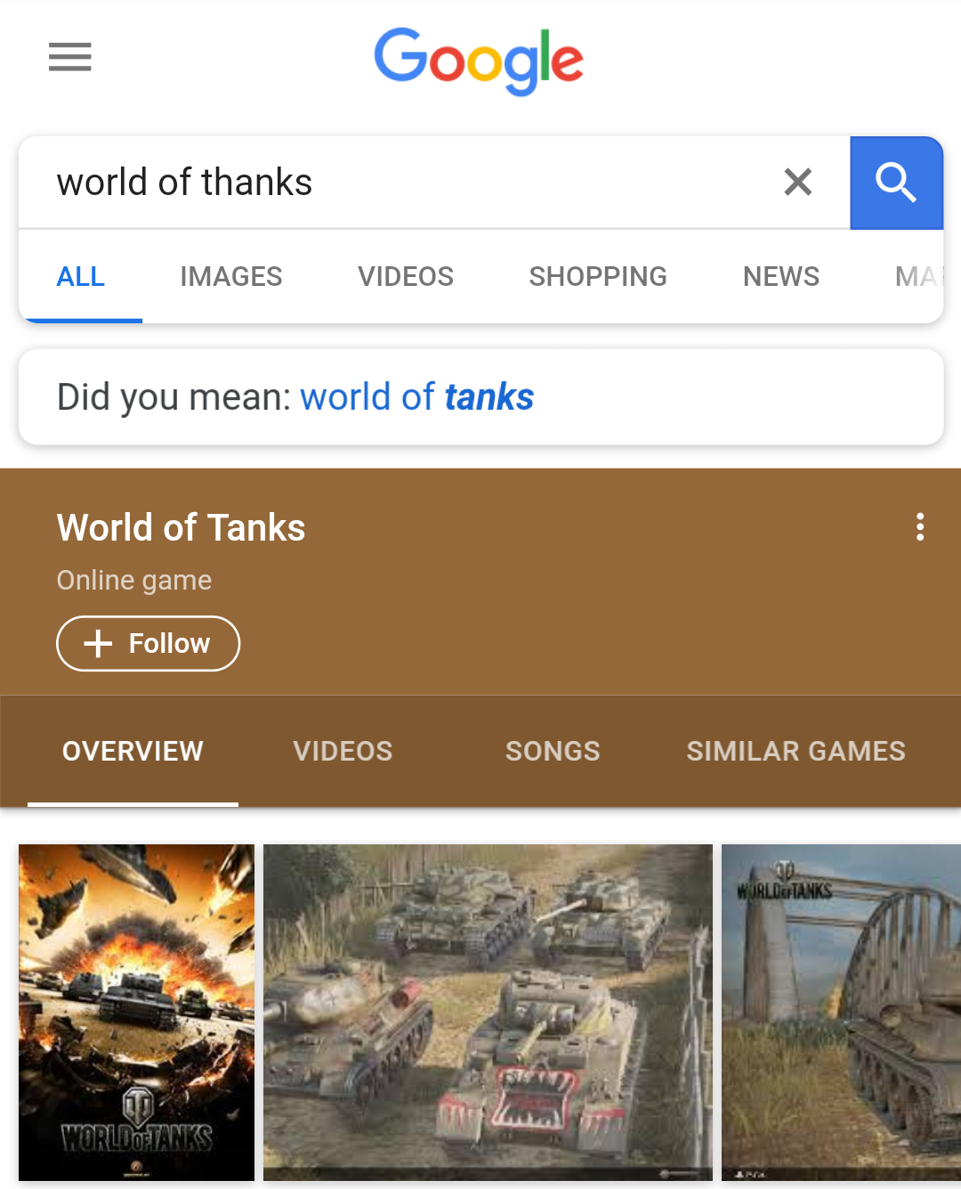
A World of Thanks!
Special thanks to people who asked/answered questions in class or on Piazza
Extra special thanks to people who suggested improvements and gave feedback
No Google. I did not mean “World of Tanks”

