Slide 1
Quiz 4 Review Session

Slide 2
Calling conventions
Callee saved/caller saved registers
Stack alignment
Compiler Toolchains
Assemblers
Linkers
Loaders
Control Flow Graphs
Basic Blocks
Edge Types
Dominators
Static Single Assignment (SSA) Form
Φ-nodes
Dataflow
Dead Code Elimination
Constant Folding
Copy/Constant Propagation
Final Code Optimization
Peephole optimization
Interference graphs
Register allocation
Instruction selection
Instruction strength reduction
Heap Management
Allocating Heap Memory
Garbage Collection
  Reference Counting
  Mark and Sweep

Slide 3
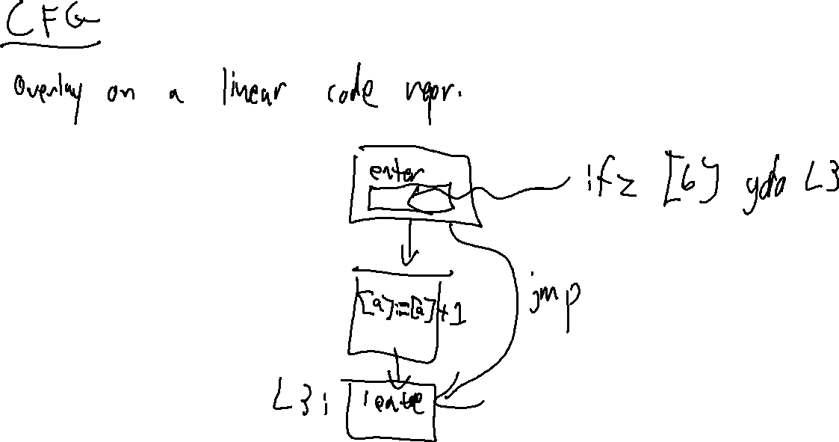

Slide 4
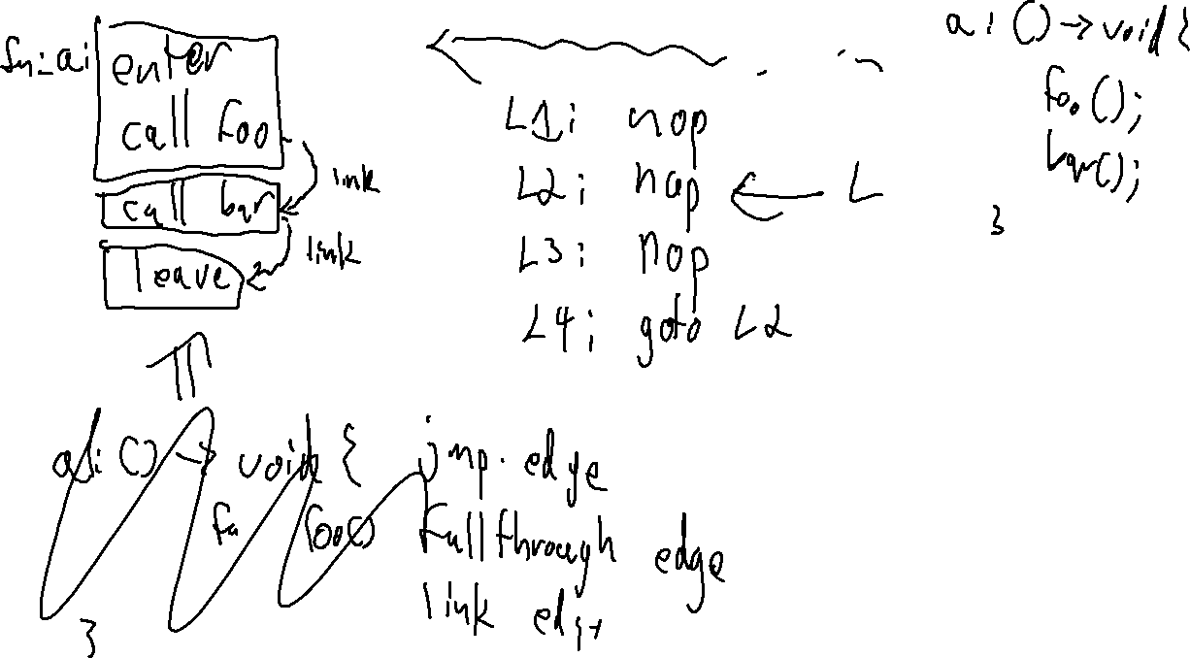

Slide 5
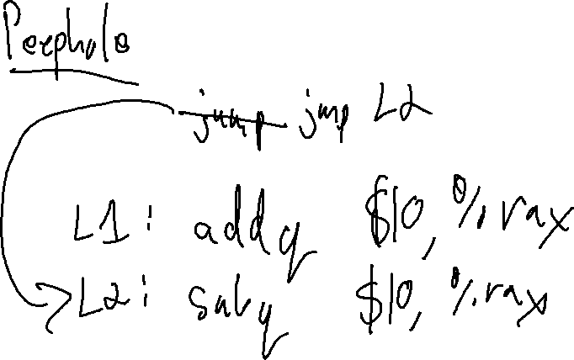

Slide 6
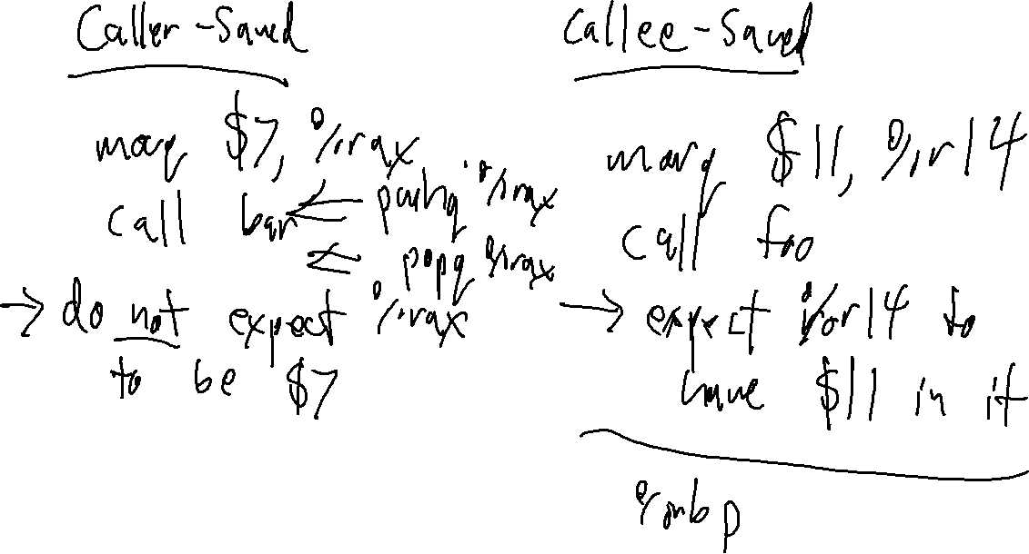

Slide 7
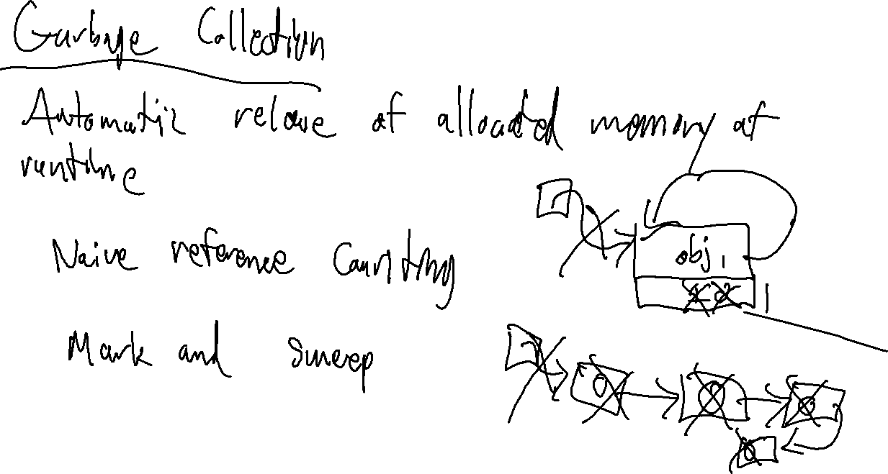

Slide 8
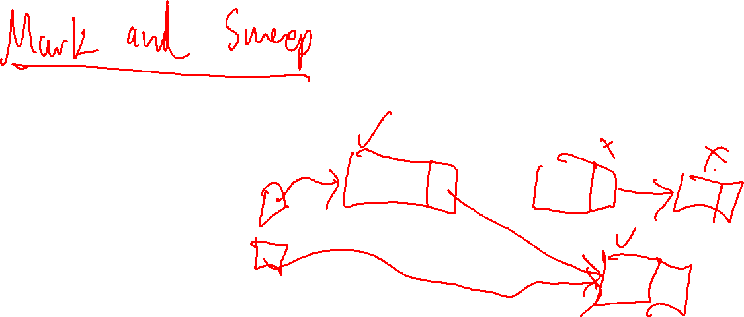

Slide 9
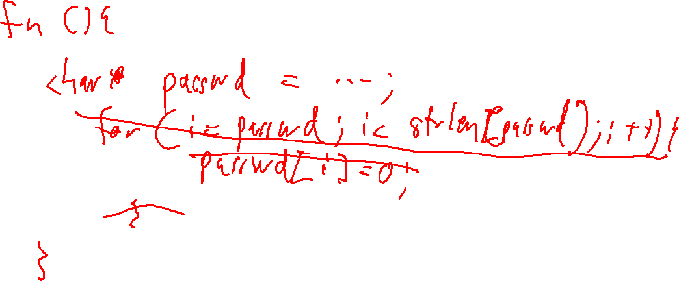

Slide 10
