Slide 1
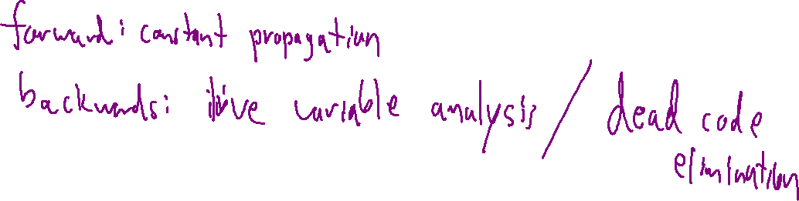
Check-in
Review: Dataflow
Give an example of a forward dataflow analysis and an example of a backward dataflow analysis.

Slide 2
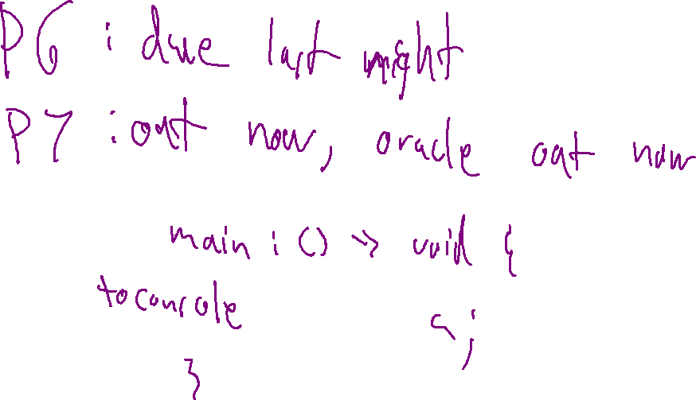
Announcements
Review: Dataflow

Slide 3

Abstract Interpretation
Drew Davidson | University of Kansas

Slide 4

Previously…
Review: Dataflow
Global Dataflow analysis
Intuition
Operations
You should know
The basic concepts of dataflow facts
  Backwards and Forward analysis
  Augment local analysis with “IN” and “OUT” sets
  You need to merge fact sets
Optimization

Slide 5
Merging Fact Sets
Dataflow Intuition
Fact sets may be different when multiple successors/predecessors join
Need to merge incoming fact sets
Merge as conservatively as possible
Don’t do anything without a guarantee!
Plan for all possible flows
Example: is L3 live? (consider both block paths)
L3 definition clobbered on the fallthrough branch (at L5)
L3 definition not clobbered on the jump branch
L1:
enter
a: 💀, b: 💀
getarg 1, [a]
a: 💀, b: 💀
L2:
getarg 2, [b]
a: 😊, b: 💀
L3:
a: 😊, b: 😊
L4:
ifz [a] goto L7
a: 😊, b: 😊
a: 😊, b: 💀
L5:
[b] := 4 * [a]
jmp
a: 💀, b: 😊
L8:
OUTPUT [b]
a: 💀, b: 😊
L9:
leave
a: 💀, b: 💀
a: 💀, b: 💀

Slide 6
Today’s Outline
IR Optimization
Rounding out dataflow analysis concepts
Some more examples
Considering more complex code
Dataflow Framework
Abstract Interpretation
Concepts
Examples
Optimization

Slide 7
Refresh Constant/Copy Propagation
Dataflow: Formalization
Copy Propagation
x := 1
x := 1
Replace RHS of simple assigns with value of assign (if known)
y := x
y := 1
Forward analysis
z := x + y
z := 1 + 1
x := 3
x := 3
Constant folding
Replace constant RHS expressions with value
Traversal order isn’t important
x := 1
x := 1
y := 1
y := 1
z := 1 + 1
z := 2
x := 3
x := 3

Slide 8










Example Analyses
Dataflow: Formalization
Dead Code Elimination
Backwards analysis
Fact sets: the liveness of each variable
Merge:
Constant Propagation
Forward analysis
Fact sets: the known value of each variable
Merge:
Known Live | Known Dead | Not Enough Info
Set of Known Values | Not Enough Info
😊
💀
🤷
{<value>, <value2}, …
🤷
😊
$$∪$$
💀
$$=$$
😊
Set Union
😊
🤷
😊
{ 1 }
$$∪$$
{ 1,2 }
$$=$$
{ 1,2 }
$$∪$$
$$=$$
💀
$$∪$$
🤷
$$=$$
🤷
…except
{ * }
$$∪$$
🤷
$$=$$
🤷

Slide 9
Example Constant Propagation
Dataflow: Formalization - Example
B1:
B1 | x | y | z
IN
OUT
What values can x take on at B6?
[y] := 0
ifz [t1] goto B2
🤷
🤷
🤷
🤷
🤷
🤷
{0}
jmp
B2 | x | y | z
IN
OUT
B2:
🤷
🤷
🤷
[x] := 2
ifz [t2] goto B4
{0}
B3:
🤷
🤷
🤷
{2}
{0}
x := 2
x := 0
goto B6
B3 | x | y | z
IN
OUT
🤷
🤷
🤷
B4:
{0}
B4 | x | y | z
IN
OUT
🤷
🤷
🤷
jmp
[x] := [y]
ifz [t3] goto B6
{0}
{0}
🤷
🤷
🤷
{2}
{0}
🤷
🤷
🤷
{0}
{0}
B5:
jmp
B5 | x | y | z
IN
OUT
🤷
🤷
🤷
[x] := 0
jmp
{0,2}
{0}
🤷
🤷
🤷
{0}
{0}
B6:
B6 | x | y | z
IN
OUT
[z] := [x]
0
🤷
🤷
🤷
{0}
{0}
🤷
🤷
{0}
{0}
{0}

Slide 10
Today’s Outline
IR Optimization
Rounding out dataflow analysis concepts
Some more examples
Considering more complex code
Instantiating Dataflow Framework
Abstract Interpretation
Concepts
Examples
Optimization

Slide 11
Handling Practical Programs
Global Dataflow: Formalization
Global variables
We only have visibility into 1 procedure
Be conservative about the effect of other procedures
  Reset fact sets across a call
  Consider global variables live at function end

Slide 12

Analysis Termination
Dataflow: Formalization
In the previous examples, we completed in one pass over the CFG
This won’t always be the case, due to a fundamental construct…

Slide 13
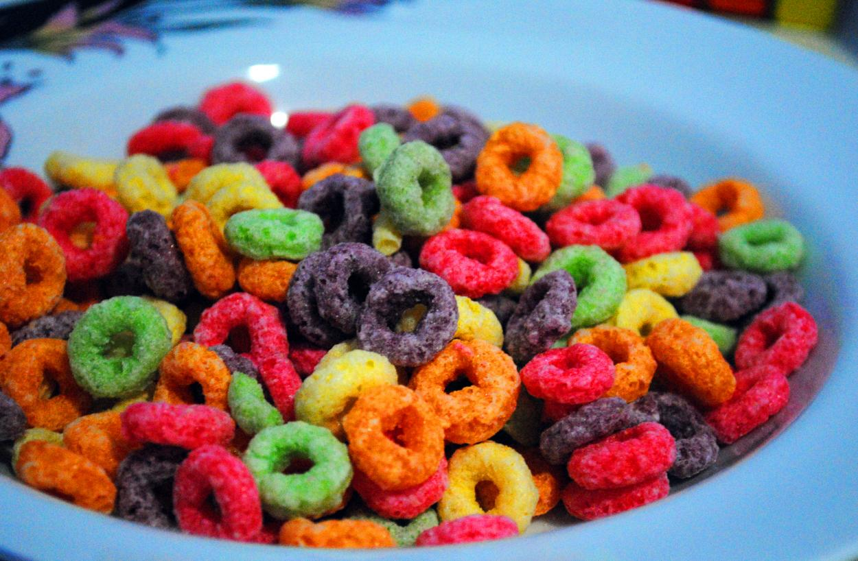
Analysis Termination
Dataflow: Formalization
In the previous examples, we completed in one pass over the CFG
This won’t always be the case, due to a fundamental construct…
Loops (specifically back edges) create cyclic dependencies
loops
Oh bröther, you might have some lööps

Slide 14
Loops: Dependency cycles
Dataflow: Formalization
Constant propagation
IN(B2) requires knowing OUT(B2)
Solution: Saturate fact sets
Start sets “TBD” (🤷) value
Run the algorithm until sets don’t change
We’ve seen the saturation approach before
(FIRST and FOLLOW sets)
OUT(B2) requires knowing IN(B2)
B1: enter
[x] := 3
B1 | x | y
IN
OUT
B1 | x | y
IN
OUT
B1 | x | y
IN
OUT
🤷
🤷
🤷
🤷
🤷
🤷
🤷
🤷
{3}
🤷
{3}
🤷
ifz rand() goto B3
B2:
[y] := [x]
B2 | x | y
IN
OUT
B2 | x | y
IN
OUT
B2 | x | y
IN
OUT
jmp
[x] := 3
🤷
🤷
🤷
🤷
{3}
🤷
🤷
🤷
{3}
🤷
{3}
{3}
B3: [t1] := [x] + [y]
setret [t1]
leave
B3 | x | y
IN
OUT
B3 | x | y
IN
OUT
B3 | x | y
IN
OUT
🤷
🤷
{3}
🤷
{3}
{3}
🤷
🤷
{3}
🤷
{3}
{3}

Slide 15
Handling Practical Data Abstractions
Global Dataflow: Formalization
ifz [t1] goto B3
B1:
enter
Undefined Behavior
Could we fold y + 3?
B1 | x | y
IN
OUT
[t1] := [x] LT64 4
🤷
🤷
int main(){
int x,y;
if (x == 4){
y = 1;
}
return y + 3;
}
🤷
🤷
B2 | x | y
IN
OUT
B2 | x | y
IN
OUT
jmp
B2: [y] := 1
🤷
🤷
🤷
🤷
🤷
🤷
🤷
🤷
{1}
4
Would need to have types of unknowns
Ain’t no law against it!
B3: [t2] := [y] + [3]
setret [t2]
leave
B1 | x | y
IN
OUT
B1 | x | y
IN
OUT
🤷
🤷
🤷
{1}
🤷
🤷
🤷
{1}

Slide 16
Today’s Outline
IR Optimization
Rounding out dataflow analysis concepts
Some more examples
Considering more complex code
Instantiating Dataflow Framework
Abstract Interpretation
Concepts
Examples
Optimization

Slide 17

Complicated Fact Sets
Dataflow: Formalization
Occasionally, fact sets exceed their usefulness, e.g.:
Constant propagation: once we have > 1 value in a set, we don’t really care what the values are
Change the domain of values to match what we can learn / use in analysis

Slide 18

Complicated Fact Sets
Dataflow: Formalization
Occasionally, fact sets exceed their usefulness, e.g.:
B0 | x | y
IN
OUT
B0:
enter
🤷
🤷
[y] = 0
🤷
🤷
ifz [x] goto B3
B1 | x | y
IN
OUT
B1:
[x] := INPUT
Constant propagation: once we have > 1 value in a set, we don’t really care what the values are
Change the domain of values to match what we can learn / use in analysis
🤷
🤷
🤷
🤷
jmp
jmp
B2: [y] := [y] + 1
goto B1
B2 | x | y
IN
OUT
🤷
🤷
🤷
🤷
B3: setret [y]
leave
B3 | x | y
IN
OUT
🤷
🤷
🤷
🤷

Slide 19


Complicated Fact Sets
Dataflow: Formalization
Occasionally, fact sets exceed their usefulness, e.g.:
Before
Set of Known Values | We Don’t Know
Constant propagation: once we have > 1 value in a set, we don’t really care what the values are
Change the domain of values to match what we can learn / use in analysis
{1}, {1,2}, …
🤷
After
Single Constant Value | We Don’t Know | Could be Anything
1, 2, 3, …
$$⊥$$
🤷
$$⊥$$
🤷
Allows “ranking” fact sets

Slide 20


Ranking Fact Sets
Dataflow: Formalization
Before
Values form a lattice
Set of Known Values | We Don’t Know
Values merge to their least upper bound
{1}, {1,2}, …
🤷
$$⊥$$
After
…
{ -2 }
{ -1 }
{ 0 }
{ 1 }
{ 2 }
…
Single Constant Value | We Don’t Know | Could be Anything
1, 2, 3, …
$$⊥$$
🤷
$$⊥$$
🤷
$$⊥$$

Slide 21
Reaching a Fixpoint
Dataflow: Formalization
Values form a lattice
When the lattice has a finite size:
Guarantees termination of the analysis
  Merges are monotonically non-decreasing
  Local steps add finite element from the lattice
  Stop when no set grows
Values merge to their least upper bound
$$⊥$$
…
{ -2 }
{ -1 }
{ 0 }
{ 1 }
{ 2 }
…
$$⊥$$

Slide 22
















Incorporating Predicates
Dataflow: Formalization
B0:
enter
B0 | x | y
IN
OUT
$$⊥$$
$$⊥$$
[y] = 0
$$⊥$$
$$⊥$$
ifz [x] goto B3
B1 | x | y
IN
OUT
B1:
[x] := INPUT
$$⊥$$
$$⊥$$
$$⊥$$
$$⊥$$
jmp
B2: [y] := [x]
OUTPUT [y]
B2 | x | y
IN
OUT
$$⊥$$
$$⊥$$
$$⊥$$
$$⊥$$
B3: setret [y]
leave
B3 | x | y
IN
OUT
$$⊥$$
$$⊥$$
$$⊥$$
$$⊥$$

Slide 23
Summary
IR Optimization
Covered some key optimization concepts
Inter-block (global) analysis
Dataflow frameworks:
  Define fact sets and how they interact
Next Time – Static Single Assignment (SSA)
A program form that eases and enhances optimization

