Slide 1
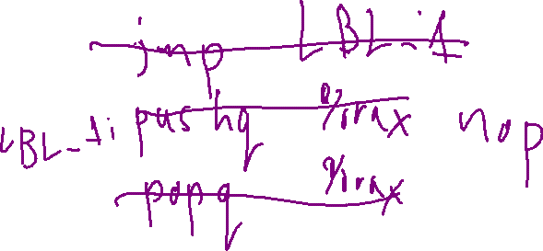
Check-In
Review: Machine-Code Optimization
Give an example of a snippet of x64 code that benefits from two peephole optimizations

Slide 2
Admin
Announcements and Housekeeping

Slide 3
All Quizzes Graded!
Announcements and Housekeeping
hooray

Slide 4
Quiz 2
Announcements and Housekeeping
P 6%
A 24%
B 28%
C 15%
D 9%
F 19%

Slide 5

Quiz 2
Announcements and Housekeeping
P | 27%
A | 30%
B | 15%
C | 9%
D | 6%
F | 13%

Slide 6
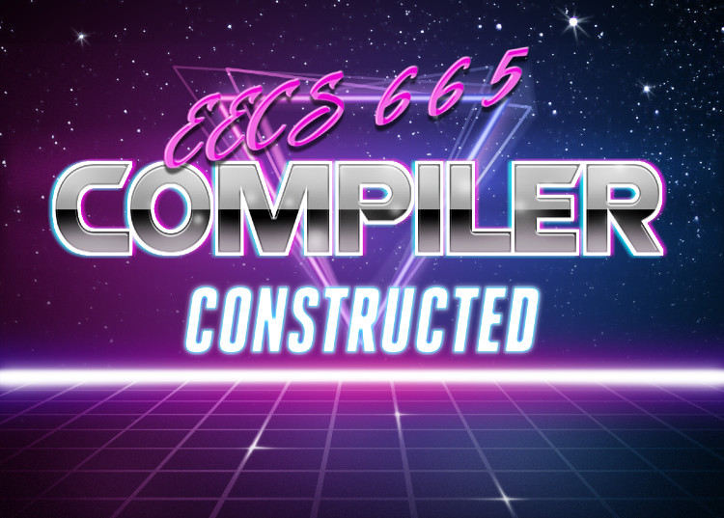

Flowgraphs
Drew Davidson | University of Kansas

Slide 7

Previously…
Machine Code Optimization
Machine code optimization overview
Improving data allocation
Register allocation
Improving Final Code
Peephole optimization
Instruction Pipelines
You should know
Interference graphs
Sharing AR slots / registers for allocation
How/where to apply peephole optimizations
How/where instruction reordering might aid a simple instruction pipeline
Optimization
7

Slide 8

Compiler Construction
Progress Pics
Basic source to target workflow:
Complete
Outputs naïve code
Advanced workflow:
“Postprocess” the output of a naïve phase
Source code
Lexical
analysis
Syntactic
analysis
Semantic analysis
Intermediate code generation
Final code generation
Target code
8

Slide 9
Compiler Construction
Progress Pics
Source code
Basic source to target workflow:
Complete
Outputs naïve code
Advanced workflow:
“Postprocess” the output of a naïve phase
Lexical
analysis
Syntactic
analysis
Semantic analysis
Intermediate code generation
We are here
Intermediate code optimization
  Discussed: final code “cleanup”
  Next up: intermediate code
Final code generation
Final code optimization
Target code
9

Slide 10
Lecture Outline
Flowgraphs
Program analysis:
Goals
Control flow graphs
Local Optimizations
Dead code elimination
Common subexpression elimination
Constant/copy propagation
Optimization

Slide 11

Making faster IR programs
Flowgraphs: Program analysis
General constraints:
We can’t violate program semantics
Minimal architecture details
Constraint-friendly goals:
Don’t do useless computation
Don’t do redundant computation

Slide 12
Simple Example: Constant Folding
Flowgraphs: Program analysis
Statically compute known expressions
Replace the runtime expression with its value
Analysis
Identify constant expressions
Compute known value
Rewrite
Replace expression with value
Before
After
[z] := 1 + 2
[z] := 3

Slide 13

Program Analysis
Flowgraphs: Program analysis
The more we know about the program the more we can improve it
What might we be interested in knowing…?

Slide 14
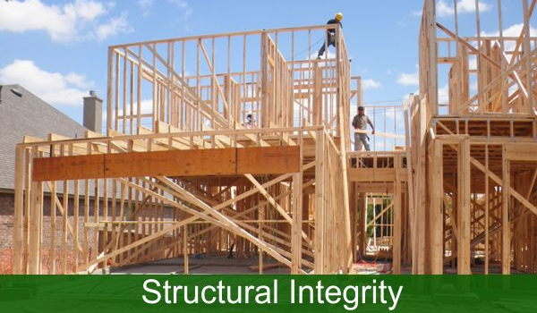
“Structural” Properties of a Program
Flowgraphs: Program analysis
E.g. for a given program point:
What paths lead there?
Is it in a deeply nested loop?
Is it reachable at all?
Knowing the above info supports other analyses
Might a variable be uninitialized?

Slide 15
“Structural” Properties of a Program
Flowgraphs: Program analysis
E.g. for a given program point:
What paths lead there?
Is it in a deeply nested loop?
Is it reachable at all?
Knowing the above info supports other analyses
Might a variable be uninitialized?
We need a program abstraction to capture these details

Slide 16
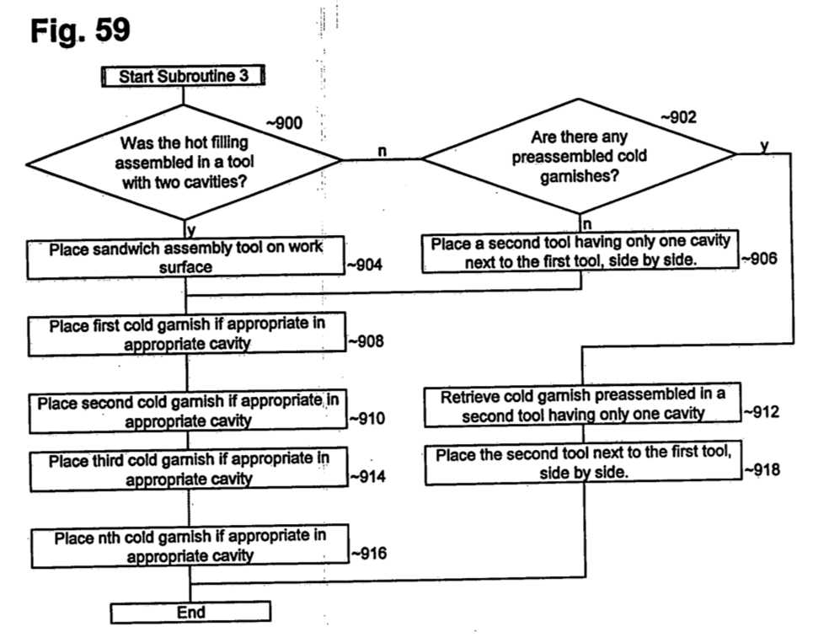
Intuition: Flow charts
Flowgraphs: Program analysis
Notation
Nodes are instructions
Edges go to successor nodes
Operation
Execute current instruction
Proceed to the right successor
Flow chart for building a sandwich,
appearing in a McDonald’s patent

Slide 17
Intuition: Flow charts
Flowgraphs: Program analysis
Notation
Nodes are instructions
Edges go to successor nodes
Operation
Execute current instruction
Proceed to the right successor
Not just for
sandwiches!
Flow chart for building a sandwich,
appearing in a McDonald’s patent

Slide 18
Intuition: Flow Charts … for Code?!
Flowgraphs: Program analysis
Notation
Nodes are instructions
Edges go to successor nodes
Operation
Execute current instruction
Proceed to the right successor
src code
3AC code
Instruction Flowgraph
a = 7;
if (a < 4){
a = 4;
}
a += 2;
1. [a] := 7
2. [t1] := [a] < 4
3. ifz [t1] goto L5
4. [a] := 4
L5: 5. [a] := [a] + 2
[a] := 7
[t1] := [a] < 4
ifz [t1] goto L5
[a] := 4
[a] := [a] + 2
L5:

Slide 19
Intuition: Flow Charts … FROM Code?!
Flowgraphs: Program analysis
enter funk
getin 1 [a]
void funk(int a, int b){
if (a < b){
if (a < 10){
a = a + b;
}
}
if (b < 3){
a = 1;
}
}
getin 2 [b]
[t1] := [a] < [b]
ifz [t1] goto L_a
[t2] := [a] < 10
ifz [t2] goto L_b
[a] := [a] + [b]
L_b:
nop
L_a:
nop
[t3] := [b] < 3
ifz [t3] goto L_c
[a] := 1
L_c:
nop
leave funk

Slide 20
Intuition: Flow Charts … FROM Code?!
Flowgraphs: Program analysis
enter funk
getin 1 [a]
getin 2 [b]
void funk(int a, int b){
if (a < b){
if (a < 10){
a = a + b;
}
}
if (b < 3){
a = 1;
}
}
[t1] := [a] < [b]
ifz [t1] goto L_a
[t2] := [a] < 10
jmp
ifz [t2] goto L_b
jmp
[a] := [a] + [b]
L_b:
nop
L_a:
nop
[t3] := [b] < 3
ifFalse tmpC3 goto L_c
jmp
a := 1
L_c:
nop
leave funk

Slide 21

Code Flowcharts: Seem Familiar?
Flowgraphs: Program analysis
Maybe this is how you learned to think about code!
It’s a nice way to visualize the control flow of the program
We can extend this intuition for program analysis

Slide 22
Lecture Outline
Flowgraphs
Program analysis:
Goals
Control flow graphs
Local Optimizations
Dead code elimination
Common subexpression elimination
Constant/copy propagation
Optimization

Slide 23

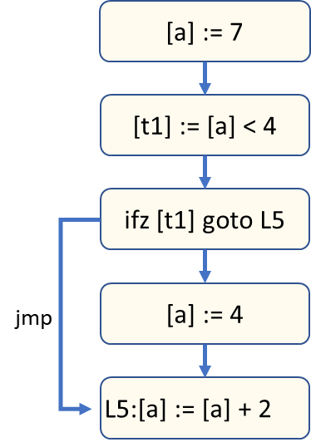
Intuition
Flowgraphs: Control flow graphs
A more compact version of the instruction flow chart
But still preserves the way in which control passes through the program

Slide 24
Compacting the Flowchart Concept
Flowgraphs: Control flow graphs
enter funk
getarg 1 [a]
The flowchart is needlessly verbose
We could put multiple instructions in a node
Group the instructions that always execute together
getarg 2 [b]
[tmpC1] := [a] < [b]
ifz [tmpC1] goto L_a
[tmpC2] := [a] < 10
ifz [tmpC2] goto L_b
jmp
jmp
[a] := [a] + [b]
L_b:
nop
L_a:
nop
[tmpC3] := [b] < 3
ifz [tmpC3] goto L_c
jmp
a := 1
L_c:
nop
leave funk

Slide 25

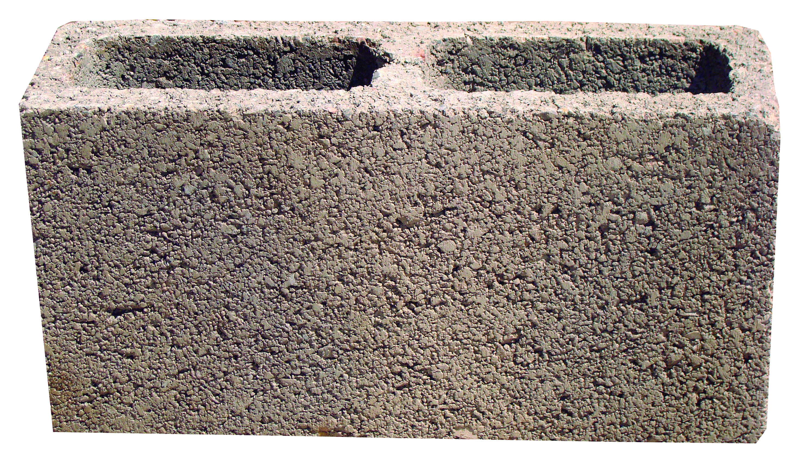
Basic Blocks
Flowgraphs: Control flow graphs
Definition: Sequence of instructions guaranteed to execute without interruption

Slide 26

Basic Blocks Boundaries
Flowgraphs: Control flow graphs
“Terminator” – An instruction that ends a basic block
“Leader” – An instruction that begins a block

Slide 27
Basic Blocks
Flowgraphs: Control flow graphs
Sequence of instructions guaranteed to execute without interruption
Terminology:
  “Leader” – An instruction that begins a block
  “Terminator” – An instruction that ends a basic block
The first instruction in the procedure
The target of a jump
The instruction after an terminator
The last instruction of the procedure
A jump (ifz, goto)
A call (We’ll use a special LINK edge)

Slide 28
Basic Blocks
Flowgraphs: Control flow graphs
Leaders
The first instruction in the procedure
The target of a jump
[a] := 7
The instruction after a terminator
[t1] := [a] < 4
Terminators
The last instruction in the procedure
A jump (ifz, goto)
ifz [t1] goto L5
A call (We’ll use a special LINK edge to successor)
Next instruction is a leader
[a] := 4
jmp
Construction algorithm
foreach instr i in procedure:
if i is a leader, begin a new BBL
if i is a terminator, end current BBL
[a] := [a] + 2
L5:

Slide 29

Building Basic Blocks
Flowgraphs: Control flow graphs
Leaders
The first instruction in the procedure
The target of a jump
The instruction after a terminator
Terminators
The last instruction in the procedure
A jump (ifz, goto)
This algorithm isn’t optimal,
but we’ll go with it
A call (We’ll use a special LINK edge to successor)
Next instruction is a leader
example
Construction algorithm
foreach instr i in procedure:
if i is a leader, begin a new BBL
if i is a terminator, end current BBL
jmp L1
L1: nop

Slide 30

The Control Flow Graph: Summary
Flowgraphs: Control flow graphs
A graph of basic blocks
One graph per procedure
  Exactly one entry block
  Exactly one exit block
Distinguished edge types:
  Back edges – an edge to a previously-encountered node
  Call edge – Connects a call site to the called function
  Link edge – Connects a function call to it’s return point
CFGs

Slide 31

Benefits of Basic Blocks
Flowgraphs: Control flow graphs
Makes CFGs a more manageable data structure
Zoom out and observe procedure structure
Loops
If-stmt
If-else
(head)
(head)
(head)
jmp
jmp
(True branch)
jmp
(body)
jmp
(True branch)
(False branch)
(after)
jmp
(after)
(after)

Slide 32
Benefits of Basic Blocks
Flowgraphs: Control flow graphs
Makes CFGs a more manageable data structure
Zoom out and observe procedure structure
Zoom in to a BBL’s “uninterrupted sequences”
Simplifies analysis:
Many properties we want to know are trivial to compute within a BBL

Slide 33
Types of CFG Analysis
Control Flow Graphs: Representation
Modularizes analysis:
Analysis within a single basic block
Analysis between multiple basic blocks in a function
What about analysis between multiple functions?
Traditionally called “Local” analysis
Traditionally called “Global” analysis
We’ll come back to this one

Slide 34
Lecture Outline
Flowgraphs
Program analysis:
Goals
Control flow graphs
Local Optimizations
Dead code elimination
Common subexpression elimination
Constant/copy propagation
Optimization

Slide 35
Dead Code Elimination
Flowgraphs: Local Optimizations
Remove “useless” instructions (those with no effect)
Analysis: live variable analysis
This definition does not reach the end of the block nor any use in the block!
[x] := 1
[x] := 2
[x] := 2
[y] := 3
[y] := 3
[z] := [x] * [y]
[z] := [x] * [y]
write [z]
write [z]

Slide 36
Constant/Copy Propagation
Flowgraphs: Local Optimizations
Replace a variable use with its definition
Analysis: “copy identification” (doesn’t really have a name)
Propagate x’s value
This assignment is
now dead code!
[y] := [x]
[y] := [x]
[z] := [x] * [y]
[z] := [x] * [x]
[y] := 1
[y] := 1
write [z]
write [z]
When propagating constant values, can aid in constant folding
[x] := 1
[x] := 1
Fold to 3
[y] := 2
[y] := 2
[z] := [x] + [y]
[z] := 1 + 2

Slide 37

Common Subexpression Elimination
Flowgraphs: Local Optimizations
Reuse already-computed expressions
Analysis: available expression analysis
[t] := [x] * [y]
[a] := [x] * [y]
[a] := [t]
[b] := [x] * [y]
[b] := [t]
[c] := [x] * [y]
[c] := [t]

Slide 38
Lecture End
Flowgraphs
Summary
Control Flow Graphs serve as an abstraction of the routes through the program
Basic blocks summarize guaranteed sequences and enable local optimizations (DCE, CP, CSE)
Next Time
Global optimizations – extending optimization across multiple basic blocks

