Slide 1
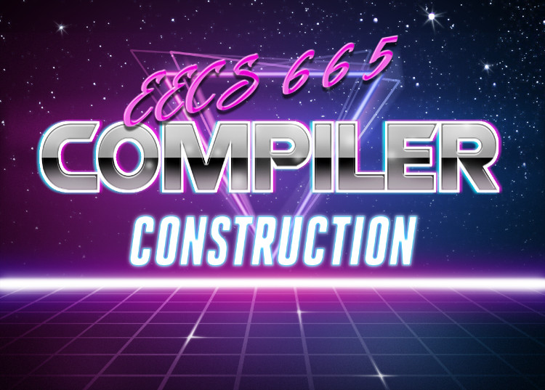
Machine Code Optimization
University of Kansas| Drew Davidson

Slide 2

Previously
Post-compilation toolchain
Compiler Toolchains
Overview
What GCC Does
Component Walkthrough
Assembler
Linker
Loader

Slide 3
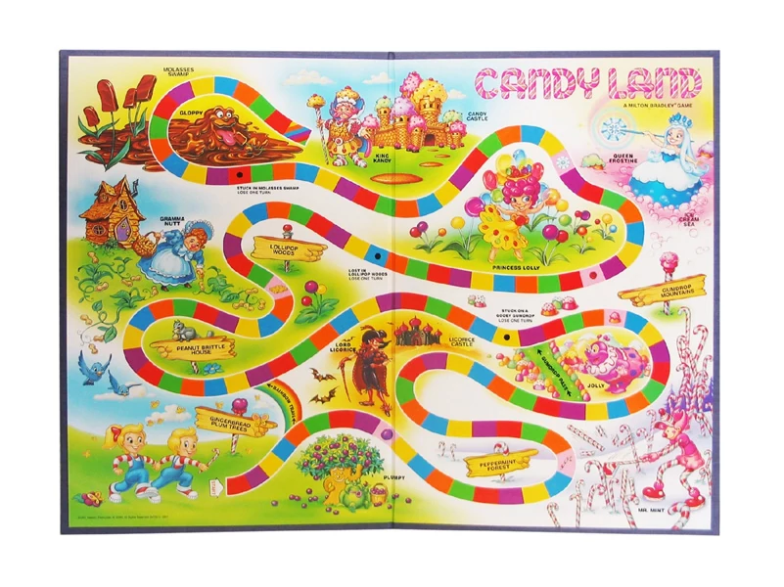
Postcompilation
Pit-stop
COMPILER
Machine Codegen
Optimization
Code Generation
Semantic Analysis
Intermediate Representation
Syntactic
Definition
Parsing
Syntax-Dir
Translation
Regular
Languages
Lexical Analysis
3

Slide 4
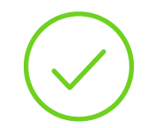
Compiler Construction
Progress Pics
Source
Code
Finished
A naïve workflow from source code to target code
To-Do
Clean up some of the corners we cut
We’ve focused on correctness over efficiency, let’s try to win back some efficiency
Scanner
Lexical analysis
Parser
Syntactic analysis
Semantic analysis
Intermediate code generation
IR optimization
Final Code generation
Final code optimization

Slide 5

Today’s Outline
Machine Code Optimization
Overview
Improving data allocation
Register allocation
Improving Final Code
Peephole optimization
Instruction Pipelines
Optimization

Slide 6

Working With the Architecture
Machine Code Optimization
Good machine code should:
Play to the strengths of the hardware
Compensate for weaknesses of the hardware
Such operations depend on specifics of the architecture

Slide 7

Disclaimer: This is a Deep Area
Machine Code Optimization
We hardly scratch the surface of compiler optimizations
There are more categories of machine-code optimization than we’ll cover
There are more optimizations within the categories we do cover
The tip of the iceberg

Slide 8
Today’s Outline
Machine Code Optimization
Overview
Improving data allocation
Register allocation
Improving Final Code
Peephole optimization
Instruction Pipelines
Optimization

Slide 9
Sizing Activation Records
Machine Code Optimization: Data Allocation
Easy mode: one AR slot for every temp, local, and arg
Source code
int foo(int a){
int v;
int r;
v = a-a*a;
r = v - 2;
}
3AC Code
enter foo
getarg 1, [a]
[t1] := [a] * [a]
[v] := [a] - [t1]
[r] := [v] - 2
Memory at Runtime
%rsp
%rbp
int r
int t1
int v
int a
old RBP
old RIP
foo AR
Surely one could use fewer memory slots!
Maybe we could
share some slots

Slide 10
Liveness
Machine Code Optimization: Data Allocation
A definition is live if it’s value is subsequently used
Insight: Variables can share space when they don’t interfere (i.e. aren’t simultaneously live)
We’ll capture the constraints via an abstraction called the interference graph
Use/Definition Sequence
Line_1
A := …
B := …
… := B
C := …
… := A
D := …
… := D
… := C
Line_2
Line_3
Line_4
Line_5
Line_6
Line_7
Line_8

Slide 11
Liveness
Machine Code Optimization: Data Allocation
The interference graph:
Nodes are variables
Edges show simultaneously live variables
Use/Definition Sequence
Interference Graph
Line_1
A := …
B := …
… := B
C := …
… := A
D := …
… := D
… := C
Line_2
A
D
Line_3
Line_4
Line_5
Line_6
Line_7
B
C
Line_8

Slide 12
Liveness
Machine Code Optimization: Data Allocation
Coloring:
Assign each storage location to a color
Color the interference graph so no nodes of the same color are adjacent
Use/Definition Sequence
Interference Graph
Line_1
A := …
B := …
… := B
C := …
… := A
D := …
… := D
… := C
A
D
Line_2
A
D
Line_3
Loc1
Line_4
Line_5
Loc2
Line_6
B
B
C
Line_7
C
Line_8

Slide 13
Liveness
Machine Code Optimization: Data Allocation
Allocation: Map all variables to their color’s location
Unfortunately, coloring is NP-Compete ☹
Memory at Runtime
%rsp
%rbp
B / C
A / D
old RBP
old RIP
foo AR
Use/Definition Sequence
Interference Graph
Allocation
Line_1
A := …
B := …
… := B
C := …
… := A
D := …
… := D
… := C
-24(%rbp) := …
-32(%rbp) := …
… := -32(%rbp)
-32(%rbp) := …
… := -24(%rbp)
-24(%rbp) := …
… := -24(%rbp)
… := -32(%rbp)
A
D
Line_2
A
D
Line_3
Loc1
Line_4
Line_5
Loc2
Line_6
B
B
C
Line_7
C
Line_8

Slide 14
Today’s Outline
Machine Code Optimization
Improving data allocation
Register allocation
Improving Final Code
Peephole optimization
Instruction Pipelines
Optimization

Slide 15
Register Allocation
Machine Code Optimization: Register Allocation
When possible, keep variables entirely in registers
Why?
Some computation requires register operands
Register operands are intrinsically faster
Register coloring
Assign a color to each available register
Optimal assignment is NP-Complete ☹

Slide 16
Problem: Callee clobbers registers!
Machine Code Optimization: Register Allocation
foo: pushq %rbp
movq %rsp, %rbp
addq $16, %rbp
movq $2, %r9
movq $3, %r10
callq bar
addq %r9, %r10
popq %rbp
retq
1
0x7FA0
0x7FA8
0x7FB0
0x7FB8
0x7FC0
enter foo
[f1] := 2
[f2] := 3
call bar
[f3] := [f2] + [f1]
leave foo
…
…
rbp
0x7FC0
%r9
rsp
0x7FB0
old rbp
old rip
r9
2
free
foo AR
r10
3
%r10
1
4
0x7FA0
0x7FB0
0x7FA8
0x7FB8
0x7FC0
4
…
…
rbp
0x7FC0
old rbp
old rip
rsp
0x7FB0
r9
9
free
foo AR
r10
7
bar: pushq %rbp
movq %rsp, %rbp
addq $16, %rbp
movq $9, %r9
movq $7, %r10
subq %r10, %r9
movq %r9, (glb_g)
popq %rbp
retq
2
0x7FA0
0x7FA8
0x7FB0
0x7FB8
0x7FC0
%r9
enter bar
[b1] := 9
[b2] := 7
[glb_g] := [b1] - [b2]
leave foo
0x7fc0
…
…
…
rbp
0x7FB0
2
old rbp
old rip
old rbp
old rip
rsp
0x7FA0
r9
2
bar AR
foo AR
r10
3
%r10
3
0x7FA0
0x7FA8
0x7FB0
0x7FB8
0x7FC0
3
rbp
0x7FB0
old rbp
old rip
old rbp
old rip
rsp
0x7FA0
r9
9
bar AR
foo AR
r10
7

Slide 17
Which Registers To Use?
Machine Code Optimization: Register Allocation
Register Allocation Complication:
Callees overwriting registers
Callees can’t statically learn which registers the caller is using
Assume these general purpose registers
%r11, %r12, %r13, %r14, %r15
baz
Needs 2
registers
%r11
%r12
foo
Needs 2
registers
%r11
%r12
Needs 3
registers
%r13
%r14
%r15
bar

Slide 18
Register Conventions
Machine Code Optimization: Register Conventions
Calling convention indicates which registers should be preserved across calls
Preserved (callee-saved): rbx, rsp, rbp, r12, r13, r14, r15
Volatile (caller-saved): rax, rdi, rsi, rdx, rcx, r8, r9, r10, r11

Slide 19


Preserving Register Values
Machine Code Optimization: Register Conventions
Imagine a function call. There’s a caller and a callee. Let’s use an analogy
Me (homeowner): caller
You (guest): callee
Function call: you stay at my house. Rooms: registers
Common rooms: you can goof around in there (volatile)
Restricted rooms: don’t touch anything (preserved)
Analogy: housesharing

Slide 20
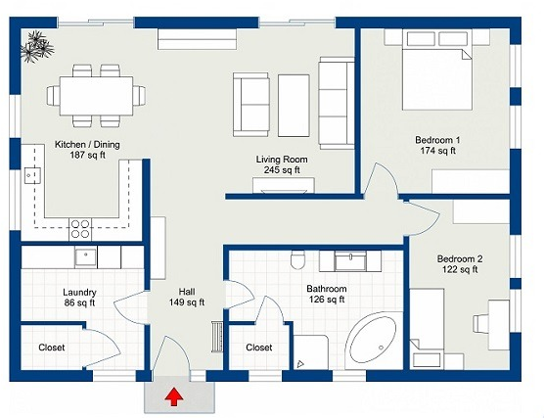
Preserving Register Values
Machine Code Optimization: Register Conventions
Imagine a function call. There’s a caller and a callee. Let’s use an analogy
Me (homeowner): caller
You (guest): callee
Function call: you stay at my house. Rooms: registers
Common rooms: you can goof around in there (volatile)
Restricted rooms: don’t touch anything (preserved)
Analogy: housesharing
volatile
%r08
0x12
%r09
0xFF
%r11
0x13
%r10
0x97
%r12
0xF3
%r13
0x1111111111
preserved

Slide 21
Preserving Register Values
Machine Code Optimization: Register Conventions
Respectful housesharing
In the call
- You only touch the volatile registers
After the caller
- I don’t care
volatile
%r09
0xFF
%r11
0x13
Allowed
%r08
0x12
0x32
0x19
I can count on
%r11’s being same
%r10
0x97
%r12
0xF3
Caller code
movq $0x13, %r11
movq $0x12, %r08
callq
addq $1, %r11
movq $0, %r08
I cannot count on
%r08’s value
%r13
0x1111111111
preserved

Slide 22
Preserving Register Values
Machine Code Optimization: Register Conventions
Respectful housesharing
In the call
- You only touch the volatile registers
After the caller
- I don’t care
volatile
%r09
0xFF
%r11
0x13
Allowed
%r08
0x12
0x32
0x19
0x88
Disrespectful housesharing
In the call
- You (also) touch the preserved registers
After the caller
- Caller’s expectation violated!!
Illegal
(violated System V ABI)
%r10
0x97
%r12
0xF3
%r13
0x1111111111
Caller code
movq $0x13, %r11
movq $0x12, %r08
callq
addq $1, %r11
movq $0, %r08
preserved

Slide 23
Preserving Register Values
Machine Code Optimization: Register Conventions
Respectful housesharing
In the call
- You only touch the volatile registers
After the caller
- I don’t care
volatile
%r09
0xFF
%r11
0x13
Allowed
%r08
0x12
0x32
0x19
0x88
0x13
Disrespectful housesharing
In the call
- You (also) touch the preserved registers
After the caller
- Caller’s expectation violated!!
Illegal
(violated System V ABI)
%r10
0x97
%r12
0xF3
%r13
0x1111111111
Sneaky housesharing
In the call
You (also) touch the preserved registers
You restore the preserved values before return
After the caller
The caller never knows of your deviance
preserved
Allowed

Slide 24
Implementing Register Conventions
Machine Code Optimization: Register Conventions
Using callee-saved registers
Being a “sneaky guest”
Push the preserved register values before you use them
Pop the stacked values before you return
Using caller-saved registers
Being a “sneaky owner”
Save a volatile register to the stack
Pop the stacked values before you return
Prologue
pushq %rbp
movq %rsp, %rbp
addq $16, %rbp
pushq %r08
pushq %r09
subq $32, %rsp
Epilogue
addq $32, %rsp
popq %r09
popq %r08
popq %rbp
retq
Call site
pushq %r11
pushq %r12
callq fn_callee
popq %r12
popq %r11

Slide 25
Today’s Outline
Machine Code Optimization
Improving data allocation
Register allocation
Improving Final Code
Peephole optimization
Instruction Pipelines
Optimization

Slide 26

Fixing “Obviously Sub-Optimal” Code
Machine Code Optimization: Peephole Optimizations
A code generator may output obviously “weak” code
why?
  Ignoring global context
  Correctness-first design
Solution: pattern-match the most obvious problems
An obvious flaw

Slide 27

The Idea of the Peephole
Machine Code Optimization: Peephole Optimizations
Called “peephole” optimization because we are conceptually sliding a small window over the code, looking for small patterns

Slide 28
Remove Semantic No-ops
Machine Code Optimization: Peephole Optimizations
Remove semantic no-op sequences
Push followed by pop
Add/sub 0
Mul/div 1
push
subq $8, %rsp
movq %r10, (%rsp)
movq (%rsp), %r10
addq $8, %rsp
addq $0 %rax
imulq $1 %rbx
pop

Slide 29
Sequence Simplification
Machine Code Optimization: Peephole Optimizations
Useless instruction
Store then load
Arithmetic equivalence
Jump to next
movq %rax, -8(%rbp)
movq -8(%rbp) %rax
Just add 3
addq $1 %r11
addq $2 %r11
Useless instruction
jmp Label1
Label1: addq $2, %rax

Slide 30

Instruction Strength Reduction
Machine Code Optimization: Peephole Optimizations
Instruction Strength Reduction
Prefer “weak” (narrow/specialized instruction) instead
Avoid “strong” (general-purpose) instruction
imulq $2 %rax
addq $1 %rax
shift-left %rax
inc %rax
Requires knowledge of the fast and
slow instructions
“Weaker” is better

Slide 31
Peephole Optimization: Summary
Machine Code Optimization: Peephole Optimizations
Concept
Final code “postprocessing”
Slide a window over the program that pattern-matches suboptimal cases
Benefits
Remove some consequences of naïve machine code generation
Leverage hardware features
  Faster instructions

Slide 32
Today’s Outline
Machine Code Optimization
Improving data allocation
Register allocation
Improving Final Code
Peephole optimization
Instruction Pipelines
Optimization

Slide 33
Background: Multi-stage Cycles
Machine Code Optimization: Delay Slots – Branch Hazards
The classic cycle of a processor:
Fetch - read value at the program counter
Decode – figure out what the instruction is
Execute – do what the instruction
Write-back – commit the results to register/memory
If we did all of this sequentially, we’d waste time & resources

Slide 34
Background: Instruction Pipelines
Machine Code Optimization: Delay Slots – Branch Hazards
Idea: Start on next instruction before current done
I₁: addq %rax %rbx
I₂ : subq %rcx %rdx
Time
t₀
Time
t₁
Time
t₂
Time
t₃
Time
t₄
Time
t₅
Time
t₆
Time
t₇
Time
t₈
I₁
I₁
I₁
I₁
I₂
I₂
I₂
I₂
Fetch
Decode
Execute
Write
Fetch
Decode
Execute
Write

Slide 35
Background: Instruction Pipelines
Machine Code Optimization: Delay Slots – Branch Hazards
Idea: Start on next instruction before current done
I₁: addq %rax %rbx
I₂ : subq %rcx %rdx
Time
t₀
Time
t₁
Time
t₂
Time
t₃
Time
t₄
Time
t₅
Time
t₆
Time
t₇
Time
t₈
Instr
Fetch
I₁
I₂
Fetch
Fetch
Instr
Decode
I₁
I₂
Decode
Decode
Execute
I₁
I₂
Execute
Execute
Writeback
I₁
I₂
Write
Write

Slide 36
Background: Instruction Pipelines
Machine Code Optimization: Delay Slots – Branch Hazards
Idea: Start on next instruction before current done
I₁: addq %rax %rbx
I₂ : subq %rcx %rdx
Time
t₀
Time
t₁
Time
t₂
Time
t₃
Time
t₄
Time
t₅
Time
t₆
Time
t₇
Time
t₈
addq %rax, %rbx
Instr
Fetch
I₁
I₂
addq %rbx, %rcx
addq %rdx, %r11
I₂
Tremendous
Savings!
Instr
Decode
I₁
Execute
I₁
I₂
addq %rax, %rbx
addq %rdx, %r11
Writeback
addq %rbx, %rcx
I₁
I₂

Slide 37
Lecture End!
Machine Code Optimization: Wrap-Up
Summary:
Be careful about which instructions you use
Selection: the choice of instructions in output
Scheduling: the order of instructions in output
Next Time:
Optimizing program structure

