Slide 1
Check-In 31
Review: Heap Management
Assume a variable a goes out of scope and the garbage collector is invoked.
Draw a heap for which more memory could be released in a mark-and-sweep garbage collector than a naïve reference-counting garbage collector.

Slide 2
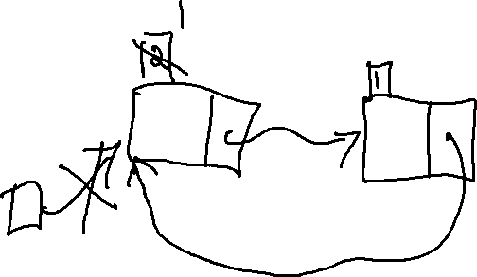
Check-In 31 Solution
Review: Heap Management
Assume a variable a goes out of scope and the garbage collector is invoked.
Draw a heap for which more memory could be released in a mark-and-sweep garbage collector than a naïve reference-counting garbage collector.

Slide 3

Announcements
Administrivia

Slide 4
Quiz 1 Graded
Administrivia
Congrats!
P (perfect): ~27%
A (excl. perfect): ~30%
B: ~15%
C: ~9%
D: ~6%
F: ~13%

Slide 5
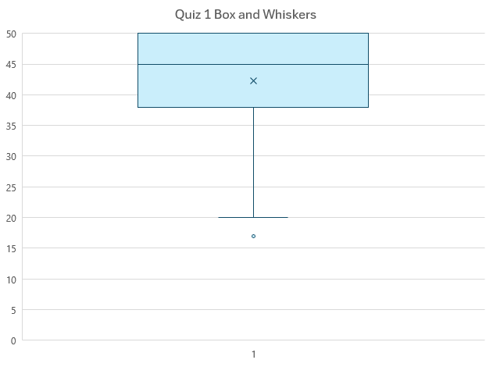
Quiz 1 Graded
Administrivia
50
Med: 45
Avg : 42
38.5

Slide 6

Postcompilation

Slide 7

Previously…
Review – The Heap
Heap Memory
Using the heap
OS interface
Garbage collection
Reference Counting
Mark and Sweep
You Should Know
How to program with heap memory
The basic concepts of the two garbage collection schemes
Machine Codegen

Slide 8
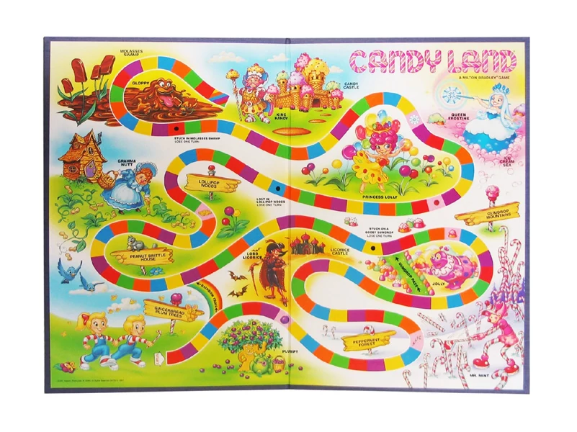
Postcompilation
Pit-stop
COMPILER
Codegen
Optimization
Architecture
Semantic Analysis
Intermediate Representation
Syntactic
Definition
Parsing
Syntax-Dir
Translation
Regular
Languages
Lexical Analysis
8

Slide 9

Today’s Lecture
Postcompilation
Compiler Toolchains
Overview
Component Definitions
Detour - History
What GCC Does
Component Walkthrough
Assembler
Linker
Loader

Slide 10
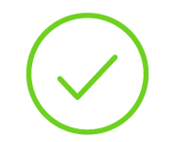
Compiler Construction: Status
Progress Pics
Source
Code
.c
file
Text File
Implemented all modules of a non-optimizing compiler
Front end, middle end, and back end are all complete
One detail remains
What use is an assembly text file?
front
end
Scanner
Lexical analysis
Parser
Syntactic analysis
Semantic analysis
middle
end
Intermediate code generation
IR optimization
back
end
Final Code generation
Final code optimization
Text File
Target
Code
.s
file

Slide 11

OS Perspective: Still Just Text
Compiler Toolchains - Overview
From text file to text file
Source code and assembly code equally useless to processor
Pretty unlike that runtime understands a text format
Nearly always a better binary representation
Some work left after the compiler has finished
From text file to text file:
OS sees nothing accomplished

Slide 12

OS Perspective: Still Just Text
Compiler Toolchains - Overview
From text file to text file
Source code and assembly code equally useless to processor
Pretty unlike that runtime understands a text format
Nearly always a better binary representation
Some work left after the compiler has finished
“Shouldn’t the
compiler target that?”
Compiler doesn’t (need to)
output object code / executables

Slide 13

“But when I run gcc I get a binary”
- You, maybe
Then perhaps gcc is more than a compiler!
Did I just blow your mind?
Probably not, because it’s just a matter of definitions

Slide 14

Compiler vs Compiler Toolchain
(A pedantic distinction)
Program lifecycle components often collectively referred to as “compiler” (vs. compiler toolchain)*
These components can be invoked separately
[*]: Unfortunately (in my opinion) this convention kinda erases the term for the high-level text code to low-level text code component

Slide 15
The Compiler Toolchain
Postcompilation - Component Walkthrough
Source
Code
(text)
.cpp
file
compile
time
assembly
time
Assembler
Compiler
Front end
Object
Code
(binary)
.o
file
Middle end
Linker
link
time
Back end
Executable
(binary)
.exe
file
Target
Code
(text)
Loader
load
time
.s
file
Running
Process
text
heap
stack
run
time
…

Slide 16

The Compiler Toolchain
Postcompilation - Component Walkthrough
Source
Code
(text)
.cpp
file
Compiler
Front end
Middle end
Back end
[visible confusion]
Target
Code
(text)
.s
file

Slide 17
The Compiler Toolchain
Postcompilation - Component Walkthrough
Assembler
assembly
time
Object
Code
(binary)
.o
file
Linker
link
time
Executable
(binary)
.exe
file
[visible excitement]
Loader
load
time
Running
Process
text
heap
stack
run
time
…

Slide 18
Today’s Lecture
Postcompilation
Compiler Toolchains
Overview
Component Definitions
Detour - History
What GCC Does
Component Walkthrough
Assembler
Linker
Loader

Slide 19
Defining Toolchain Components
Postcompilation - Component Walkthrough
DEF INI T ION S
(They’re a little bit fuzzy)

Slide 20

Historical Factors
Detour: Component Terminology
Compiler toolchain largely evolved from need to handle more complex programming tasks
  Definitions have likewise evolved, with somewhat uneven consensus

Slide 21

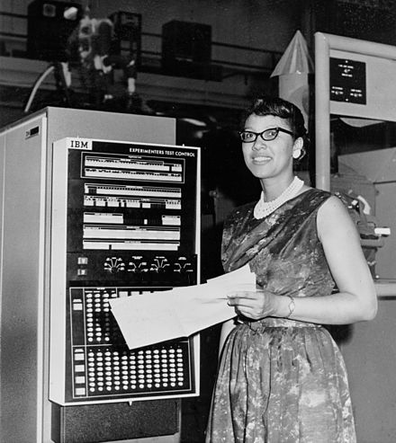
Genesis of “Computer”
Detour: Component Terminology
From 1613-1945:
“Computer” exclusively meant “a person who carries out computations”
Original programming consists of inputting numeric machine codes
Melba Roy Mouton: Early “human computer”

Slide 22
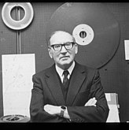

Genesis of “Assembler”
Detour: Component Terminology
1949: EDSAC features first code akin to modern notion of assembler
1953: Term “assembler” popularized for a program that concretized symbolic programs
Maurice Wilkes: developed
assembler for EDSAC
Nathanial Rochester:
Published assembler design

Slide 23
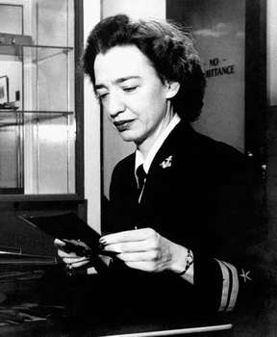
Genesis of “Linker”
Detour: Component Terminology
1952: A-0 system features first code akin to the modern notion of a linker (confusingly called a compiler at the time)
Allowed multiple programs to be combined together before being run
Grace Hopper: developed A-0

Slide 24
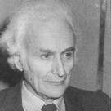
Genesis of “Compiler”
Detour: Component Terminology
1951: Publication of a translator from a high-level language to low-level code, considered the first compiler
(Also specifies the compiler in new high-level language)
Corrado Böhm: published first compiler in his PhD thesis

Slide 25
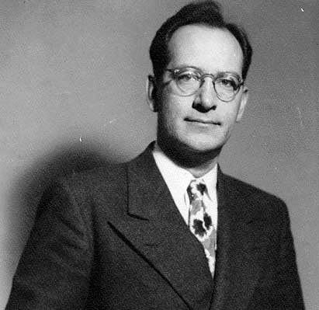
Genesis of “Loader”
Detour: Component Terminology
1947: ENIAC introduces the notion of relocating code to accommodate pre-defined subroutines, a feature somewhat akin to loaders (though pre-OS)
John Mauchley: Wrote about ENIAC procedures to relocate code in memory so that debugged subprograms could be loaded

Slide 26

Enough History for Now
Detour: Component Terminology
Practical upshot: terms have changed somewhat

Slide 27
Program Lifecycle for Our Purpose
Postcompilation - Component Walkthrough
Compile high-level source code text to low-level assembly code text
Assemble assembly code into object code binary modules
Link object code into a single executable
Load program into memory and run
Compiler
cc
Assembler
These modules
can be invoked
separately!
as
Linker
ld
Loader
(launch program)

Slide 28
Today’s Lecture
Postcompilation
Compiler Toolchains
Overview
Component Definitions
Detour - History
What GCC Does
Component Walkthrough
Assembler
Linker
Loader

Slide 29
The gcc “subprograms”
Fun home experiment:
Create empty.c
Run gcc in verbose mode on empty.c
int main(){}
cycle1: gcc –v empty.c

Slide 30
a807d786@cycle1:~/libc_link$ gcc -v empty.c
Target: x86_64-linux-gnu
[…]
Thread model: posix
gcc version 7.5.0 (Ubuntu 7.5.0-3ubuntu1~18.04)
COLLECT_GCC_OPTIONS='-v' '-mtune=generic' '-march=x86-64'
/usr/lib/gcc/x86_64-linux-gnu/7/cc1 -quiet -v -imultiarch x86_64-linux-gnu empty.c -quiet -dumpbase empty.c -mtune=generic -march=x86-64 -auxbase empty -version -fstack-protector-strong -Wformat -Wformat-security -o /tmp/ccs6BRmG.s
[…]
GNU C11 (Ubuntu 7.5.0-3ubuntu1~18.04) version 7.5.0 (x86_64-linux-gnu)
compiled by GNU C version 7.5.0, GMP version 6.1.2, MPFR version 4.0.1, MPC version 1.1.0, isl version isl-0.19-GMP
GGC heuristics: --param ggc-min-expand=100 --param ggc-min-heapsize=131072
Compiler executable checksum: b62ed4a2880cd4159476ea8293b72fa8
COLLECT_GCC_OPTIONS='-v' '-mtune=generic' '-march=x86-64'
as -v --64 -o /tmp/cc4FfCb1.o /tmp/ccs6BRmG.s
[…]
COLLECT_GCC_OPTIONS='-v' '-mtune=generic' '-march=x86-64'
/usr/lib/gcc/x86_64-linux-gnu/7/collect2 -plugin /usr/lib/gcc/x86_64-linux-gnu/7/liblto_plugin.so -plugin-opt=/usr/lib/gcc/x86_64-linux-gnu/7/lto-wrapper -plugin-opt=-fresolution=/tmp/ccAxjj1l.res -plugin-opt=-pass-through=-lgcc -plugin-opt=-pass-through=-lgcc_s -plugin-opt=-pass-through=-lc -plugin-opt=-pass-through=-lgcc -plugin-opt=-pass-through=-lgcc_s --build-id --eh-frame-hdr -m elf_x86_64 --hash-style=gnu --as-needed -dynamic-linker /lib64/ld-linux-x86-64.so.2 -pie -z now -z relro /usr/lib/gcc/x86_64-linux-gnu/7/../../../x86_64-linux-gnu/Scrt1.o /usr/lib/gcc/x86_64-linux-gnu/7/../../../x86_64-linux-gnu/crti.o /usr/lib/gcc/x86_64-linux-gnu/7/crtbeginS.o -L/usr/lib/gcc/x86_64-linux-gnu/7 -L/usr/lib/gcc/x86_64-linux-gnu/7/../../../x86_64-linux-gnu -L/usr/lib/gcc/x86_64-linux-gnu/7/../../../../lib -L/lib/x86_64-linux-gnu -L/lib/../lib -L/usr/lib/x86_64-linux-gnu -L/usr/lib/../lib -L/usr/lib/x86_64-linux-gnu -L/usr/lib/gcc/x86_64-linux-gnu/7/../../.. /tmp/cc4FfCb1.o -lgcc --push-state --as-needed -lgcc_s --pop-state -lc -lgcc --push-state --as-needed -lgcc_s --pop-state /usr/lib/gcc/x86_64-linux-gnu/7/crtendS.o /usr/lib/gcc/x86_64-linux-gnu/7/../../../x86_64-linux-gnu/crtn.o
COLLECT_GCC_OPTIONS='-v' '-mtune=generic' '-march=x86-64'
The compiler proper
Source code (input)
The assembler
Assembly code
Runtime components
The linker
Object code

Slide 31
Today’s Lecture
Postcompilation
Compiler Toolchains
Overview
Component Definitions
Detour - History
What GCC Does
Component Walkthrough
Assembler
Linker
Loader

Slide 32
The Assembler
Module Role and Operation
Target
Code
(text)
.s
file
Modern use:
  Translates labels and instruction mnemonics to binary equivalent
Output may still contain placeholders for some code and data
assembly
time
Assembler
Object
Code
(binary)
.o
file
link
time
Linker
Executable
(binary)
.exe
file
load
time
Loader
Running
Process
text
heap
stack
run
time
…

Slide 33
The Assembler: Responsibilities
Module Role and Operation
.data
_label1: .word
Collect symbolic definitions (e.g. labels) into “low-level” symbol table
Put code and data into segments
Replace uses of labels with placeholder addresses (where available)
.text
jal _label7
.data
_str: .asciiz …
.text
la $t0 _label1
symbols
.data
(binary)
.text
(binary)

Slide 34
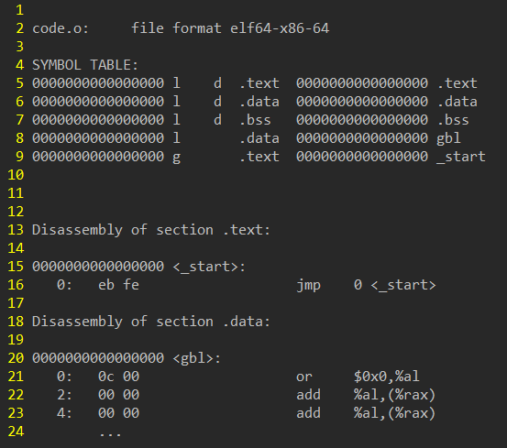
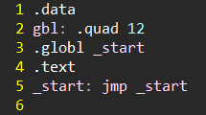
The Assembler
Module Role and Operation
object code
src code
as –o out.o file.s
objdump –Dwrt out.o

Slide 35
The Assembler: Invocation
Module Role and Operation
(to get assembly): cc –S ret3.c –o /tmp/a.s
as /tmp/a.s -o /tmp/a.o

Slide 36
Today’s Lecture
Postcompilation
Compiler Toolchains
Overview
Component Definitions
Detour - History
What GCC Does
Component Walkthrough
Assembler
Linker
Loader

Slide 37
The Linker
Module Role and Operation
Target
Code
(text)
.s
file
Resolves placeholders betwixt multiple object files
Stitches objects files (and static libraries) into a single binary
assembly
time
Assembler
Object
Code
(binary)
.o
file
link
time
Linker
Executable
(binary)
.exe
file
load
time
Loader
Running
Process
run
time
text
heap
stack
…

Slide 38
The Linker: Responsibilities
Module Role and Operation
obj1.o
obj2.o
lib.a
Calculate segment size
Relocate segments
Resolve symbol imports with exports where available
  e.g. call in obj1.o, callee in obj2.o
Add initialization routines
Optimization!
symbols
symbols
symbols
opcodes
(binary)
opcodes
(binary)
opcodes
(binary)
data
(binary)
data
(binary)
symbols
opcodes
(binary)
data
(binary)

Slide 39
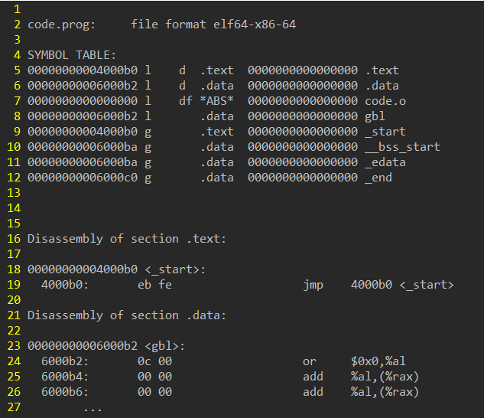
The Linker
Module Role and Operation
ld –o prog code.o
objdump –Dwrt prog
Object code
Executable code

Slide 40

The Linker: Simple Invocation
Module Role and Operation
Project
concept
The simplest use, “linking” a single object file:
ld prog.o -o prog.exe
More complex use, linking multiple object files
ld prog.o a.o b.o -o a.exe
40

Slide 41

Cross-language linking
Module Role and Operation
Object code is raw x64 code (containing placeholders)
Should obey the System V ABI
We can link with object code from other languages!
Source Code
(Language 1)
Source Code
(Language 2)
Linker
Sys V ABI-compliant Assembly
Sys V ABI-compliant Assembly
41

Slide 42
Cross-language linking
Module Role and Operation
End-to-end compiler toolchain workflow
<src code>
Key
Our compiler
user input
prog.s
components we write
artifacts
as
existing
components
prog.o
ld
executable

Slide 43
Cross-language linking
Module Role and Operation
End-to-end compiler toolchain workflow
<src code>
ourlanglib.c
Key
Create functionality
in other languages
(i.e. intrinsics)
Our compiler
user input
prog.s
Reuse functionality
from other languages
(i.e. string printing)
components we write
artifacts
as
gcc -c
existing
components
prog.o
ourlanglib.o
libc.so
ld
executable

Slide 44

Benefits of Cross-Linking
Module Role and Operation
Project
concept
Inter-language compatibility
Let each language’s strengths shine
Functionality reuse
Avoid coding against the OS directly
Do not reinvent this
44

Slide 45
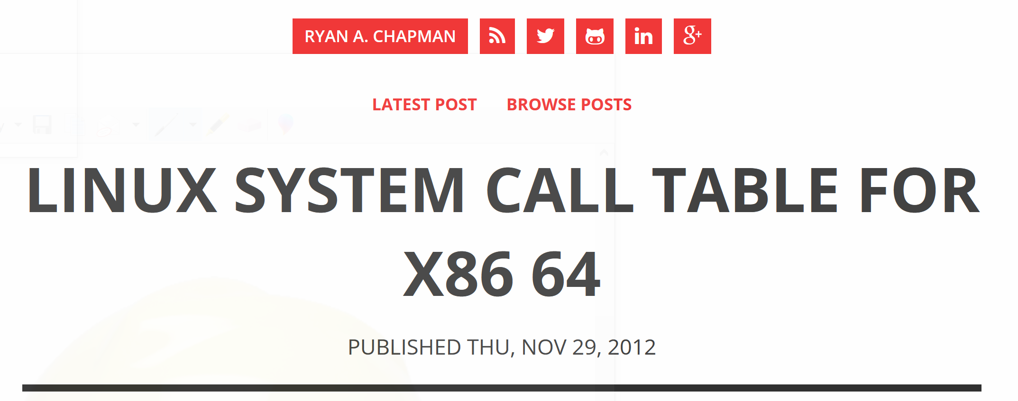
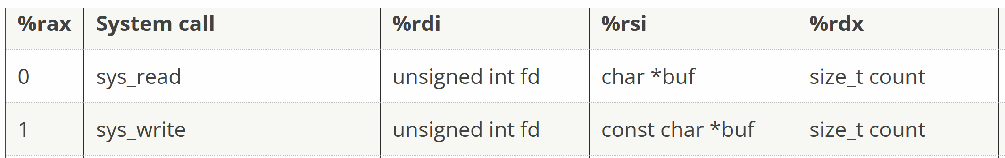
Why use the C Runtime?
Module Role and Operation
Project
concept
Src Code
int main(){
output 7;
}
https://blog.rchapman.org/posts/Linux_System_Call_Table_for_x86_64/
45

Slide 46
Why use the C Runtime?
Module Role and Operation
Project
concept
Src Code
int main(){
output 7;
}
Asm Code
.globl _start
.text
_start: callq fn_main
movq %rax, %rdi
movq $60, %rax
syscall
fn_main: <fn prologue>
# output 7
…
syscall
<fn epilogue>
46

Slide 47
Why use the C Runtime?
Module Role and Operation
Project
concept
Src Code
int main(){
output 7;
}
Asm Code
.globl _start
.text
_start: callq fn_main
movq %rax, %rdi
movq $60, %rax
syscall
fn_main: <fn prologue>
# output 7
movq $1, %rax #select sys_write
…
syscall
<fn epilogue>
47

Slide 48
Why use the C Runtime?
Module Role and Operation
Project
concept
Src Code
int main(){
output 7;
}
Asm Code
.globl _start
.text
_start: callq fn_main
movq %rax, %rdi
movq $60, %rax
syscall
fn_main: <fn prologue>
# output 7
movq $1, %rax #select sys_write
movq $1, %rdi #write to stdout
…
syscall
<fn epilogue>
48

Slide 49
Why use the C Runtime?
Module Role and Operation
Project
concept
Src Code
int main(){
output 7;
}
Asm Code
.globl _start
.text
_start: callq fn_main
movq %rax, %rdi
movq $60, %rax
syscall
fn_main: <fn prologue>
# output 7
movq $1, %rax #select sys_write
movq $1, %rdi #write to stdout
movq ???????, %rsi #buffer address
…
syscall
<fn epilogue>
49

Slide 50
Why use the C Runtime?
Module Role and Operation
Project
concept
Src Code
int main(){
output 7;
}
Asm Code
.data
buffer: .asciz “?”
.globl _start
.text
_start: callq fn_main
movq %rax, %rdi
movq $60, %rax
syscall
fn_main: <fn prologue>
# output 7
movq $1, %rax #select sys_write
movq $1, %rdi #write to stdout
movq ???????, %rsi #buffer address
…
syscall
<fn epilogue>
50

Slide 51
Why use the C Runtime?
Module Role and Operation
Project
concept
Src Code
int main(){
output 7;
}
Asm Code
.data
buffer: .asciz “?”
.globl _start
.text
_start: callq fn_main
movq %rax, %rdi
movq $60, %rax
syscall
fn_main: <fn prologue>
# output 7
movq $1, %rax #select sys_write
movq $1, %rdi #write to stdout
movq ???????, %rsi #buffer address
…
syscall
<fn epilogue>
51

Slide 52
Why use the C Runtime?
Module Role and Operation
Project
concept
Src Code
int main(){
output 7;
}
Asm Code
.data
buffer: .asciz “?”
.globl _start
.text
_start: callq fn_main
movq %rax, %rdi
movq $60, %rax
syscall
fn_main: <fn prologue>
# output 7
movq $1, %rax #select sys_write
movq $1, %rdi #write to stdout
movq ???????, %rsi #buffer address
$buffer,
…
syscall
<fn epilogue>
52

Slide 53
Why use the C Runtime?
Module Role and Operation
Project
concept
Src Code
int main(){
output 7;
}
Asm Code
.data
buffer: .asciz “?”
.globl _start
.text
_start: callq fn_main
movq %rax, %rdi
movq $60, %rax
syscall
fn_main: <fn prologue>
# output 7
movq $1, %rax #select sys_write
movq $1, %rdi #write to stdout
movq ???????, %rsi #buffer address
$buffer,
movq $0x37, (buffer)
movq $7, (buffer)
#write to buffer
…
syscall
<fn epilogue>
53

Slide 54
Why use the C Runtime?
Module Role and Operation
Project
concept
Src Code
int main(){
output 7;
}
Asm Code
.data
buffer: .asciz “?”
.globl _start
.text
_start: callq fn_main
movq %rax, %rdi
movq $60, %rax
syscall
fn_main: <fn prologue>
# output 7
movq $1, %rax #select sys_write
movq $1, %rdi #write to stdout
movq ???????, %rsi #buffer address
$buffer,
movq $0x37, (buffer)
#write to buffer
…
syscall
<fn epilogue>
54

Slide 55
Why use the C Runtime?
Module Role and Operation
Project
concept
Src Code
int main(){
output 7;
}
Asm Code
.data
buffer: .asciz “?”
.globl _start
.text
_start: callq fn_main
movq %rax, %rdi
movq $60, %rax
syscall
fn_main: <fn prologue>
# output 7
movq $1, %rax #select sys_write
movq $1, %rdi #write to stdout
movq ???????, %rsi #buffer address
$buffer,
movq $0x37, (buffer)
#write to buffer
movq $1, %rdx #string length
syscall
<fn epilogue>
55

Slide 56
Why use the C Runtime?
Module Role and Operation
Project
concept
Src Code
int main(){
output 7;
}
Asm Code
It gets even
worse!
.data
buffer: .asciz “?”
.globl _start
.text
_start: callq fn_main
movq %rax, %rdi
movq $60, %rax
syscall
fn_main: <fn prologue>
# output 7
movq $1, %rax #select sys_write
movq $1, %rdi #write to stdout
movq ???????, %rsi #buffer address
$buffer,
movq $0x37, (buffer)
#write to buffer
movq $1, %rdx #string length
syscall
<fn epilogue>
56

Slide 57
Why use the C Runtime?
Module Role and Operation
Project
concept
Prefill Buffer to all null bytes?
Src Code
…
int main(){
output gbl;
}
Asm Code
fn_main: <fn prologue>
# output gbl
movq $1, %rax #select sys_write
movq $1, %rdi #write to stdout
movq $buffer, %rsi #string to print
movq ??, (buffer) #write characters to buffer
movq ??, %rdx #string length
syscall
<fn epilogue>
“I miss printf”
Loop over Buffer counting non-null bytes?
Repeatedly call idivq $10?
Gbl: 173
Buffer:
0x31
0x37
0x33
ASCII 1
ASCII 7
ASCII 3
57

Slide 58
Use the C Runtime
Module Role and Operation
Project
concept
Src Code
int main(){
output 7;
}
Old assembly
.globl _start
.data
buffer: .asciz “?”
.text
_start: callq fn_main
movq %rax, %rdi
movq $60, %rax
syscall
fn_main: <fn prologue>
# output 7
movq $1, %rax #select sys_write
movq $1, %rdi #write to stdout
movq $buffer, %rsi #string to print
movq $31, (buffer) #write to buffer
movq $1, %rdx #string length
syscall
<fn epilogue>
New Assembly
.text
main: <fn prologue>
# output 7
movq $7, %rdi #int to print
callq myPrintInt
<fn epilogue>
myStdLib
#include <stdio.h>
#include <inttypes.h>
void myPrintInt(int64_t arg){
fprintf(stdout, “%ld”, arg);
}
58

Slide 59
Use the C Runtime
Module Role and Operation
Project
concept
Src Code
int main(){
output 7;
}
New Assembly
.text
main: <fn prologue>
# output 7
movq $7, %rdi #int to print
callq myPrintInt
<fn epilogue>
prog.o
User code
(calls myPrintInt)
mystdlib.o
myStdLib
#include <stdio.h>
#include <inttypes.h>
void myPrintInt(int64_t arg){
fprintf(stdout, “%ld”, arg);
}
Shim code
(calls fprintf)
C runtime
fprintf definition
_start label
and so much more!
59

Slide 60
Basing our runtime on C’s
Module Role and Operation
Project
concept
enable dynamic linking
SYSPATH=/usr/lib/x86_64-linux-gnu
ld \
-dynamic-linker /lib64/ld-linux-x86-64.so.2 \
$SYSPATH/crt1.o \
$SYSPATH/crti.o \
-lc \
prog.o \
$SYSPATH/crtn.o \
-o prog.exe
entrypoint code
_start: exit(main)
link the libc library
init runtime data structures
release runtime data structures
60

Slide 61
Today’s Lecture
Postcompilation
Compiler Toolchains
Overview
Component Definitions
Detour - History
What GCC Does
Component Walkthrough
Assembler
Linker
Loader

Slide 62
The Loader
Module Role and Operation
Target
Code
(text)
.s
file
Move code from secondary storage (disk) into primary storage (RAM)
Resolves placeholders for dynamically-linked libraries (e.g. .so files)
Kick off the program
assembly
time
Assembler
Object
Code
(binary)
.o
file
link
time
Linker
Executable
(binary)
.exe
file
load
time
Loader
Running
Process
run
time
text
heap
stack
…

Slide 63
The Loader
Module Role and Operation
symbols
Historically:
  Map program code into free memory
  May need to relocate symbols again
Modern Loaders:
  Simpler, as virtual memory handles physical address mapping
  Resolves dynamically-loaded libraries (.so, .dll)
  Part of the Operating System
opcodes
(binary)
data
(binary)
Running
Process
text
globals

Slide 64
That’s all the Components!
Postcompilation: Underview
This basic process completes the “lifecycle” from source code to process
From source to assembly
From assembly to object code
From object code to executable
From executable to running process

Slide 65
Lecture Summary
Postcompilation: Underview
This Lecture
Conceptual workflow from source text to process
Tooling to perform this process
Using cross-language linking to avoid re-implementation
Next up: Optimization!
Improving on the naïve code generation we’ve performed
  Better machine code
  Better intermediate code
Project
concept

