Slide 1
Check-in 30
Review – Other Codegen
Translate the following to x64
int main(){
int8_t a;
int8_t b;
return a + -b;
}

Slide 2
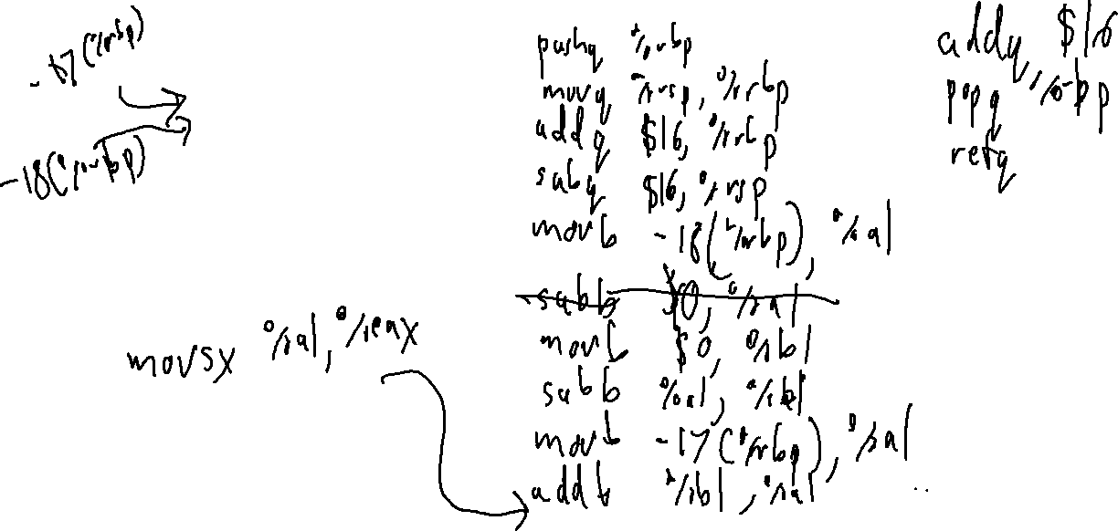
Check-in 30 Solution
Review – Other Codegen
Translate the following to x64
int main(){
int8_t a;
int8_t b;
return a + -b;
}

Slide 3
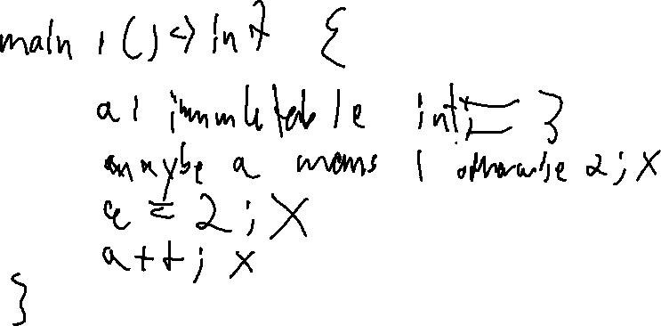
Announcements
Administrivia
Quiz 3 Friday
Review session TOMORROW at 7:00 (room TBA ☹ )

Slide 4

Heap Management

Slide 5

Previously…
Other Code Generation
You Should Know
How to compile programs with strings
How to compile programs with arrays
The general idea behind pointers and shorter primitive types
Other constructs
Shorter primitive types
Arrays
Pointers
Strings
Structs
Machine Codegen

Slide 6
Today’s Outline
Heap Management
Heap Memory
Using the heap
OS interface
Garbage collection
Reference Counting
Mark and Sweep
Machine Codegen

Slide 7
The Stack “Budget”
Heap Management – Heap Memory
Fixed overall budget, managed internally
(On Linux):
rsp
rbp
stack “budget”
remaining
AR3
AR2
AR1
…
free
Stack Segment
The stack segment is actually pretty small (10 MB)!

Slide 8

When the Stack isn’t enough
Heap Management – Heap Memory
Stack memory is efficient but constrained
(De)Allocation is easy (just move the stack ptr)
Object lifetime is at most the lifetime of the activation record
  This is a significant limitation!

Slide 9
Don’t Forget the Heap!
Heap Management – Heap Memory
Memory snapshot
0x20
0x40
0x60
0x61
0x62
0xc8
0xd0
0xd8
0xe0
…
movq $1 %rax
…
…
subq $8, %rsp
…
0x123
0x48
0x69
0x0
…
int g
char * str
obj1
locals
saved rbp
saved rip
rip
rsp
rbp
fn 1 code
fn 2 code
fn1 AR
code segment
global data
heap
free
stack

Slide 10
Expressiveness/Efficiency Limitations
Heap Management
int[200] getArrayOf5s(){
int[200] res;
for (int i = 0 ; i < 200 ; i++){
res[i] = 5;
}
return res;
}
main(){
int[200] fives = getArrayOf5s();
}
Would like res
allocated in the
callee but alive
in the caller

Slide 11
The Heap: Basic Idea
Heap Management
Disassociate memory region from ARs
Memory snapshot
…
…
…
g
obj2
res
books
rsp
rbp
fn 1 code
fn 2 code
fn2 AR
.text
globals
free
stack
Obj * g;
Obj * fn1(){
Obj * obj1 = new Obj();
return obj1;
}
void fn2(){
Obj * res = fn1();
Obj * obj2 = new Obj();
g = new Obj();
}

Slide 12
The Heap: Basic Idea
Heap Management
Disassociate memory region from ARs
Memory snapshot
0x60
…
…
…
g
0x60
Obj
obj1
books
obj2
res
books
rsp
rbp
fn 1 code
fn 2 code
fn1 AR
fn2 AR
.text
globals
heap
free
stack
Obj * g;
Obj * fn1(){
Obj * obj1 = new Obj();
return obj1;
}
void fn2(){
Obj * res = fn1();
Obj * obj2 = new Obj();
g = new Obj();
}

Slide 13
The Heap: Basic Idea
Heap Management
Disassociate memory region from ARs
Memory snapshot
0x60
…
…
…
g
0x60
Obj
obj2
res
books
rsp
rbp
fn 1 code
fn 2 code
fn2 AR
.text
globals
heap
free
stack
Obj * g;
Obj * fn1(){
Obj * obj1 = new Obj();
return obj1;
}
void fn2(){
Obj * res = fn1();
Obj * obj2 = new Obj();
g = new Obj();
}

Slide 14
The Heap: Basic Idea
Heap Management
Disassociate memory region from ARs
Memory snapshot
0x60
0x70
…
…
…
0x70
g
0x60
Obj
Obj
obj2
res
books
rsp
rbp
fn 1 code
fn 2 code
fn2 AR
.text
globals
heap
free
stack
Obj * g;
Obj * fn1(){
Obj * obj1 = new Obj();
return obj1;
}
void fn2(){
Obj * res = fn1();
Obj * obj2 = new Obj();
g = new Obj();
}

Slide 15
The Heap: Basic Idea
Heap Management
Disassociate memory region from ARs
Memory snapshot
0x60
0x70
0x80
…
…
0x80
…
0x70
g
0x60
Obj
Obj
Obj
obj2
res
books
rsp
rbp
fn 1 code
fn 2 code
fn2 AR
.text
globals
heap
free
stack
Obj * g;
Obj * fn1(){
Obj * obj1 = new Obj();
return obj1;
}
void fn2(){
Obj * res = fn1();
Obj * obj2 = new Obj();
g = new Obj();
}

Slide 16

About the Heap
Heap Management
Appropriately named:
Not as well-ordered compared to the stack
Benefits
Reduces data copied between caller and callee

Slide 17
About the Heap
Heap Management
Appropriately named:
Not as well-ordered compared to the stack
Benefits
Reduces data copied between caller and callee
Obj * g;
Obj * fn1(){
Obj * obj1 = new Obj();
return obj1;
}
void fn2(){
Obj * res = fn1();
Obj * obj2 = new Obj();
g = new Obj();
}
Just return address
0x60 in register
Memory snapshot
0x60
0x70
0x80
…
…
0x80
…
0x60
g
0x70
Obj
Obj
Obj
obj2
res
books
rsp
rbp
fn 1 code
fn 2 code
fn2 AR
code segment
globals
heap
free
stack

Slide 18
About the Heap
Heap Management
Appropriately named:
Not as well-ordered compared to the stack
Benefits
Reduces data copied between caller and callee
Flexible lifetime
Allows for various non-stack abstractions

Slide 19
Heap-Appropriate Abstractions
Heap Management
Some Functions don’t fit the tradition stack-based lifecycle
First-class functions
Function closures
Simply allocate the closure on the heap
def outer {
int a;
def inner(){
a = 1;
}
return inner;
}

Slide 20
Heap Allocation
Heap Management
Naïve approach 1:
Allocate all process memory at load time
Incredibly wasteful (probably not even possible)!
A modern 64-bit OS will actually limit heap / stack size to discrete, never-overlapping segments
This might seem like a limitation – it isn’t
2⁶⁴ bytes > 18 million terabytes of RAM

Slide 21

Managing the Heap
Heap Management
Only use the memory you need
The whole point is to allocate memory dynamically
Memory

Slide 22
Heap Allocation: brk / sbrk
Heap Management
Linux syscall for growing the heap
int brk(void *addr);
- Set the position of the program break
- Linux: when addr is 0, returns current program break
program
break
rsp
rbp
stack “budget”
remaining
AR3
AR2
AR1
heap
free
Stack Segment (doesn’t grow)

Slide 23
Heap Allocation
Heap Management
Naïve approach 2:
Ask the OS to allocate exactly the number of bytes we need for each new object
Very slow!
Naïve Scheme
program
break
rsp
rbp
Object 1
Object 2
Object 3
stack “budget”
remaining
AR3
AR2
AR1
heap (grow per object) ->
free
Stack Segment (doesn’t grow)
Better Scheme (another budget)
program
break
rsp
rbp
Object 1
Object 2
Object 3
heap “budget”
remaining
stack “budget”
remaining
AR3
AR2
AR1
heap (grow in chunks) ->
free
Stack Segment (doesn’t grow)

Slide 24
Heap Deallocation
Heap Management
When the heck do you free up heap memory?
Obj * g;
Obj * fn1(){
Obj * obj1 = new Obj();
return obj1;
}
void fn2(){
Obj * res = fn1();
Obj * obj2 = new Obj();
g = new Obj();
}
Obj * g;
Obj * fn1(){
Obj * obj1 = new Obj();
return obj1;
}
void fn2(){
fn1();
Obj * obj2 = new Obj();
g = new Obj();
}

Slide 25

Heap Deallocation
Heap Management
When the heck do you free up heap memory?
Whose job is it?
Simplest approach: rely on the programmer

Slide 26
Heap Deallocation
Heap Management
When the heck do you free up heap memory?
Whose job is it?
Simplest approach: rely on the programmer
  The C/C++ way
  Still some complexity in managing the heap
    Heap compaction
“Modern” approach: free heap space automatically

Slide 27
Heap Management Terminology Heap Management
Cells: data items on the heap
  Cells are pointed to by other cells, or by registers, stack pointers, global variables
Roots: registers, stack pointers, global variables
A cell is live if it pointed to by a root or another live cell

Slide 28

Garbage Collection
Heap Management: Garbage Collection Overview
Garbage: A memory block that cannot be (validly) accessed by the program
  Obviously: a cell that is no longer live
  Less Obviously: An explicitly deallocated cell still pointed-to
Garbage collection: Automatically reclaiming garbage for use in future allocation

Slide 29
Garbage Collection: Considerations
Heap Management: Garbage Collection Overview
Because it’s automatic it can be unpredictable
  It better not be too disruptive to performance
  It better be correct
    Don’t deallocate live cells / minimize memory leaks

Slide 30
Garbage Collection: Real-Time Issue
Heap Management: Garbage Collection
Because it’s automatic it can be unpredictable
When is the garbage collector kick in?
How long will it take to run?
The software product may contain support for programs written in Java. Java technology is not fault tolerant and is not designed, manufactured, or intended for use or resale as on-line control equipment in hazardous environments requiring fail-safe performance, such as in the operation of nuclear facilities, aircraft navigation or communication systems, air traffic control, direct life support machines, or weapon systems, in which the failure of Java technology could lead directly to death, personal injury, or severe physical or environmental damage.
- From the Windows EULA

Slide 31
Today’s Outline
Heap Management: Garbage Collection
Heap Memory
Using the heap
OS interface
Garbage collection
Reference Counting
Mark and Sweep
Machine Codegen

Slide 32
Naïve Reference Counting
Heap Management: Garbage Collection
Associate a count with each Heap cell
When a pointer is assigned to the cell, increment count
When a pointer leaves scope (i.e. dies), decrement count
Predictable, fairly fast
Used by C++ smart pointers / Python
Garbage!
0
1
Not garbage?!
root
set
1
2
1
1
1
1
2
1
(null)
(null)
(null)

Slide 33

Naïve Reference Counting: Limitations
Heap Management: Garbage Collection
Space Overhead
1 counter per cell
Time Overhead
Fix up counts
Check for self-loops
Potential leaks
Cycles

Slide 34
Reference Counting: Summary
Heap Management: Garbage Collection
Associate a count with each Heap cell
When a pointer is assigned to the cell, increment the count
When a pointer goes out of scope/goes dead, decrement the count
Pretty predictable, relatively fast
Used by C++ smart pointers / Python

Slide 35
Mark and Sweep
Heap Management: Garbage Collection
“Lazy” garbage collection
(Can be) performed when needed
Two-phase approach:
Mark – Traverse memory from the roots, set a “mark bit” on each cell
Sweep – Free all memory that wasn’t marked
Garbage!
root
set
Garbage!
Garbage!
(null)
(null)
(null)

Slide 36

Mark and Sweep - Tradeoffs
Heap Management: Garbage Collection
Space Overhead - Low
Only need 1 bit per cell
Time Overhead - High
Need to traverse all data structures

Slide 37
Summary
Heap Management: Garbage Collection
Compiler-adjacent topic
Probably implemented in a library and linked into the code
Still an important aspect of the design and implementation of a language!
Finished the basic workflow for the compiler!

Slide 38
Next Time
Lecture Preview
How do we go from assembly code to an executable?
The postcompilation toolchain
  The assembler
  The linker
  The loader

