Slide 1
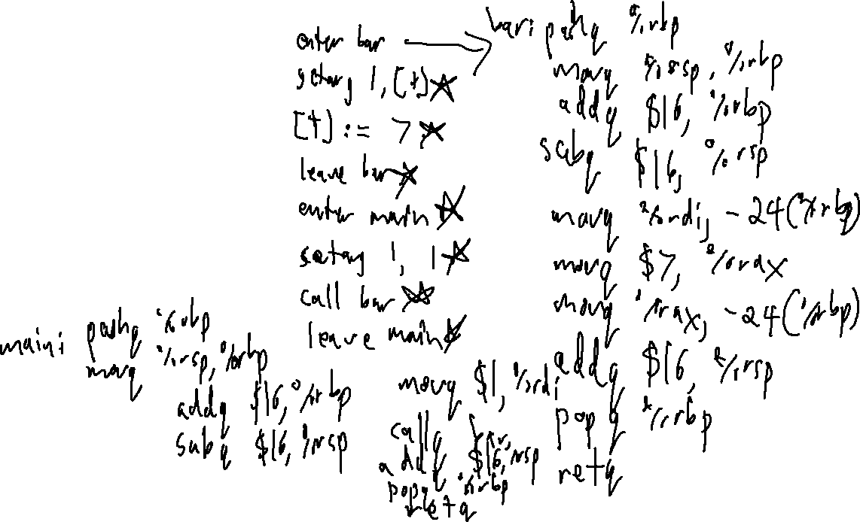
Checkin 29
Write X64 code for the following:
int bar(int t) {
t = 7;
}
int main {
int a;
bar(1);
}

Slide 2
Bonus exercise!
Translate the following code to x64 from
A
a : int;
b : int;
main : () -> int {
a = 3;
b = 1;
while (b < a){
b = b + 1;
}
return 0;
}

Slide 3
Bonus Exercise
main:
pushq %rbp
movq %rsp, %rbp
addq $16, %rbp
subq $32, %rsbp
movq $3, -24(%rbp)
movq $1, -32(%rbp)
LBL_1: movq -32(%rbp), %rbx
movq -24(%rbp), %rax
cmpq %rax, %rbx
setl %dil
andq $0xFF %rdi
movq %rdi, -40(%rbp)
movq -40(%rbp), %rax
cmpq $0, %rax
je LBL_2
movq -32(%rbp), %rbx
movq $1, %rax
addq %rax, %rbx
movq %rbx, -32(%rbp)
jmp LBL_1
LBL_2: nop
movq $0, %rax
jmp LV_main
LV_main: addq $32, $rsp
popq %rbp
retq
Translate the following code to x64 from
A
a : int;
b : int;
main : () -> int {
a = 3;
b = 1;
while (b < a){
b = b + 1;
}
return 0;
}

Slide 4
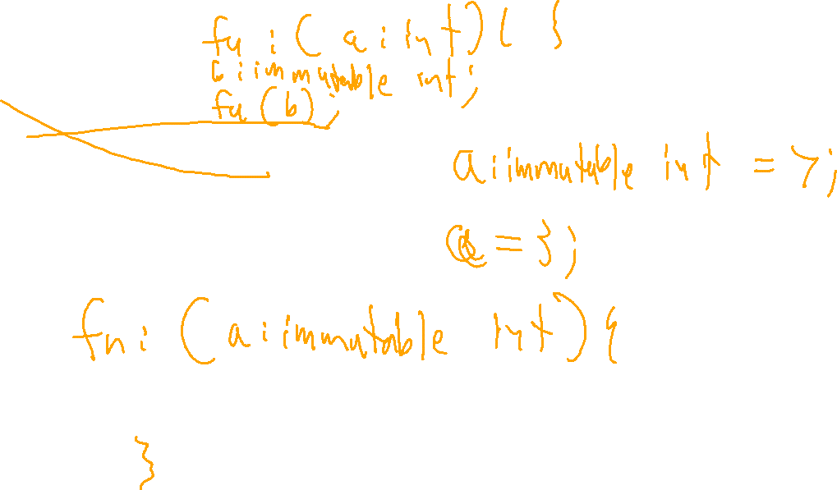
Announcements & Housekeeping
Administrivia

Slide 5

“Other” Codegen
University of Kansas | Drew Davidson

Slide 6

Last Time
Function Codegen
The Control Flow quads
ifz / goto / nop
Function Parameters and Returns
System V ABI conventions
You should know
How to pass primitives arguments
How to access primitive formals
How to return primitive values
How to access return values
Code generation

Slide 7
Stack Alignment
Other Code Generation
System V ABI Assumes %rsp is 16-byte aligned before a call
Easiest interpretation of this: every AR size should be a multiple of 16
void a(){
int v1;
int v2;
}
void v(){
}
8 bytes
8 bytes
8 bytes
8 bytes
8 bytes
8 bytes
Saved RBP
Saved RIP
v2
v1
Saved RBP
Saved RIP
books
locals
books

Slide 8
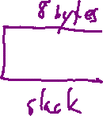
Stack Alignment
Other Code Generation
System V ABI Assumes %rsp is 16-byte aligned before a call
Easiest interpretation of this: every AR size should be a multiple of 16
x misaligned!
void c(){
int v1;
}
8 bytes
8 bytes
8 bytes
v1
Saved RBP
Saved RIP
locals
books

Slide 9

Today’s Lecture
Other Code Generation
Other constructs
Shorter primitive types
Arrays
Pointers
Strings
Structs
Examples (time permitting)
Machine Codegen

Slide 10
Shorter Primitive Types
Other Code Generation
Recall that the instruction suffix indicates operation size
movq %rax, (gbl_var)
movb %al, (gbl_var)
movb %rax, (gbl_var)
Copy 8 byte from
from all the 8-byte of %rax
to address 8-bytes at address gbl_var
Copy 1 byte
from lowest byte of A register
to the 1 byte at address gbl_var
x nonsense!

Slide 11
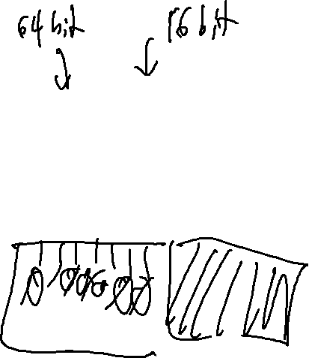
Sign Extension
Other Code Generation
void foo (){
short v;
v = -2S;
}
[v] := -2
movw $-2, %ax
movw %ax, -32(%rbp)
movq %rax, -32(%rbp)
movsx %ax, %rbx
movq %rbx, -32(%rbp)

Slide 12
Today’s Lecture
Other Code Generation
Other constructs
Shorter primitive types
Arrays
Pointers
Strings
Structs
Examples (time permitting)
Machine Codegen

Slide 13
Array Codegen
Other Code Generation
Two parts to worry about:
Data allocation:
  How will we store an array?
Code allocation:
  How are we going to access it?

Slide 14

Array Codegen: Data
Other Code Generation
Looks like sequential values in the AR
Lay out Cell 0 below Cell 1
Access cell i by getting address of cell 0, then adding offset * data type
void fn(){
int a;
int b;
int[20] c;
int d;
}
globals
free space
← stack
fn AR
g1
g2
d
c[0]
c[20]
b
a
books
…
gbl_g1
gbl_g2
sp
bp

Slide 15
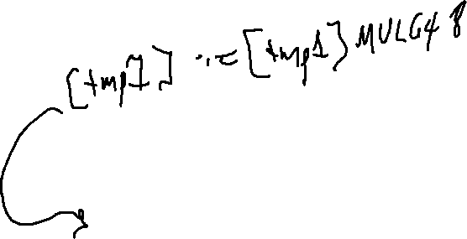
Array Codegen: Code
Other Code Generation
We can do math with the array index and value
Introduce a new Opd type for a memory location
c[3 + a] + b
loc1 := c
[tmp1] := 3 + [a]
loc2 := loc1 + [tmp1]
[tmp2] := [loc2]
[tmp3] := [tmp2] + [b]
globals
free space
← stack
fn AR
g1
g2
d
c[0]
c[20]
b
a
books
…
gbl_g1
gbl_g2
sp
fp

Slide 16
Array Codegen: Code
Other Code Generation
We can do math with the array index and value
Introduce a new Opd for a memory location
c[3 + a] + b
Need a new set of semantics for operations on a memory location
loc1 := c
[tmp1] := 3 + [a]
loc2 := loc1 + [tmp1]
[tmp2] := [loc2]
[tmp3] := [tmp2] + [b]

Slide 17
Array Codegen: Example
Other Code Generation
int[3] aG;
fn : () int main {
int aL[3];
int idx;
aG[1] = aL[idx + 1] + 1;
}

Slide 18
Today’s Lecture
Other Code Generation
Other constructs
Shorter primitive types
Arrays
Pointers
Strings
Structs
Examples (time permitting)
Machine Codegen

Slide 19
Pointer Codegen
Other Code Generation
Once you’ve got arrays, you’ve got pointers
Operations on a pointer are just like operations on an array index
  Need to account for the data type
  May add bounds checking depending on the language
movq -24(%rbp), %rax
movq (%rax), %rbx
movq %rbx, -32(%rbp)
Dereference local int64_t a
[tmp1] = [[a]]
movq (gbl_b), %rax
movb (%rax), %bl
movb %bl, -32(%rbp)
Dereference global int8_t b
[tmp2] = [[b]]

Slide 20
Today’s Lecture
Other Code Generation
Other constructs
Shorter primitive types
Arrays
Pointers
Strings
Structs
Examples (time permitting)
Machine Codegen

Slide 21
String Codegen
Other Code Generation
Put static data in global memory (e.g. .asciz)
finn(){
char * text = “Riverrun past[…]”;
int pages = 676;
finn();
}
text₂
‘R’
‘i’
‘v’
‘e’
‘r’
‘u’
‘n’
‘ ’
0x9200
‘R’
‘i’
‘v’
‘e’
‘p’
‘a’
‘s’
‘t’
finn₂
‘r’
‘u’
‘n’
‘ ’
…
‘p’
‘a’
‘s’
‘t’
pages₂
676
…
text₁
‘R’
‘i’
‘v’
‘e’
…
‘r’
‘u’
‘n’
‘ ’
text₂
0x9200
‘p’
‘a’
‘s’
‘t’
finn₁
finn₂
pages₂
676
…
0x9200
text₁
finn₁
pages₁
676
pages₁
676

Slide 22
String Codegen
Other Code Generation
Put static data in global memory (e.g. .asciz)
finn(){
char * text = “Riverrun past[…]”;
int pages = 676;
finn();
}
.data
str_text:
.asciz “Riverrun past[…]”;
len_text:
.quad 700000
…
.text
finn:
…
movq $str_text, %rdi
movq (len_text), %rsi
movq $0, $rax
syscall
…
0x9200
‘R’
‘i’
‘v’
‘e’
‘r’
‘u’
‘n’
‘ ’
‘p’
‘a’
‘s’
‘t’
…
…
text₂
0x9200
finn₂
pages₂
676
text₁
0x9200
finn₁
pages₁
676

Slide 23
Today’s Lecture
Other Code Generation
Other constructs
Shorter primitive types
Arrays
Pointers
Strings
Structs
Examples (time permitting)
Machine Codegen

Slide 24
Struct/Class Handling
Code Generation III (Other Codegen)
Basic idea:
Flatten all fields, lay out sequentially in memory
  struct TwoInts {
  int f1;
  int f2;
  }
  void fun(){
  int a;
  struct TwoInts t;
  int z;
  }

Slide 25
Struct/Class Handling
Code Generation III (Other Codegen)
  struct TwoInts {
  int f1;
  int f2;
  }
  void fun(){
  int a;
  struct TwoInts t;
  int z;
  }
free space
← stack
fun AR
t
z
f1
f2
a
books
sp
fp

Slide 26
Struct/Class Dot Access
Code Generation III (Other Codegen)
Fortunately, we know the offset from the base of a struct to a certain field statically
  The compiler can do the math for the slot address
  (In contrast with pointers)
struct Inner{
bool hi;
int there;
int c;
};
struct Demo inst;
struct Demo inst2;
inst.b.c = inst2.b.c + 1;
struct Demo{
struct Inner b;
int val;
};
load this address
load this value

Slide 27
What About Our Compiler?
Other Code Generation: Addendum
Much of the preceding discussion won’t be necessary for the projects:
  We do have strings and classes
  Our 3AC already expects that strings will be global

Slide 28
Lecture Outline
Other Code Generation
Other constructs
Scopes
Arrays
Pointers
Strings
Structs
Examples
Not an exhaustive list!
Machine Codegen

Slide 29
Summary
Other Code Generation
Best practices for the language depend on the constructs
Helpful to have a notion of memory address
Immutable strings means they can be global

Slide 30
Next Time
Other Code Generation
We’ll look at optimizing the machine code

Slide 31
(BONUS MATERIAL)
Anything after this slide is bonus material and will not be on exams / projects / written work

Slide 32
Accessing Outer Scopes
Other Code Generation
Static scope
  Variable declared in one procedure and accessed in a nested one
Dynamic scope
  Any variable use not locally declared

Slide 33
Nested Functions
Code Generation III (Other Codegen)
Each function has it’s own AR
  Inner function accesses the outer AR
function main(){
int a = 0;
function subprog(){
a = a + 1;
}
}

Slide 34

Static Scope, Non-Local Access
Code Generation III (Other Codegen)
void procA(){ // level 1
int x, y;
void procB(){ // level 2
void procC(){ //level 3
int z;
void procD(){
int x;
x = z + y;
procB();
}
x = 4;
z = 2;
procB();
procD();
}
x = 3;
y = 5;
}

Slide 35
Access Links
Code Generation III (Other Codegen)
Add an additional field to the AR
%rsp
%rbp
…
local n
local 2
local 1
old RBP
old RIP
free
current AR

Slide 36
Access Links
Code Generation III (Other Codegen)
Add an additional field to the AR
Points to the locals area of the outer function
Sometimes called the static link (since it refers to the static nesting)
%rsp
%rbp
new!
…
local n
local 2
local 1
old RBP
access link
old RIP
free
current AR

Slide 37
Access Links
Code Generation III (Other Codegen)
Add an additional field to the AR
Points to the locals area of the outer function
Sometimes called the static link (since it refers to the static nesting)
NOT NECESSARILY the caller AR
void procA(){
int a1;
void procB(){
}
void procC(){
int c1;
procB();
}
}
%rsp
%rbp
free
current AR
caller AR
enclosing AR

Slide 38
How Access Links Work
Code Generation III (Other Codegen)
We know how many levels to traverse statically
  Example: In nesting level 3 and the variable is in nesting level 1: go back access links
  (3 – 1) 2 levels

Slide 39
Traversing Access Links
Code Generation III (Other Codegen)
Using 1 access link
movq -16(%rbp), %rax
movq -32(%rax), %rax
Using 4 access links
movq -16(%rbp), %rax
movq -16(%rax) %rax
movq -16(%rax) %rax
movq -32(%rax), %rax

Slide 40
Thinking About Access Links
Code Generation III (Other Codegen)
We know the variable we want to access statically
  Why don’t we just index into the parent’s AR using a large positive offset from $fp?
  movq 38(%rbp) %rax

