Slide 1
Check-In #27
Review: Activation Records
Show the layout of an activation record with two 64-bit locals. Write the function prologue and epilogue corresponding to that function

Slide 2
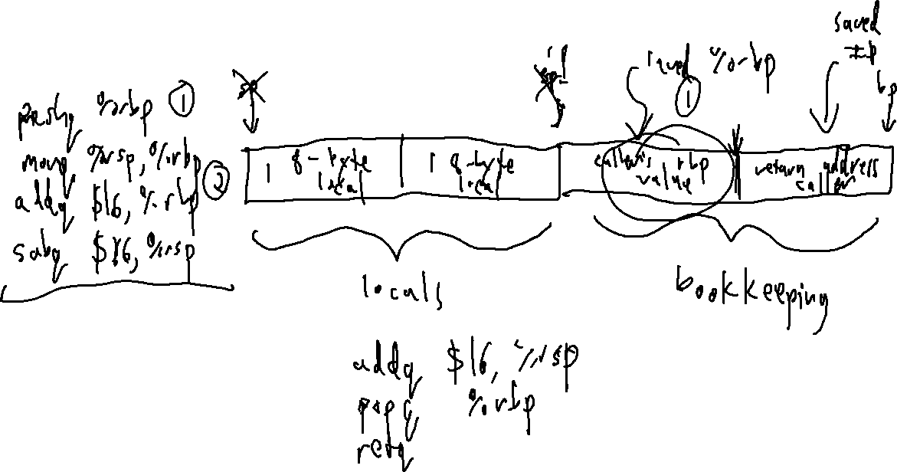
Check-In #27 Solution
Review: Activation Records

Slide 3
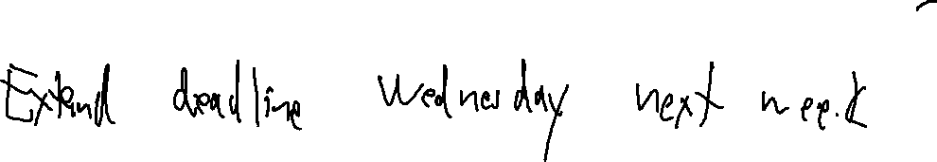
Announcements
Administrivia
P5 outdated instructions

Slide 4

Statement Code Generation
University of Kansas | Drew Davidson

Slide 5

Last Lecture
Activation Records
Managing the Stack
Managing data
Managing control
Architecture

Slide 6

Big Picture: Architecture Aims and Means
Review: Activation Records

Slide 7
Big Picture: Architecture Aims and Means
Review: Activation Records
Aim: Simulate source code concepts
Means: Leverage x64 capabilities
Functions with local variables
A region of available memory bounded by rsp
Call chains
subq $X, %rsp: claim X bytes on the stack
addq $X, %rsp: free X bytes on the stack
movq(%rsp): access top of stack
Divide used memory into frames, one frame per function invocation
Program memory
%rsp
Track the base of the current frame with %rbp
Address
Address
Address
Address
Address
Address
Address
0x9006
0x9007
0x9008
0x9009
0x900A
0x900B
0x900C
Store return address and previous frame base in the activation record
Free space
<- Stack

Slide 8
Big Picture: Architecture Aims and Means
Review: Activation Records
Two useful instructions for manipulating stack memory
pushq <opd> - decrement %rsp by 8, place opd in memory at %rsp location
popq <opd> - read value at %rsp location, incremenent %rsp by 8
Two useful instructions for simulating call chains
callq <lbl> - effectively does pushq the return point instruction’s address, then sets %rip to <lbl>
retq – effectively does popq %rip

Slide 9
Maintaining Activation Records
Review: Activation Records
Each activation record can store…
Local data for a function invocation
Enough bookkeeping to restore the caller’s frame
AR setup / break-down
Claim AR memory with the function prologue at entry to each function
pushq %rbp
movq %rsp, %rbp
addq $16, %rbp
subq $X, %rsp
Release AR memory with the function epilogue at exit point of the function
addq $X, %rsp
popq $rbp
retq

Slide 10
Addressing modes
Toward Local Variables
Some Nice “Shortcuts”
Often want to read memory at a fixed offset from some register
“the memory at 8 bytes before %rbp”
Good news! X64 can do that:
movq -8(%rbp), %rax
This is a very handy addressing mode
leaq -8(%rbp), %rax
movq %rbp, %rdx
subq $8, %rdx
movq (%rdx), %rax
“Move the value AT
%rbp – 8 into %rax”
=
movq %rbp, %rdx
subq $8, %rdx
movq %rdx, %rax
“Move the value OF
%rbp – 8 into %rax”
=

Slide 11
Last Lecture
Activation Records
Managing the Stack
Managing data
Managing control
You Should Know
How to code up stack frames
The function prologue
The function epilogue
Architecture

Slide 12

Where We’re At
Progress Pics
Assembled quite a few x64 concepts
Basic data manipulation (movq)
Basic math (addq, idivq, etc)
Global data (.data, .quad, .byte)
Local data
Function calls
This is really all we need for a basic language!

Slide 13
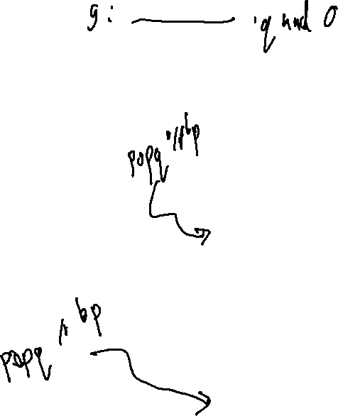
A Less-Trivial x64 Program
Working with Activation Records
.data
.quad g 0
.globl main
.text
fn_v: pushq %rbp
movq %rsp, %rbp
addq $16, %rbp
subq $16, %rsp
movq (g), %rax
subq $1, %rax
movq %rax, -24(%rbp)
addq $16, %rsp
retq
main: pushq %rbp
movq %rsp, %rbp
addq $16, %rbp
subq $16, $rsp
movq $2, (g)
callq fn_v
addq $16
retq
g : int;
v : () -> void {
local : int;
k :int;
local = g – 1;
}
main : () -> int {
loc1 : int;
loc2 : int;
g = 2;
v();
};

Slide 14

COMPILER
Code Generation
Optimization
Architecture
Semantic Analysis
Runtime Environments
Syntactic
Definition
Parsing
Syntax-Dir
Translation
Regular
Languages
Lexical Analysis
14

Slide 15

Lecture Outline
Statement Code Generation
From Quads to Assembly
Approach Overview
Planning out memory
Writing out x64
Code generation

Slide 16


Representing Abstract Constructs
Statement Code Generation
Combine (simple) target language constructs…
Logical ops
math ops
Stack ops
jumps
…to build (complex) source language constructs
output
program

Slide 17
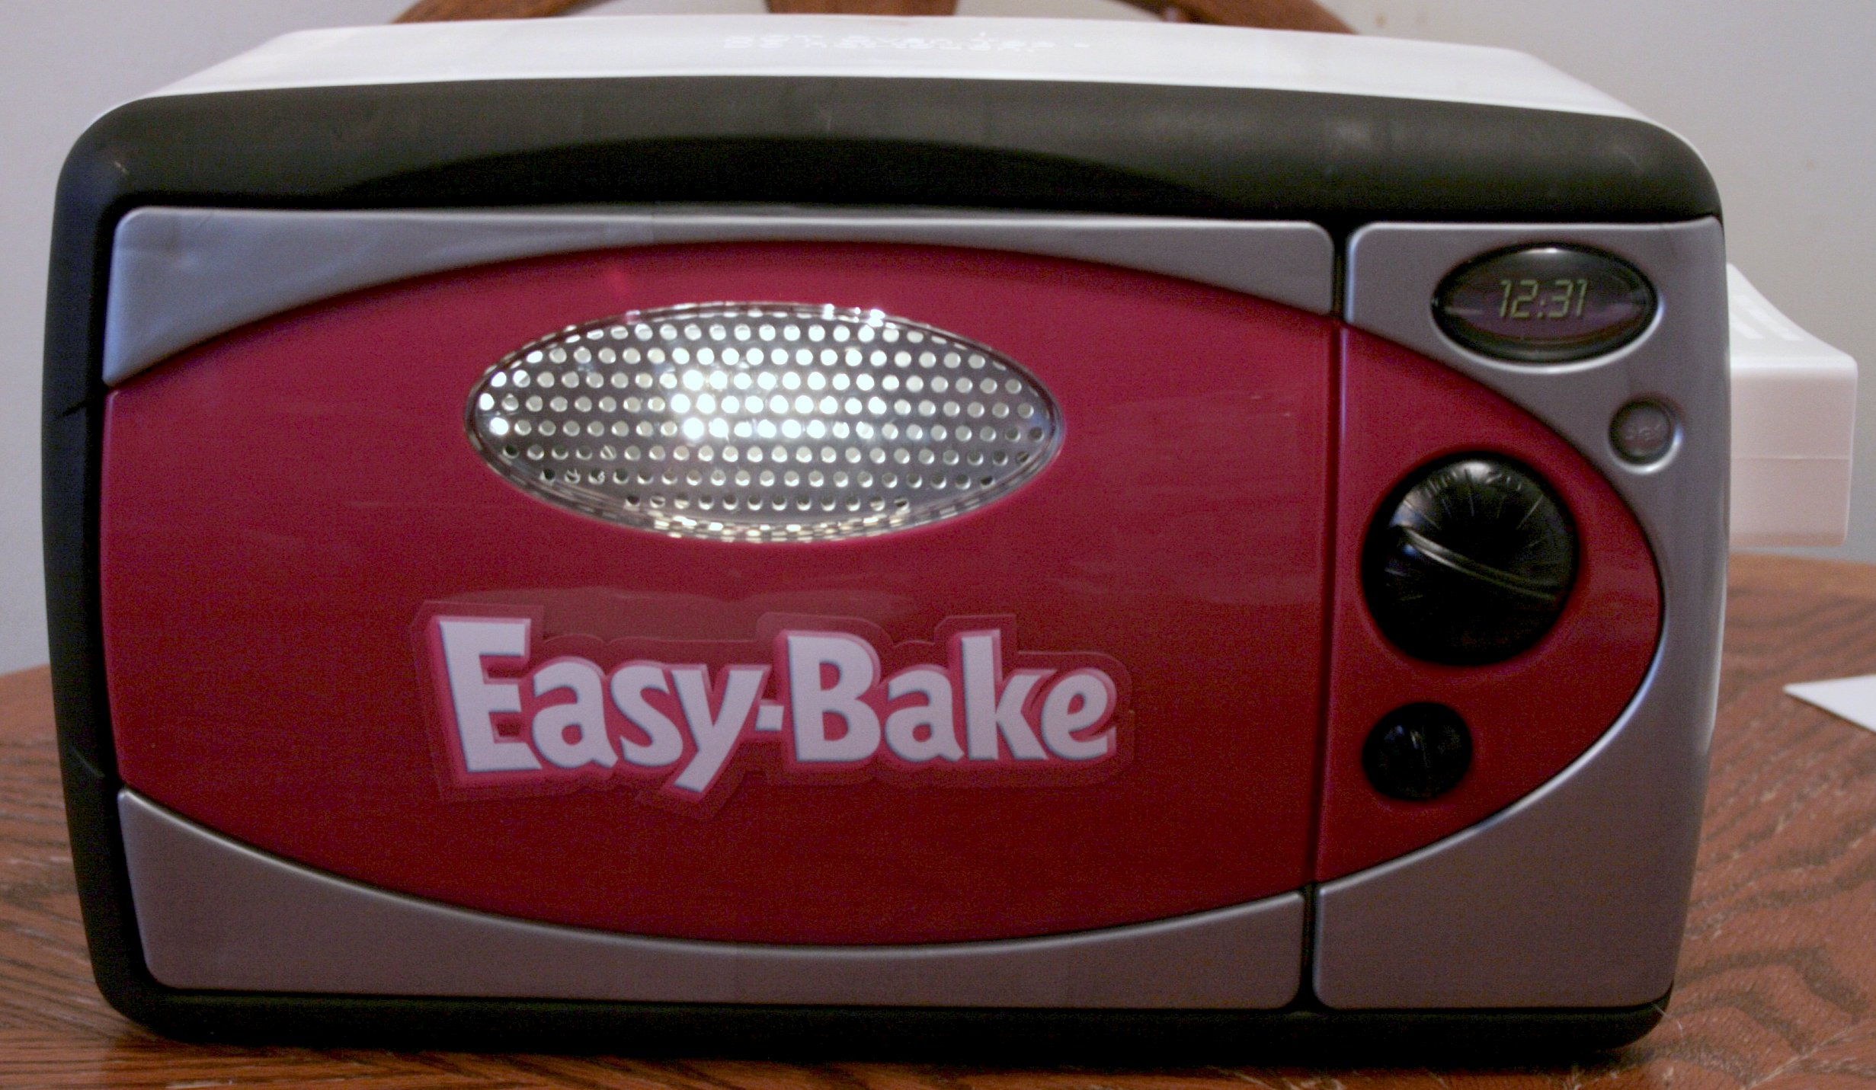
Our Approach: Small Steps
Code Generation
2 passes over IRProgram (like passes over AST)
  Allocate memory for opds (data pass)
  Generate code for quads (code pass)

Slide 18

Code Generation Objectives
Designing Code Generators
Two high level goals:
  Generate correct code
  Generate efficient code
It can be difficult to achieve both at once
  Efficient code can be harder to understand
  Efficient code may have unanticipated side effects
Top priority
Difficult

Slide 19
Our Approach: Small Steps
Code Generation
2 passes over IRProgram (like passes over AST)
  Allocate memory for opds (data pass)
  Generate code for quads (code pass)
Preparing the
3AC memory
layout

Slide 20
Variable Allocation
Code Generation
Big picture:
Every variable needs space in enough space in memory for its type
Every quad using that variable needs to access the same location
Need a mix of static/dynamic allocation
Put globals/strings at fixed addresses in memory (absolute locations)
Put locals/formals at stack offsets in memory (relative locations)
caller
%rsp
caller
%rbp
%rsp
%rbp
Program memory
Address
Address
Address
Address
Address
Address
Address
Address
Address
Address
Address
Address
Address
0x0000
0x0001
0x0002
0x0003
0x0004
0x0005
0x0006
0x0007
0x0008
0x0009
0x000A
0x000B
0x000C
…
…
…
…
…
(instructions)
int16 g
Malloc
data
int16 v
save IP
save BP
int16 k
save IP
save BP
function
code
global
vars
Current Activation Record
Caller Activation Record
code
data
Heap
<- Stack

Slide 21
Allocation: In Code (suggestion)
Code Generation
Add a location field (std::string) to semantic symbols
All related SymOpds have pointers to the same symbol
Location can be a string
For globals, the label that you’ll write
For locals, the stack offset you’ll arrange

Slide 22
Variable Allocation: Globals
Code Generation
3AC Code
X64 Code
… in .data section …
[g] := 4
gbl_g:
.quad 0
location:
At label
gbl_g
Where g is a global int
… somewhere in .text section …
movq $4, (gbl_g)
Compiler Data Structure
SemSymbol
SymOpd
kind: var
type: int
IR
Program
globals
g
location: “gbl_g”
Procs
main
LitOpd
locals
(none)
val: 4
EnterQuad
quads
AssignQuad
dst
src
LeaveQuad

Slide 23
Variable Allocation: Locals
Code Generation
3AC Code
X64 Code
[v] := 7
… assume stack frame setup …
location:
At offset
-24(%rbp)
… somewhere in main’s asm …
Where v is a local int
movq $7, -24(%rbp)
Compiler Data Structure
SemSymbol
kind: var
type: int
IR
Program
globals
(none)
location: “-24(%rbp)”
SymOpd
Procs
main
v
locals
LitOpd
EnterQuad
val: 7
quads
AssignQuad
dst
src
LeaveQuad

Slide 24
Our Approach: Small Steps
Code Generation
2 passes over IRProgram (like passes over AST)
  Allocate memory for opds (data pass)
  Generate code for quads (code pass)
Write the
assembly
file

Slide 25
Assembly Directives/Initialization
Code Generation
We’re gonna write the whole file in one shot
Aided greatly by our preparatory layout pass
Also aided by the assembler
Write out .data section:
.data
.globl: main
<global1_label> : <global1_type> <global1_val>
…
<global1_label> : <global1_type> <global1_val>
Walk each 3AC Procedure, output each quad
enter main

Slide 26

Generating Code for Quads
Code Generation
Compiling

Slide 27
Generating Code for Quads
Code Generation
enter <proc>
leave <proc>
<opd> := <opd>
<opd> := <opr> <opd>
<opd> := <opd> <opr> <opd>
<lbl>: <INSTR>
ifz <opd> goto <lbl>
goto Li
nop
call <name>
setin <int> <operand>
getin <int> <operand>
setout <int> <operand>
getout <int> <operand>

Slide 28
Generating Code for Quads: enter/leave
Code Generation
enter <proc>
leave <proc>
On entry to the function:
Set up the activation record
On exit from the function
Break down the activation record
Prologue
Epilogue
pushq %rbp
movq %rsp, %rbp
addq $16, %rbp
subq $X, %rsp
addq $X, %rsp
popq %rbp
retq
Make function prologue/epilogue
28

Slide 29
Generating Code for Quads: enter/leave
Code Generation
enter <proc>
leave <proc>
Prologue
Epilogue
src code
3ac code
asm code
pushq %rbp
movq %rsp, %rbp
addq $16, %rbp
subq $X, %rsp
addq $X, %rsp
popq %rbp
retq
int main(){
}
enter main
leave main
lbl_main: pushq %rbp
movq %rsp, %rbp
addq $16, %rbp
subq $0, %rsp
addq $0, %rsp
pushq %rbp
retq
29

Slide 30
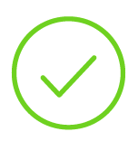
Generating Code for Quads
Code Generation
enter <proc>
leave <proc>
<opd> := <opd>
For assignment-style quads…
<opd> := <opr> <opd>
<opd> := <opd> <opr> <opd>
1) Load operand src locations into registers
<lbl>: <INSTR>
2) Compute a value to register
ifz <opd> goto <lbl>
3) Store result at dst location
goto Li
nop
call <name>
setin <int> <operand>
getin <int> <operand>
setout <int> <operand>
getout <int> <operand>

Slide 31
Assignment-Style Quads
Code Generation
SymOpd
Symbol location: “gbl_a”
3AC
For assignment-style quads…
[a] := [b] + 4
SymOpd
Symbol location: “-24(%rbp)
1) Load operand src locations into registers
2) Compute a value to register
3) Store result at dst location
ASM
1)
movq -24(%rbp), %rax
1)
movq $4, %rbx
2)
addq %rbx %rax
3)
movq %rax (gbl_a)

Slide 32
Questions?
Code Generation

