Slide 1
Check-in #26
Review: x64 Practice
In what direction does the stack grow?

Slide 2
Administrivia
Announcements

Slide 3
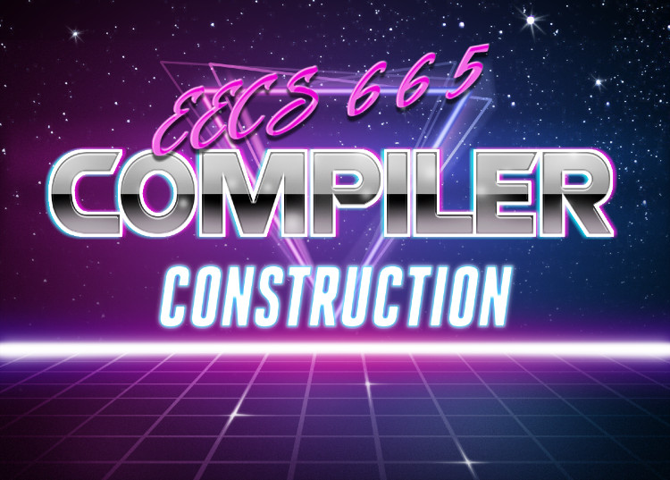
Activation Records
University of Kansas | Drew Davidson

Slide 4

Previously
Memory Layout
Memory Layout
Static allocation
The heap and the stack
Architecture

Slide 5
The Memory Sections Concept
Review: Memory Layout
Let’s do a quick
recursion example
Memory Zones for different uses
Text section (assembled opcodes of the program)
Data section (global variables at hard-coded locations)
Heap (runtime-allocated memory – malloc and new)
Stack (function locals and bookkeeping)
Free (unallocated space)
We’ll visualize just these sections
Address
Address
Address
Address
Address
Address
Address
Address
Address
Address
Address
Address
Address
0x0000
0x0001
0x0002
0x0003
0x0004
0x0005
0x0006
0x0007
0x0008
0x0009
0x000A
0x000B
0x000C
(instructions)
global
vars
heap data
…
callee’s callee locals
main’s callee locals
main’s locals
function
code
callee’s callee
main’s callee
main
code
data
Heap ->
free
<- Stack

Slide 6
The Memory Sections Concept
Review: Memory Layout
1. int16 g = 2;
2. void main(){
3. int16 a;
4. a = g;
5. g = g – 1;
6. if (0 < g){
7. main();
8. }
9. cout << a;
10. }
Address
Address
Address
Address
Address
Address
Address
Address
0x0002
0x0003
0x0007
0x0008
0x0009
0x000A
0x000B
0x000C
global
vars
…
callee’s callee locals
main’s callee locals
main’s locals
callee’s callee
main’s callee
main
data
<- Stack

Slide 7
The Memory Sections Concept
Review: Memory Layout
Code Operations
1. int16 g = 2;
2. void main(){
3. int16 a;
4. a = g;
5. g = g – 1;
6. if (0 < g){
7. main();
8. }
9. cout << a;
10. }
On initialization
- globals set (g = 2)
- setup empty stack
- setup call frame
Enter main
Address
Address
Address
Address
Address
Address
Address
Address
0x0002
0x0003
0x0007
0x0008
0x0009
0x000A
0x000B
0x000C
2
int16 g
…
unused
global
vars
data
<- Stack

Slide 8
The Memory Sections Concept
Review: Memory Layout
Code Operations
1. int16 g = 2;
2. void main(){
3. int16 a;
4. a = g;
5. g = g – 1;
6. if (0 < g){
7. main();
8. }
9. cout << a;
10. }
On initialization
- globals set (g = 2)
- setup empty stack
- setup call frame
- update local a
Enter main
- update global g
- call main
- setup call frame
Enter main
Address
Address
Address
Address
Address
Address
Address
Address
0x0002
0x0003
0x0007
0x0008
0x0009
0x000A
0x000B
0x000C
1
2
2
int16 g
…
unused
int16 a
global
vars
Main frame 1
data
<- Stack

Slide 9
The Memory Sections Concept
Review: Memory Layout
Code Operations
Output
- globals set (g = 2)
1
2
1. int16 g = 2;
2. void main(){
3. int16 a;
4. a = g;
5. g = g – 1;
6. if (0 < g){
7. main();
8. }
9. cout << a;
10. }
On initialization
- setup empty stack
- setup call frame
- update local a
Enter main
- update global g
- call main
- setup call frame
- update local a
Enter main
- update global g
- print a
- return
Address
Address
Address
Address
Address
Address
Address
Address
0x0002
0x0003
0x0007
0x0008
0x0009
0x000A
0x000B
0x000C
0
1
2
2
1
int16 g
…
unused
int16 a
int16 a
global
vars
Main frame 1
Main frame 1
data
<- Stack

Slide 10
The Memory Sections Concept
Review: Memory Layout
Code Operations
Output
- globals set (g = 2)
1
2
1. int16 g = 2;
2. void main(){
3. int16 a;
4. a = g;
5. g = g – 1;
6. if (0 < g){
7. main();
8. }
9. cout << a;
10. }
On initialization
- setup empty stack
- setup call frame
- update local a
Enter main
- update global g
- call main
- print a
- return
- setup call frame
- update local a
Enter main
- update global g
- print a
- return
Address
Address
Address
Address
Address
Address
Address
Address
0x0002
0x0003
0x0007
0x0008
0x0009
0x000A
0x000B
0x000C
0
1
2
2
int16 g
…
unused
int16 a
global
vars
Main frame 1
data
<- Stack

Slide 11
The Memory Sections Concept
Review: Memory Layout
Code Operations
Output
- globals set (g = 2)
1
2
1. int16 g = 2;
2. void main(){
3. int16 a;
4. a = g;
5. g = g – 1;
6. if (0 < g){
7. main();
8. }
9. cout << a;
10. }
On initialization
- setup empty stack
- setup call frame
- update local a
The compiler needs
to write code to do
all of this!
Enter main
- update global g
- call main
- print a
- return
- setup call frame
- update local a
Enter main
- update global g
- print a
- return
Address
Address
Address
Address
Address
Address
Address
Address
0x0002
0x0003
0x0007
0x0008
0x0009
0x000A
0x000B
0x000C
0
1
2
int16 g
…
unused
global
vars
data
<- Stack

Slide 12
Today’s Outline
Activation Records
Managing the Stack
Managing data
Managing control
Architecture

Slide 13

Stack Frames Complicate Code
Beyond Static Allocation
Program must manage usage of stack memory

Slide 14
Stack Pointer as Register
Beyond Static Allocation
Program must manage usage of stack memory
Keep a pointer that tracks the base of the entire stack size
%rsp = “stack pointer”: track the edge of the stack

Slide 15
Review: The Stack
Beyond Static Allocation
int16 g = 2;
void main(){
int16 a;
a = g;
g = g – 1;
if (0 < g){
main();
}
TOCONSOLE a;
}
Keep a pointer that tracks the base of the entire stack size
%rsp = “stack pointer”: track the edge of the stack
%rsp
At Program entry
Address
Address
Address
Address
Address
Address
Address
Address
Address
Address
Address
Address
Address
0x0000
0x0001
0x0002
0x0003
0x0004
0x0005
0x0006
0x0007
0x0008
0x0009
0x000A
0x000B
0x000C
…
…
…
…
…
(instructions)
int16 g
Malloc’ed data
unused
function
code
global
vars
code
data
Heap ->
free
<- Stack

Slide 16
Review: The Stack
Beyond Static Allocation
int16 g = 2;
void main(){
int16 a;
a = g;
g = g – 1;
if (0 < g){
main();
}
TOCONSOLE a;
}
Keep a pointer that tracks the base of the entire stack size
%rsp = “stack pointer”: track the edge of the stack
%rsp
In first main activation
Address
Address
Address
Address
Address
Address
Address
Address
Address
Address
Address
Address
Address
0x0000
0x0001
0x0002
0x0003
0x0004
0x0005
0x0006
0x0007
0x0008
0x0009
0x000A
0x000B
0x000C
…
…
…
…
…
(instructions)
int16 g
Malloc’ed data
unused
int16 a
function
code
global
vars
Main frame 1
code
data
Heap ->
free
<- Stack

Slide 17
Review: The Stack
Beyond Static Allocation
int16 g = 2;
void main(){
int16 a;
a = g;
g = g – 1;
if (0 < g){
main();
}
TOCONSOLE a;
}
Keep a pointer that tracks the base of the entire stack size
%rsp = “stack pointer”: track the edge of the stack
%rsp
In recursive main activation
Address
Address
Address
Address
Address
Address
Address
Address
Address
Address
Address
Address
Address
0x0000
0x0001
0x0002
0x0003
0x0004
0x0005
0x0006
0x0007
0x0008
0x0009
0x000A
0x000B
0x000C
…
…
…
…
…
(instructions)
int16 g
Malloc’ed data
unused
int16 a
int16 a
function
code
global
vars
Main frame 2
Main frame 1
code
data
Heap ->
free
<- Stack

Slide 18
Stack Frames Complicate Code
Beyond Static Allocation
Program must manage usage of stack memory
Variable’s address is no longer static: can’t be hard-coded

Slide 19
Frame-Relative Variable Addressing
Beyond Static Allocation
Variable’s address is no longer static: can’t be hard-coded
int16 g = 2;
void main(){
int16 a;
a = g;
g = g – 1;
if (0 < g){
main();
}
TOCONSOLE a;
}
Keep a pointer that tracks the base of the current stack frame
%rsp = “stack pointer”: track the edge of the stack
%rbp = “base pointer”: track the base (beginning of the current frame)

Slide 20
Frame-Relative Variable Addressing
Beyond Static Allocation
int16 g = 2;
void main(){
int16 a;
a = g;
g = g – 1;
if (0 < g){
main();
}
TOCONSOLE a;
}
Keep a pointer that tracks the base of the current stack frame
%rsp = “stack pointer”: track the edge of the stack
%rbp = “base pointer”: track the base (beginning of the current frame)
%rbp
%rsp
At Program entry
Address
Address
Address
Address
Address
Address
Address
Address
Address
Address
Address
Address
Address
0x0000
0x0001
0x0002
0x0003
0x0004
0x0005
0x0006
0x0007
0x0008
0x0009
0x000A
0x000B
0x000C
…
…
…
…
…
(instructions)
int16 g
Malloc’ed data
unused
function
code
global
vars
code
data
Heap ->
free
<- Stack

Slide 21
Frame-Relative Variable Addressing
Beyond Static Allocation
int16 g = 2;
void main(){
int16 a;
a = g;
g = g – 1;
if (0 < g){
main();
}
TOCONSOLE a;
}
Keep a pointer that tracks the base of the current stack frame
%rsp = “stack pointer”: track the edge of the stack
%rbp = “base pointer”: track the base (beginning of the current frame)
%rsp
%rbp
In initial main activation
Address
Address
Address
Address
Address
Address
Address
Address
Address
Address
Address
Address
Address
0x0000
0x0001
0x0002
0x0003
0x0004
0x0005
0x0006
0x0007
0x0008
0x0009
0x000A
0x000B
0x000C
…
…
…
…
…
(instructions)
int16 g
Malloc’ed data
unused
int16 a
function
code
global
vars
Main frame 1
code
data
Heap ->
free
<- Stack

Slide 22
Frame-Relative Variable Addressing
Beyond Static Allocation
int16 g = 2;
void main(){
int16 a;
a = g;
g = g – 1;
if (0 < g){
main();
}
TOCONSOLE a;
}
Keep a pointer that tracks the base of the current stack frame
%rsp = “stack pointer”: track the edge of the stack
%rbp = “base pointer”: track the base (beginning of the current frame)
%rsp
%rbp
In recursive main activation
Address
Address
Address
Address
Address
Address
Address
Address
Address
Address
Address
Address
Address
0x0000
0x0001
0x0002
0x0003
0x0004
0x0005
0x0006
0x0007
0x0008
0x0009
0x000A
0x000B
0x000C
…
…
…
…
…
(instructions)
int16 g
Malloc’ed data
unused
int16 a
int16 a
function
code
global
vars
Main frame 2
Main frame 1
code
data
Heap ->
free
<- Stack

Slide 23
Complicating Code
Beyond Static Allocation
Program must manage usage of stack memory
Variable’s address is no longer static: can’t be hard-coded
Return address is not static

Slide 24
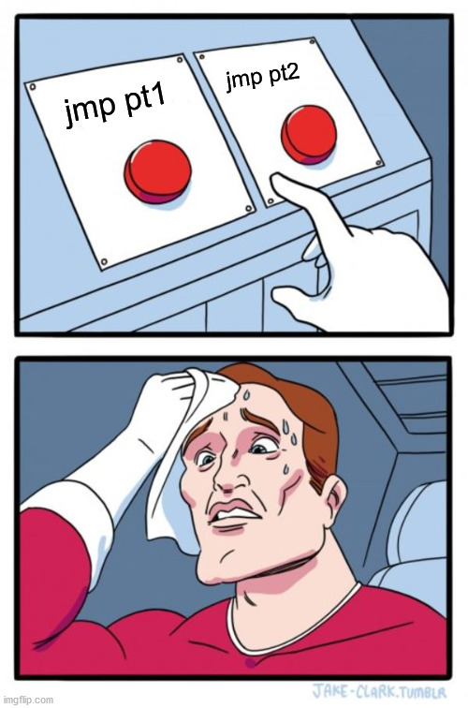
Returning Control to Caller x64 Stack Frames
We need a way to transfer control into a callee
We need a way to transfer control back to the caller
Could we just use jmp for this?
.globl _start
.data
gbl_g: .quad 5
.text
fn_bar:
movq (glb_g), %rax
addq $5, %rax
movq %rax, (glb_g)
jmp pt1
int g = 5;
void bar(){
g = g + 5;
}
void main(){
bar();
}
bar();
_start:
jmp fn_bar
pt1: nop
jmp fn_bar
pt2: nop

Slide 25
Callq/Retq
Parameter Passing
callq: Do a jump, save the address of the instruction to which to return
retq: Jump back to the saved address

Slide 26
Restoring the Caller’s Frame
Beyond Static Allocation
When we’re done with a call, we need to restore the OLD frame
Return the instruction pointer to the call site
Restore the base pointer to the base of the caller’s frame
Restore the stack pointer to the edge of the caller’s frame
We need to keep track of some of this information!

Slide 27
Call Stack Bookkeeping
Beyond Static Allocation
We need to store (on the stack):
The call site to resume execution after call
The base pointer to restore the old stack frame after call
Add bookkeeping space at the
beginning of the AR
old
%rsp
old
%rbp
%rsp
%rbp
Address
Address
Address
Address
Address
Address
Address
Address
Address
Address
Address
Address
Address
0x0000
0x0001
0x0002
0x0003
0x0004
0x0005
0x0006
0x0007
0x0008
0x0009
0x000A
0x000B
0x000C
…
…
…
…
…
(instructions)
int16 g
Malloc
data
unused
int16 a
int16 a
function
code
global
vars
Main frame 2
Main frame 1
code
data
Heap
free
<- Stack

Slide 28
Call Stack Bookkeeping
Beyond Static Allocation
We need to store (on the stack):
The call site to resume execution after call
The base pointer to restore the old stack frame after call
Add bookkeeping space at the
beginning of the AR
old
%rsp
old
%rbp
%rsp
%rbp
Address
Address
Address
Address
Address
Address
Address
Address
Address
Address
Address
Address
Address
0x0000
0x0001
0x0002
0x0003
0x0004
0x0005
0x0006
0x0007
0x0008
0x0009
0x000A
0x000B
0x000C
…
…
…
…
…
(instructions)
int16 g
Malloc
data
int16 a
save BP
save IP
int16 a
save BP
save IP
function
code
global
vars
Main frame 2
Main frame 1
code
data
Heap
<- Stack

Slide 29
Solving Stack Frame Complications
Beyond Static Allocation
Program must manage usage of stack memory
Variable’s address is no longer static: can’t be hard-coded
Return address is not static

Slide 30
Solving Stack Frame Complications
Beyond Static Allocation
Program must manage usage of stack memory
%rsp tracks the stack edge
Variable’s address is no longer static: can’t be hard-coded
%rbp tracks the current frame’s base
allows restore of
data context
Caller’s rbp saved on the stack when we enter a callee
Return address is not static
allows restore of
control context
Call instruction saves the return point on top of the stack
Ret instruction jumps to the address on top of the stack

Slide 31
Putting it all together
Beyond Static Allocation
Let’s show how stack frames are maintained in code
Save caller context as bookkeeping values
Set up callee frame
Address locals relative to the frame
Break down the callee frame
Restore caller context from bookkeeping values

Slide 32
Putting it all together
Beyond Static Allocation
Two new instructions will be convenient to add
Pushq <op1> - decrements %rsp by 8, and stores op1 at (%rsp)

Slide 33
Putting it all together
Beyond Static Allocation
Two new instructions will be convenient to add
Pushq <op1> - decrements %rsp by 8, and stores op1 at (%rsp)
Popq <op1> - retrieves the value at %rsp, increments %rsp by 8

Slide 34

Activation Records
Where we left off…
int g;
void bar(){
int b1;
}
void foo(){
int f1;
int f2;
bar();
}
%rsp:
%rbp:
0x00c8
0x00e8
0x0020
0x0068
0x0090
0x0098
0x00a0
0x00a8
0x00b0
0x00b8
0x00c0
0x00c8
0x00d0
0x00d8
0x00e0
0x00e8
int f2
old RBP
int f1
“books”
foo
bar
int g
Malloc data
old RIP
x64 instructions
globals
foo AR
code
data
heap $→$
free
<- Stack

Slide 35
Activation Records
Where we left off…
int g;
void bar(){
int b1;
}
void foo(){
int f1;
int f2;
bar();
}
%rsp:
%rbp:
0x00c8
0x00e8
0x0020
0x0068
0x0090
0x0098
0x00a0
0x00a8
0x00b0
0x00b8
0x00c0
0x00c8
0x00d0
0x00d8
0x00e0
0x00e8
“books”
foo
bar
int g
Malloc data
int f2
int f1
old RBP
old RIP
x64 instructions
globals
foo AR
code
data
heap $→$
free
<- Stack

Slide 36
Activation Records
Where we Left off…
int g;
void bar(){
int b1;
}
void foo(){
int f1;
int f2;
bar();
}
Let’s zoom in on just the stack + free space
(since that’s all that changes for AR setup/teardown
%rsp:
%rbp:
0x00b0
0x00c8
0x0020
0x0068
0x0090
0x0098
0x00a0
0x00a8
0x00b0
0x00b8
0x00c0
0x00c8
0x00d0
0x00d8
0x00e0
0x00e8
0x00e0
0x0028ish
“books”
foo
bar
int g
Malloc data
int b1
old RBP
old RIP
int f2
int f1
old RBP
old RIP
x64 instructions
globals
bar AR
foo AR
code
data
heap $→$
free
<- Stack

Slide 37
Activation Record Setup
Finishing off ARs
%rsp
%rbp
0x00c8
0x00e8
0x00b0
0x00b8
0x00c0
0x00c8
0x00d0
0x00d8
0x00e0
0x00e8
“books”
int g;
void bar(){
int b1;
}
void foo(){
int f1;
int f2;
bar();
}
int f2
int f1
old RBP
old RIP
free
foo AR
How do we get
from the above ARs
to the below ARs?
enter bar
leave bar
enter foo
call bar
leave foo
%rsp:
%rbp:
0x00b0
0x00c8
0x00b0
0x00b8
0x00c0
0x00c8
0x00d0
0x00d8
0x00e0
0x00e8
0x00e8
0x0028ish
“books”
int b1
old RBP
old RIP
int f2
int f1
old RBP
old RIP
bar AR
foo AR

Slide 38
Activation Record Setup
Finishing off ARs
%rsp
%rbp
0x00c8
0x00e8
0x00b0
0x00b8
0x00c0
0x00c8
0x00d0
0x00d8
0x00e0
0x00e8
“books”
int g;
void bar(){
int b1;
}
void foo(){
int f1;
int f2;
bar();
}
int f2
int f1
old RBP
old RIP
free
foo AR
callq bar
%rsp
%rbp
0x00c8
0x00e8
0x00b0
0x00b8
0x00c0
0x00c8
0x00d0
0x00d8
0x00e0
0x00e8
0x0028ish
“books”
old RIP
int f2
int f1
old RBP
old RIP
free
bar AR
foo AR
enter bar
leave bar
enter foo
call bar
leave foo
%rsp:
%rbp:
0x00b0
0x00c8
0x00b0
0x00b8
0x00c0
0x00c8
0x00d0
0x00d8
0x00e0
0x00e8
0x00e8
0x0028ish
“books”
int b1
old RBP
old RIP
int f2
int f1
old RBP
old RIP
bar AR
foo AR

Slide 39
Activation Record Setup
Finishing off ARs
%rsp
%rbp
0x00c8
0x00e8
0x00b0
0x00b8
0x00c0
0x00c8
0x00d0
0x00d8
0x00e0
0x00e8
“books”
int g;
void bar(){
int b1;
}
void foo(){
int f1;
int f2;
bar();
}
int f2
int f1
old RBP
old RIP
free
foo AR
-8
callq bar
%rsp
%rsp
%rbp
0x00c0
0x00c8
0x00e8
0x00b0
0x00b8
0x00c0
0x00c8
0x00d0
0x00d8
0x00e0
0x00e8
0x00e8
0x0028ish
“books”
old RIP
int f2
int f1
old RBP
old RIP
free
bar AR
foo AR
enter bar
leave bar
enter foo
call bar
leave foo
%rsp:
%rbp:
0x00b0
0x00c8
0x00b0
0x00b8
0x00c0
0x00c8
0x00d0
0x00d8
0x00e0
0x00e8
0x00e8
0x0028ish
“books”
int b1
old RBP
old RIP
int f2
int f1
old RBP
old RIP
bar AR
foo AR

Slide 40
Activation Record Setup
Finishing off ARs
%rsp
%rbp
0x00c8
0x00e8
0x00b0
0x00b8
0x00c0
0x00c8
0x00d0
0x00d8
0x00e0
0x00e8
“books”
int g;
void bar(){
int b1;
}
void foo(){
int f1;
int f2;
bar();
}
int f2
int f1
old RBP
old RIP
free
foo AR
-8
callq bar
%rsp
%rsp
store in value at %rsp
%rbp
0x00b8
0x00c0
0x00e8
pushq %rbp
0x00b0
0x00b8
0x00c0
0x00c8
0x00d0
0x00d8
0x00e0
0x00e8
0x00e8
0x0028ish
“books”
old RIP
int f2
int f1
old RBP
old RIP
free
bar AR
foo AR
enter bar
leave bar
enter foo
call bar
leave foo
%rsp:
%rbp:
0x00b0
0x00c8
0x00b0
0x00b8
0x00c0
0x00c8
0x00d0
0x00d8
0x00e0
0x00e8
0x00e8
0x0028ish
“books”
int b1
old RBP
old RIP
int f2
int f1
old RBP
old RIP
bar AR
foo AR

Slide 41
Activation Record Setup
Finishing off ARs
%rsp
%rbp
0x00c8
0x00e8
0x00b0
0x00b8
0x00c0
0x00c8
0x00d0
0x00d8
0x00e0
0x00e8
“books”
int g;
void bar(){
int b1;
}
void foo(){
int f1;
int f2;
bar();
}
int f2
int f1
old RBP
old RIP
free
foo AR
%rbp
change %rbp to value of %rsp
callq bar
%rsp
%rbp
0x00b8
0x00e8
pushq %rbp
0x00b0
0x00b8
0x00c0
0x00c8
0x00d0
0x00d8
0x00e0
0x00e8
0x00e8
0x0028ish
“books”
movq %rsp, %rbp
old RBP
old RIP
int f2
int f1
old RBP
old RIP
free
bar AR
foo AR
enter bar
leave bar
enter foo
call bar
leave foo
%rsp:
%rbp:
0x00b0
0x00c8
0x00b0
0x00b8
0x00c0
0x00c8
0x00d0
0x00d8
0x00e0
0x00e8
0x00e8
0x0028ish
“books”
int b1
old RBP
old RIP
int f2
int f1
old RBP
old RIP
bar AR
foo AR

Slide 42
Activation Record Setup
Finishing off ARs
%rsp
%rbp
0x00c8
0x00e8
0x00b0
0x00b8
0x00c0
0x00c8
0x00d0
0x00d8
0x00e0
0x00e8
“books”
int g;
void bar(){
int b1;
}
void foo(){
int f1;
int f2;
bar();
}
int f2
int f1
old RBP
old RIP
free
foo AR
callq bar
%rbp
%rbp:
%rsp
+16
0x00b8
0x00c8
pushq %rbp
0x00b0
0x00b8
0x00c0
0x00c8
0x00d0
0x00d8
0x00e0
0x00e8
0x00e8
0x0028ish
“books”
movq %rsp, %rbp
old RBP
old RIP
int f2
int f1
old RBP
old RIP
addq $16, %rbp
free
bar AR
foo AR
enter bar
leave bar
enter foo
call bar
leave foo
%rsp:
%rbp:
0x00b0
0x00c8
0x00b0
0x00b8
0x00c0
0x00c8
0x00d0
0x00d8
0x00e0
0x00e8
0x00e8
0x0028ish
“books”
int b1
old RBP
old RIP
int f2
int f1
old RBP
old RIP
bar AR
foo AR

Slide 43
Activation Record Setup
Finishing off ARs
%rsp
%rbp
0x00c8
0x00e8
0x00b0
0x00b8
0x00c0
0x00c8
0x00d0
0x00d8
0x00e0
0x00e8
“books”
int g;
void bar(){
int b1;
}
void foo(){
int f1;
int f2;
bar();
}
int f2
int f1
old RBP
old RIP
free
foo AR
-8
callq bar
%rsp:
%rsp
%rbp:
0x00b0
0x00b8
0x00c8
pushq %rbp
0x00b0
0x00b8
0x00c0
0x00c8
0x00d0
0x00d8
0x00e0
0x00e8
0x00e8
0x0028ish
“books”
movq %rsp, %rbp
old RBP
old RIP
int f2
int f1
old RBP
old RIP
addq $16, %rbp
free
bar AR
foo AR
enter bar
leave bar
enter foo
call bar
leave foo
subq $8, %rsp
%rsp:
%rbp:
0x00b0
0x00c8
0x00b0
0x00b8
0x00c0
0x00c8
0x00d0
0x00d8
0x00e0
0x00e8
0x00e8
0x0028ish
“books”
int b1
old RBP
old RIP
int f2
int f1
old RBP
old RIP
bar AR
foo AR

Slide 44
Activation Record Setup
Finishing off ARs
%rsp
%rbp
0x00c8
0x00e8
0x00b0
0x00b8
0x00c0
0x00c8
0x00d0
0x00d8
0x00e0
0x00e8
“books”
int g;
void bar(){
int b1;
}
void foo(){
int f1;
int f2;
bar();
}
int f2
int f1
old RBP
old RIP
free
foo AR
callq bar
%rsp:
%rbp:
0x00b0
0x00c8
pushq %rbp
0x00b0
0x00b8
0x00c0
0x00c8
0x00d0
0x00d8
0x00e0
0x00e8
0x00e8
0x0028ish
“books”
movq %rsp, %rbp
int b1
old RBP
old RIP
int f2
int f1
old RBP
old RIP
addq $16, %rbp
bar AR
foo AR
enter bar
leave bar
enter foo
call bar
leave foo
subq $8, %rsp
%rsp:
%rbp:
Done!
0x00b0
0x00c8
0x00b0
0x00b8
0x00c0
0x00c8
0x00d0
0x00d8
0x00e0
0x00e8
0x00e8
0x0028ish
“books”
int b1
old RBP
old RIP
int f2
int f1
old RBP
old RIP
bar AR
foo AR

Slide 45
Activation Record Setup
Finishing off ARs
Function prologue
The sequence of instructions at the beginning of a function to set up the AR
Basically the same for every function
Function epilogue
The sequence of instructions at the end of a function to tear down the AR
pushq %rbp
movq %rsp, %rbp
addq $16, %rbp
subq $8, %rsp

Slide 46
Activation Record Setup
Finishing off ARs
int g;
void bar(){
int b1;
}
void foo(){
int f1;
int f2;
bar();
}
%rsp:
%rbp:
0x00b0
0x00c8
0x00b0
0x00b8
0x00c0
0x00c8
0x00d0
0x00d8
0x00e0
0x00e8
0x00e8
0x0028ish
“books”
int b1
old RBP
old RIP
int f2
int f1
old RBP
old RIP
bar AR
foo AR
+8
%rsp
%rsp
%rbp:
addq $8, %rsp
0x00b0
0x00b8
0x00c8
enter bar
leave bar
enter foo
call bar
leave foo
popq %rbp
0x00b0
0x00b8
0x00c0
0x00c8
0x00d0
0x00d8
0x00e0
0x00e8
retq
0x00e8
0x0028ish
“books”
old RBP
old RIP
int f2
int f1
old RBP
old RIP
free
bar AR
foo AR
%rsp
%rbp
0x00c8
0x00e8
0x00b0
0x00b8
0x00c0
0x00c8
0x00d0
0x00d8
0x00e0
0x00e8
“books”
int f2
int f1
old RBP
old RIP
free
foo AR

Slide 47
Activation Record Setup
Finishing off ARs
int g;
void bar(){
int b1;
}
void foo(){
int f1;
int f2;
bar();
}
%rsp:
%rbp:
0x00b0
0x00c8
0x00b0
0x00b8
0x00c0
0x00c8
0x00d0
0x00d8
0x00e0
0x00e8
0x00e8
0x0028ish
“books”
int b1
old RBP
old RIP
int f2
int f1
old RBP
old RIP
bar AR
foo AR
+8
set %rbp to value at %rsp
%rsp
%rsp
%rbp
%rbp:
addq $8, %rsp
0x00b8
0x00b8
0x00c8
0x00e8
enter bar
leave bar
enter foo
call bar
leave foo
popq %rbp
0x00b0
0x00b8
0x00c0
0x00c8
0x00d0
0x00d8
0x00e0
0x00e8
retq
0x00e8
0x0028ish
“books”
old RBP
old RIP
int f2
int f1
old RBP
old RIP
free
bar AR
foo AR
%rsp
%rbp
0x00c8
0x00e8
0x00b0
0x00b8
0x00c0
0x00c8
0x00d0
0x00d8
0x00e0
0x00e8
“books”
int f2
int f1
old RBP
old RIP
free
foo AR

Slide 48
Activation Record Setup
Finishing off ARs
int g;
void bar(){
int b1;
}
void foo(){
int f1;
int f2;
bar();
}
%rsp:
%rbp:
0x00b0
0x00c8
0x00b0
0x00b8
0x00c0
0x00c8
0x00d0
0x00d8
0x00e0
0x00e8
0x00e8
0x0028ish
“books”
int b1
old RBP
old RIP
int f2
int f1
old RBP
old RIP
bar AR
foo AR
+8
%rip
%rsp
%rsp
%rbp:
addq $8, %rsp
0x0028ish
0x00b8
0x00b8
0x00e8
enter bar
leave bar
enter foo
call bar
leave foo
popq %rbp
0x00b0
0x00b8
0x00c0
0x00c8
0x00d0
0x00d8
0x00e0
0x00e8
retq
0x00e8
0x0028ish
“books”
old RIP
int f2
int f1
old RBP
old RIP
free
bar AR
foo AR
Next instruction
to execute will
be at address
0x0028ish
%rsp
%rbp
0x00c8
0x00e8
0x00b0
0x00b8
0x00c0
0x00c8
0x00d0
0x00d8
0x00e0
0x00e8
“books”
int f2
int f1
old RBP
old RIP
free
foo AR

Slide 49
Activation Record Setup
Finishing off ARs
int g;
void bar(){
int b1;
}
void foo(){
int f1;
int f2;
bar();
}
%rsp:
%rbp:
0x00b0
0x00c8
0x00b0
0x00b8
0x00c0
0x00c8
0x00d0
0x00d8
0x00e0
0x00e8
0x00e8
0x0028ish
“books”
int b1
old RBP
old RIP
int f2
int f1
old RBP
old RIP
bar AR
foo AR
%rsp
%rbp:
addq $8, %rsp
0x00b8
0x00e8
enter bar
leave bar
enter foo
call bar
leave foo
popq %rbp
0x00b0
0x00b8
0x00c0
0x00c8
0x00d0
0x00d8
0x00e0
0x00e8
retq
0x00e8
0x0028ish
“books”
int f2
int f1
old RBP
old RIP
free
foo AR
Done!
%rsp
%rbp
0x00c8
0x00e8
0x00b0
0x00b8
0x00c0
0x00c8
0x00d0
0x00d8
0x00e0
0x00e8
“books”
int f2
int f1
old RBP
old RIP
free
foo AR

Slide 50
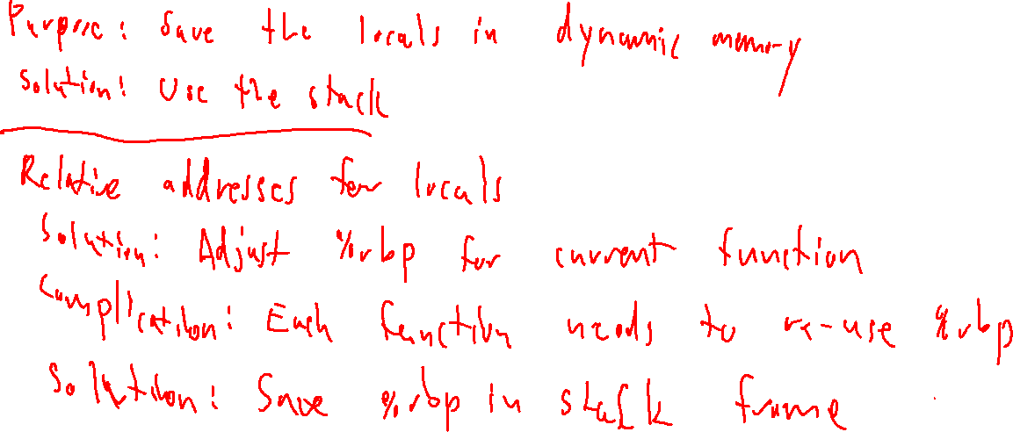
Activation Record
Finishing off ARs

Slide 51
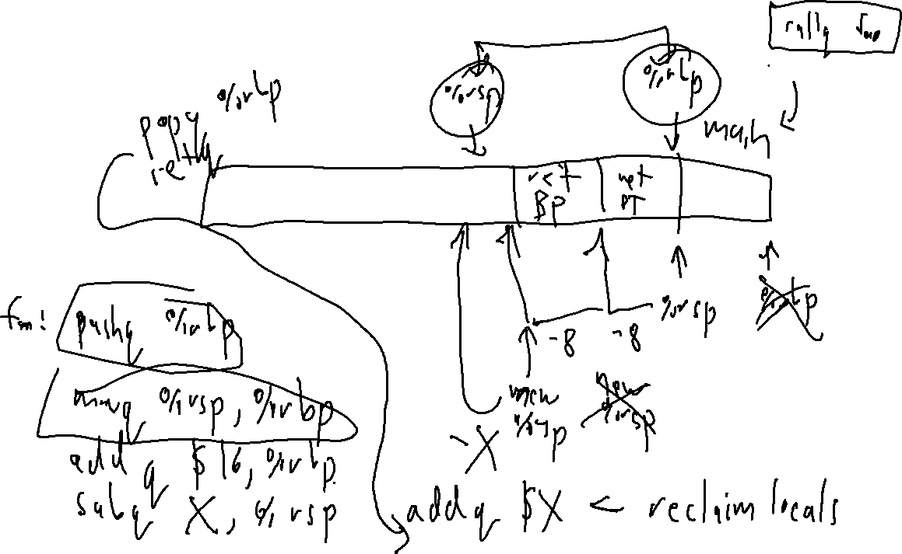
Activation Record
Finishing off ARs

