Slide 1
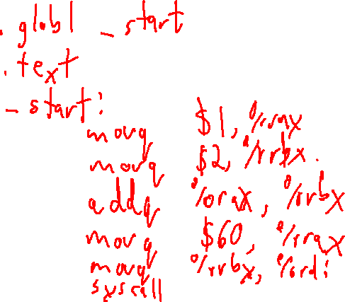
Check-in #24
Encoding Programs
Write an X64 assembly-code program that adds the values of %rax and %rbx and exits with the sum as the exit value

Slide 2
Check-in #24 Solution
Encoding Programs

Slide 3
Announcements
Administrivia

Slide 4

x64 Memory
University of Kansas | Drew Davidson

Slide 5

Where We’re At
Progress Pics
Collecting the x86 pieces needed to represent source code

Slide 6

Last Lecture
X64 Basics
X64 Discussion
Some assurances
Architecture Details
Basic instructions
Basic memory allocation
What you should know:
The register manipulation oprs
The conditional jmp / cmp
Architecture

Slide 7
Recall: Memory as an Array
X64 Basics
Memory is just a big ol’ array of bytes (with OS mediation)
Assembler and friends will map the code into memory
We still need to map data to memory
  variables, objects, strings, arrays, etc.
Assembly code
Binary memory
Lbl1: subq %r12, %r13
0x400086: 0x4d 0xe9 0x25
Lbl2: movq %r13, %rdi
0x400089: 0x4c 0x89 0xef
????????????????
0x40008C: 0x7
Address
Address
Address
Address
Address
Address
Address
Address
Address
Address
0x400086
0x40087
0x400088
0x400089
0x40008A
0x40008B
0x40008C
0x40008D
0x40008E
0x40008F
0x4d
0xe9
0x25
0x4c
0x89
0xef
0x07
0x00
0x00
0x00
subq %r12, %r13
movq %r13, %rdi
The 32-bit value 7
code
data

Slide 8
Memory Allocation x64 Basics
How we allocate memory has performance implications
Can we run out of memory at runtime?
Is memory access fast?
Two types of allocation
Static – memory locations pre-arranged at compile time
Dynamic – memory locations determined at run time

Slide 9
Static Allocation Data Directives x64 Basics
.quad 13
Statically allocate 8 bytes containing the value 13
.byte 13
Statically allocate 1 byte containing the value 13
.asciz “Hello”
Dedicate as many bytes as needed
to fit H e l l o \0

Slide 10
Visualizing Static Allocation x64 Basics
.globl _start
.data
str: .asciiz “hi”
.text
_start:
subq %r12, %r13
Address
Address
Address
Address
Address
Address
0x400086
0x40087
0x400088
0x400089
0x40008A
0x40008B
0x68
0x69
0x00
0x4d
0xe9
0x25
The string “hi”
subq %r12, %r13
data
code

Slide 11
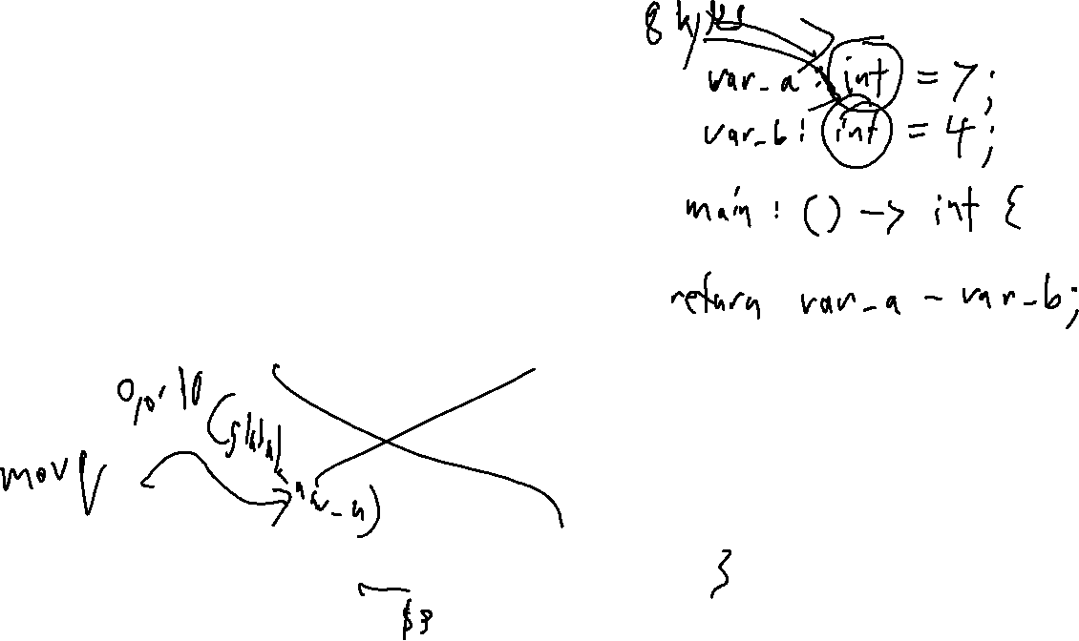
A Complete Program x64 Basics
.globl _start
.data
global_var_a: .quad 7
global_var_b: .quad 4
.text
_start:
# a b
# r10 = r10 - r11
movq (global_var_a), %r10
movq (global_var_b), %r11
subq %r11, %r10
#exit
movq $60, %rax
movq %r10, %rdi
syscall

Slide 12
Recall: Endianness
X64 Basics
x64 is little-endian (the little byte comes first)
global_var_a: .quad 7
global_var_b: .byte 2
Address
Address
Address
Address
Address
Address
Address
Address
Address
Address
0x400080
0x40081
0x400088
0x400089
0x40008A
0x40008B
0x40008C
0x40008D
0x40008E
0x40008F
0x07
0x00
0x00
0x00
0x00
0x00
0x00
0x00
0x02
0x00
data

Slide 13
Data Directives Example
X64 Basics –Memory Directives
.globl _start
.data
v1: .quad 7
v2: .quad 4
.text
_start:
movq (v1), %r10
movq (v2), %r11
subq %r11, %r10
#exit
movq $60, %rax
movq %r10, %rdi
syscall

Slide 14
Today’s Outline
Memory Layout
Memory Layout
Static allocation
The heap and the stack
Architecture

Slide 15
Visualizing Memory
Memory Layout
.globl _start
.data
v1: .quad 7
v2: .quad 4
.text
_start:
movq (v1), %r10
movq (v2), %r11
subq %r11, %r10
#exit
movq $60, %rax
movq %r10, %rdi
syscall

Slide 16
Visualizing Memory
Memory Layout
.globl _start
.data
v1: .quad 7
v2: .quad 4
.text
_start:
movq (v1), %r10
movq (v2), %r11
subq %r11, %r10
#exit
movq $60, %rax
movq %r10, %rdi
syscall
assembler
linker
.o file
executable

Slide 17
Visualizing Memory
Memory Layout
SYMBOL TABLE:
00000000004000b0 l d .text 0000000000000000 .text
00000000006000cc l d .data 0000000000000000 .data
00000000006000cc l .data 0000000000000000 v1
00000000006000d4 l .data 0000000000000000 v2
00000000004000b0 g .text 0000000000000000 _start
00000000006000e0 g .data 0000000000000000 _end
Disassembly of section .text:
00000000004000b0 <_start>:
4000b0: 48 8b 3c 25 cc 00 60 00 mov 0x6000cc,%rdi
4000b8: 4c 8b 14 25 d4 00 60 00 mov 0x6000d4,%r10
4000c0: 4c 29 d7 sub %r10,%rdi
4000c3: 48 c7 c0 3c 00 00 00 mov $0x3c,%rax
4000ca: 0f 05 syscall
objdump
executable

Slide 18
Visualizing Memory
Memory Layout
SYMBOL TABLE:
00000000004000b0 l d .text 0000000000000000 .text
00000000006000cc l d .data 0000000000000000 .data
00000000006000cc l .data 0000000000000000 v1
00000000006000d4 l .data 0000000000000000 v2
00000000004000b0 g .text 0000000000000000 _start
00000000006000e0 g .data 0000000000000000 _end
Disassembly of section .text:
00000000004000b0 <_start>:
4000b0: 48 8b 3c 25 cc 00 60 00 mov 0x6000cc,%rdi
4000b8: 4c 8b 14 25 d4 00 60 00 mov 0x6000d4,%r10
4000c0: 4c 29 d7 sub %r10,%rdi
4000c3: 48 c7 c0 3c 00 00 00 mov $0x3c,%rax
4000ca: 0f 05 syscall
Let’s zoom out
on memory…
Address
Address
0x004000xx
0x006000xx
b0
b1
b2
b3
b4
b5
b6
b7
b8
b9
ba
bb
bc
bd
be
bf
c0
c1
c2
c3
c4
c5
c6
c7
c8
c9
ca
cb
cc
cd
ce
cf
d0
d1
d2
d3
d4
d5
d6
d7
d8
d9
da
db
4c
8b
3c
25
cc
00
60
00
4c
8b
14
25
d4
00
60
00
4d
29
d7
48
c7
c0
3c
00
00
00
0f
05
…
07
00
00
00
00
00
00
00
04
00
00
00
00
00
00
00
movq
(v1), rdi
movq
(v2), r10
subq
r10, rdi
movq
$60, rax
sys
call
unused
v1
v2
.text
.data

Slide 19
Visualizing Memory
Memory Layout
SYMBOL TABLE:
00000000004000b0 l d .text 0000000000000000 .text
00000000006000cc l d .data 0000000000000000 .data
00000000006000cc l .data 0000000000000000 v1
00000000006000d4 l .data 0000000000000000 v2
00000000004000b0 g .text 0000000000000000 _start
00000000006000e0 g .data 0000000000000000 _end
Disassembly of section .text:
00000000004000b0 <_start>:
4000b0: 48 8b 3c 25 cc 00 60 00 mov 0x6000cc,%rdi
4000b8: 4c 8b 14 25 d4 00 60 00 mov 0x6000d4,%r10
4000c0: 4c 29 d7 sub %r10,%rdi
4000c3: 48 c7 c0 3c 00 00 00 mov $0x3c,%rax
4000ca: 0f 05 syscall
Let’s zoom out
on memory
some more…
Address
Address
Address
Address
Address
Address
Address
0x4000b0
0x4000b8
0x4000c0
0x4000c3
0x4000ca
0x6000cc
0x6000d4
…
…
…
…
…
…
7
4
movq
(v1), rdi
movq
(v2), r10
subq
r10, rdi
movq
$60, rax
syscall
unused
v1
v2
.text
…
.data

Slide 20
Visualizing Memory
Memory Layout
SYMBOL TABLE:
00000000004000b0 l d .text 0000000000000000 .text
00000000006000cc l d .data 0000000000000000 .data
00000000006000cc l .data 0000000000000000 v1
00000000006000d4 l .data 0000000000000000 v2
00000000004000b0 g .text 0000000000000000 _start
00000000006000e0 g .data 0000000000000000 _end
Disassembly of section .text:
00000000004000b0 <_start>:
4000b0: 48 8b 3c 25 cc 00 60 00 mov 0x6000cc,%rdi
4000b8: 4c 8b 14 25 d4 00 60 00 mov 0x6000d4,%r10
4000c0: 4c 29 d7 sub %r10,%rdi
4000c3: 48 c7 c0 3c 00 00 00 mov $0x3c,%rax
4000ca: 0f 05 syscall
Address
Address
0x4000b0
- 0x4000cb
0x6000cc
- 0x6000db
…
…
…
…
…
prog. instructions
unused
globals
…
.text
…
.data
…

Slide 21
Static Allocation
Memory Layout
This layout scheme is known as static allocation (why?):
One fixed-size segment for all data
One fixed-sized segment for all program instructions
Static allocation is sufficient for some simple languages
e.g, FORTRAN I (1957)
prog. instructions
unused
globals
.text
…
.data

Slide 22
Static Allocation
Memory Layout
As languages evolve, static allocation still sufficient…
Subroutines
  Like functions with no callees
prog. instructions
unused
globals
.text
…
.data

Slide 23
Static Allocation
Memory Layout
As languages evolve, static allocation still sufficient…
Subroutines
  Like functions with no callees
byte g;
byte g2;
foo(int16 v){
byte a;
…
}
main(){
byte m;
…
}
Address
Address
Address
Address
Address
Address
Address
Address
Address
Address
Address
0x0000
0x0001
0x0002
0x0003
0x0004
0x0005
0x0006
0x0007
0x0008
0x0009
0x000A
…
…
…
…
…
(instructions)
(instructions)
g
g2
m
a
v
main
code
foo
code
global
vars
main
locals
foo
locals
.text
.data

Slide 24
Static Allocation
Memory Layout
Some languages features are difficult/impossible to support with purely-static allocation
Recursion
Address
Address
Address
Address
Address
Address
Address
Address
Address
Address
Address
0x0000
0x0001
0x0002
0x0003
0x0004
0x0005
0x0006
0x0007
0x0008
0x0009
0x000A
…
…
…
…
…
(instructions)
(instructions)
g
g2
m
a
v
main
code
foo
code
global
vars
main
locals
foo
locals
.text
.data

Slide 25
The Recursion Problem
Beyond Static Allocation
int16 g = 2;
void main(){
int16 a;
a = g;
g = g – 1;
if (0 < g){
main();
}
cout << a;
}
Call Stack
Main frame 2
a: 1
Main frame 1
a: 2
Address
Address
Address
Address
Address
Address
Address
Address
Address
Address
Address
Address
Address
0x0000
0x0001
0x0002
0x0003
0x0004
0x0005
0x0006
0x0007
0x0008
0x0009
0x000A
0x000B
0x000C
…
…
(instructions)
g
int16 a
main
code
global
vars
main
locals
code
data
free

Slide 26
Static Allocation
Memory Layout
Some languages features are difficult/impossible to support with purely-static allocation
Recursion
Runtime-allocated objects
  Can’t know, apriori, how much memory we’ll need
  Would be super wasteful to just allocate the entire space
We need new memory segments for these features
Address
Address
Address
Address
Address
Address
Address
Address
Address
Address
Address
0x0000
0x0001
0x0002
0x0003
0x0004
0x0005
0x0006
0x0007
0x0008
0x0009
0x000A
…
…
…
…
…
(instructions)
(instructions)
g
g2
m
a
v
main
code
foo
code
global
vars
main
locals
foo
locals
.text
.data

Slide 27
Today’s Outline
Memory Layout
Memory Layout
Static allocation
The heap and the stack
Architecture

Slide 28
The Heap and the Stack: Capabilities
Memory Layout
The heap
Stores malloc’ed data
Segment size managed at runtime (via syscall to OS)
The stack
Holds function invocations (1 per call)
Fixed size, but starts off with lots of free space
Low
Address
High
Address
(instructions)
(instructions)
g
g2
unused
main
code
foo
code
global
vars
.text
.data
free

Slide 29
The Heap and the Stack: Capabilities
Memory Layout
The heap
Stores malloc’ed data
Segment size managed at runtime (via syscall to OS)
The stack
Holds function invocations (1 per call)
Fixed size, but starts off with lots of free space
Low
Address
High
Address
(instructions)
(instructions)
g
g2
Object 1
unused
main
code
foo
code
global
vars
.text
.data
heap
free

Slide 30
The Heap and the Stack: Capabilities
Memory Layout
The heap
Stores malloc’ed data
Segment size managed at runtime (via syscall to OS)
The stack
Holds function invocations (1 per call)
Fixed size, but starts off with lots of free space
Low
Address
High
Address
(instructions)
(instructions)
g
g2
Object 1
Object 2
unused
main
code
foo
code
global
vars
.text
.data
heap
free

Slide 31
The Heap and the Stack: Capabilities
Memory Layout
The heap
Stores malloc’ed data
Segment size managed at runtime (via syscall to OS)
The stack
Holds function invocations (1 per call)
Fixed size, but starts off with lots of free space
Low
Address
High
Address
(instructions)
(instructions)
g
g2
Object 1
Object 2
unused
main
code
foo
code
global
vars
.text
.data
heap
free

Slide 32
The Heap and the Stack: Capabilities
Memory Layout
The heap
Stores malloc’ed data
Segment size managed at runtime (via syscall to OS)
The stack
Holds function invocations (1 per call)
Fixed size, but starts off with lots of free space
Low
Address
High
Address
(instructions)
(instructions)
g
g2
Object 1
Object 2
unused
unused
a
main
code
foo
code
global
vars
main₁
locals
.text
.data
heap
free
stack

Slide 33

The Heap and the Stack: Capabilities
Memory Layout
The heap
Stores malloc’ed data
Segment size managed at runtime (via syscall to OS)
The stack
Holds function invocations (1 per call)
Fixed size, but starts off with lots of free space
Low
Address
High
Address
(instructions)
(instructions)
g
g2
Object 1
Object 2
unused
unused
a
a
main
code
foo
code
global
vars
main₂
locals
main₁
locals
.text
.data
heap
free
stack

Slide 34
Note: the Stack grows DOWN
Memory Layout
For historical reasons
Needed to share limited memory space
vintage memory diagram, scenario #1
Low
Address
big heap
small stack
High
Address
(instructions)
(instructions)
g
g2
Object 1
Object 1
…
Object n
a
a
main
code
foo
code
global
vars
main₂
locals
main₁
locals
.text
.data
Shared program memory
vintage memory diagram, scenario #2
Low
Address
Small heap
big stack
High
Address
(instructions)
(instructions)
g
g2
Object 1
v
g
v
g
a
a
main
code
foo
code
global
vars
foo
locals
foo
locals
main₂
locals
main₁
locals
.text
.data
Shared program memory

Slide 35
Summary: “Modern” Memory Allocation
Memory Layout
Instruction code
Static allocation in the .text section
Global variables
Static allocation in the .data section
Malloc’ed data
Dynamic allocation on the heap
Local variables
Dynamic allocation on the stack
Address
Address
Address
Address
Address
Address
Address
Address
Address
Address
Address
Address
Address
0x0000
0x0001
0x0002
0x0003
0x0004
0x0005
0x0006
0x0007
0x0008
0x0009
0x000a
0x7ffe
0x7fff
…
…
…
…
…
…
(instructions)
(instructions)
g
g2
Object 1
Object 2
unused
a
a
main
code
foo
code
global
vars
main₂
locals
main₁
locals
.text
.data
heap
free
stack

Slide 36
Lecture Done!
Next Time: x64 Practice
Next Time
Handling more complicated programs in x64

