Slide 1
Check-in #23
Encoding Programs
Rather than using bit-addressable or word-addressable (16-bit) memory, X64 uses byte addressable memory. Why?

Slide 2
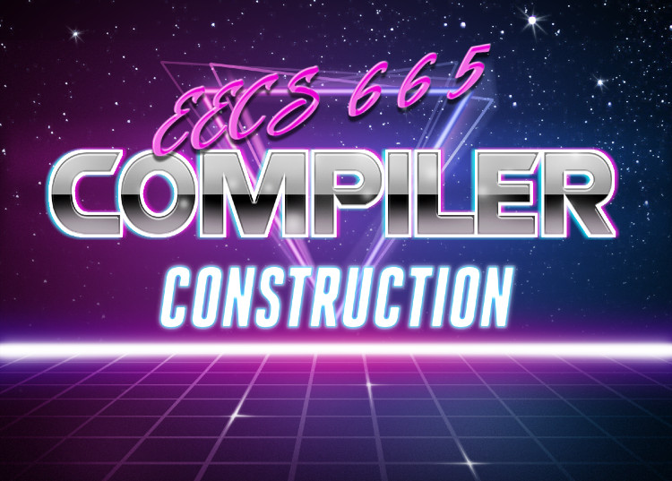
x64 Basics
University of Kansas | Drew Davidson

Slide 3
Administrivia
Announcements
P5 out tonight
Thanks for the nom!

Slide 4

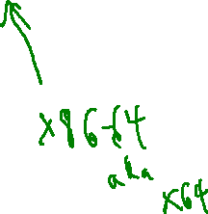
Last Lecture
Encoding Programs
Representing Whole Programs in Hardware
Data
Code
ISAs
X86 – Example target
What you should know:
ISA concept
That data and code share memory
  The instruction pointer
How to play with ASM code
Architecture

Slide 5
Recall: Instructions
Review x64 Intro
We’ve already seen two instructions:
movq <o₁> <o₂>
  Move quadword in o₁ into quadword o₂
syscall
  Invoke a system service
Flow of data
.text
.globl _start
_start:
movq $60, %rax # Choose syscall exit
movq $4, %rdi # Set syscall arg - return code
syscall

Slide 6
Recall: x64 Registers
Review x64 Intro
Computation needs to be done on registers
General workflow:
Name | Number | “Nickname”
%rax | 0 | Accumulator
%rbx | 1 | Base
%rcx | 2 | Counter
%rdx | 3 | I/O
%rsi | 4 | String source
%rdi | 5 | String destination
%rbp | 6 | Base pointer
%rsp | 7 | Stack pointer
%r08 – %r15 | 8 - 15 | General purpose
%rip | - | Instruction pointer
%rflags | - | Status flags
General purpose
For our needs
src code
a = b <opr> c
asm code
Load b into a register
Load c into another register
Do opr on registers
Store result register into a
Used for bookkeeping
Bonus general purpose for us
Inaccessible as
regular operands

Slide 7
Today’s Lecture
X64 Basics
X64 Discussion
Some perspective
Architecture Details
Basic operators
Memory Directives
Architecture

Slide 8
ASM Instruction Syntax
Lecture Outline –Writing x64
As with everything x86-related, it’s complicated
We’ll use the AT&T Syntax:
  <opcode><sizesuffix> <src operand(s)> <dst operand>
Immediates (i.e. constant values) prefixed by $
Registers prefixed by %
Memory lookup (i.e. dereference) in parens
movq $5, (%rax)
mov the 64-bit value 5 into the 64-bit
memory address specified by register rax

Slide 9
Directives
Lecture Outline –Writing x64
Indicates a command to the assembler
  Layout, program entrypoint, etc.
Example:
.globl X
Indicates that symbol X is visible outside of the file

Slide 10
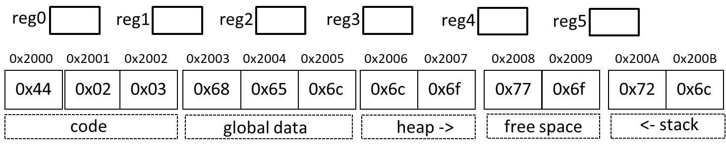
Segment Directives
Lecture Outline –Writing x64
.text
Lay out items in the user text segment
.data
Lay out items in the data segment
Instructions go here
Globals go here

Slide 11
Labels
Lecture Outline –Writing x64
The assembler allows us to specify “placeholder” addresses that will be used later
  Translated to “real” addresses by a utility called the linker
Valid for both data and code locations
jmp LBL1
…
LBL1: movq $5 (%rax)
jmp 0x12d34a5678a

Slide 12
System Calls
Lecture Outline –Writing x64
To interact outside program memory, need the help of the OS
syscall
%rax # Which system call (60 is exit)
%rdi # Set syscall arg – (exit takes the return code)

Slide 13

Time to put it all together!
Lecture Outline –Writing x64
Photo Credit: Tim Klein - https://puzzlemontage.crevado.com

Slide 14
A Complete Program
Lecture Outline –Writing x64
.text
.globl _start _start: movq $60, %rax # Choose syscall exit movq $4, %rdi # Set syscall arg - return code
syscall

Slide 15
Actually Running a Program
Lecture Outline –Writing x64
Invoking the assembler and linker
as –o start.o start.s
ld start.o –o prog
./prog
echo $?

Slide 16
Summary
ISAs
ISAs
Provide an interface from software to hardware
We’ll target assembly code, assembler will take it from there
X64
A popular architecture
We’ve covered the basic instruction format and a simple program

Slide 17
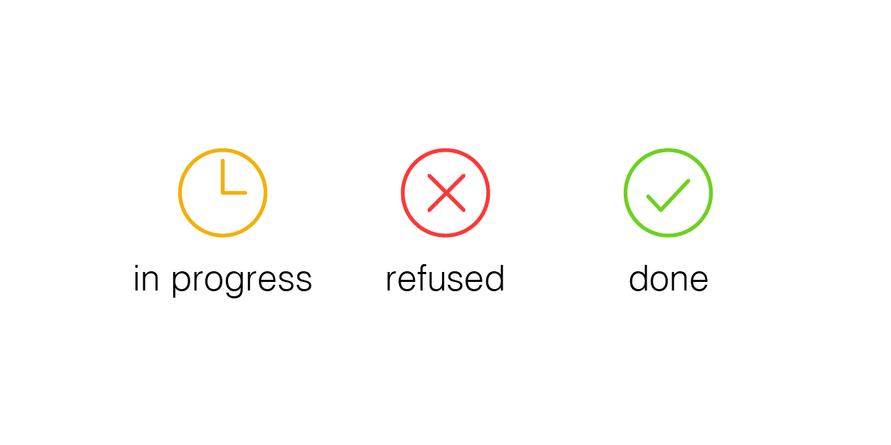
Compiler Construction
Progress Pics
Source code (sequence of chars)
Done:
Validated and abstracted input program
Flattened the input program to a linear representation
ToDo:
Concretize to the target architecture
Done!
Scanner
Lexical analysis
Done!
Parser
Syntactic analysis
Done!
Semantic analysis
Done!
Intermediate code generation
We gotta
understand
this!
In progress
Final Code generation
Output code in T

Slide 18
A Moment of Appreciation x64 Basics: Perspective
We’re writing real-deal x64 - no special tools needed
Our x64 code looks (mostly) like what comes out of gcc
gcc –S prog.c –o prog.s
gcc –c prog.s –o prog.o
gcc prog.o –o prog.exe
Unfortunately for clarity, there are a lot of extra directives we might want to strip:
gcc -fno-asynchronous-unwind-tables -fno-dwarf2-cfi-asm -O0 -S blah.c -o blah.nodebug.S

Slide 19
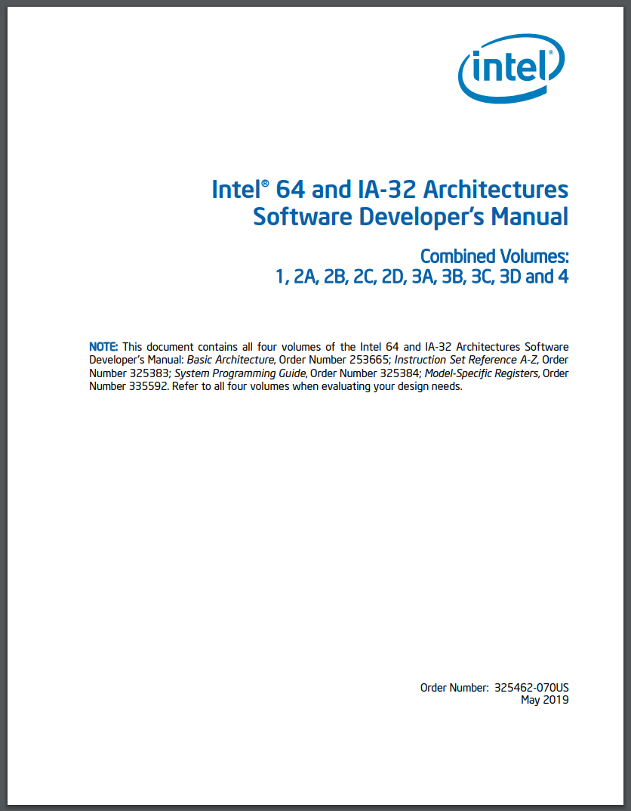
Docs: A Benefit to x64’s Popularity x64 Basics: Perspective
Lots of good, thorough documentation out there
Some best used as reference rather than walkthrough
4922
Pages!
https://software.intel.com/sites/default/files/managed/39/c5/325462-sdm-vol-1-2abcd-3abcd.pdf

Slide 20
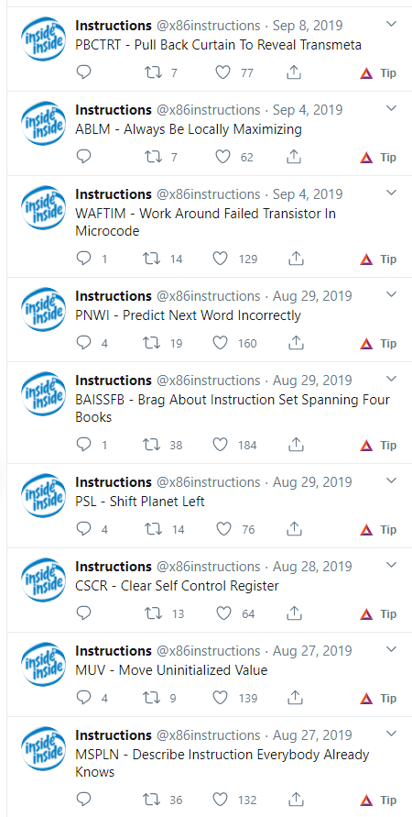

There are a LOT of Instructions in X64!
X64 Basics: Perspective

Slide 21

Keeping to the “Easy” Path
X64 Basics: Perspective
We’ll sidestep most of the x64 complexity
We’ll just stick to those instructions we need
Give you the pointers to explore the rest of the ISA
The rest of x86
665
Like 15
opcodes

Slide 22
Today’s Lecture
X64 Basics
X64 Discussion
Some perspective
Architecture Details
Basic operators
Memory Directives
Architecture

Slide 23

Let’s Dive In to X64!
X64 Basics – Architecture Details
X64

Slide 24
Simple Arithmetic Instructions x64 Basics
“Support”
operand
“Main”
operand
negq <o₁>
addq <o₁> <o₂>
subq <o₁> <o₂>
o₁ = -o₁
o₂ = o₂ + o₁
o₂ = o₂ - o₁
Take <o₂> and “do” <o₁> to it
Example
movq $4, %rax
negq %rax
Example
movq $4, %rax
movq $5, %rbx
addq %rax, %rbx
Example
movq $4, %rax
movq $5, %rbx
subq %rax, %rbx
At this pt:
%rax = -4
At this pt:
%rbx = 9
At this pt:
%rbx = 1

Slide 25
Wacky Arithmetic Instructions x64 Basics
imulq <o₁>
idivq <o₁>
%rax = %rdx:%rax / o₁
%rdx:%rax = %rax * o₁
%rdx = %rdx:%rax % o₁
Example
movq $2, %rax
movq $4, %r11
imulq %r11
Example
movq $0, %rdx
movq $6, %rax
movq $2, %r8
idivq %r8
2 * 4
6 / 2
At this pt:
%rax = 8
%rdx = 0
At this pt:
%rax = 3
%rdx = 0

Slide 26

Logical Instructions x64 Basics
notq <o₁>
andq <o₁> <o₂>
orq <o₁> <o₂>
xorq <o₁> <o₂>
o₁ = bitflip o₁
o₂ = o₂ & o₁
o₂ = o₂ | o₁
o₂ = o₁ ^ o₂
Example
movq $1, %rcx
notq %rcx
Example
movq $12, %rdx
movq $10, %rax
andq %rax, %rdx
Example
movq $12, %rdx
movq $10, %rax
orq %rax, %rdx
Example
movq $9, %rdx
movq $10, %rax
xorq %rax, %rdx
At this pt:
%rcx = -2
At this pt:
%rdx = 8
At this pt:
%rdx = 14
At this pt:
%rdx = 3
Why -2?
Before and
Before or
Before xor
Before bitflip
%rdx 0..1100
%rdx 0..1100
%rdx 0..0101
%rcx 0..01
%rax 0..1010
%rax 0..1010
%rax 0..0110
After bitflip
After and
After or
After xor
%rcx 1..10
%rax 0..1000
%rax 0..1110
%rax 0..0011
2’s complement…
0..01
Flip all bits
0 + 8 + 0 + 0 + 0 = 8
0 + 8 + 4 + 2 + 0 = 14
0 + 2 + 1 = 3
0..10
Add 1
0 + 2 + 0 = (negative) 2

Slide 27
Conditionals x64 Basics
movq $1, %rbx
movq $1, %rax
cmpq %rax, %rbx
je LBL_1
Another weird x86 thing
conditional jump instructions – no explicit condition!
Uses the flags register rflags
  Assumes a previous operation has set the flags register
Jump to LBL_1
je <LBL>
Jump to label LBL if equal, else fallthrough
“Wait… jump if what is equal?”
cmpq %rax, %rbx
je <LBL>
Jump to label LBL if rax and rbx are equal,
else fallthrough

Slide 28





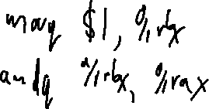
Conditionals and rflags x64 Basics
rflags: bitvector register of conditions
OF “Overflow Flag”
movq $1, %rax
movq $2, %rbx
cmpq %rax, %rbx
sete <o₁>
Result exceeds storage
SF “Sign Flag”
Result was negative
ZF “Zero Flag”
Result was zero
At this pt:
<o₁> = 0
cmpq src1 src2 : Set flags as though computing src2 – src1
sete %rax
je
sete
sete %al
E
(E)quality
ZF
jne
setne
NE
(N)ot (E)qual
$¬$ZF
G
(G)reater
($¬$ZF $∧$ $¬SF$) $⨁$ OF
jg
setg
L
(L)ess
$SF$ $⨁$ OF
jl
setl
jge
GE
(G)reater or (E)qual
$¬S$F $⨁$ OF
setge
jle
setle
LE
(L)ess or (E)qual
(SF$⨁$OF) $∨$ ZF

Slide 29

You can now (kinda) write assembly programs! x64 Basics
src code
int main(){
return 2 – 1;
}
GCC
asm code
.globl _start
.text
_start:
movq $1, %r10
movq $2, %r11
subq %r10, %r11
#exit
movq $60, %rax
movq %r11, %rdi
syscall

Slide 30
Today’s Lecture
X64 Basics
X64 Discussion
Some assurances
Architecture Details
Basic operators
Memory directives
Architecture

Slide 31

Manipulating Memory
X64 Basics
Data can’t always fit into registers
Two things we need to do:
Allocate memory
Read/write memory
A different kind of memory being
manipulated

Slide 32
Recall: Memory as an Array
X64 Basics
Memory is just a big ol’ array of bytes (with OS mediation)
Assembler and friends will map the code into memory
We still need to map data to memory
  variables, objects, strings, arrays, etc.
Assembly code
Binary memory
Lbl1: subq %r12, %r13
0x400086: 0x4d 0xe9 0x25
Lbl2: movq %r13, %rdi
0x400089: 0x4c 0x89 0xef
????????????????
0x40008C: 0x7
Address
Address
Address
Address
Address
Address
Address
Address
Address
Address
0x400086
0x40087
0x400088
0x400089
0x40008A
0x40008B
0x40008C
0x40008D
0x40008E
0x40008F
0x4d
0xe9
0x25
0x4c
0x89
0xef
0x07
0x00
0x00
0x00
subq %r12, %r13
movq %r13, %rdi
The 32-bit value 7
code
data

Slide 33
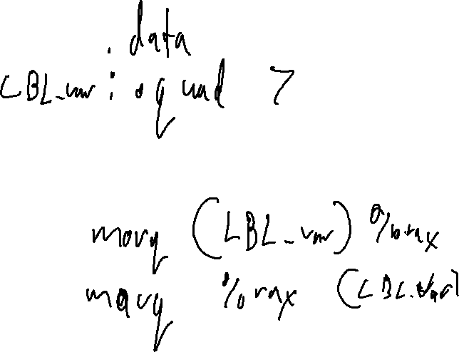
Lecture Done! x64 Basics: Summary
Some basic x64 details
Instructions
Data directives
Memory intuition
Next Time
Dive further into x64
Describe memory operations

