Slide 1
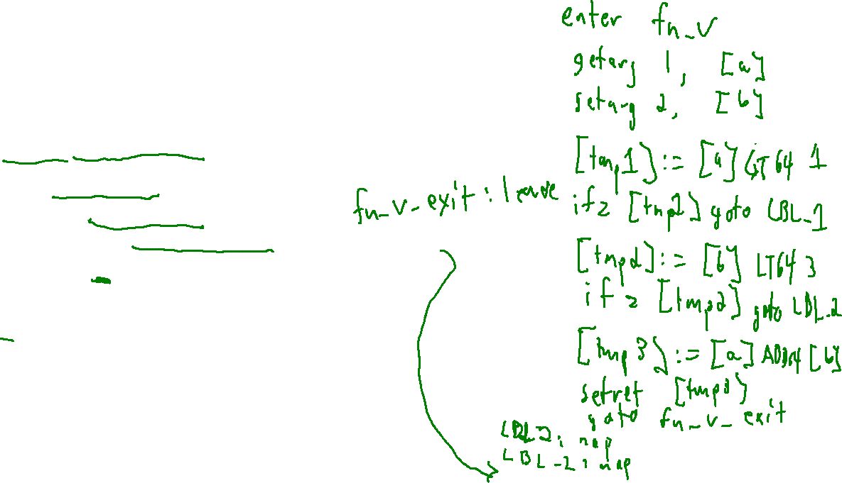
This Time
Lecture Outline – ISAs
Write 3AC code for the following program
int v(int a, int b){
if (a > 1){
if (b < 3){
return a + b;
}
}
}

Slide 2
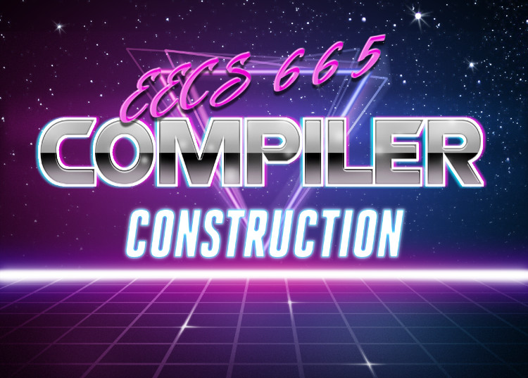

Last Time
Lecture Review - Runtimes
Drew Davidson | University of Kansas
Runtimes
Runtime Environments
Tradeoff between what’s done
dynamically vs statically
Hardware Intuition
Memory is a big 1D array
Runtime
Environments
Instruction Set Architectures
You Should Know
Different runtime environment types
  Advantages/Disadvantages
Compiling vs Interpreting

Slide 3
Last Time
Lecture Review - Runtimes
Runtimes
Runtime Environments
Tradeoff between what’s done
dynamically vs statically
Hardware Intuition
Memory is a big 1D array
You Should Know
Different runtime environment types
  Advantages/Disadvantages
Compiling vs Interpreting
Runtime
Environments

Slide 4

This Time
Lecture Outline – ISAs
Instruction-Set Architectures
Introduction
What an ISA does
Our target ISA: x64
Writing x64
Architecture

Slide 5

Hardware Capabilities
ISAs - Intro
Computers can store binary sequences in memory
An entire program thus needs to be mapped to binary sequences
Computer
Scientists
0s and 1s
Electrical
Engineers

Slide 6
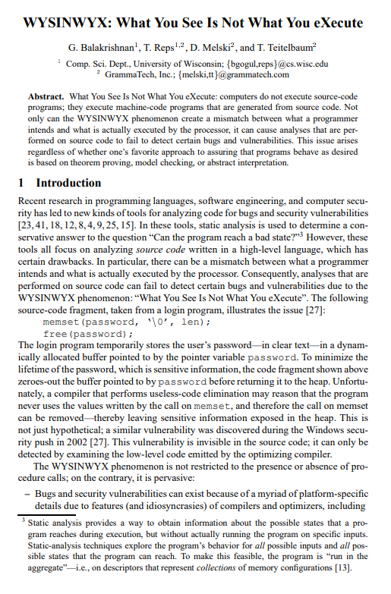
W.Y.S.I.N.W.Y.X
ISAs - Introduction
What You See (in source code) Is Not What You eXecute
  Many of our abstractions lack explicit representation in machine code

Slide 7
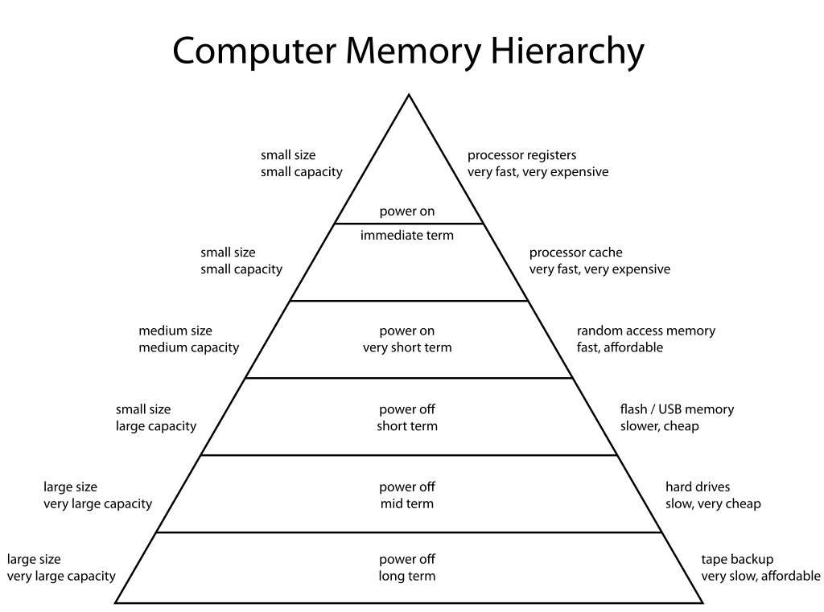
Hardware Generally Has…
ISAs - Introduction
Limited number of very fast registers with which to do computation
Comparatively large region of memory to hold data
Some basic instructions from which to build more complex behaviors

Slide 8
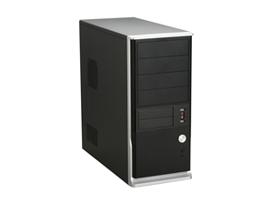

Missing Abstractions of Machine Code
ISAs - Introduction
Loops
Expressions
Variables
Scope
Functions
Opcodes
Registers
Byte-addressable
memory

Slide 9

Programs as Numeric Sequences
ISAs - Introduction
We gotta encode the whole dang program into a 1D-array!
Encode data as binary sequences
Encode instructions as binary sequences
Address
Address
Address
Address
Address
Address
Address
Address
Address
Address
Address
0x0000
0x0001
0x0002
0x0003
0x0004
0x0005
0x0006
0x0007
0x0008
0x0009
0x000A
0x44
0x01
0x02
0x44
0x01
0x03
0x07
0x00
0x00
0x00
0x03
Need to use the
same space for
many things

Slide 10
Memory: Intuition
ISAs – Hardware Features
Cells have a (numeric) address and hold (numeric) value
We can think of program memory as a big ol’ 1D-array
Data access is like indexing into that array
Address
Address
Address
Address
Address
Address
Address
0x0000
0x0001
0x0002
0x0003
0x0004
0x0005
0x0006
0x4
0x4
0x2
0x6
0x2
0x3
0x5
a
b
[a] := [b]
memory[a]
memory[b]
assume a takes up address 0x0001
assume b takes up address 0x0005
Address
Address
Address
Address
Address
Address
Address
0x0000
0x0001
0x0002
0x0003
0x0004
0x0005
0x0006
0x4
0x3
0x2
0x6
0x2
0x3
0x5
a
b

Slide 11
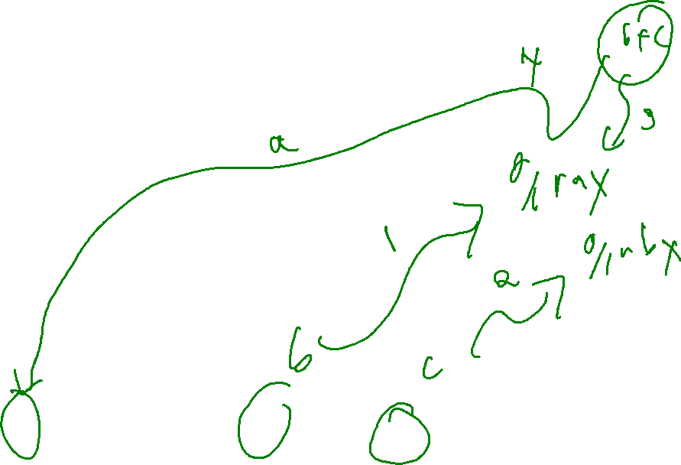
Registers: Intuition
ISAs – Hardware Features
Specialized, super-fast circuitry
Computation must be done on registers
Memory: “data at rest”
Registers: “data in flight”
3AC code
Corresponding Hardware tasks
[a] := [b] + [c]
Get operand 1 into a register
Get operand 2 into another register
Sum the two registers to a destination register
Store destination register back to memory
Address
Address
Address
Address
Address
Address
Address
Address
Address
Address
Address
0x0000
0x0001
0x0002
0x0003
0x0004
0x0005
0x0006
0x0007
0x0008
0x0009
0x000A
0x44
0x01
0x02
0x44
0x01
0x03
0x07
0x00
0x00
0x00
0x03

Slide 12
This Time
Lecture Outline – ISA Hardware Features
Instruction-Set Architectures
Introduction
What an ISA does
Our target ISA: x64
Writing x64
Architecture

Slide 13
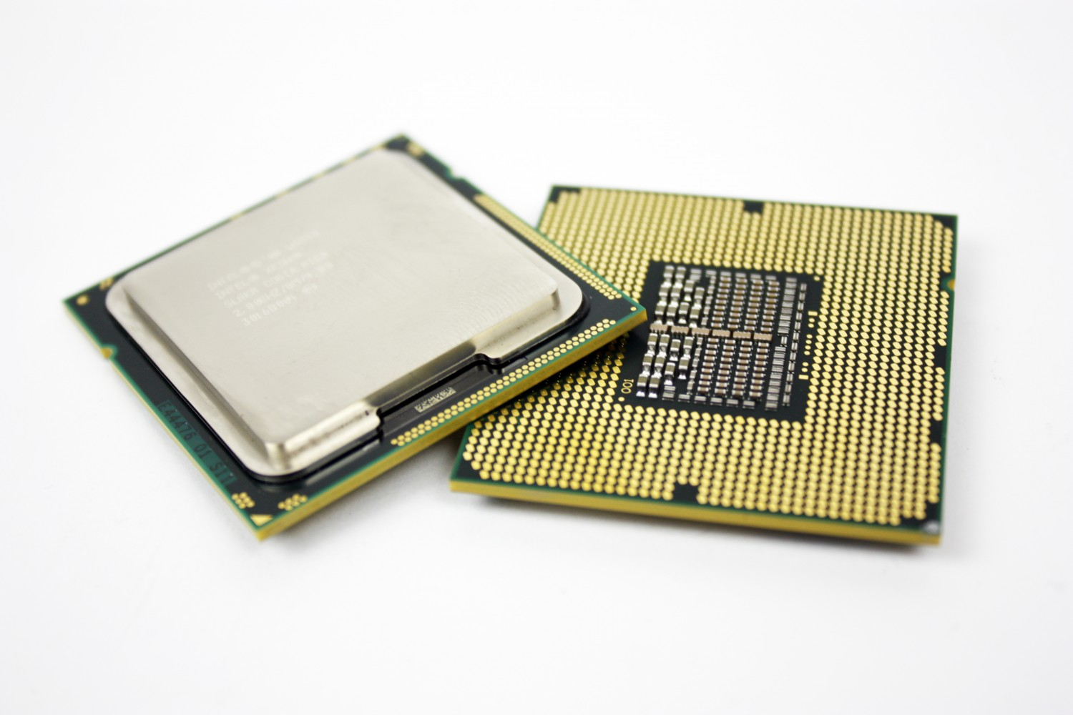
Processors Conform to ISAs
ISAs – Hardware Features
Upon encountering a byte sequence an ISA-conformant “knows” how to interpret the sequence
Still has some flexibility on how to execute it, specified via the microarchitecture
You’re speakin’ my language!

Slide 14

The ISA Contract
ISAs - Intro
An ISA specifies
How data is encoded
Instructions that can transform data
Opcodes for how instructions are encoded
Program state
Software
Hardware
ISA: A contract of hardware aspects

Slide 15
Instruction Set Architectures
ISAs - Intro
Hypothetical ISA
An ISA specifies
How data is encoded
Instructions that can transform data
Opcodes for how instructions are encoded
Program state
-2 is encoded as 1110
-1 is encoded as 1111
8 is encoded as 1000
12 is encoded as 1100
The INC_ADDR <X> instruction
increments the value at
memory address <X>
INC_ADDR 8 is encoded as 1010
Next instruction to execute
is stored in register I

Slide 16
Completely Hypothetical ISA Example
ISAs - Intro
-2 is encoded as 1110
-1 is encoded as 1111
8 is encoded as 1000
12 is encoded as 1100
The INC_ADDR <X>
increments the value at
memory address <X>
INC_ADDR 8
encoded as
1010
Next instruction
to execute
stored in Register K
Fetch: the instruction at address 12
Register K:
1100
Address
Address
Address
Address
Address
Address
Address
Address
Address
Address
Address
Address
0x8
0x9
0xA
0xB
0xC
0xD
0xE
0xF
0x10
0x12
0x13
0x14
…
1
1
1
0
1
0
1
0
1
0
1
0
…
1
1
1
1
Execute: the value at
address 8 is -2
Decode: the 4-bit instruction at address 12 is INC_ADDR 8

Slide 17

More Realistic Encodings
ISAs - Intro
The previous ISA uses unrealistic encodings
Let’s consider some more likely choices

Slide 18
Encoding Data: Granularity of Access
ISAs - Intro
How “big” is a memory cell?
Let’s say we’re storing the byte 0x61 = 01100001
Bit-addressable
Address
Address
Address
Address
Address
Address
Address
Address
Address
Address
Address
0x0000
0x0001
0x0002
0x0003
0x0004
0x0005
0x0006
0x0007
0x0008
0x0009
0x000A
0
1
0
0
0
1
0
0
0
0
0
Byte-addressable
Address
Address
Address
Address
Address
Address
Address
Address
Address
Address
Address
0x0000
0x0001
0x0002
0x0003
0x0004
0x0005
0x0006
0x0007
0x0008
0x0009
0x000A
0x44
0x01
0x02
0x44
0x01
0x03
0x07
0x00
0x00
0x00
0x03
Could even go bigger?
But why (and why not)?

Slide 19

Data Encodings
ISAs - Intro
You should already know the basic idea here
Type dictates numeric representation
Devote a certain size (in bits) to representation
Use binary hardware to store the numeric value
Bit Sequence (binary)
0100 0011
0100 1111
0100 1111
0100 1100
Byte Sequence (Hex)
0x43
0x4F
0x4F
0x4C
ASCII Value: char type (8 bits, i.e. 1 byte)
‘C’
‘O’
‘O’
‘L’
Integer Value: int32 type (32 bits, i.e. 4 bytes)
0x434F4F41
1,129,271,105‬

Slide 20
Convention: Memory Regions
ISAs - Intro
Portions of memory “zoned” by purpose
Simplest form:
  Code region
  Data region
  The rest is free space
Memory
Address
Address
Address
Address
Address
Address
Address
Address
Address
Address
Address
0x0000
0x0001
0x0002
0x0003
0x0004
0x0005
0x0006
0x0007
0x0008
0x0009
0x000A
code
data
free

Slide 21
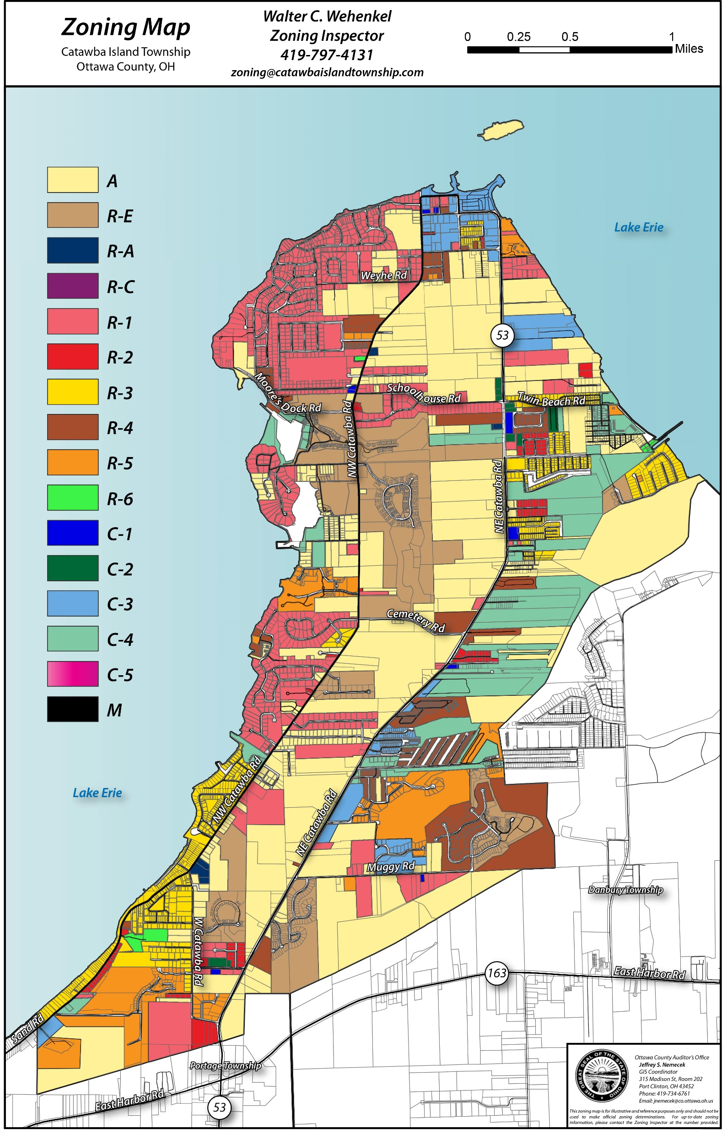
Data Sub-Regions
ISAs - Intro
Further break up data region for different kinds of data
Global variables
Local variables
Objects

Slide 22
This Time
Lecture Outline – About x64
Instruction-Set Architectures
Introduction
What an ISA does
Our target ISA: x64
Writing x64
Architecture

Slide 23
Our ISA: x64
Lecture Outline – About x64
Probably the most popular architecture in modern use
Almost certainly what your computer is running
Definitely what the cycle servers are running

Slide 24

x86 and x64: A Reputation for Difficulty
Lecture Outline – About x64
Highly complex instruction set
~1000 different instructions via the most conservative count*
Some instructions context-sensitive (i.e. work differently based on preceding instructions)
*that we don’t have a canonical
instruction count
is already a pretty bad sign

Slide 25
x64 Registers
Lecture Outline – About x64
Name | Number | Nominal Purpose
rax | 0 | Computation Accumulator
rbx | 1 | Computation Base
rcx | 2 | Computation counter
rdx | 3 | Data for I/O
rsi | 4 | String source address
rdi | 5 | String destination address
rbp | 6 | Base pointer (base of the stack)
rsp | 7 | Stack pointer (edge of the stack)
r08 – r15 | 8 - 15 | True general purpose registers
rip | - | Instruction pointer
rflags | - | Status flags
Can be used in
Instruction opcodes
Cannot be used in
instruction opcodes

Slide 26
x64 Register Compatibility
Lecture Outline – About x64
Register #0 – the “A” register
byte 8
byte 7
byte 6
byte 5
byte 4
byte 3
byte 2
byte 1
rax
64
eax
32
ax
16
ah
al
8

Slide 27
This Time
Lecture Outline – Writing x64
Instruction-Set Architectures
Introduction
What an ISA does
Our target ISA: x64
Writing x64
Architecture

Slide 28

Stepping Back From Binary
Lecture Outline –Writing x64
Dealing with binary directly is tedious and error-prone
Laying out code / data is super difficult to do manually
Remembering the binary opcode sequence for every instruction is difficult
Fortunately, we don’t have to do that

Slide 29

The Assembler
Lecture Outline –Writing x64
Write low-level textual mnemonics (assembly code)
Assembly code isn’t directly executable
Nearly 1-1 with the binary encoding
Different assemblers, different syntax
Compiler
Code
Assembler

Slide 30
ASM Instruction Syntax
Lecture Outline –Writing x64
As with everything x86-related, it’s complicated
We’ll use the AT&T Syntax:
  <opcode><sizesuffix> <src operand(s)> <dst operand>
Immediates (i.e. constant values) prefixed by $
Registers prefixed by %
Memory lookup (i.e. dereference) in parens
movq $5, (%rax)
mov the 64-bit value 5 into the 64-bit
memory address specified by register rax

Slide 31
Directives
Lecture Outline –Writing x64
Indicates a command to the assembler
  Layout, program entrypoint, etc.
Example:
.globl X
Indicates that symbol X is visible outside of the file

Slide 32
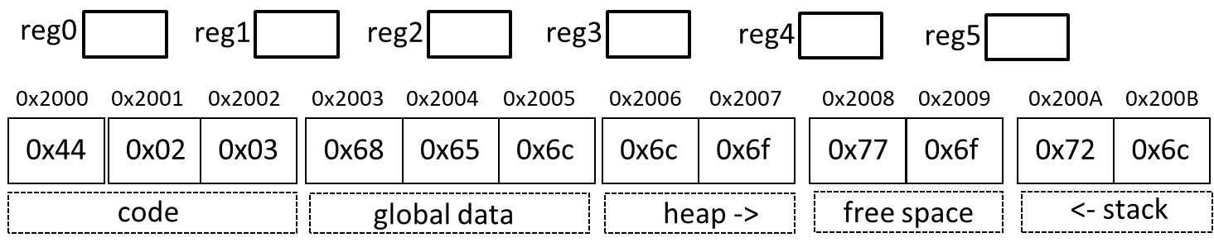
Segment Directives
Lecture Outline –Writing x64
.text
Lay out items in the user text segment
.data
Lay out items in the data segment
Instructions go here
Globals go here

Slide 33
Labels
Lecture Outline –Writing x64
The assembler allows us to specify “placeholder” addresses that will be used later
  Translated to “real” addresses by a utility called the linker
Valid for both data and code locations
jmp LBL1
…
LBL1: movq $5 (%rax)
jmp 0x12d34a5678a

Slide 34
System Calls
Lecture Outline –Writing x64
To interact outside program memory, need the help of the OS
syscall
%rax # Which system call (60 is exit)
%rdi # Set syscall arg – (exit takes the return code)

Slide 35

Time to put it all together!
Lecture Outline –Writing x64
Photo Credit: Tim Klein - https://puzzlemontage.crevado.com

Slide 36
A Complete Program
Lecture Outline –Writing x64
.text
.globl _start _start: movq $60, %rax # Choose syscall exit movq $4, %rdi # Set syscall arg - return code
syscall

Slide 37
Actually Running a Program
Lecture Outline –Writing x64
Invoking the assembler and linker
as –o start.o start.s
ld start.o –o prog
./prog
echo $?

Slide 38
Summary
ISAs
ISAs
Provide an interface from software to hardware
We’ll target assembly code, assembler will take it from there
X64
A popular architecture
We’ve covered the basic instruction format and a simple program

Slide 39
Next Time
ISAs
We’ll dive into more details about X64

