Slide 1

Check-In 20
Review – Runtime Environments
Give an example of a programming language and its runtime environment

Slide 2
Check-In 20
Review – Runtime Environments
Give an example of a programming language and its runtime environment

Slide 3
Announcements
Administrivia
Notes:
Quiz 2 on Monday

Slide 4

Intermediate Representations
University of Kansas | Drew Davidson

Slide 5

Last Time
Lecture Review – Runtime Environments
Runtimes
Runtime Environments
You Should Know
What a runtime environment is
Basic notions of how we might execute programs
  OS mediation
  Virtual machine
Runtimes

Slide 6

COMPILER
Code Generation
Optimization
Architecture
Runtimes
Intermediate Code
SDD
Parsing
Semantics
Lexical Analysis
Syntactic
Definiton

Slide 7

Today’s Outline
Lecture Outline – Intermediate Representations
Introduce IRs
What they are
How they’re used
Three Address Code (3AC)
Introduction
Inventory
Intermediate
Representations

Slide 8
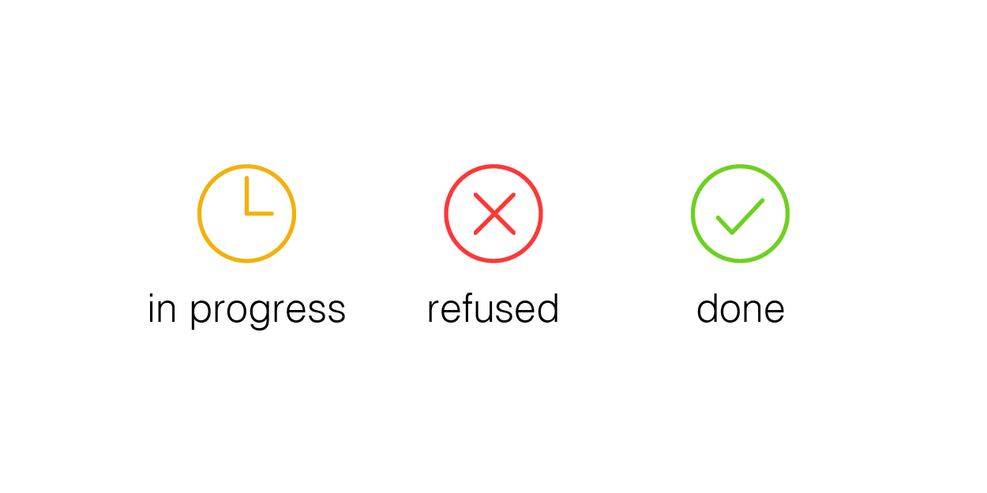
Compiler Construction
Progress Pics
Source code (sequence of chars)
Done:
Derived an AST, augmented with types and identifier symbols
Ensured the program is legal to the best of our abilities
ToDo:
Get that sucker to run!
Scanner
Lexical analysis
Parser
Syntactic analysis
Semantic analysis
In progress
Intermediate code generation
IR optimization
Final Code generation
Final code optimization
Output code in T

Slide 9

IRs: The Big Idea
Intermediate Representations
A big, basic concept
“Encoding of a program”
“The output of a compiler frontend and input of a compiler backend”
“What a compiler knows about a program”
“A simpler language to which the source language is mapped”

Slide 10

Intermediate Representation Benefits
Introducing IRs
M source languages
Abstraction
N target languages
Write M$×$N compilers
Decouple compiler frontend from the backend
S₁
…
S₂
S_{m}
T₁
T₂
…
T_{m}
Analysis
or M+N compiler modules
S₁
S₂
…
S_{m}
IR
T₁
T₂
…
T_{m}

Slide 11
Intermediate Representation Benefits
Introducing IRs
Source Language
Abstraction
Decouple compiler frontend from the backend
Break down source language constructs over several small steps towards target
IR₁
Analysis
IR₂
Target Language

Slide 12
Intermediate Representation Benefits
Introducing IRs
Abstraction
Decouple compiler frontend from the backend
Improve…
Run time
Memory usage
Power usage
Security
Break down source language constructs over several small steps towards target
Analysis
Optimize programs

Slide 13
Intermediate Representation Benefits
Introducing IRs
Abstraction
For example…
typechecking
Decouple compiler frontend from the backend
Break down source language constructs over several small steps towards target
Analysis
But isn’t this an
analysis on the AST?
Optimize programs
Predict faults

Slide 14

Intermediate Representation Benefits
Introducing IRs
Abstraction
For example…
typechecking
ASTs are an example of an IR!!
Decouple compiler frontend from the backend
Break down source language constructs over several small steps towards target
We’ve been talking about IR for a week!!
Analysis
But isn’t this an
analysis on the AST?
Optimize programs
Predict faults
M. Night Shyamalan, famous for
(ill-considered) plot twists in
movies he writes/directs

Slide 15
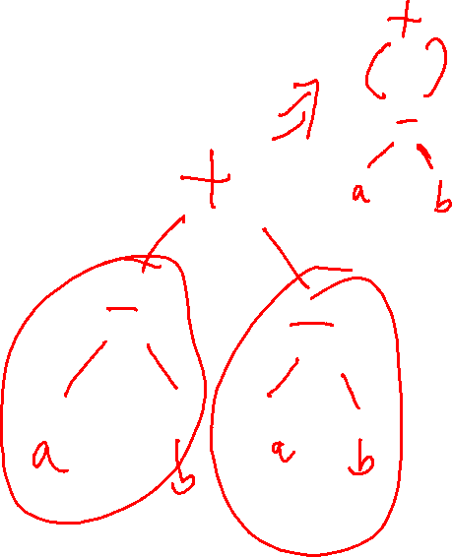
Classes of IR
Introducing IRs
Structural
  Abstract-Syntax Tree (AST)
  Abstract Syntax DAG
Linear
  Three-Address Code (3AC)
  Stack machine code
Hybrid
  Control-Flow Graph

Slide 16

Limitations of Trees
Introducing IRs
AST is great for some things, but not everything
  Doesn’t represent control flow very well
Compilers could go directly from AST to machine code
Let’s consider a different IR

Slide 17
Today’s Outline
Lecture Outline – Intermediate Representations
Introduce IRs
What they are
How they’re used
Three Address Code (3AC)
Introduction
Inventory
Intermediate
Representations

Slide 18

Introducing 3AC
3AC Description
A Simplified Instruction Set Architecture (ISA)
A family of pseudocode notations
Like ASTs, there’s no canonical 3AC
We’re more interested in the general idea

Slide 19
Introducing 3AC
3AC Description
A Simplified Instruction Set Architecture (ISA)
A family of pseudocode notations
Memory model: infinite “symbolic store”
“Memory”
age
7
Naming a variable adds a location
in the store
spd
4.2
We’ll assume that the store can handle scope
arr
1
2
3
str
abcd

Slide 20
Introducing 3AC
3AC Description
A Simplified Instruction Set Architecture (ISA)
A family of pseudocode notations
Memory model: infinite “symbolic store”
Instruction model: linear instructions divided into procedures
Discrete code listings

Slide 21
From Variables to Locations (“locs”)
3AC Description
A loc is…
An address in memory
A container for a value
Use [ ] around loc to denote value at that location
[a] is the “value at a”
(sort of like adding a pointer
level into every access)
int a;
int * a;
int * b;
int ** b;
a = 1;
*a = 1;
*b = 2;
**b = 2;

Slide 22
3AC: What’s With the Name?
3AC Description
Instructions have at most 3 operands
a = b + c * d – e
becomes
[tmp1] := [c] * [d];
[tmp2] := [b] + [tmp1];
[tmp3] := [tmp2] – [e];
[a] := [tmp3];

Slide 23
3AC: Instruction Classes
3AC Description
Data flow
Assignment
Math/Logic
Control flow
Labels
Jumps
Interprocedural
Boundaries
Bodies
Calls
<opd> := <opd>
Opd stands for “operand”
Literals, variables, etc.
Example:
[a] := 1
[b] := [a]

Slide 24
3AC: Instruction Classes
3AC Description
Data flow
Assignment
Math/Logic
Control flow
Labels
Jumps
Interprocedural
Boundaries
Bodies
Calls
<opd> := <opd> <opr> <opd>
<opd> := <opr> <opd>
Opd stands for “operand”
Literals, variables, etc.
Opr stands for “operator”
MULT64, DIV64, SUB64, ADD64, etc.
Example:
[a] := 1 MULT64 2
[b] := [a] SUB64 4

Slide 25
3AC: Instruction Classes
3AC Description
Data flow
Assignment
Math/Logic
Control flow
Labels
Jumps
Interprocedural
Boundaries
Bodies
Calls
<lbl>: <instr>
Example:
Label1: [a] := 1
nop
Example:
Label1: nop

Slide 26
3AC: Instruction Classes
3AC Description
goto <lbl>
Data flow
Assignment
Math/Logic
Control flow
Labels
Jumps
Interprocedural
Boundaries
Bodies
Calls
Example:
Label2: goto Label2
ifz <opd> goto <lbl>
Example:
ifz [a] goto Label1
[a] := 1
Label1: [a] := 2

Slide 27
3AC: Instruction Classes
3AC Description
Data flow
Assignment
Math/Logic
Control flow
Labels
Jumps
Interprocedural
Boundaries
Bodies
Calls
enter <proc>
leave <proc>
Example:
enter fn
[global] := 7
leave fn

Slide 28
3AC: Instruction Classes
3AC Description
getarg <idx> <opd>
Data flow
Assignment
Math/Logic
Control flow
Labels
Jumps
Interprocedural
Boundaries
Bodies
Calls
setret <opd>
Example:
int fn(int a, int b){
a = b;
return 42;
}
Example:
enter fn
getarg 1, [a]
getarg 2, [b]
[a] := [b]
setret 42
leave fn

Slide 29
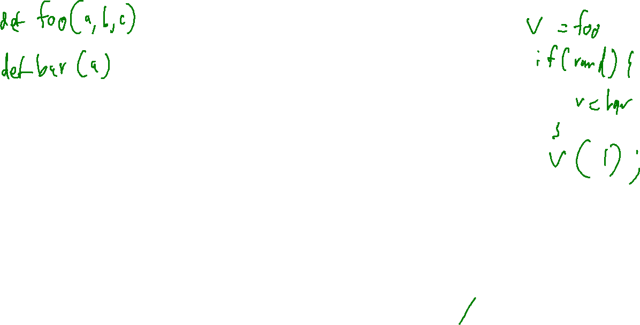
3AC: Instruction Classes
3AC Description
call <proc>
Data flow
Assignment
Math/Logic
Control flow
Labels
Jumps
Interprocedural
Boundaries
Bodies
Calls
setarg <int> <opd>
getret <opd>
Example:
int fn(int a, int b){
a = b;
return 42;
}
Example:
enter fn
getarg 1, [a]
getarg 2, [b]
[a] := [b]
setret 42
leave fn
int v(){
int k;
k = fn(7, 9);
}
enter v
setarg 1, 7
setarg 2, 9
call fn
getret [k]
leave v

Slide 30

That’s All we Need!
3AC Description
We can build complex behavior out of these simple building blocks
One minor loose end to tie up…

Slide 31
Dealing with Scope
3AC Description
void fn(){
int a;
a = 9;
if (true){
int a;
a = 6;
}
}
enter fn
[ a ] := 9
…
[ a ] := 6
…
leave fn
¹
Name clash?
²
Only in notation!
These assignment connect to different symbols
We can use superscripts if needed

Slide 32
3AC Data Structures
AST Translation to 3AC – Implementation
One class per 3AC node type
  Often referred to as “Quads” – has at most 4 fields (+ label)
  Each procedure maintains a list of its quads
lbl
dst
src1
opr
src2
L1
[t1]
[a]
SUB
64
2

Slide 33


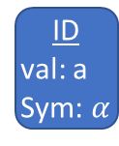






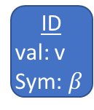


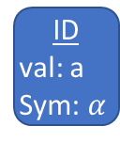

Translation Implementation
AST Translation to 3AC – Implementation
Propagate context to parent & generate 3AC instruction(s)
AssignStmt
lbl
dst
src₁
opr
src₂
a = 7 + (a – v)
AssignExp
t1
$$(γ)$$
a
($α$)
SUB
64
v
($β$)
ID
val: a
Sym: $α$
Plus
t2
$$(δ)$$
7
ADD
64
[t1]
($γ$)
IntLit
7
Sub
[t1] := [a] SUB64 [v]
[t2] := 7 ADD64 [t1]
[a] := [t2]
[a]
$$(α)$$
[t2]
($δ$)
ID
val: a
Sym: $α$
ID
val: v
Sym: $β$
$$α$$
$$δ$$
Symbol:
Kind: var
Type: int
Name: a
$$β$$
$$γ$$
Symbol:
Kind: tmp
Type: int
Name: tmp2
Symbol:
Kind: var
Type: int
Name: v
Symbol:
Kind: tmp
Type: int
Name: tmp1

Slide 34

Next Time
3AC Translation
Translating AST code into 3AC
A final walk of the AST
3AC
AST

