Slide 1
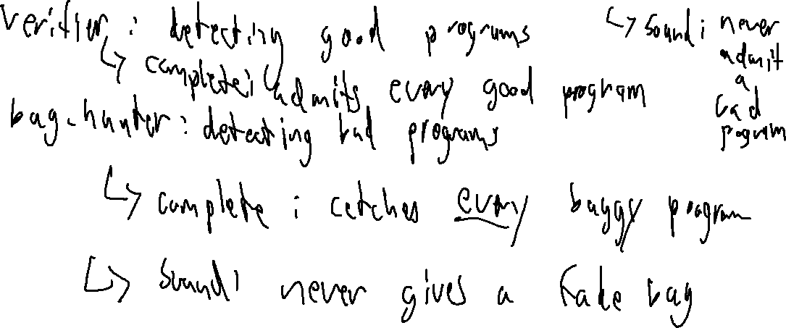
Check in 18
Lecture Review – Error Checking
Give an example of a program analysis that is sound but not complete

Slide 2
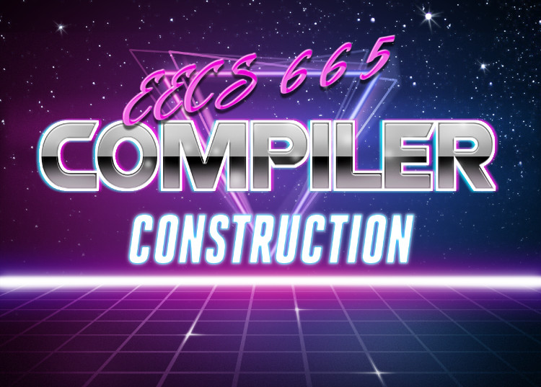
Parameters
University of Kansas | Drew Davidson

Slide 3
Administrivia
Announcements

Slide 4
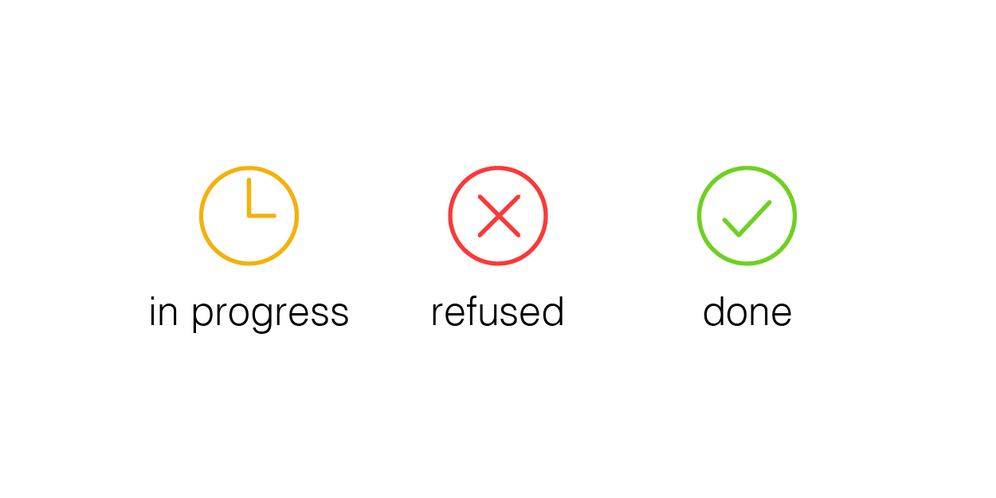
Compiler Construction: Progress
You are here
Source code (sequence of chars)
Continuing exploration of language semantic features
Informs design/behavior of our semantic analysis
Scanner
Lexical analysis
Parser
Syntactic analysis
We are here
Semantic analysis
Intermediate code generation
IR optimization
Final Code generation
Final code optimization
Output code in T

Slide 5

Last Time
Lecture Review – Error Checking
The Limits of Error Checking
Halting problem
Partial Correctness
Partial Correctness
Soundness
Completeness
Semantics

Slide 6
Today’s Outline
Parameters
Vocabulary
lval/rval
Memory references
Calls
Parameter Passing
Call by value
Call by reference
Call by name
Call by value-result
Semantics

Slide 7

Vocabulary
Parameters
Define a couple of terms that are helpful to talk about parameters
  We already encountered some of these in passing

Slide 8
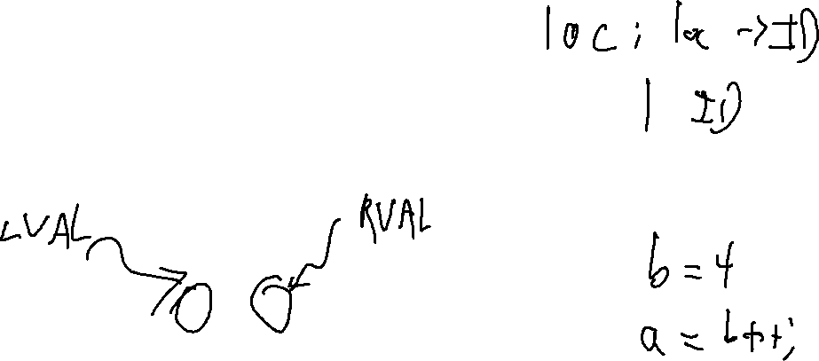
L and R Values
Parameters
L-Value
  A value with a place of storage
R-Value
  A value that may not have storage
a = 1;
a = b;
b++;

Slide 9
Bad Use of R-Values
Parameters
Can prevent programs that are valid in pass by value from working in pass by reference
  Literals (for example) do not have locations in memory
The type checker should catch these errors.

Slide 10
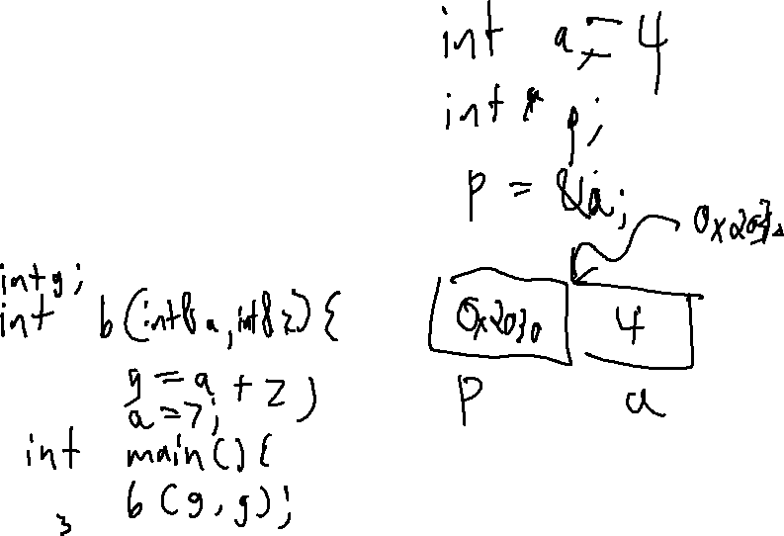
Memory References
Parameters
Pointer
  A variable whose value is a memory address
Aliasing
  When two or more variables reference the same address

Slide 11
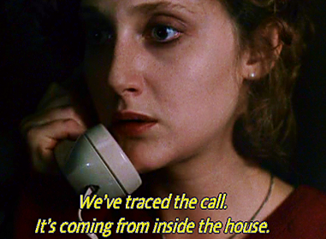
Calls
Parameters
Caller
The source function initiating the call
Callee
The target function receiving the call
Call Site
The location within the caller where the call happens
caller

Slide 12
Calls
Parameters
Caller
The source function initiating the call
Callee
The target function receiving the call
Call Site
The location within the caller where the call happens
void a(){
return;
}
void b(){
a();
}
void c(){
b();
a();
}
Here
b is the caller
a is the callee
Here
c is the caller
b is the callee
Here
c is the caller
a is the callee

Slide 13
Call Chains & Graphs
Parameters
Call Graph
A node-based representation of possible call structure
  Edge: caller -> callee
Call chain
A realizable path of calls (c,b,a)
a
void a(){
return;
}
void b(){
a();
}
void c(){
b();
a();
}
b
c

Slide 14

Arguments
Parameters
In definition:
  void v(int a, int b, bool c) { … }
  Terms
    Formals / formal parameters / parameters
In call:
v(a+b,8,true);
  Terms
    Actuals / actual parameters / arguments

Slide 15
Parameter Passing Schemes
Parameters
We’ll talk about some different varieties
  Some of these are more used than others
  Each has advantages / uses

Slide 16
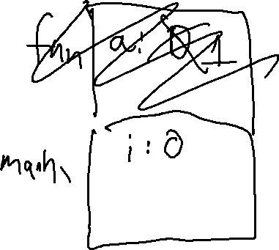
Pass by Value
Parameters
On function call
  Values of actuals are copied into the formals
  C and java always pass by value
void fun(int a){
int a = 1;
}
void main(){
int i = 0;
fun(i);
print(i);
}

Slide 17
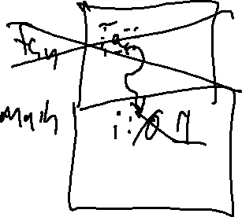
Pass by Reference
Parameters
On function call
  The address of the actuals are implicitly copied
void fun(int a){
a = 1;
}
void main(){
int i = 0;
fun(i);
print(i);
}

Slide 18
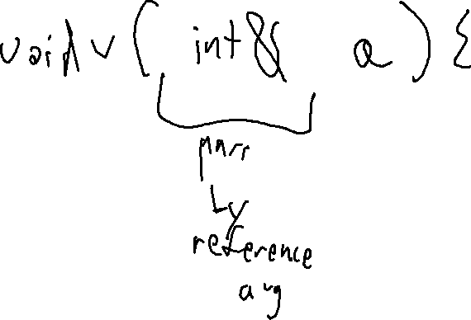
Language Examples
Parameters
Pass by value
  C, Java, C#
Pass by reference
  Allowed in C++ and Pascal

Slide 19
Java and C# Are Pass by Value?!
Parameters
All non-primitive L-values are references
void fun(int a, Point p){
a = 0;
p.x = 5;
}
void main(){
int i = 0;
Point k = new Point(1, 2);
fun(i,k);
}

Slide 20

Pass by Value-Result
Parameters
When function is called
  Value of actual is passed
When function returns
  Final values are copied back to the actuals
Used by Fortran IV, Ada
  As the language examples show, not very modern

Slide 21
Pass by Name
Parameters
Conceptually works as follows:
  When a function is called
    Body of the callee is rewritten with the text of the argument
    Only really makes sense with non-local scope rules
  Like macros in C / C++

Slide 22
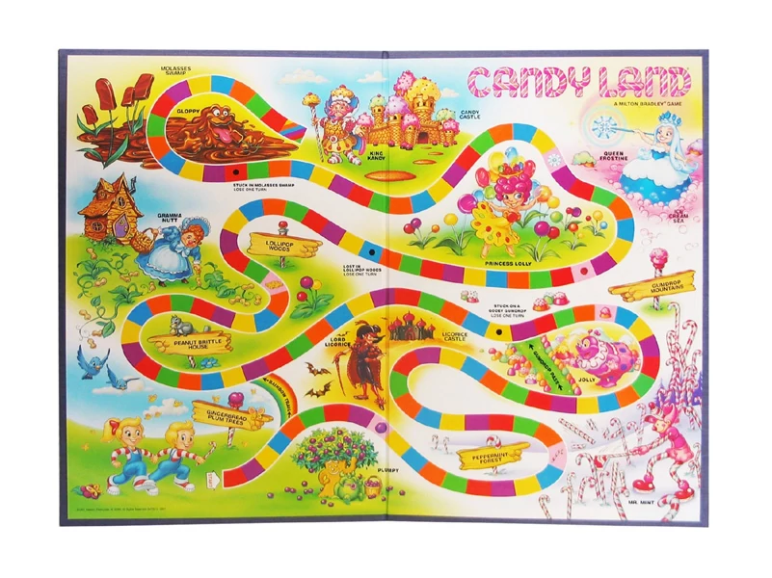
COMPILER
Optimization
Execution
Codegen
Intermediate
Representation
Runtimes
SDD
Parsing
Semantics
Lexical Analysis
Syntactic
Definiton

