Slide 1
Check-In 16
Review: Type Systems
Give an example of a C program that uses type coercion

Slide 2
Check-In 16: Solution
Review: Type Systems

Slide 3
Administrivia
Housekeeping
P3 deadline tonight
P4 released “Monday morning”, i.e. Sunday @ 11:59 PM + 1 minute

Slide 4
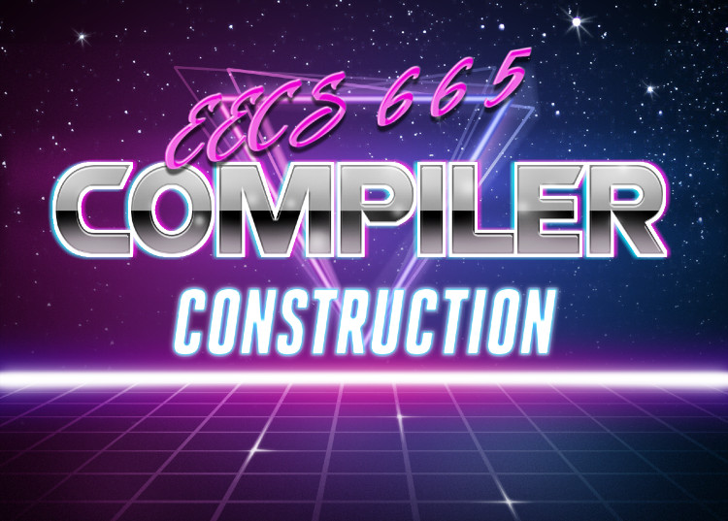
Type Analysis
University of Kansas| Drew Davidson

Slide 5

Last Lecture
Review: Type Systems
Discuss Type Systems
What they are
Why we use them
Type Specification (optional)
How we communicate type systems
You Should Know
What a type system is
How type systems effect semantics
Semantics

Slide 6
Today’s Outline
Type Analysis
Enforcing Type Systems
Design points
Type Analysis
Type checking
Type inference / synthesis
Semantics

Slide 7
Enforcing Type Systems
Type Analysis
Language property: how much enforcement / checking to do?
Idea 1: check what you can, allow uncertainty
Idea 2: check what you can, disallow uncertainty completely
Idea 3: check what you can, force user to dispel uncertainty
e.g. C
e.g. Haskell
e.g. Java, Rust

Slide 8

Escaping the Type System
Enforcing Types
Some languages allow an explicit means to “escape” the type system
Typecasting – allow one type to be used as another type

Slide 9
Casting Within Hierarchy
Enforcing Types
Cross-casting (static check in Java)
Apple a = new Apple();
Orange o = (Orange)a;
Downcasting (dynamic check in Java)
Fruit f = new Apple();
if ( rand() ) {
f = new Orange();
}
Apple dApp = (Apple)f;
Class Hierarchy
Compiler check
Fruit
Apple
Orange
Runtime check
ok

Slide 10
Casting Within Hierarchy
Enforcing Types
Cross-casting (static check in Java)
Apple a = new Apple();
Orange o = (Orange)a;
Downcasting (dynamic check in Java)
Fruit f = new Apple();
if ( rand() ) {
f = new Orange();
}
Apple dApp = (Apple)f;
Class Hierarchy
Compiler check
Fruit
Apple
Orange
Runtime check
ok
bad!

Slide 11

Strongly-Typed vs Weakly-Typed
Enforcing Types
Colloquial classification of a language’s type system
Degree to which type errors are allowed to happen at runtime
Continuum without precise definitions

Slide 12

Type Safety
Enforcing Types
Has a precise definition
  All successful operations must be allowed by the type system
Java was explicitly designed to be type safe
  A variable of some type can only be used as that type without causing an error
C is very much not type safe
C++ isn’t either but it is safer

Slide 13

Type Safety Violations
Type Enforcement
C
Format specifier
printf(“%s”, 1);
Memory safety
struct big{
int a[1000000];
};
struct big * b = malloc(1);
C++
Unchecked casts
class T1 { char a };
class T2 { int b };
int main {
T1 * myT1 = new T1();
T2 * myT2 = new T2();
myT1 = (T1*)myT2;
}

Slide 14

Type Research
Detour: Ungraded Material

Slide 15

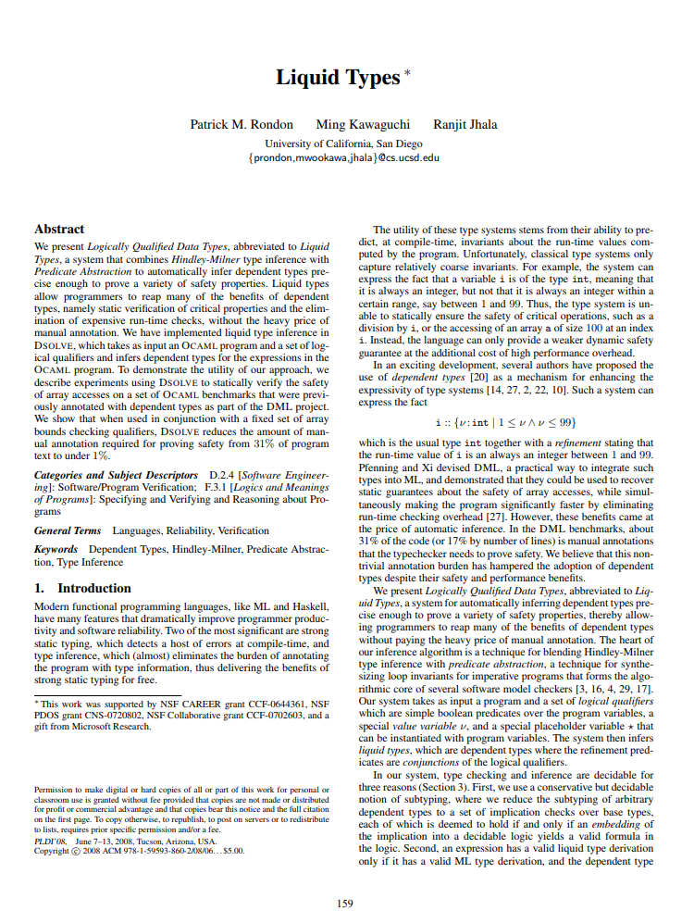
Research on Types
Type Checking
A huge topic in and of itself
Some CS Deparments have a “PLT” focus: “Programming Languages and Types”

Slide 16
Refinement Types
Type Checking
A type enhanced with a predicate which must hold for any element of that type
Could imagine enhancing a type system with annotations for all kinds of properties
  Single-use variable
  High security/low security (non-interference)
$$f : ℕ →\left\{ n :ℕ| n\%2=0\right\}$$

Slide 17
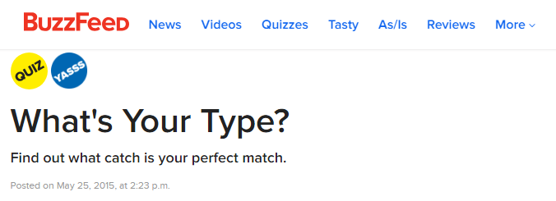

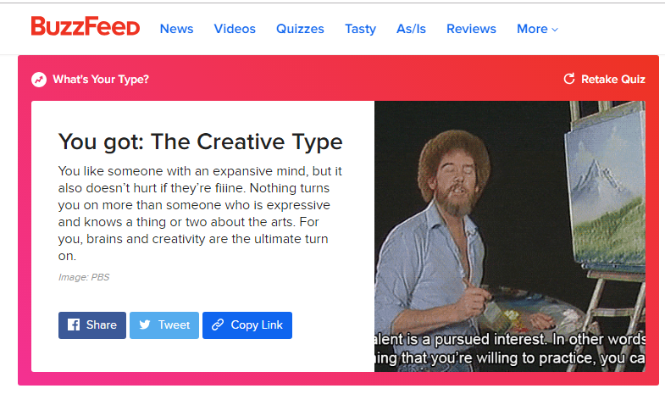
More Research on Types
Type Checking
?
A huge topic in and of itself
  Some CS Departments have a “PLT” focus: “Programming Languages and Types”
??
?

Slide 18

Piggybacking on Type Checking
Type Checking
Type checking is a good place to get extra programmer hints:
  Programmers are already familiar with typing logic
  The analysis is already well-formulated

Slide 19

Formal Type Systems
End Detour: Done with Ungraded Material

Slide 20
Reasons for Typing
Type Checking
Generate appropriate code for operations
A + B
  String concatenation? Integer addition? Floating-point addition
Catch runtime errors / security
  Make sure operations are sensible
  Augment type system with addition checks

Slide 21

Types In Action
Type Checking
Type Analysis
Assigning types to expressions
Flavors:
  Type synthesis – get type of an AST node from it’s children
  Type inference – get type of an AST node from it’s use context
Type Checking
Ensure that type of a construct is allowed by the type system

Slide 22
Implementing Our Type Checker
Type Checking

Slide 23
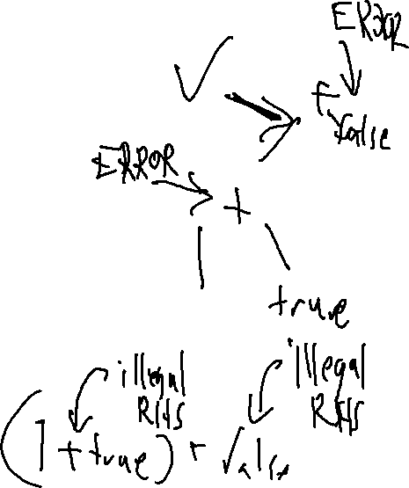
Implementing Typing
Our Type System
Structurally similar to nameAnalysis
Historically, intermingled with nameAnalysis
Done as part of AST attribute “decoration”
Add a typeCheck method to AST nodes
Recursively walk the AST checking subtypes
  “Inside out” analysis
  Attach types to nodes
  Propagate an error symbol

Slide 24
Binary Operators
Implementing Static Typing
Get the type of the LHS
Get the type of the RHS
Check that the types are compatible for the operator
Set the kind of the node be a value
Set the type of the node to be the type of the operation’s result
(int)
PlusNode
lhs
rhs
(int)
(int)

Slide 25
Literals
Implementing Static Typing
Cannot be wrong
  Just pass the type of the literal up the tree
(int)
IntLitNode

Slide 26
Variables
Implementing Static Typing
Look up the type of the declaration
  There should be a symbol “linked” to the node
Pass symbol type up the tree
(int)
IdNode
mySymbol
Kind: VAR
type: int
Name: “v”

Slide 27

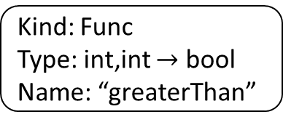
Function Calls
Implementing Type Checking
Get type of each actual
Match against formals of the called function’s symbol
Propagate return type to parent node
(bool)
FnCallNode
myID
args
(int,int $→$bool)
(int,int)
mySymbol
IDNode
ActualsList
[0]
[1]
(int)
(int)
Kind: Func
Type: int,int $→$ bool
Name: “greaterThan”
…
…

Slide 28
Statements
Implementing Type Checking
Always have void type
Make sure to check child expression
No type to propagate
Some versions of analysis may propagate boolean: error / no error
(void)
OutputStmt
(int)
PlusNode
(int)
(int)
IntLit
IDNode
mySymbol
Kind: VAR
type: int
Name: “v”

Slide 29
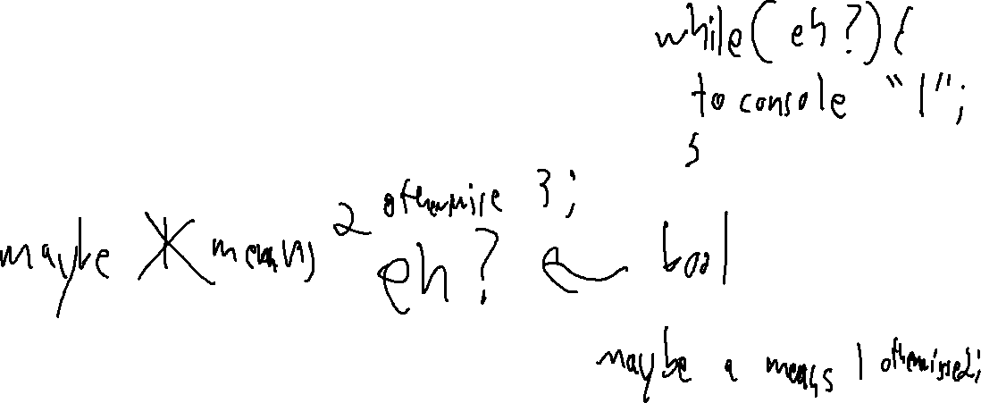
Other AST Node Types
Implementing Type Checking
Follow these same principles
Ensure that children are well-typed
Apply a combination rule
  If valid: infer a type and propagate out
  If invalid: propagate error

Slide 30
Exercise: Draw Type Analysis
Bonus Exercise
1. int a;
2. bool f;
3. int m(int arg){
4. int b;
5. return arg + 1;
6. }

Slide 31
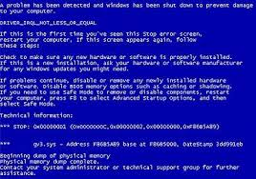
Handling Errors
Implementing Type Checking
We’d like all distinct errors at the same time
  Don’t give up at the first error
  Don’t report the same error multiple times
When you get error as an operand
  Don’t (re)report an error
  Again, pass error up the tree

Slide 32
Operator Errors vs Operand Errors
Implementing Type Checking
The difference between…
true + false
… and
true == 7
Neither operand works with the operator
error
error
These operands could work with the operator
… but they don’t work with each other
error

Slide 33
Type Error Example
Implementing Type Checking
int a;
bool b;
a = true + 1 + 2 + b;
b = 2;
StmtList
AssignStmt
AssignStmt
error
REPORT
error
AssignExp
AssignExp
int
error
bool
int
IdNode
Plus
REPORT
IdNode
IntLit
symbol
bool
error
type: int
name: a
Plus
IdNode
symbol
symbol
error
int
REPORT
Plus
IntLit
2
type: bool
name: b
bool
int
BoolLit
true
IntLit
1

Slide 34
Lecture Summary
Wrap-Up: Typechecking
We’d like all distinct errors at the same time
  Don’t give up at the first error
  Don’t report the same error multiple times
When you get error as an operand
  Don’t (re)report an error
  Again, pass error up the tree

Slide 35
Next Time
Preview: Error Reports
Having explorer two semantic analyses, let’s generalize
What’s the limit of semantic analysis, especially error checking?

