Slide 1
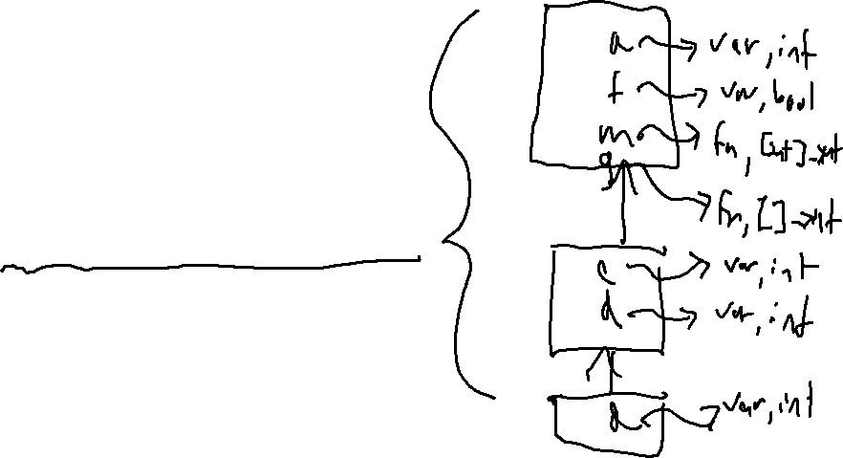
Check-in
Review: Semantic Analysis
1. int a;
2. bool f;
3. int m(int arg){
4. int b;
5. return arg + 1;
6. }
7.
8. int g(){
9. int c;
10. int d;
11. if (a){
12. int d;
13. int f;
14. int g;
15. }
16. }
Show the symbol table
After line 12 but before line 13

Slide 2
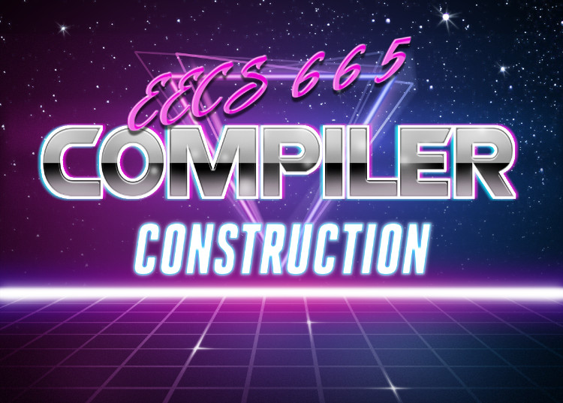
Type systems
University of Kansas | Drew Davidson

Slide 3

Compiler Construction
Progress Pics
Live Assignments
P1
H2
Source code
Semantic Analysis
We have a lightweight program representation
Figuring out what the program means
  Roughly, “what it does”
Lexical
analysis
Syntactic
analysis
Abstract syntax
tree
We are here
Semantic analysis
Intermediate code generation
Abstract syntax
Tree + Annotations
Intermediate code optimization
Code generation
Final code optimization
Target code

Slide 4

Last Time
Semantic Analysis
You should know
Name analysis
What it is
What it does
How it works
Name Analysis
Enforcing scope
Symbol Table
What it is
What it does
Semantics

Slide 5
Lecture Outline
Type Systems
Discuss Type Systems
What they are
Why we use them
Type Specification
Formally communicating type systems
Our type system (for the project)
Semantics

Slide 6

Specification vs Implementation
Discussing Type Systems
A big idea in compilers
Thinking at different layers of abstraction
Types are a nice instance
  (so were syntax and tokenization)
Today: Specification
Next time: Implementation

Slide 7

Recall: Aim of Semantic Analysis
Type Systems – Rationale
Deduce what the programmer meant
Philosophy: don’t let bugs get by
Give programmer means to express intent

Slide 8

Types as Hints From Programmer
Type Systems – Rationale
Types Communicate programmer intention
Compiler can choose the appropriate operation
Compiler can tell if the operations are sensible

Slide 9
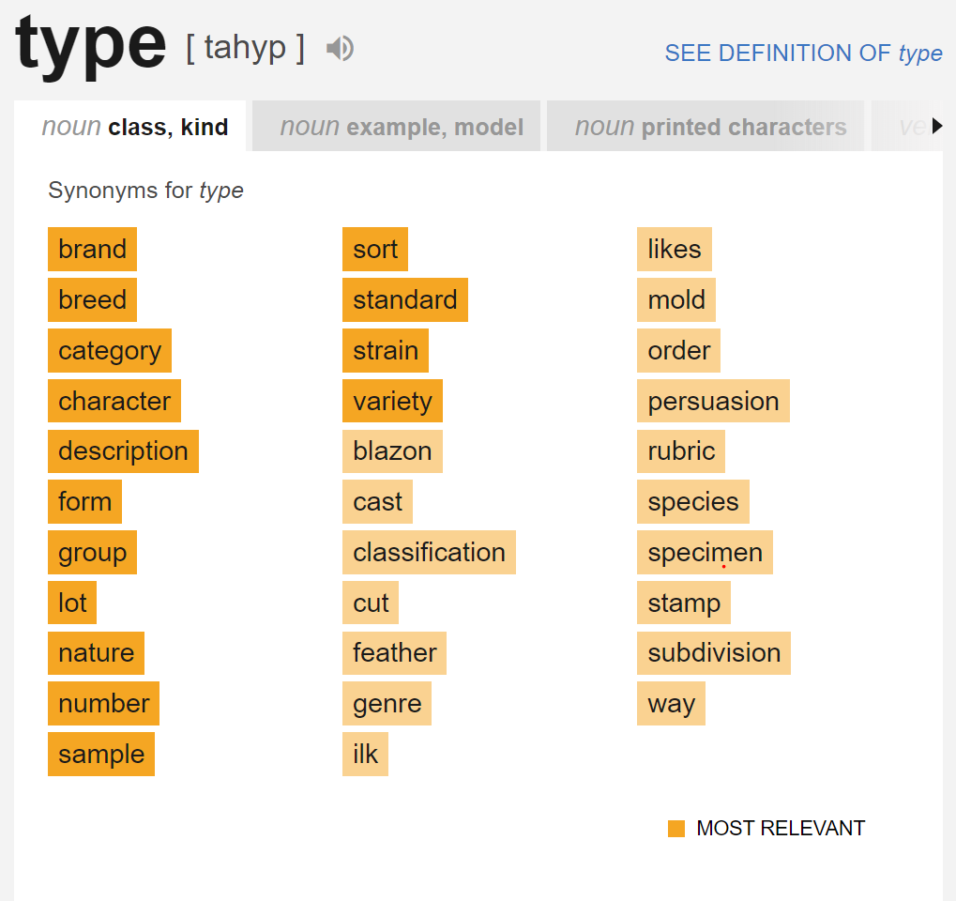
What we Mean by “ Type”
Type Systems
Short for “data type”
Classification for various kinds of data
A set of possible values which a variable can possess
May imply representation
(perhaps in memory)
int32

Slide 10
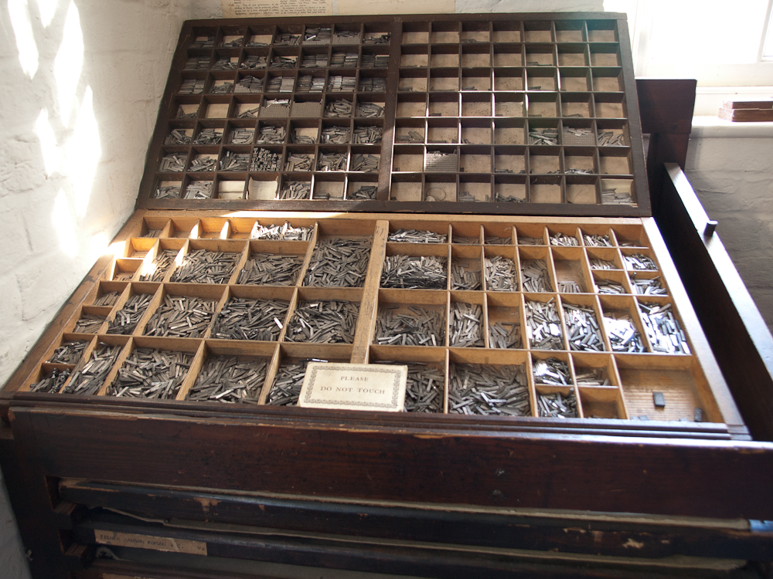
Type Systems: The Context for Types
Type Systems
Type System: lists types and describes how they may be used
What operations that can be done on member values
How type system may be extended

Slide 11
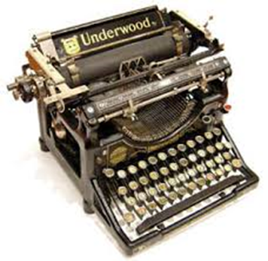
Components of a Type System
Type Systems
Base types and means of building aggregate types
  int, bool, void, class, function, struct, pointer, reference
A means of determining if types are compatible
  Can disparate types be combined? How?
Rules for inferring the type of an expression

Slide 12
Type Rules
Type Systems
For every operator (including assignment)…
  - What types can the operand have?
  - What type is the result?
Example:
double a;
int b;
a = b;
b = a;
Legal in Java, C++
Legal in C++, Illegal in Java

Slide 13

Type Conversion
Type Systems
Defn: Using One Type as a Different Type
May require explicit acknowledgement by user (e.g. casting)

Slide 14
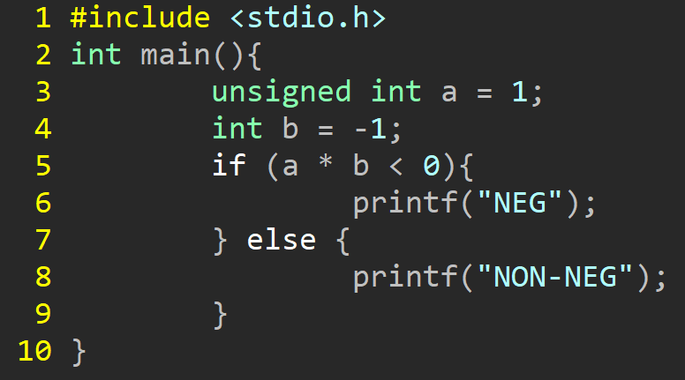
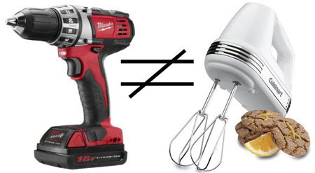
Type Coercion
Type Systems
Defn: Implicit cast from one data type to another
For example:
int to unsigned int

Slide 15

Type Promotion
Type Systems
A narrow form of coercion
When destination type can represent the source type without loss of precision
float to double (ok)
double to float (not ok)
A promotion ceremony

Slide 16
Subtyping
Type Systems
When a more narrow type can be used in place of a another
Explicit inheritance / class hierarchy
class Lunch
class Sandwich: public Lunch
class Soup: public Lunch
class Hotdog: public Sandwich

Slide 17

Duck Typing
Type Systems
Defn: Type is defined by the methods and properties
“If it walks like a duck and talks like a duck, it’s a duck”

Slide 18
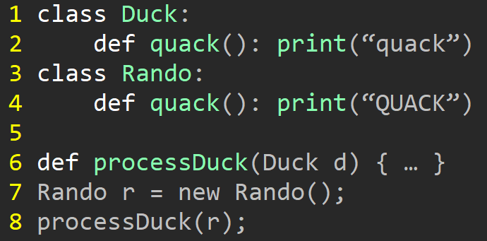
Duck Typing: Example
Type Systems

Slide 19

Duck Punching
Type Systems
Defn: Type defined by the methods/properties at time of use
“If it walks like a duck but isn’t giving you the noise you want,
punch it until it quacks. Now it’s a duck”

Slide 20


Brief Aside: Duck Punching
Type Systems
Also sometimes called gorilla typing
guerilla (as in covert/secret)
gorilla (sounds like guerilla)

Slide 21
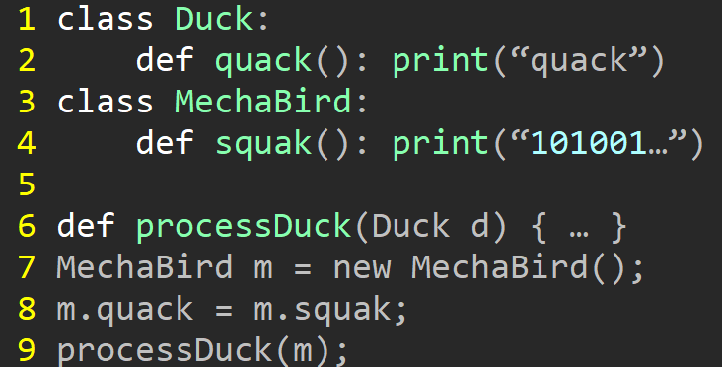
Duck Punching: Example
Type Systems
class Duck:
def quack(): print(“quack”)
class MechaBird:
def squak(): print(“101001…”)
def processDuck(Duck d) { … }
MechaBird m = new MechaBird();
m.quack = m.squak;
processDuck(m);

Slide 22
Let’s Talk about The Type System Used in the Projects
Type Checking

Slide 23
Our Type System: Fundamentals
Type Checking
Primitive Types
  int, bool, string, void
Aggregate types
  ref, functions, custom
Coercion
  Bool cannot be used as an int (nor vice-versa)

Slide 24
Our Type Rules
Our Type System
Arithmetic operators must have int
Equality operators == and !=
  Operands must have same type
    CANNOT be applied to functions
    CAN be applied to function results
Other relational operators must have int type
Logical operators must have bool operands

Slide 25
Type Errors II
Our Type System
Assignment operator
  Must have operands of the same type
  Can’t be applied to functions
    Functions (but CAN be applied to function results)
For sending data to the console
  x must be an rval (usable on RHS of an assignment)
For reading data from the console
  x must be an lval (usable on LHS of an assignment)
Condition of if and condition of while must be boolean

Slide 26
Type Errors III
Our Type System
Invoking (calling) something that’s not a function
Invoking a function with
  Wrong number of args
  Wrong type of args
Returning a value from a void function
Not returning a value in a non-void function
Returning a wrong type of value in a non-void function

Slide 27
Summary
Type Systems
Invoking (calling) something that’s not a function
Invoking a function with
  Wrong number of args
  Wrong type of args
Returning a value from a void function
Not returning a value in a non-void function
Returning a wrong type of value in a non-void function

Slide 28
Upcoming Project: P4
Type Systems
Implement name analysis

Slide 29
Let’s stop here

Slide 30

Formalizing Type Systems
Detour: Ungraded Material

Slide 31





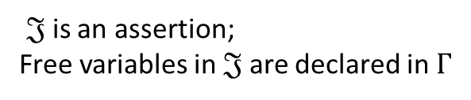
Representing Type Systems
Formal Type Systems
Particular formalism: Judgements + rules
Judgements:
$Γ⊢𝔍$
Rules:
$𝔍$is an assertion;
Free variables in $𝔍$ are declared in $Γ$
(rule name)
$Γ1⊢𝔍$₁
…
$Γn⊢𝔍$_{n}
(annotations)
$$Γ⊢𝔍$$

Slide 32

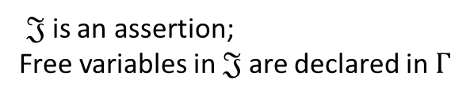




Judgements
Formal Type Systems
$$Γ⊢𝔍$$
$𝔍$is an assertion;
Free variables in $𝔍$ are declared in $Γ$
Example Judgements
$$Γ⊢\text{◊}$$
$$Γ⊢M :A$$
$$∅⊢true :bool$$
$$∅,x:int⊢x+1 :int$$

Slide 33










Rules
Formal Type Systems
(rule name)
$Γ1⊢𝔍$₁
…
$Γn⊢𝔍$_{n}
$$Γ⊢𝔍$$
Example type rules
(Env $∅$)
(Val 1)
(Val +)
$$Γ ⊢\text{◊}$$
$$Γ ⊢\text{M}\text{ : }\text{int}$$
$$Γ ⊢\text{N}\text{ : }\text{int}$$
$$∅⊢\text{◊}$$
$$Γ ⊢\text{1:}\text{int}$$
$$Γ ⊢\text{M}\text{+}\text{N}\text{:}\text{int}$$

Slide 34







Proof Trees
Formal Type Systems
$$∅⊢\text{◊}$$
By (Env $∅$)
$$∅⊢\text{◊}$$
By (Env $∅$)
$$∅⊢\text{1:}\text{int}$$
By (Val 1)
$$∅⊢\text{1:}\text{int}$$
By (Val 1)
$$∅⊢\text{1+1:}\text{int}$$
By (Val +)
Example type rules
(Env $∅$)
(Val 1)
(Val +)
$$Γ ⊢\text{◊}$$
$$Γ ⊢\text{M}\text{ : }\text{int}$$
$$Γ ⊢\text{N}\text{ : }\text{int}$$
$$∅⊢\text{◊}$$
$$Γ ⊢\text{1:}\text{int}$$
$$Γ ⊢\text{M}\text{+}\text{N}\text{:}\text{int}$$

Slide 35







Well-Typedness
Formal Type Systems
A way to express that the program can be correctly typed
Basic Scheme
State rules for language constructs
Well-typed if it can be placed at root of a complete proof tree
Hypothetical proof tree
$$∅⊢\text{◊}$$
By (Env $∅$)
$$∅⊢\text{◊}$$
By (Env $∅$)
$$∅⊢\text{1:}\text{int}$$
By (Val 1)
$$∅⊢\text{1:}\text{int}$$
By (Val 1)
$$∅⊢\text{1+1:}\text{int}$$
By (Val +)

Slide 36







Example Type Rules
Formal Type Systems
(val arr-len)
$$Γ⊢\text{E}\text{ : }\text{T}\text{[ ]}$$
$$Γ⊢\text{E}\text{.}\text{length}\text{ : }\text{int}$$
(val arr-elt)
$$Γ⊢\text{E}\text{0}\text{ : }\text{T}\text{[ ]}$$
$$Γ⊢\text{E}\text{1}\text{ : }\text{int}$$
$$Γ⊢\text{E}\text{0}\text{[}\text{E}\text{1}\text{] : }\text{T}$$
(val arr-alloc)
$$Γ⊢\text{E}\text{ : }\text{int}$$
$$Γ⊢\text{new} \text{T}\text{[}\text{E}\text{] : }\text{T}\text{[ ]}$$

Slide 37


Example Type Rules
Formal Type Systems
(val stmt)
$$Γ⊢\text{E}\text{ : }\text{T}$$
Where statement S
contains only expression E
$$Γ⊢\text{S}\text{ : }\text{void}$$

Slide 38
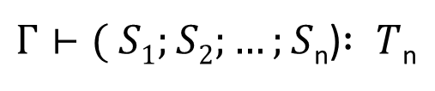
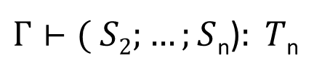

Example Type Rules
Formal Type Systems
(val sequence)
$$Γ⊢S1:T1$$
$Γ⊢( S2;…;S$_{n})$: T$_{n}
$Γ⊢( S1;S2;…;S$_{n})$: T$_{n}

Slide 39



Example Type Rules
Formal Type Systems
(val declaration)
$$Γ⊢\text{E}\text{ : }\text{T}$$
$$Γ, id:T ⊢(\text{S}\text{2}\text{ ; }…\text{; }\text{Sn}\text{) : }\text{T}\text{′}$$
$$Γ⊢\text{(}\text{id}\text{ : }\text{T}\text{ = }\text{E}\text{ ; }\text{S}\text{2}\text{ ; }…\text{; }\text{Sn}\text{): }\text{T}\text{′}$$

Slide 40



Example Type Rules
Formal Type Systems
(val fn-call)
$$Γ⊢E1:T1 ×…×En:Tn→Tr$$
$$Γ⊢Ei:Ti (i∈1..n)$$
$$Γ⊢\text{E}\text{(}\text{E}\text{1}\text{ , }…\text{, }\text{En}\text{) : }\text{Tr}$$

Slide 41

Formal Type Systems
End Detour: Done with Ungraded Material

