Slide 1
Flipped Wednesday

Slide 2
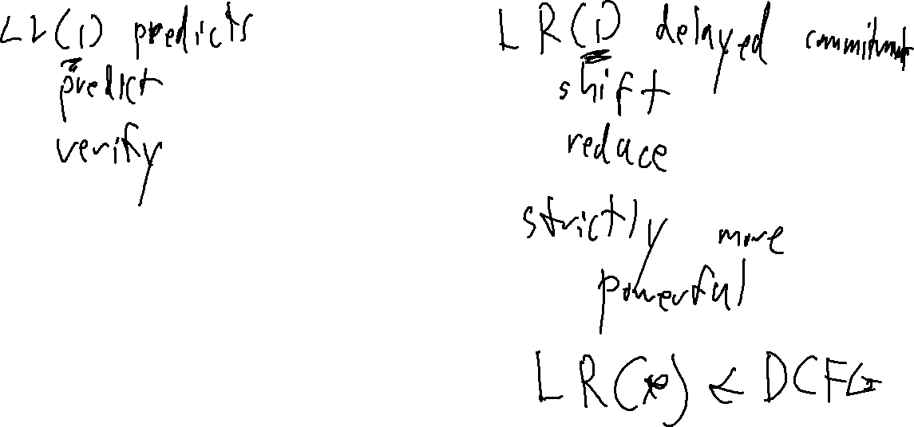
What is the difference between an LR(1) and LL(1) parser? Which is more powerful

Slide 3
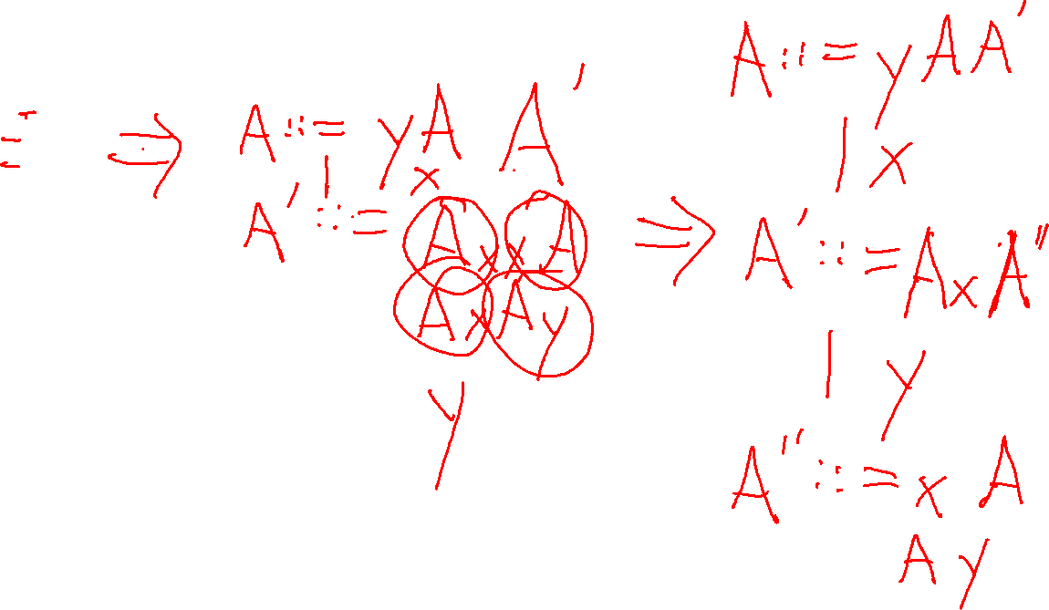
Left –factor this grammar
A ::= yAAxxA
| yAAxAy
| yAy
| x

Slide 4
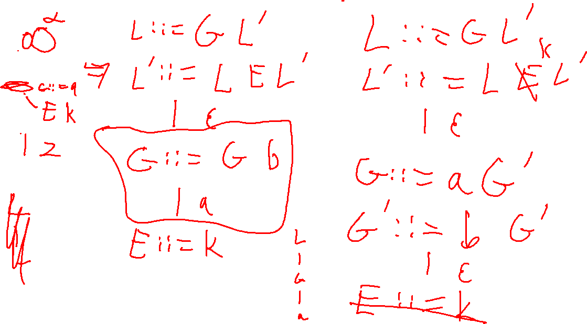
Eliminate left-recursion in the following grammar:
L ::= L L E
L ::= G
G ::= G b
| a
E ::= k

Slide 5
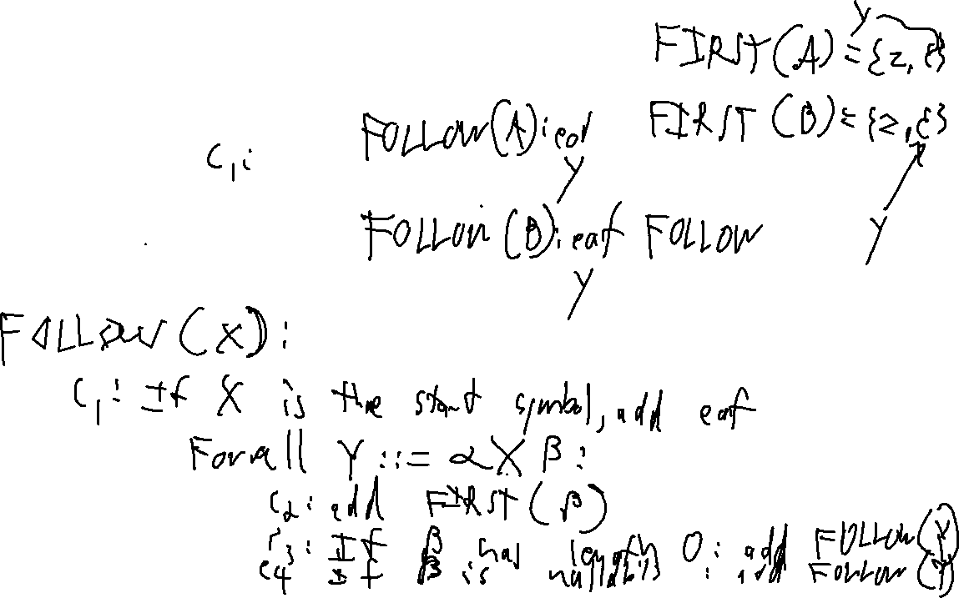
What are the FIRST and FOLLOW sets for the following grammar:
A ::= A y B
A ::= z
A ::= ε
B ::= A

Slide 6
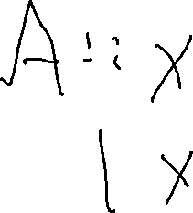
Is it possible to generate FIRST sets for a grammar with syntactic ambiguity? Explain your reasoning.

