Slide 1

Check-in
Review – FIRST Sets
Calculate first sets for this grammar
S ::= lpar X rpar
X ::= id comma X
| $ε$

Slide 2
Flipped Wednesday
Agenda
Some P2 info
Some First Set stuff

Slide 3
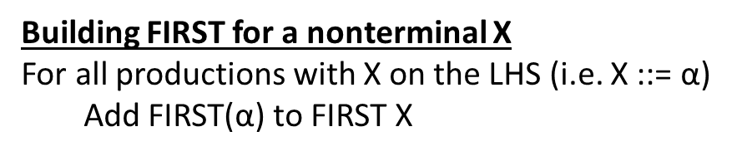
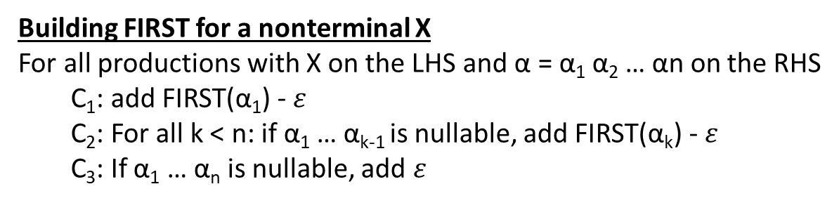
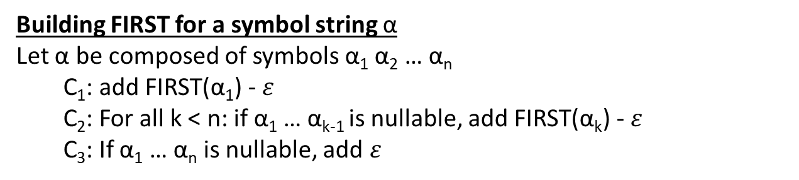
Building FIRST for a symbol string $\text{α}$
Let $\text{α}$ be composed of symbols $\text{α}$₁ $\text{α}$₂ … $\text{α}$_{n}
C₁: add FIRST($\text{α}$₁) - $ε$
C₂: For all k < n: if $\text{α}$₁ … $\text{α}$_{k-1} is nullable, add FIRST($\text{α}$_{k}) - $ε$
C₃: If $\text{α}$₁ … $\text{α}$_{n} is nullable, add $ε$
Building FIRST for a nonterminal X
For all productions with X on the LHS and $\text{α}\text{ = }\text{α}\text{1} \text{α}\text{2}\text{ … }\text{αn}$ on the RHS
C₁: add FIRST($\text{α}$₁) - $ε$
C₂: For all k < n: if $\text{α}$₁ … $\text{α}$_{k-1} is nullable, add FIRST($\text{α}$_{k}) - $ε$
C₃: If $\text{α}$₁ … $\text{α}$_{n} is nullable, add $ε$
Building FIRST for a nonterminal X
For all productions with X on the LHS (i.e. X ::= $\text{α}$)
Add FIRST($\text{α}$) to FIRST X

Slide 4
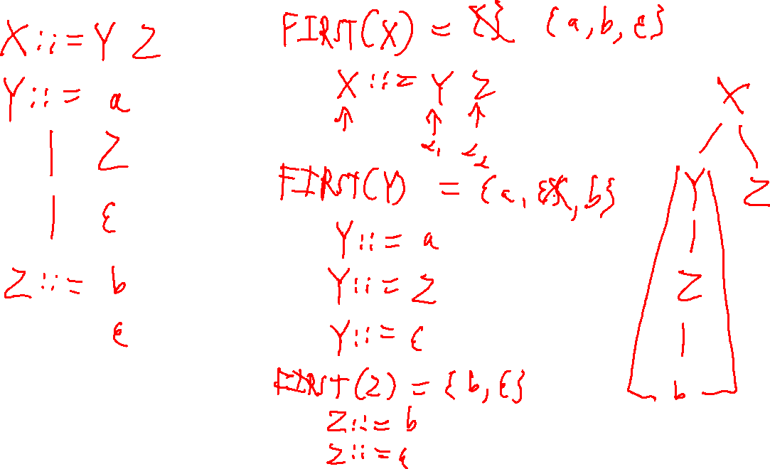

Slide 5
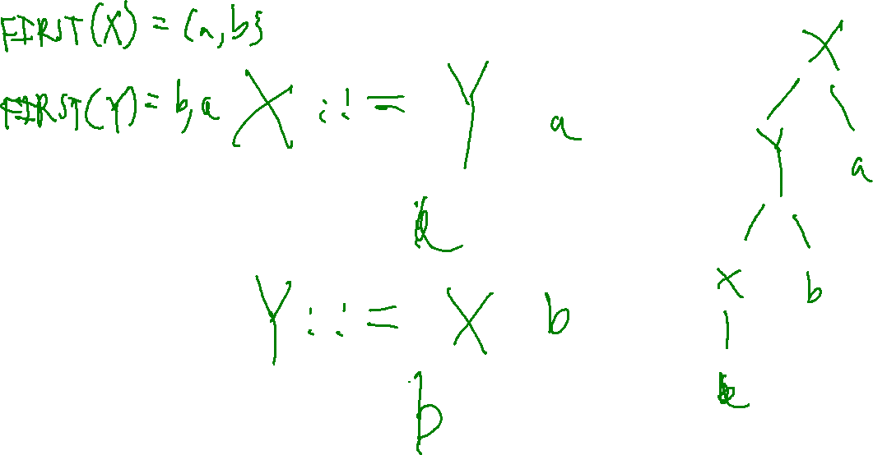

Slide 6
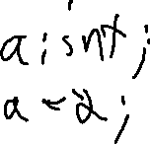

Slide 7
