Slide 1
Check-in
Review - ASTs
Live Assignments
P1
H2
Show the AST for the expression
(1 + x) * 2

Slide 2
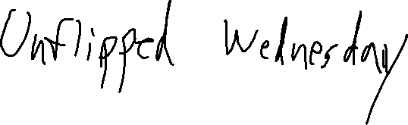
Administrivia
Live Assignments
P1
H2

Slide 3

(Predictive) Parsing
University of Kansas | Drew Davidson

Slide 4

Compiler Construction
Progress Pics
Live Assignments
P1
H2
Source code
Syntactic Analysis
We know what we want (induce an AST from a given token stream)
Lexical
analysis
Token stream
We are here
Syntactic
analysis
(Parse tree)
Semantic analysis
Abstract syntax
tree
Intermediate code generation
Intermediate code optimization
Code generation
Final code optimization
Target code

Slide 5

Last Time
Review - ASTs
Live Assignments
P1
H2
Syntax-Directed Definition
Showed how to use SDD to induce program’s AST
We can specify a correct syntactic analysis
You Should Know
The concepts of Parse Trees / ASTs
How to specify syntax-directed definitions (to induce scalar values, data structures, etc. from parse trees)
Syntax-Directed
Definition

Slide 6
AST For Input Code Snippet
Abstract Syntax Trees – ASTs in Code
FnBody
void foo(int x, int y)
{
if (x != y)
return;
while ( x < y){
console << “hi”;
x = (x + 1);
}
return;
}
stmtList
if
while
return
condition
body
condition
body
notEqual
isLess
LHS
RHS
LHS
write
assign
ID: x
ID: y
return
RHS
dst
src
LHS
RHS
ID: x
ID: y
ID:
console
StrLit:
“hi”
ID: x
plus
LHS
RHS
ID:x
IntLit: 1

Slide 7

The Goal and The Path
Abstract Syntax Trees – ASTs in Code
Goal: ASTs for input programs
Specification: Syntax-directed Definitions
Implementation: ???
Us

Slide 8

COMPILER
Code Generation
Execution
Runtime Environment
Intermediate
Representation
Optimization
SDD
Parsing
Semantics
Lexical Analysis
Syntactic
Definiton

Slide 9

Today’s Outline
(Predictive) Parsing
Live Assignments
P1
H2
Parsing
Complexity
The LL(k) Languages
Intro
LL(1) parsing
LL(1) transformations
Parsing

Slide 10

The Price of Expressive Power
(Predictive) Parsing – Parsing Complexity
Live Assignments
P1
H2
Parsing is costly
Jumping from Regular Languages to CF-Languages incurs penalties
  Lose lots of language properties
  Complexity for some operations goes up
Power always comes at a price

Slide 11

Parsing: Bad News/Good News
(Predictive) Parsing – Parsing Complexity
Live Assignments
P1
H2
Bad News
Complexity - CFL recognition:
  CYK: O(n³)
  Best known bound: O(n^{2.3728639})
Parsing is at least as hard
Good News
We don’t need to recognize all CFLs
  We can assume ambiguity-free syntax
  Exchange expressiveness for faster parsers

Slide 12

Scaling Back Expressive Power
(Predictive) Parsing – Parsing Complexity
Live Assignments
P1
H2
Compilers aren’t concerned with arbitrary languages
Programming languages should be unambiguous
Complex operations can be built from simple syntax
“Don’t buy the truck if
you ain’t haulin’ freight”
-Drew Davidson
Paying for features
we don’t need!

Slide 13
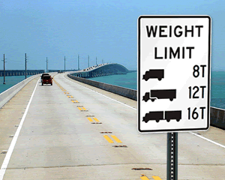
Restricting the Language Class
(Predictive) Parsing – Parsing Complexity
Live Assignments
P1
H2
Allows us to…
  Build linear-time parsers
  Detect ambiguity
Let’s consider one such class of restrictions
Disallowing Heavyweight Languages

Slide 14
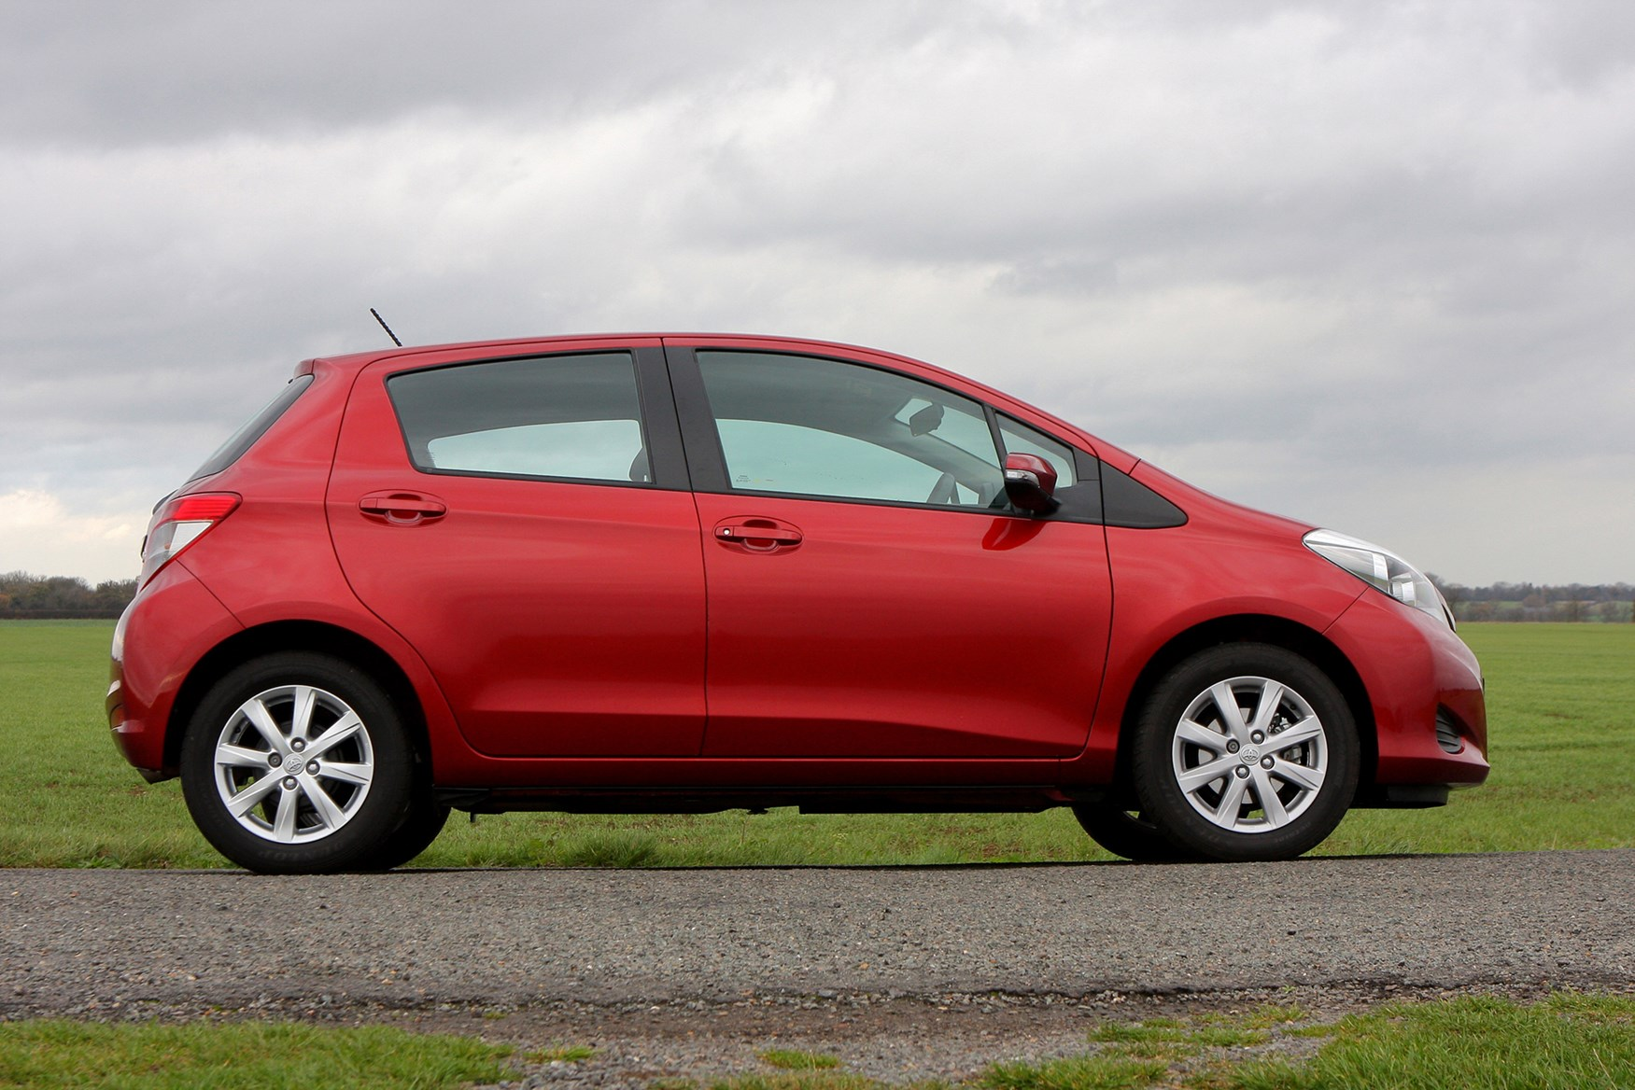
Today’s Outline
Preview Lecture 8 – Predictive Parsing
Live Assignments
P1
H2
Parsing
Complexity
The LL(k) languages
Intro
LL(1) parsing
LL(1) transformations
Toyota Yaris: A sensible compact
LL(1) languages are the Yaris of the
Parsing world

Slide 15
Parser Type
LL(k) Parsers - Definitions
Most parsers classified by how they build the parse tree
e.g. LL(k)
L
P2
Top-Down
L
D
Bottom-Up
Start at the root
Work downwards
Use productions
P2
P3
Start at the leaves
Work upwards
Use reductions
L
D
T
I
;
L ::= D
P1
P3
P4
P5
D ::= T I ;
D
T
I
;
int
id: c
P6
P4
T
I
;
bool
id: b
P5
P4
int
id: a
Input String:
int a; bool b; int c;

Slide 16

Predictive Parsers
LL(k) Parsers - Definitions
“Predict” correct production for the given nonterminal before seeing all RHS symbols
Based on input prefix “Guess and check” the suffix

Slide 17
LL Grammars: Anatomy of Notation
LL Grammars - Intro
2nd L: Performs
Leftmost derivation
Lookahead:
Number of tokens
needed to choose
next production
LL(k)
1st L: Single
Left-to-right Scan
of token stream
Bigger K means more
expressive languages

Slide 18
LL Grammar Examples
LL Grammars - Intro
Live Assignments
P1
H2
LL(0) Grammars
Takes leftmost derivation step knowing zero underived input tokens
S ::= X Y
X ::= a
Y ::= b Z
Z ::= c
S
S
X
Y
a
b
Z
c

Slide 19
LL Grammar Examples
LL Grammars - Intro
Live Assignments
P1
H2
LL(0) Grammars
LL(1) Grammars
Takes leftmost derivation step knowing zero underived input tokens
Takes leftmost derivation step knowing one underived input token
S ::= X Y
X ::= a
Y ::= b Z
Z ::= c
S ::= a a X
| b X
X ::= a
| b
Lookahead is a
Lookahead is b
S
S
S
a
a
X
a
a
X
b

Slide 20
LL Grammar Examples
LL Grammars - Intro
Live Assignments
P1
H2
LL(0) Grammars
LL(1) Grammars
LL(2) Grammars
Takes leftmost derivation step knowing zero underived input tokens
Takes leftmost derivation step knowing one underived input token
Takes leftmost derivation step knowing two underived input tokens
S ::= X Y
X ::= a
Y ::= b Z
Z ::= c
S ::= a a X
| b X
X ::= a
| b
S ::= a a
| a b
(Lookahead a is insufficient)
Lookahead is a a
S
S
a
a

Slide 21
LL Grammar Examples
LL Grammars - Intro
Live Assignments
P1
H2
Efficient
table-driven
parsers
LL(1) Grammars
Takes leftmost derivation step knowing one underived input token
Column
Lookahead
token
Row:
leftmost leaf nonterminal
Cell:
Production

Slide 22
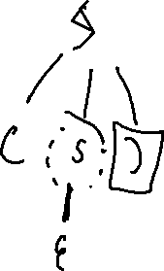


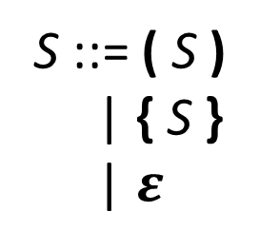
LL Grammar Examples
LL Grammars - Intro
With some grammars you can
just eyeball the selector table
S ::= ( S )
| { S }
| $ε$
Column
Lookahead
token
Row:
leftmost leaf nonterminal
 | ( | { | ) | }
S
( S )
{ S }
$$ε$$
$$ε$$
Cell:
Production

Slide 23
Today’s Outline
(Predictive) Parsing
Live Assignments
P1
H2
Parsing
Complexity
A New Type of Language - LL
Intro
LL(1) parsing
LL(1) transformations
Parsing

Slide 24
LL(1) Algorithm Psuedocode
Predictive Parsing - LL(1) Parsing
Live Assignments
P1
H2
stack.push(eof)
stack.push(Start non-term)
lookahead = scanner.first_token()
Repeat
if stack.top is a terminal
match stack.top with lookahead
pop y from the stack
lookahead = scanner.next_token()
if stack.top is a nonterminal
X = stack.pop()
get P = table[X,lookahead]
push P’s RHS symbols Right-to-Left
Until one of the following:
stack is empty (accept)
stack.top is a terminal that doesn’t match t (reject)
stack.top is a non-term and table entry is empty (reject)
Initialization
Case 1
Terminal on stack:
check prediction
Case 2
Non-terminal on stack:
Derive new prediction
Exit

Slide 25
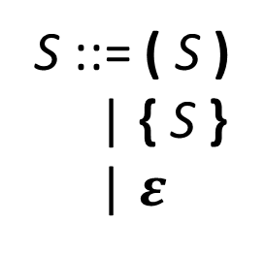
LL(1) Example
(Predictive) Parsing - LL(1) Parsing
Example Grammar
S ::= ( S )
| { S }
| $ε$
Initialization
1
stack.push(eof)
stack.push(Start non-term)
lookahead = scanner.first_token()
2
3
Selector Table
Input Stream
 | ( | ) | { | }
S | ( S ) | ε | { S } | ε
(
{
}
)
eof
P₀
P₁
P₂
P₃
P₄
1
2
3
Push
eof
Push
S
Start
lookahead
S
S
eof
eof
eof
P₀ = (
Syntax
Stack
Look
Ahead
Syntax
Stack
Look
Ahead
Syntax
Stack
Look
Ahead
Syntax
Stack
Look
Ahead

Slide 26
LL(1) Example
(Predictive) Parsing - LL(1) Parsing
Example Grammar
S ::= ( S )
| { S }
| $ε$
Initialization
1
stack.push(eof)
stack.push(Start non-term)
lookahead = scanner.first_token()
2
3
“Predicted”
Derivation Sequence
Selector Table
Input Stream
(
{
}
)
eof
S
 | ( | ) | { | }
S | ( S ) | ε | { S } | ε
S
P₀
P₁
P₂
P₃
P₄
Becomes
S
eof
P₀ = (
Syntax
Stack
Look
Ahead
Syntax
Stack
Look
Ahead

Slide 27


LL(1) Example
(Predictive) Parsing - LL(1) Parsing
Example Grammar
S ::= ( S )
| { S }
| $ε$
Nonterminal on stack:
1
X = pop(stack)
get P = table[X,lookahead]
push P’s symbols Right-to-Left
2
3
“Predicted”
Derivation Sequence
Selector Table
Input Stream
 | ( | ) | { | }
S | ( S ) | ε | { S } | ε
(
{
}
)
eof
S
P₀
P₁
P₂
P₃
P₄
2
Check
table
S $×$ (
$→$ ( S )
3
(
Push
( S )
R-to-L
1
S
Pop
S
S
)
eof
P₀ = (
eof
P₀ = (
eof
P₀ = (
Syntax
Stack
Look
Ahead
Syntax
Stack
Look
Ahead
Syntax
Stack
Look
Ahead

Slide 28

LL(1) Example
(Predictive) Parsing - LL(1) Parsing
Example Grammar
S ::= ( S )
| { S }
| $ε$
Nonterminal on stack:
1
X = pop(stack)
get P = table[X,lookahead]
push P’s symbols Right-to-Left
2
3
“Predicted”
Derivation Sequence
Selector Table
Input Stream
 | ( | ) | { | }
S | ( S ) | ε | { S } | ε
(
{
}
)
eof
S
$⇒$( S )
P₀
P₁
P₂
P₃
P₄
(
Becomes
S
S
)
eof
P₀ = (
eof
P₀ = (
Syntax
Stack
Look
Ahead
Syntax
Stack
Look
Ahead

Slide 29
LL(1) Example
(Predictive) Parsing - LL(1) Parsing
Example Grammar
S ::= ( S )
| { S }
| $ε$
Terminal on stack:
1
match stack.top with lookahead
pop stack
lookahead = scanner.next_token()
2
3
“Predicted”
Derivation Sequence
Selector Table
Input Stream
 | ( | ) | { | }
S | ( S ) | ε | { S } | ε
(
{
}
)
eof
S
$⇒$( S )
P₀
P₁
P₂
P₃
P₄
(
1
match!
S
S
S
)
2
)
3
Pop
(
Advance
lookahead
)
eof
P₀ = (
eof
P₀ = (
eof
P₁ = {
Syntax
Stack
Look
Ahead
Syntax
Stack
Look
Ahead
Syntax
Stack
Look
Ahead

Slide 30
LL(1) Example
(Predictive) Parsing - LL(1) Parsing
Example Grammar
S ::= ( S )
| { S }
| $ε$
Terminal on stack:
1
match stack.top with lookahead
pop stack
lookahead = scanner.next_token()
2
3
“Predicted”
Derivation Sequence
Selector Table
Input Stream
 | ( | ) | { | }
S | ( S ) | ε | { S } | ε
(
{
}
)
eof
S
$⇒$( S )
P₀
P₁
P₂
P₃
P₄
(
S
Becomes
S
)
)
eof
P₀ = (
eof
P₁ = {
Syntax
Stack
Look
Ahead
Syntax
Stack
Look
Ahead

Slide 31


LL(1) Example
(Predictive) Parsing - LL(1) Parsing
Example Grammar
S ::= ( S )
| { S }
| $ε$
Nonterminal on stack:
1
X = pop(stack)
get P = table[X,lookahead]
push P’s RHS symbols Right-to-Left
2
3
“Predicted”
Derivation Sequence
Selector Table
Input Stream
 | ( | ) | { | }
S | ( S ) | ε | { S } | ε
(
{
}
)
eof
S
$⇒$( S )
P₀
P₁
P₂
P₃
P₄
{
2
Check
table
S $×$ {
$→$ { S }
3
S
Push
{ S }
R-to-L
S
}
1
)
Pop S
)
)
eof
P₁ = {
eof
P₁ = {
eof
P₁ = {
Syntax
Stack
Look
Ahead
Syntax
Stack
Look
Ahead
Syntax
Stack
Look
Ahead

Slide 32

LL(1) Example
(Predictive) Parsing - LL(1) Parsing
Example Grammar
S ::= ( S )
| { S }
| $ε$
Nonterminal on stack:
1
X = pop(stack)
get P = table[X,lookahead]
push P’s RHS symbols Right-to-Left
2
3
“Predicted”
Derivation Sequence
Selector Table
Input Stream
 | ( | ) | { | }
S | ( S ) | ε | { S } | ε
(
{
}
)
eof
S
$⇒$( S )
P₀
P₁
P₂
P₃
P₄
$⇒$( { S } )
{
S
S
Becomes
}
)
)
eof
P₁ = {
eof
P₁ = {
Syntax
Stack
Look
Ahead
Syntax
Stack
Look
Ahead

Slide 33
LL(1) Example
(Predictive) Parsing - LL(1) Parsing
Example Grammar
S ::= ( S )
| { S }
| $ε$
Terminal on stack:
1
match stack.top with lookahead
pop stack
lookahead = scanner.next_token()
2
3
“Predicted”
Derivation Sequence
Selector Table
Input Stream
 | ( | ) | { | }
S | ( S ) | ε | { S } | ε
(
{
}
)
eof
S
$⇒$( S )
P₀
P₁
P₂
P₃
P₄
$⇒$( { S } )
{
S
1
S
S
match!
}
}
}
)
2
)
3
Pop
{
Advance
lookahead
)
eof
P₁ = {
eof
P₁ = {
eof
P₂ = }
Syntax
Stack
Look
Ahead
Syntax
Stack
Look
Ahead
Syntax
Stack
Look
Ahead

Slide 34
LL(1) Example
(Predictive) Parsing - LL(1) Parsin)
Example Grammar
S ::= ( S )
| { S }
| $ε$
Terminal on stack:
1
match stack.top with lookahead
pop stack
lookahead = scanner.next_token()
2
3
“Predicted”
Derivation Sequence
Selector Table
Input Stream
 | ( | ) | { | }
S | ( S ) | ε | { S } | ε
(
{
}
)
eof
S
$⇒$( S )
P₀
P₁
P₂
P₃
P₄
$⇒$( { S } )
{
S
S
}
Becomes
}
)
)
eof
P₁ = {
eof
P₂ = }
Syntax
Stack
Look
Ahead
Syntax
Stack
Look
Ahead

Slide 35
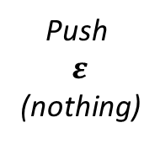


LL(1) Example
(Predictive) Parsing - LL(1) Parsin)
Example Grammar
S ::= ( S )
| { S }
| $ε$
Nonterminal on stack:
1
X = pop(stack)
get P = table[X,lookahead]
push P’s RHS symbols Right-to-Left
2
3
“Predicted”
Derivation Sequence
Selector Table
Input Stream
 | ( | ) | { | }
S | ( S ) | ε | { S } | ε
(
{
}
)
eof
S
$⇒$( S )
P₀
P₁
P₂
P₃
P₄
$⇒$( { S } )
2
Check
table
S $×$ }
$→$ $ε$
S
3
Push
$$ε$$
(nothing)
}
1
}
}
Pop
S
)
)
)
eof
P₂ = }
eof
P₂ = }
eof
P₂ = }
Syntax
Stack
Look
Ahead
Syntax
Stack
Look
Ahead
Syntax
Stack
Look
Ahead

Slide 36

LL(1) Example
(Predictive) Parsing - LL(1) Parsing
Example Grammar
S ::= ( S )
| { S }
| $ε$
Nonterminal on stack:
1
X = pop(stack)
get P = table[X,lookahead]
push P’s RHS symbols Right-to-Left
2
3
“Predicted”
Derivation Sequence
Selector Table
Input Stream
 | ( | ) | { | }
S | ( S ) | ε | { S } | ε
(
{
}
)
eof
S
$⇒$( S )
P₀
P₁
P₂
P₃
P₄
$⇒$( { S } )
$⇒$( { } )
S
}
Becomes
}
)
)
eof
P₂ = }
eof
P₂ = }
Syntax
Stack
Look
Ahead
Syntax
Stack
Look
Ahead

Slide 37
LL(1) Example
(Predictive) Parsing - LL(1) Parsing
Example Grammar
S ::= ( S )
| { S }
| $ε$
Terminal on stack:
1
match stack.top with lookahead
pop stack
lookahead = scanner.next_token()
2
3
“Predicted”
Derivation Sequence
Selector Table
Input Stream
 | ( | ) | { | }
S | ( S ) | ε | { S } | ε
(
{
}
)
eof
S
$⇒$( S )
P₀
P₁
P₂
P₃
P₄
$⇒$( { S } )
$⇒$( { } )
1
match!
}
)
2
)
3
)
Pop
}
Advance
lookahead
eof
P₂ = }
eof
P₂ = }
eof
P₃ = )
Syntax
Stack
Look
Ahead
Syntax
Stack
Look
Ahead
Syntax
Stack
Look
Ahead

Slide 38
LL(1) Example
(Predictive) Parsing - LL(1) Parsing
Example Grammar
S ::= ( S )
| { S }
| $ε$
Terminal on stack:
1
match stack.top with lookahead
pop stack
lookahead = scanner.next_token()
2
3
“Predicted”
Derivation Sequence
Selector Table
Input Stream
 | ( | ) | { | }
S | ( S ) | ε | { S } | ε
(
{
}
)
eof
S
$⇒$( S )
P₀
P₁
P₂
P₃
P₄
$⇒$( { S } )
$⇒$( { } )
)
eof
P₃ = )
Syntax
Stack
Look
Ahead

Slide 39
LL(1) Example
(Predictive) Parsing - LL(1) Parsing
Example Grammar
S ::= ( S )
| { S }
| $ε$
Terminal on stack:
1
match stack.top with lookahead
pop stack
lookahead = scanner.next_token()
2
3
“Predicted”
Derivation Sequence
Selector Table
Input Stream
 | ( | ) | { | }
S | ( S ) | ε | { S } | ε
(
{
}
)
eof
S
$⇒$( S )
P₀
P₁
P₂
P₃
P₄
$⇒$( { S } )
$⇒$( { } )
1
match!
)
2
3
Pop
)
Advance
lookahead
eof
P₃ = )
eof
P₃ = )
eof
P₄ = eof
Syntax
Stack
Look
Ahead
Syntax
Stack
Look
Ahead
Syntax
Stack
Look
Ahead

Slide 40
LL(1) Example
(Predictive) Parsing - LL(1) Parsing
Example Grammar
S ::= ( S )
| { S }
| $ε$
Terminal on stack:
1
match stack.top with lookahead
pop stack
lookahead = scanner.next_token()
2
3
“Predicted”
Derivation Sequence
Selector Table
Input Stream
 | ( | ) | { | }
S | ( S ) | ε | { S } | ε
(
{
}
)
eof
S
$⇒$( S )
P₀
P₁
P₂
P₃
P₄
$⇒$( { S } )
$⇒$( { } )
eof
P₄ = eof
Syntax
Stack
Look
Ahead

Slide 41
LL(1) Example
(Predictive) Parsing - LL(1) Parsing
Example Grammar
S ::= ( S )
| { S }
| $ε$
Terminal on stack:
1
match stack.top with lookahead
pop stack
lookahead = scanner.next_token()
2
3
“Predicted”
Derivation Sequence
Selector Table
Input Stream
 | ( | ) | { | }
S | ( S ) | ε | { S } | ε
(
{
}
)
eof
S
$⇒$( S )
P₀
P₁
P₂
P₃
P₄
$⇒$( { S } )
$⇒$( { } )
1
match!
2
3
Pop
eof
Advance
lookahead
eof
P₄ = eof
P₄ = eof
Syntax
Stack
Look
Ahead
Syntax
Stack
Look
Ahead
Syntax
Stack
Look
Ahead

Slide 42
LL(1) Example
(Predictive) Parsing - LL(1) Parsing
Example Grammar
S ::= ( S )
| { S }
| $ε$
Terminal on stack:
1
match stack.top with lookahead
pop stack
lookahead = scanner.next_token()
2
3
“Predicted”
Derivation Sequence
Selector Table
Input Stream
 | ( | ) | { | }
S | ( S ) | ε | { S } | ε
(
{
}
)
eof
S
$⇒$( S )
P₀
P₁
P₂
P₃
P₄
$⇒$( { S } )
$⇒$( { } )
Syntax
Stack
Look
Ahead

Slide 43

LL(1) Example
(Predictive) Parsing - LL(1) Parsing
Example Grammar
S ::= ( S )
| { S }
| $ε$
Exit
Stack and Lookahead both empty:
Accept!
“Predicted”
Derivation Sequence
Selector Table
Input Stream
 | ( | ) | { | }
S | ( S ) | ε | { S } | ε
(
{
}
)
eof
S
$⇒$( S )
P₀
P₁
P₂
P₃
P₄
$⇒$( { S } )
$⇒$( { } )
Syntax
Stack
Look
Ahead

Slide 44
Running LL(1)
(Predictive) Parsing - LL(1) Parsing
Live Assignments
P1
H2
Linear parse!
Once we verify a position we never look at it again
Pretty fast given general parsing complexity
Especially once you start combining steps
Let’s do another quick example
This time we’ll show rejecting bad input

Slide 45
LL(1) Reject Example
(Predictive) Parsing - LL(1) Parsing
Example Grammar
S ::= ( S )
| { S }
| $ε$
“Predicted”
Derivation Sequence
Selector Table
Input Stream
 | ( | ) | { | }
S | ( S ) | ε | { S } | ε
(
}
eof
S
$⇒$( S )
P₀
P₁
P₂
Initialization
1,2,3
(
Nonterminal
Actions
Terminal
Actions
S
S
1,2,3
)
1,2,3
eof
P₀ = (
eof
P₀ = (
Syntax
Stack
Look
Ahead
Syntax
Stack
Look
Ahead

Slide 46
LL(1) Reject Example
(Predictive) Parsing - LL(1) Parsing
Example Grammar
S ::= ( S )
| { S }
| $ε$
“Predicted”
Derivation Sequence
Selector Table
Input Stream
 | ( | ) | { | }
S | ( S ) | ε | { S } | ε
(
}
eof
S
$⇒$( S )
P₀
P₁
P₂
Initialization
1,2,3
(
Nonterminal
Actions
Terminal
Actions
S
S
S
1,2,3
)
1,2,3
)
eof
P₀ = (
eof
P₀ = (
eof
P₁ = }
Syntax
Stack
Look
Ahead
Syntax
Stack
Look
Ahead
Syntax
Stack
Look
Ahead

Slide 47
LL(1) Reject Example
(Predictive) Parsing - LL(1) Parsing
Example Grammar
S ::= ( S )
| { S }
| $ε$
“Predicted”
Derivation Sequence
Selector Table
Input Stream
 | ( | ) | { | }
S | ( S ) | ε | { S } | ε
(
}
eof
S
$⇒$( S )
P₀
P₁
P₂
1
mismatch!
S
Nonterminal
Actions
Terminal
Actions
)
)
)
1,2,3
1 – Fails!
eof
P₁ = }
eof
P₁ = }
eof
P₁ = }
Syntax
Stack
Look
Ahead
Syntax
Stack
Look
Ahead
Syntax
Stack
Look
Ahead

Slide 48

This Grammar is Great!
(Predictive) Parsing - LL(1) Parsing
With 1 token we know exactly what production it starts
Deeply unsatisfying
The Language
may be LL(1)
Even when the
Grammar is not LL(1)
…as long as the grammar is LL(1)

Slide 49
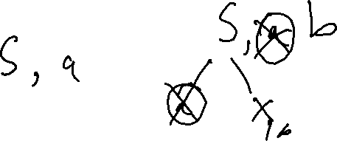
Consider a Concerning Grammar…
(Predictive) Parsing - LL(1) Parsing
Our prior
LL(2) Grammar
Equivalent
LL(1) Grammar
S ::= a a
| a b
S ::= a X
X ::= a | b
The Language
may be LL(1)
Even when the
Grammar is not LL(1)

