Slide 1
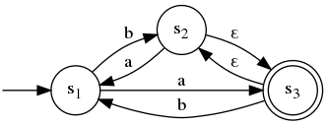
Check-In C4
Review: Syntactic Ambiguity
Draw out an equivalent finite automaton to the given one after applying the ε-elimination technique described in class.
Is the state machine an NFA (non-deterministic finite automaton) or DFA (deterministic finite automaton)?
If the machine is a DFA, create an NFA that recognizes the same language. If the machine is an NFA, create a DFA that recognizes the same language

Slide 2

Administrivia
On Written Work…
If you attend class when a written work is due, you DO NOT have to turn it in
(but you should still do it to make sure you’re keeping up)

Slide 3

Administrivia
Office Hours TBA
Will be posted on https://compilers.cool and posted on the class website
However, Drew does have an “open door” policy – if available, you’re free to come ask a question
How will I know when Drew is available?
- You, maybe

Slide 4
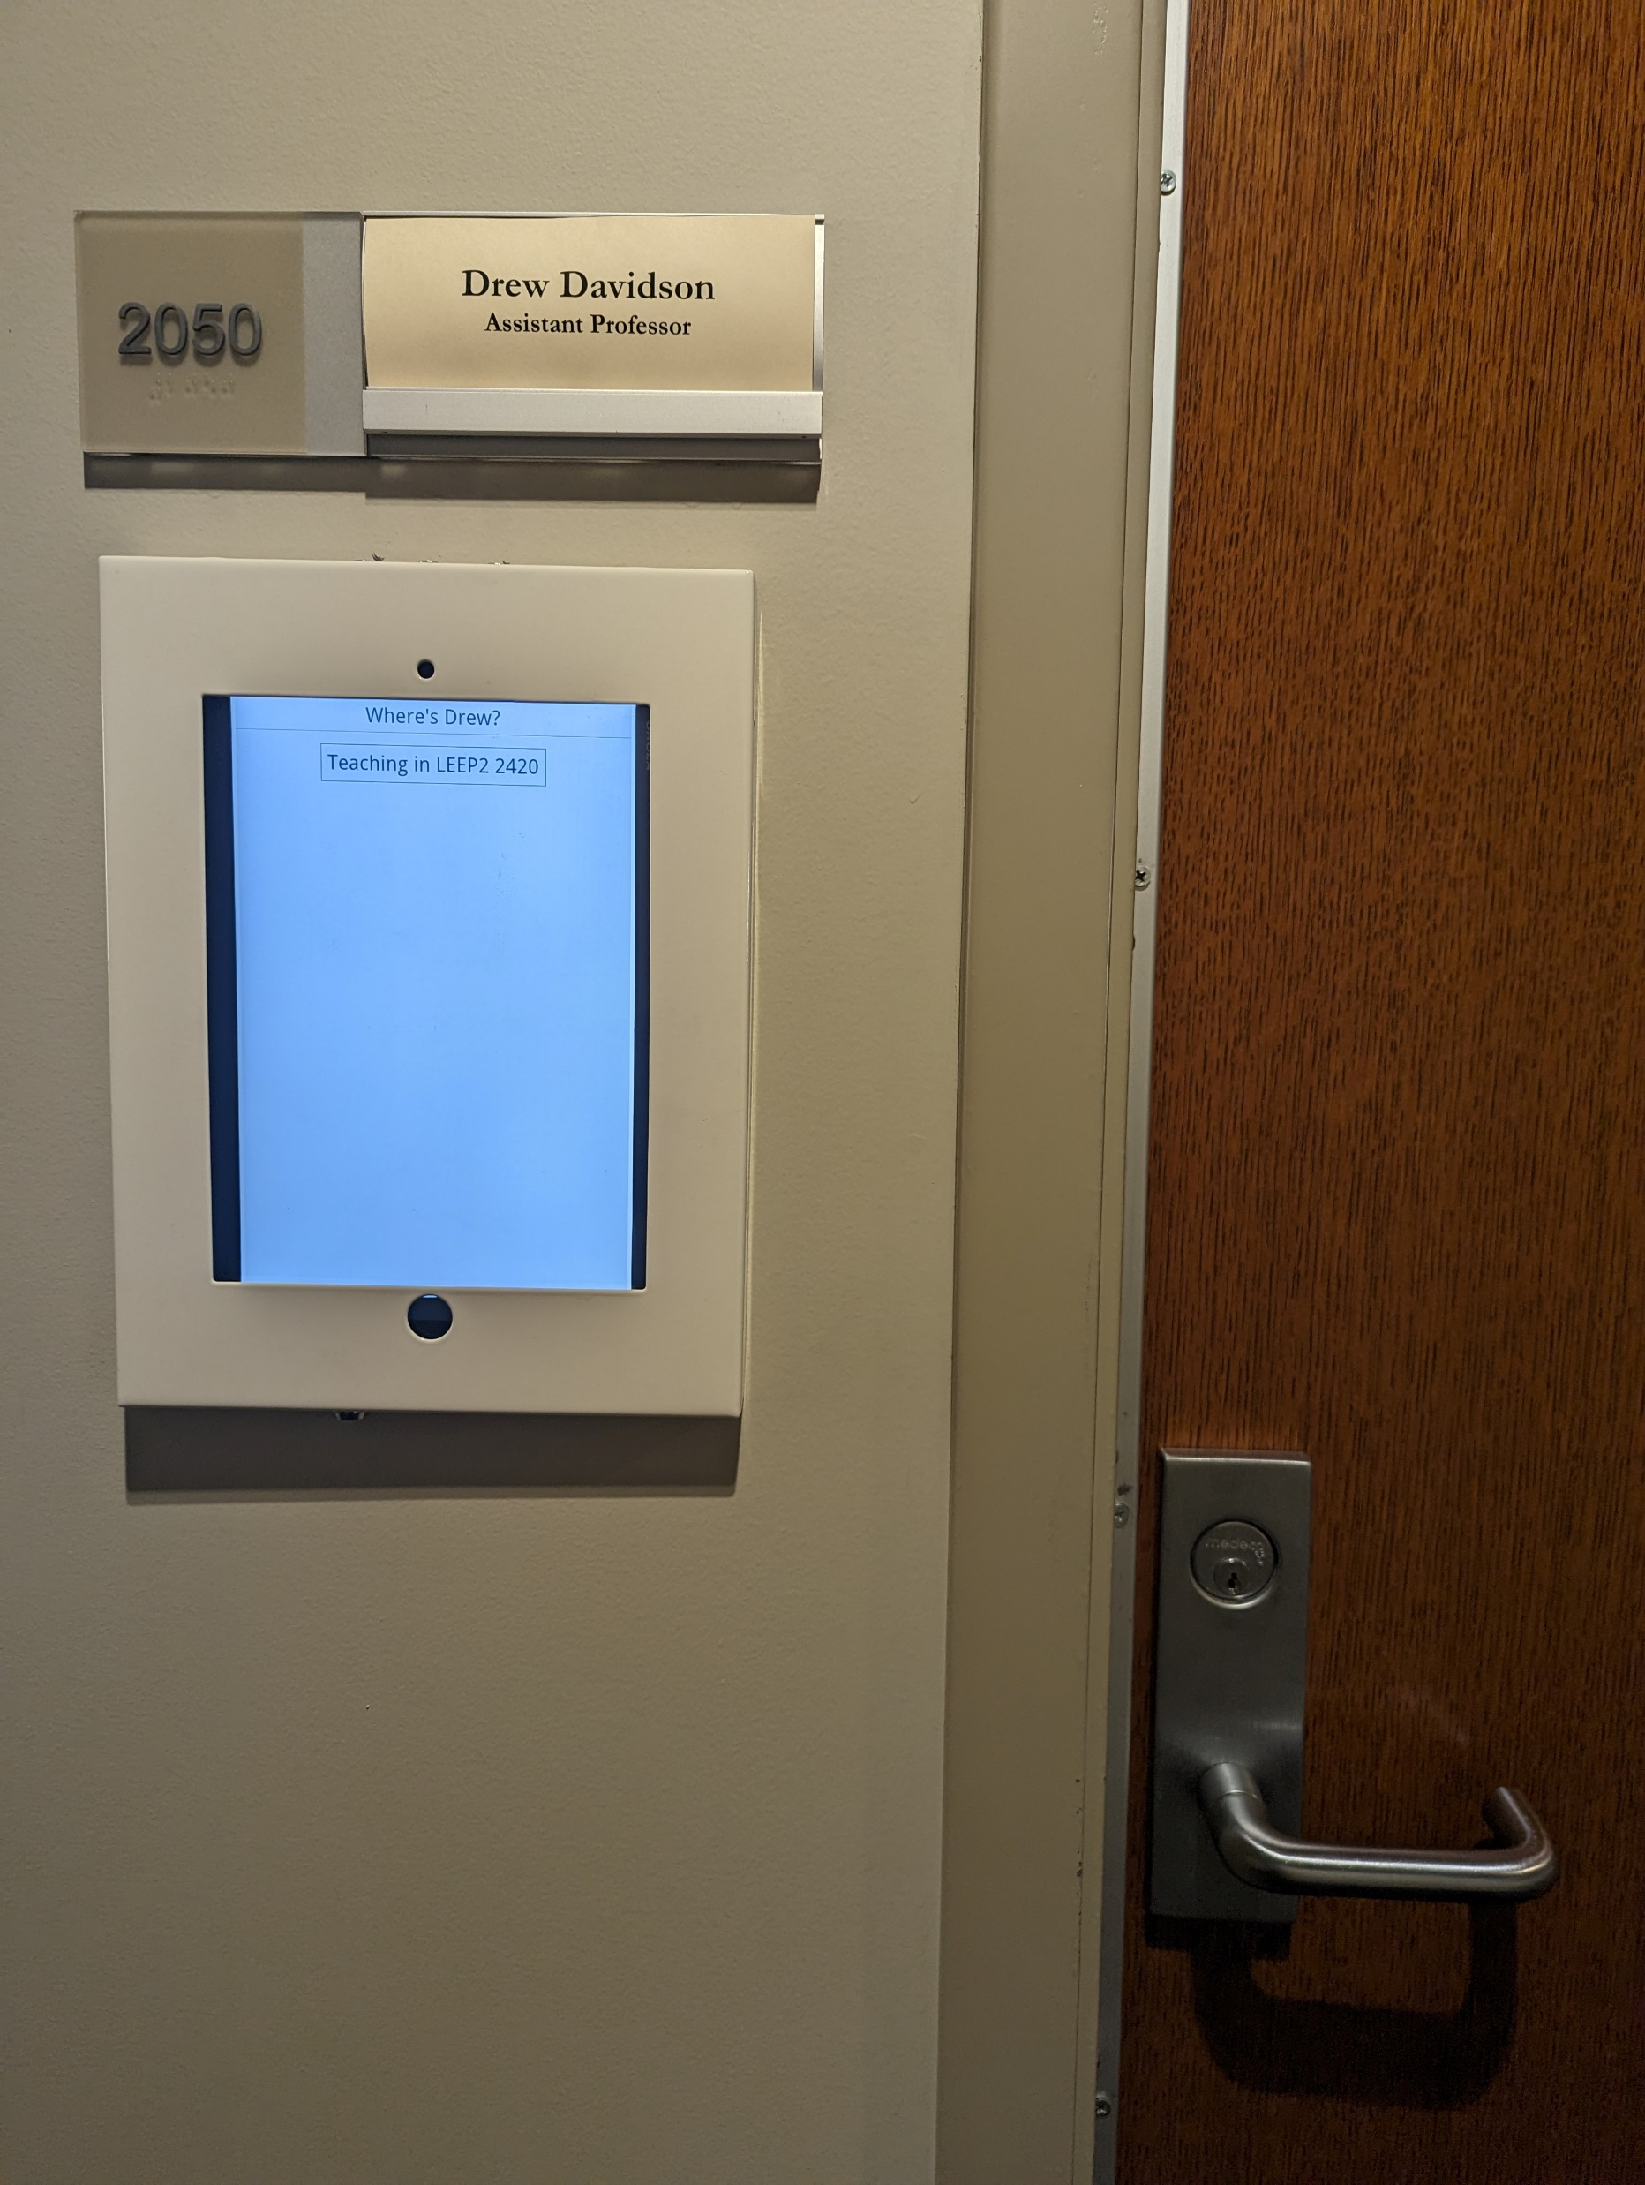
Administrivia
The Drew Positioning System
https://drew.davidson.cool/where
also displayed outside Drew’s office
If the sign (or website) says “available in Eaton Hall”, feel free to stop by with a question
Corrrolary: if the sign says not available please don’t disturb (even if the door is open)

Slide 5
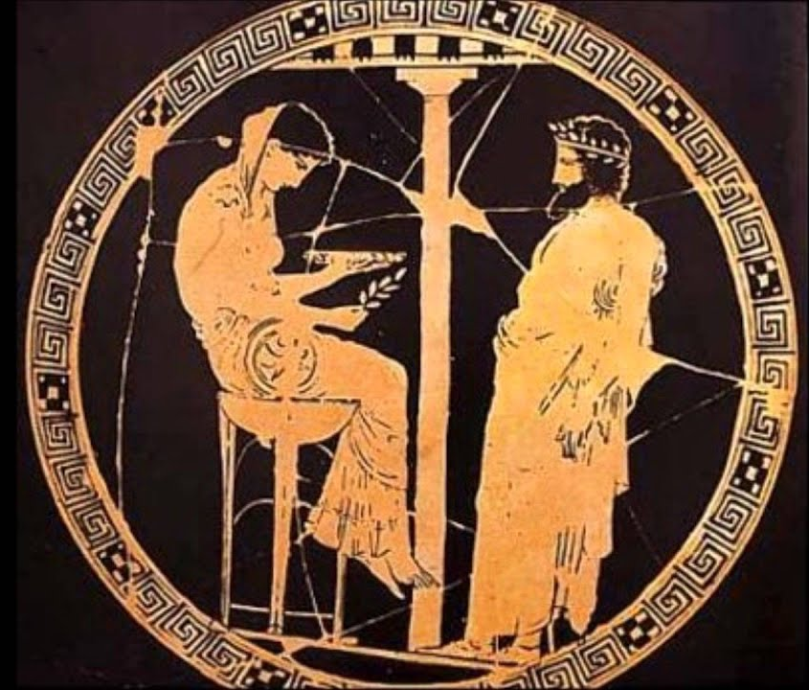
Administrivia
Behold: The Project Oracle!
https://compilers.cool/oracles/o1
What’s the format of output <x> ?
Submit input to the Oracle
What’s the token for character <y> ?
- Submit y to the Oracle

Slide 6
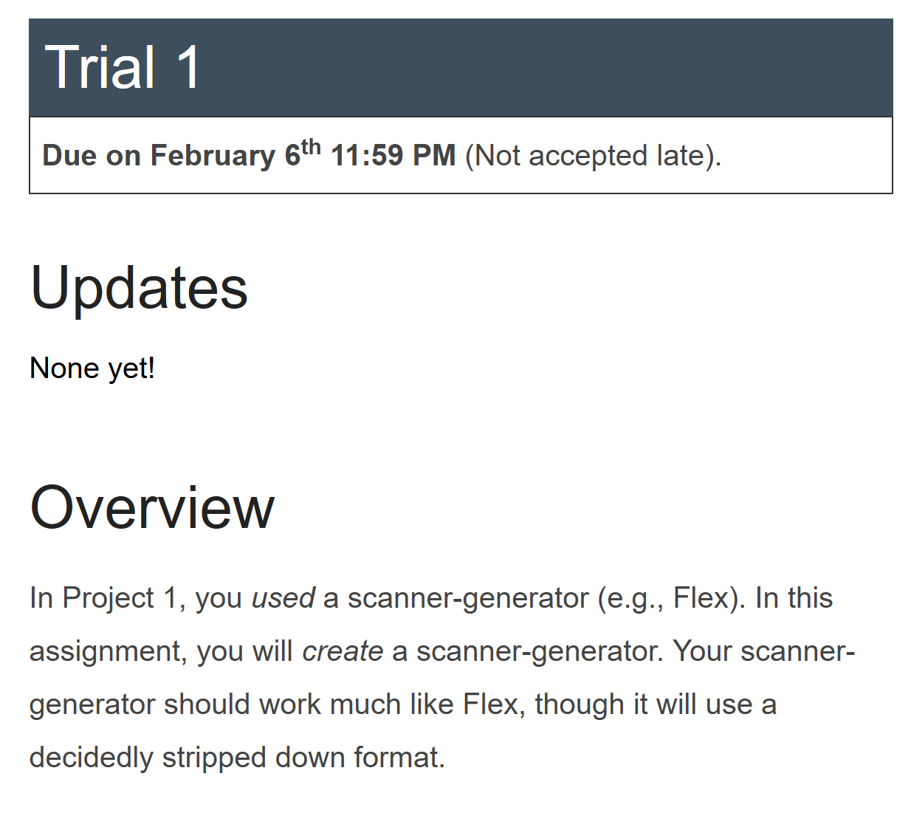
Administrivia
Behold: The Dragon Trials!
https://compilers.cool/trials/t1

Slide 7

Flipped Wednesday

Slide 8
Written Work #1
Topics:
Compiler Overview

Slide 9
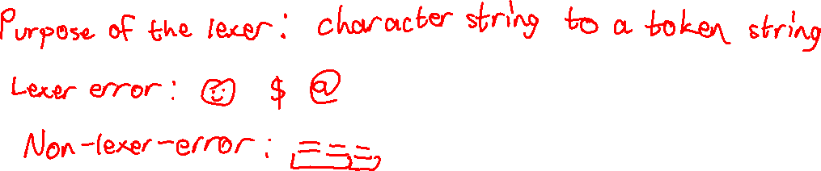
Written Work #1: Question 1
What is the purpose of the lexer component of a compiler? Give an example of an input that GCC would flag for a lexical error.

Slide 10
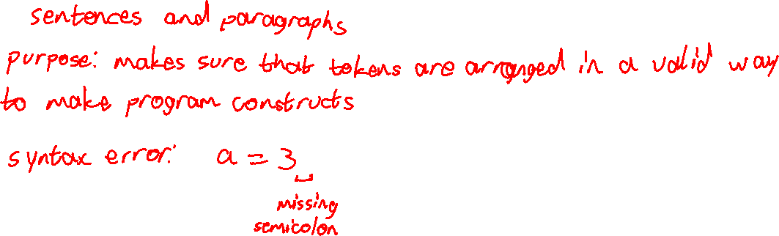
Written Work #1: Question 2
What is the purpose of the syntactic analysis component of a compiler? Give an example of an input that GCC would flag for a syntactic error.

Slide 11
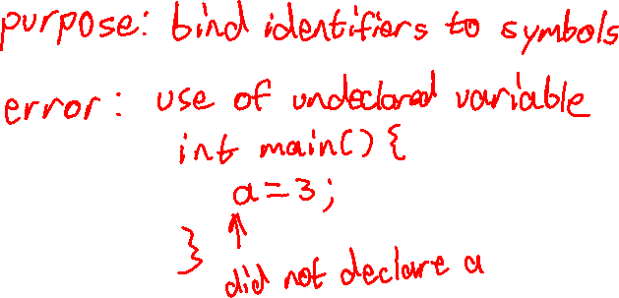
Written Work #1: Question 3
What is the purpose of name analysis in a compiler? Give an example of an input that GCC would flag for failing name analysis.

Slide 12
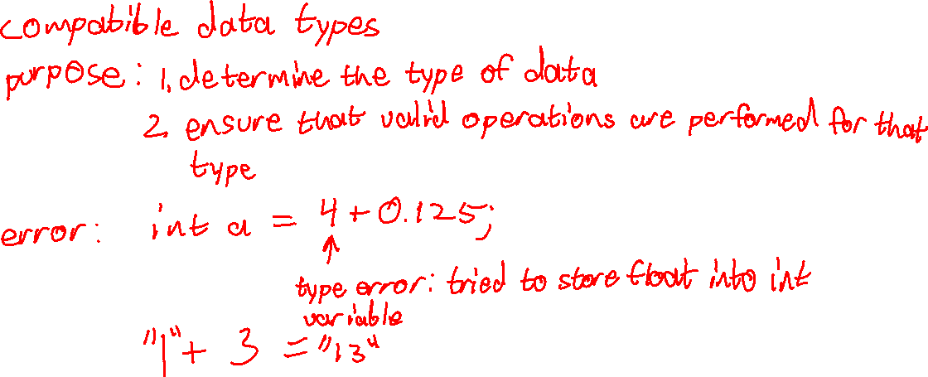
Written Work #1: Question 4
What is the purpose of type analysis in a compiler? Give an example of an input that GCC would flag for failing type analysis.

Slide 13
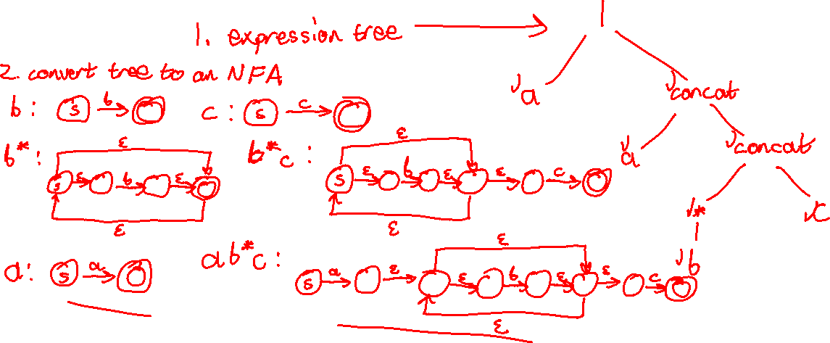
Bonus: Time Permitting
Convert the following regular expression to a DFA using the transformations discussed in class
(RegEx to $ε$-NFA, $ε$-NFA to $ε$-free-NFA, $ε$-free-NFA to DFA)
a|(ab*c)

Slide 14
