Slide 1
Check-in
Review: Flex
Write a Flex rule for Fortran real literals:
An optional sign (+ or -)
One of the following:
  An integer
  One or more digits followed by a ‘.’ followed by 0 or more digits
  a ‘.’ followed by one or more digits

Slide 2
Administrivia
Housekeeping
P1 Out

Slide 3

Lecture 3
Syntactic Definition
KU | EECS| Drew Davidson

Slide 4
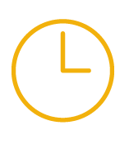
Compiler Construction
Progress Pics
Source code (sequence of chars)
Done:
Shown RegEx as a good token formalism
Lexical specification
Lexical recognition
In progress
Scanner
Lexical analysis
Parser
Syntactic analysis
Semantic analysis
Intermediate code generation
IR optimization
Final Code generation
Final code optimization
Output code in T

Slide 5
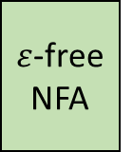
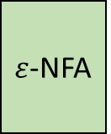
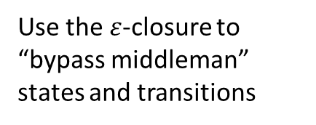

Last Time
Lecture Review
RegEx
$ε$-NFA
$ε$-free NFA
DFA
Thompson’s
Construction
Algorithm
$ε$-elimination
Rabin-Scott
Powerset
Construction
Replace sub-RegExes with sub-FSMs “bottom-up” in the expression tree
Use the $ε$-closure to “bypass middleman” states and transitions
Create a DFA that tracks all possible states the NFA could be in
Good news
Bad news
DFAs have a natural
implementation
(use a 2-D array)
DFAs don’t exactly
do tokenization

Slide 6
Today’s Lecture
Outline
Finish lexical analysis
How to build a scanner
Begin discussing syntax
How to specify the syntax of a programming language

Slide 7
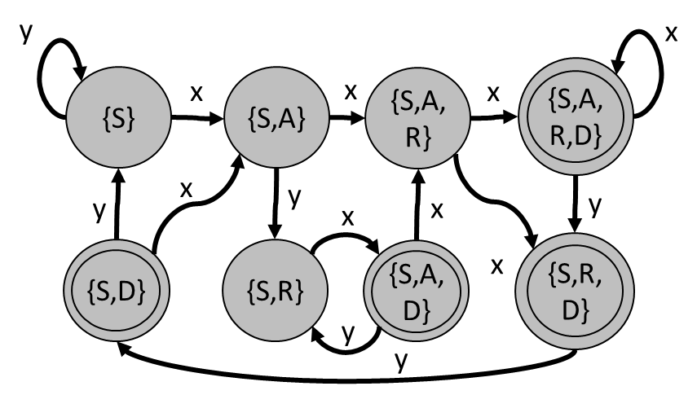



DFA $≠$ Tokenizer
Limitations
Finite automata only check for language membership of a string (recognition)
The Scanner needs to
  Break the input into many different tokens
  Know what characters comprise the token
input string
int a; b = 3 + 2;
DFA
recognition
or

Slide 8

DFA $≠$ Tokenizer
Limitations
Finite automata only check for language membership of a string (recognition)
The Scanner needs to
  Break the input into many different tokens
  Know what characters comprise the token
We need to go… beyond recognition
input string
int a; b = 3 + 2;
DFA
recognition
or

Slide 9
Lecture Outline
Syntactic Definition
Live Assignments
P1
H2
From DFAs to Tokenizer
Algorithms
Implementation details
How Language Syntax is Formally Defined: CFGs
Why we need context-free grammars
How we use context-free grammars

Slide 10

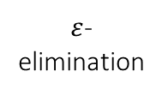
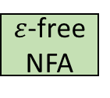
From RegExes to Tokenizer
Algorithms
Live Assignments
P1
H2
Thompson’s
Construction
$ε$-
elimination
Powerset
Construction
RegEx
$ε$-NFA
$ε$-free NFA
DFA
Language
true
true
‘+’
‘-’
{ Token(true) }
{ Token(cross) }
{ Token(dash) }
T₀
‘t’
T₁
‘r’
T₂
‘u’
T₃
‘e’
T₄
cross
C₀
‘+’
C₁
dash
D₀
‘-’
D₁

Slide 11

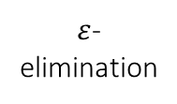

From RegExes to Tokenizer
Algorithms
Live Assignments
P1
H2
Thompson’s
Construction
$ε$-
elimination
Powerset
Construction
???
RegEx
$ε$-NFA
$ε$-free NFA
DFA
Tokenizer
1st Idea (flawed)
Consume char stream to accept state: return accepted token, restart DFAs with next char
Language
true
true
‘+’
‘-’
{ Token(true) }
{ Token(cross) }
{ Token(dash) }
T₀
‘t’
T₁
‘r’
T₂
‘u’
T₃
‘e’
T₄
cross
C₀
‘+’
C₁
dash
D₀
‘-’
D₁

Slide 12
From RegExes to Tokenizer
Algorithms
Live Assignments
P1
H2
1st Idea (flawed)
Consume char stream to accept state: return accepted token, restart DFAs with next char
Language
true
‘+’
‘-’
{ Token(true) }
{ Token(cross) }
{ Token(dash) }
true
T₀
‘t’
T₁
‘r’
T₂
‘u’
T₃
‘e’
T₄
Char Stream
cross
t
r
u
e
+
t
r
u
e
EOF
C₀
‘+’
C₁
0
1
2
3
4
5
6
7
8
9
10
T₀
T₁
T₂
T₃
T₄
T₀
dash
C₀
C₀
D₀
D₀
D₀
‘-’
D₁
E₀
E₀
Token Stream
eof
Special State:
Return EOF
Accept stream
EOF
true
[0,4)
E₀
E₁

Slide 13
From RegExes to Tokenizer
Algorithms
Live Assignments
P1
H2
1st Idea (flawed)
Consume char stream to accept state: return accepted token, restart DFAs with next char
Language
true
‘+’
‘-’
{ Token(true) }
{ Token(cross) }
{ Token(dash) }
true
T₀
‘t’
T₁
‘r’
T₂
‘u’
T₃
‘e’
T₄
Char Stream
cross
t
r
u
e
+
t
r
u
e
EOF
C₀
‘+’
C₁
0
1
2
3
4
5
6
7
8
9
10
T₀
T₀
dash
C₀
C₁
C₀
D₀
D₀
D₀
‘-’
D₁
E₀
E₀
Token Stream
eof
Special State:
Return EOF
Accept stream
EOF
true
[0,4)
cross
[4,5)
E₀
E₁

Slide 14
From RegExes to Tokenizer
Algorithms
Live Assignments
P1
H2
1st Idea (flawed)
Consume char stream to accept state: return accepted token, restart DFAs with next char
Language
true
‘+’
‘-’
{ Token(true) }
{ Token(cross) }
{ Token(dash) }
true
T₀
‘t’
T₁
‘r’
T₂
‘u’
T₃
‘e’
T₄
Char Stream
cross
t
r
u
e
+
t
r
u
e
EOF
C₀
‘+’
C₁
0
1
2
3
4
5
6
7
8
9
10
T₀
T₁
T₂
T₃
T₄
T₀
dash
C₀
C₀
D₀
D₀
D₀
‘-’
D₁
E₀
E₀
Token Stream
eof
Special State:
Return EOF
Accept stream
EOF
true
[0,4)
cross
[4,5)
true
[5,9)
E₀
E₁

Slide 15
From RegExes to Tokenizer
Algorithms
Live Assignments
P1
H2
1st Idea (flawed)
Consume char stream to accept state: return accepted token, restart DFAs with next char
Language
true
‘+’
‘-’
{ Token(true) }
{ Token(cross) }
{ Token(dash) }
true
T₀
‘t’
T₁
‘r’
T₂
‘u’
T₃
‘e’
T₄
Char Stream
cross
t
r
u
e
+
t
r
u
e
EOF
C₀
‘+’
C₁
0
1
2
3
4
5
6
7
8
9
10
T₀
dash
C₀
D₀
D₀
‘-’
D₁
E₀
E₁
Token Stream
eof
Special State:
Return EOF
Accept stream
EOF
true
[0,4)
cross
[4,5)
true
[5,9)
eof
[9,10)
E₀
E₁

Slide 16
From RegExes to Tokenizer
Algorithms
Live Assignments
P1
H2
1st Idea (flawed)
Consume char stream to accept state: return accepted token, restart DFAs with next char
Language
true
‘+’
‘-’
{ Token(true) }
{ Token(cross) }
{ Token(dash) }
true
T₀
‘t’
T₁
‘r’
T₂
‘u’
T₃
‘e’
T₄
Char Stream
cross
t
r
u
e
+
t
r
u
e
EOF
C₀
‘+’
C₁
0
1
2
3
4
5
6
7
8
9
10
dash
D₀
‘-’
D₁
Accept!
Token Stream
eof
Special State:
Return EOF
Accept stream
EOF
true
[0,4)
cross
[4,5)
true
[5,9)
eof
[9,10)
E₀
E₁
Problem
What happens when token languages overlap / prefix each other?

Slide 17
From RegExes to Tokenizer
Algorithms
Live Assignments
P1
H2
1st Idea (flawed)
Consume char stream to accept state: return accepted token, restart DFAs with next char
Problem
What happens when token languages overlap / prefix each other?
Language
[A-Za-z][A-Za-z0-9]*
+
++
{ Token(id) }
id
[A-Za-z0-9]
{ Token(cross) }
I₀
[A-Za-z]
I₁
{ Token(increment) }
Char Stream
cross
a
g
e
+
+
EOF
C₀
‘+’
C₁
0
1
2
3
4
5
6
I₀
I₁
I₀
increment
C₀
C₀
N₀
N₀
N₀
‘+’
N₁
‘+’
N₂
E₀
E₀
Token Stream
eof
EOF
id: a
[0,1)
E₀
E₁

Slide 18
From RegExes to Tokenizer
Algorithms
Live Assignments
P1
H2
1st Idea (flawed)
Consume char stream to accept state: return accepted token, restart DFAs with next char
Problem
What happens when token languages overlap / prefix each other?
Language
[A-Za-z][A-Za-z0-9]*
+
++
{ Token(id) }
id
[A-Za-z0-9]
{ Token(cross) }
I₀
[A-Za-z]
I₁
{ Token(increment) }
Char Stream
cross
a
g
e
+
+
EOF
C₀
‘+’
C₁
0
1
2
3
4
5
6
I₀
I₁
I₀
increment
C₀
C₀
N₀
N₀
N₀
‘+’
N₁
‘+’
N₂
E₀
E₀
Token Stream
eof
EOF
id: a
[0,1)
id: g
[1,2)
E₀
E₁

Slide 19
From RegExes to Tokenizer
Algorithms
Live Assignments
P1
H2
1st Idea (flawed)
Consume char stream to accept state: return accepted token, restart DFAs with next char
Problem
What happens when token languages overlap / prefix each other?
Language
[A-Za-z][A-Za-z0-9]*
+
++
{ Token(id) }
id
[A-Za-z0-9]
{ Token(cross) }
I₀
[A-Za-z]
I₁
{ Token(increment) }
Char Stream
cross
a
g
e
+
+
EOF
C₀
‘+’
C₁
0
1
2
3
4
5
6
I₀
I₁
I₀
increment
C₀
C₀
N₀
N₀
N₀
‘+’
N₁
‘+’
N₂
E₀
E₀
Token Stream
eof
EOF
id: a
[0,1)
id: g
[1,2)
id: e
[2,3)
E₀
E₁

Slide 20
From RegExes to Tokenizer
Algorithms
Live Assignments
P1
H2
1st Idea (flawed)
Consume char stream to accept state: return accepted token, restart DFAs with next char
Problem
What happens when token languages overlap / prefix each other?
Language
[A-Za-z][A-Za-z0-9]*
+
++
{ Token(id) }
id
[A-Za-z0-9]
{ Token(cross) }
I₀
[A-Za-z]
I₁
{ Token(increment) }
Char Stream
cross
a
g
e
+
+
EOF
C₀
‘+’
C₁
0
1
2
3
4
5
6
I₀
I₀
increment
C₀
C₁
C₀
N₀
N₁
N₀
N₀
‘+’
N₁
‘+’
N₂
E₀
E₀
Token Stream
eof
EOF
id: a
[0,1)
id: g
[1,2)
id: e
[2,3)
cross
[3,4)
E₀
E₁

Slide 21
From RegExes to Tokenizer
Algorithms
Live Assignments
P1
H2
1st Idea (flawed)
Consume char stream to accept state: return accepted token, restart DFAs with next char
Problem
What happens when token languages overlap / prefix each other?
Language
[A-Za-z][A-Za-z0-9]*
+
++
{ Token(id) }
id
[A-Za-z0-9]
{ Token(cross) }
I₀
[A-Za-z]
I₁
{ Token(increment) }
Char Stream
cross
a
g
e
+
+
EOF
C₀
‘+’
C₁
0
1
2
3
4
5
6
I₀
I₀
increment
C₀
C₁
C₀
N₀
N₁
N₀
N₀
‘+’
N₁
‘+’
N₂
E₀
E₀
Token Stream
eof
EOF
id: a
[0,1)
id: g
[1,2)
id: e
[2,3)
cross
[3,4)
cross
[4,5)
E₀
E₁

Slide 22
From RegExes to Tokenizer
Algorithms
Live Assignments
P1
H2
1st Idea (flawed)
Consume char stream to accept state: return accepted token, restart DFAs with next char
Problem
What happens when token languages overlap / prefix each other?
Language
[A-Za-z][A-Za-z0-9]*
+
++
{ Token(id) }
id
[A-Za-z0-9]
{ Token(cross) }
I₀
[A-Za-z]
I₁
{ Token(increment) }
Char Stream
cross
a
g
e
+
+
EOF
C₀
‘+’
C₁
0
1
2
3
4
5
6
I₀
increment
C₀
N₀
N₀
‘+’
N₁
‘+’
N₂
E₀
E₁
Token Stream
eof
EOF
id: a
[0,1)
id: g
[1,2)
id: e
[2,3)
cross
[3,4)
cross
[4,5)
eof
[5,6)
E₀
E₁

Slide 23
From RegExes to Tokenizer
Algorithms
Live Assignments
P1
H2
1st Idea (flawed)
Consume char stream to accept state: return accepted token, restart DFAs with next char
Problem
What happens when token languages overlap / prefix each other?
Language
[A-Za-z][A-Za-z0-9]*
+
++
{ Token(id) }
id
[A-Za-z0-9]
{ Token(cross) }
I₀
[A-Za-z]
I₁
{ Token(increment) }
Char Stream
cross
a
g
e
+
+
EOF
C₀
‘+’
C₁
increment
Accept,
but…
shortest
match!
‘+’
‘+’
N₀
N₁
N₂
Token Stream
eof
EOF
id: a
[0,1)
id: g
[1,2)
id: e
[2,3)
cross
[3,4)
cross
[4,5)
eof
[5,6)
E₀
E₁

Slide 24

From RegExes to Tokenizer
Algorithms
Live Assignments
P1
H2
1st Idea (flawed)
Consume char stream to accept state: return accepted token, restart DFAs with next char
Problem
What happens when token languages overlap / prefix each other?
Language
[A-Za-z][A-Za-z0-9]*
+
++
{ Token(id) }
id
[A-Za-z0-9]
{ Token(cross) }
I₀
[A-Za-z]
I₁
{ Token(increment) }
Char Stream
We want the
immediate longest
(AKA “greedy”)
match
cross
a
g
e
+
+
EOF
C₀
‘+’
C₁
increment
Accept,
but…
shortest
match!
‘+’
‘+’
N₀
N₁
N₂
Token Stream
eof
EOF
id: a
[0,1)
id: g
[1,2)
id: e
[2,3)
cross
[3,4)
cross
[4,5)
eof
[5,6)
E₀
E₁

Slide 25
From RegExes to Tokenizer
Algorithms
Live Assignments
P1
H2
1st Idea (flawed)
Consume char stream to accept state: return accepted token, restart DFAs with next char
NEW Idea (good)
Consume char stream to reject states: return last accepted token, restart DFAs with that char
Language
[A-Za-z][A-Za-z0-9]*
+
++
{ Token(id) }
id
[A-Za-z0-9]
{ Token(cross) }
I₀
[A-Za-z]
I₁
{ Token(increment) }
Char Stream
We want the
immediate longest
(AKA “greedy”)
match
cross
a
g
e
+
+
EOF
C₀
‘+’
C₁
increment
Accept,
but…
shortest
match!
Let’s modify the
Implementation to
support this!
N₀
‘+’
N₁
‘+’
N₂
Token Stream
eof
EOF
id: a
[0,1)
id: g
[1,2)
id: e
[2,3)
cross
[3,4)
cross
[4,5)
eof
[5,6)
E₀
E₁

Slide 26
From RegExes to Tokenizer
Algorithms
Live Assignments
P1
H2
1st Idea (flawed)
Consume char stream to accept state: return accepted token, restart DFAs with next char
NEW Idea (good)
Consume char stream to reject states: return last accepted token, restart DFAs with that index
Language
[A-Za-z][A-Za-z0-9]*
+
++
{ Token(id) }
id
[A-Za-z0-9]
{ Token(cross) }
I₀
[A-Za-z]
I₁
{ Token(increment) }
Char Stream
cross
a
g
e
+
+
EOF
C₀
‘+’
C₁
0
1
2
3
4
5
6
I₀
I₁
I₁
I₁
I₀
increment
C₀
C₀
N₀
N₀
N₀
‘+’
N₁
‘+’
N₂
E₀
E₀
Token Stream
Last accept
eof
id: age
[0,3)
EOF
E₀
E₁

Slide 27
From RegExes to Tokenizer
Algorithms
Live Assignments
P1
H2
1st Idea (flawed)
Consume char stream to accept state: return accepted token, restart DFAs with next char
NEW Idea (good)
Consume char stream to reject states: return last accepted token, restart DFAs with that index
Language
[A-Za-z][A-Za-z0-9]*
+
++
{ Token(id) }
id
[A-Za-z0-9]
{ Token(cross) }
I₀
[A-Za-z]
I₁
{ Token(increment) }
Char Stream
cross
a
g
e
+
+
EOF
C₀
‘+’
C₁
0
1
2
3
4
5
6
I₀
I₀
increment
C₀
C₁
C₀
N₀
N₁
N₂
N₀
N₀
‘+’
N₁
‘+’
N₂
E₀
E₀
Token Stream
Last accept
eof
id: age
[0,3)
increment
[3,5)
EOF
E₀
E₁

Slide 28
From RegExes to Tokenizer
Algorithms
Live Assignments
P1
H2
1st Idea (flawed)
Consume char stream to accept state: return accepted token, restart DFAs with next char
NEW Idea (good)
Consume char stream to reject states: return last accepted token, restart DFAs with that index
Language
[A-Za-z][A-Za-z0-9]*
+
++
{ Token(id) }
id
[A-Za-z0-9]
{ Token(cross) }
I₀
[A-Za-z]
I₁
{ Token(increment) }
Char Stream
cross
a
g
e
+
+
EOF
C₀
‘+’
C₁
0
1
2
3
4
5
6
I₀
increment
C₀
N₀
N₀
‘+’
N₁
‘+’
N₂
E₀
E₁
Token Stream
eof
id: age
[0,3)
increment
[3,5)
eof
[5,6)
EOF
E₀
E₁

Slide 29
From RegExes to Tokenizer
Algorithms
Live Assignments
P1
H2
1st Idea (flawed)
Consume char stream to accept state: return accepted token, restart DFAs with next char
NEW Idea (good)
Consume char stream to reject states: return last accepted token, restart DFAs with that index
Language
[A-Za-z][A-Za-z0-9]*
+
++
{ Token(id) }
id
[A-Za-z0-9]
{ Token(cross) }
I₀
[A-Za-z]
I₁
{ Token(increment) }
Char Stream
cross
a
g
e
+
+
EOF
C₀
‘+’
C₁
Accept
longest
match!
increment
N₀
‘+’
N₁
‘+’
N₂
Token Stream
eof
id: age
[0,3)
increment
[3,5)
eof
[5,6)
EOF
E₀
E₁

Slide 30
Tokenizer Action Tables
Implementation
Live Assignments
P1
H2
NEW Idea (good)
Consume char stream to reject states: return last accepted token, restart DFAs with that index
Language
[A-Za-z][A-Za-z0-9]*
+
++
{ Token(id) }
{ Token(cross) }
{ Token(increment) }
id
[A-Za-z0-9]
 | + | letter | digit | EOF
I₀ |  | I₁
I₁ |  | I₁ | I₁
C₀ | C₁
C₁
N₀ | N₁
N₁ | N₂
N₂
E₀ |  |  |  | E₁
E₁
 | Token
I₀
I₁ | id
C₀
C₁ | cross
N₀
N₁
N₂ | increment
E₀
E₁ | eof + accept
I₀
[A-Za-z]
I₁
cross
C₀
‘+’
C₁
increment
N₀
‘+’
N₁
‘+’
N₂
eof
EOF
E₀
E₁

Slide 31
Tokenizer Action Tables
Implementation
Live Assignments
P1
H2
 | + | letter | digit | EOF
I₀ |  | I₁
I₁ |  | I₁ | I₁
C₀ | C₁
C₁
N₀ | N₁
N₁ | N₂
N₂
E₀ |  |  |  | E₁
E₁
 | Token
I₀
I₁ | id
C₀
C₁ | cross
N₀
N₁
N₂ | increment
E₀
E₁ | eof + accept
This basic machinery lets us implement a scanner from a RegEx spec!

Slide 32

Lexical Analysis Done
Lecture 3 Preview
Source code in S (sequence of chars)
Lexical Definition
Lexical Recognition
Tokenization
Scanner
Lexical analysis
Syntactic Definition
Syntactic Recognition
Parsing
Parser
Syntactic analysis
Now
(Soon)
(Soon)
Semantic analysis
Intermediate code generation
Naïve Approach
IR optimization
“Just use a RegEx for all valid syntax”
Final Code generation
Final code optimization
Output code in T

Slide 33
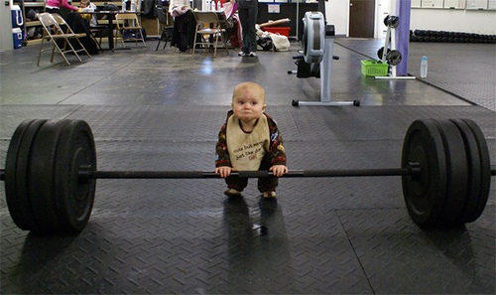
Regular Languages Lack Strength
How Languages are Defined: CFGs
Our RegEx-based scanner can emit a stream of tokens:
Char Stream
X
\t
Y
=
Z
+
EOF
Token Stream
ID: X
ID: Y
ASSIGN
ID: Z
PLUS
EOF
Cute, but weak
Observation: scanner ignores token order
Audience Q: Could you enforce construct order another RegEx?
Answer: Nope!
RegEx simply can’t capture all PL structures (e.g. parentheses nesting)

Slide 34

Defining Languages with Grammars
Syntactic Definition: How we use CFGs
A set of (recursive) rewriting rules to rewrite sequence of symbols
Any “completed” sequence represents a string in the language

Slide 35
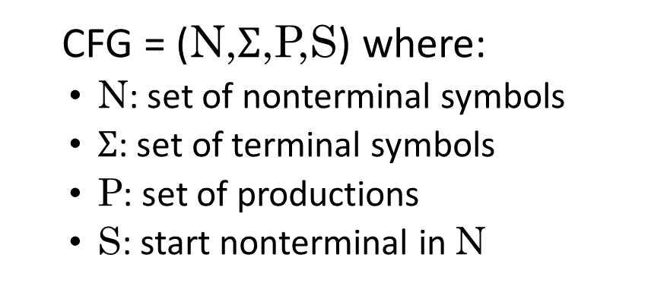
Defining Languages with Grammars
Syntactic Definition: How we use CFGs
A set of (recursive) rewriting rules to rewrite sequence of symbols
Any “completed” sequence represents a string in the language
CFG = (N,$Σ$,P,S) where:
  N: set of nonterminal symbols
  $Σ$: set of terminal symbols
  P: set of productions
  S: start nonterminal in N
Rules where
LHS: a single nonterminal symbol
RHS: a sequence of any symbols

Slide 36

Defining Languages with Grammars
Syntactic Definition: How we use CFGs
Example:
N = { A }
$Σ$ = { (, ) }
S = A
P $=\left\{\begin{aligned} P1: A →( A ) \\ P2: A → ε \end{aligned}\right\}$
CFG = (N,$Σ$,P,S) where:
  N: set of nonterminal symbols
  $Σ$: set of terminal symbols
  P: set of productions
  S: start nonterminal in N

Slide 37





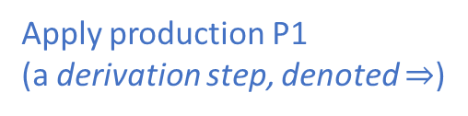

Defining Languages with Grammars
Syntactic Definition: How we use CFGs
Example:
N = { A }
$Σ$ = { (, ) }
S = A
P $=\left\{\begin{aligned} P1: A →( A ) \\ P2: A → ε \end{aligned}\right\}$
Producing a string
A
Begin with start symbol
$$A →( A )$$
Apply production P1
(a derivation step, denoted $⇒$)
$$( A )$$
Get a new symbol string
$$A →( A )$$
Apply production P1 again
$$( ( A ) )$$
Get a new symbol string
$$A →ε$$
Apply another production in P
$$( ( ) )$$
Get a new symbol string
All terminals, this string is in language
(a sentence)

Slide 38

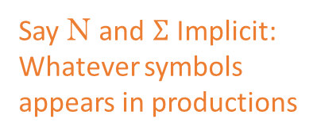
Simplifying Notation: Shorthand
Syntactic Definition: How we use CFGs
Example:
N = { A }
$Σ$ = { (, ) }
S = A
P $=\left\{\begin{aligned} P1: A →( A ) \\ P2: A → ε \end{aligned}\right\}$
Say N and $Σ$ Implicit:
Whatever symbols
appears in productions
Say S Implicit: LHS of top production
Collapse rules with
the same LHS
using bar
of context-free grammar notation

Slide 39
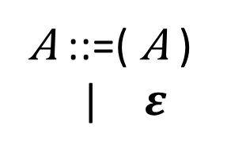
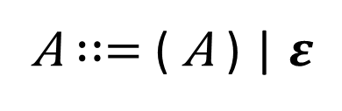
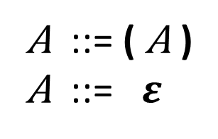
Simplifying Notation: Shorthand
Syntactic Definition: How we use CFGs
Example:
N = { A }
$Σ$ = { (, ) }
S = A
P $=\left\{\begin{aligned} P1: A →( A ) \\ P2: A → ε \end{aligned}\right\}$
Denote grammar as
Say N and $Σ$ Implicit:
Whatever symbols
appears in productions
A ::= ( A )
A ::= $ε$
Say S Implicit: LHS of top production
or equivalently as
A ::=( A )
| $ε$
Collapse rules with
the same LHS
using bar
or even
A $∷=$ ( A ) | $ε$

Slide 40
Simplifying Notation: Shorthand
Syntactic Definition: How we use CFGs
Denote grammar as
A ::= ( A )
A ::= $ε$
“BNF”
or equivalently as
A ::=( A )
| $ε$
or even
A $∷=$ ( A ) | $ε$

Slide 41
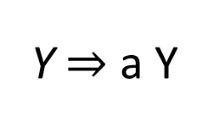
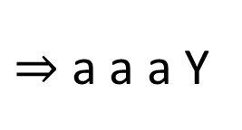
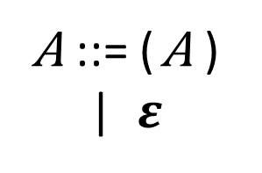
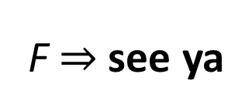
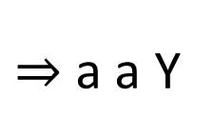
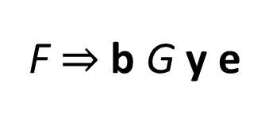
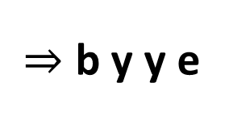
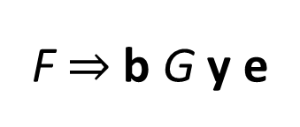
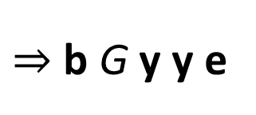
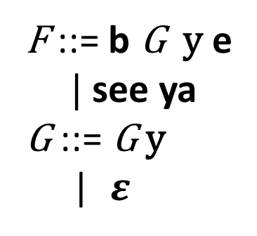
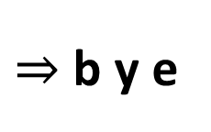

Some languages denoted in BNF
Syntactic Definition: How we use CFGs
A ::= ( A )
| $ε$
F b G y e
b y e
F ::= b G y e
| see ya
G ::= G y
| $ε$
F b G y e
b G y y e
b y y e
F see ya
Y ::= aY
Z ::= w t f
Y a Y
a a Y
a a a Y
…
Accepts no strings
(not even the empty string)

Slide 42

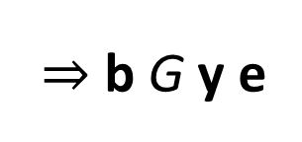
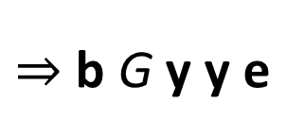
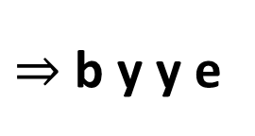
Parse Trees
Syntactic Definition: How we use CFGs
b G y e
b G y y e
b y y e
F
Represent Derivations
Nodes are symbols in a tree
Rooted at start symbol
Children are derivation step
Leaves are final string (if all nonterminals)
F
b
G
y
e
G
y
$$ε$$

Slide 43

CFG use in the Compiler
Syntactic Definition: How we use CFGs
Compile
Push Symbols

Slide 44
CFG use in the Compiler
Syntactic Definition: How we use CFGs
CFG for PL Syntactic Structure
Productions specify valid programs
Let the terminals be the tokens in the language
Let the nonterminals be the groupings that form language constructs
  (loops, statements, functions, calls, etc)
The grammar will recognize (or reject) the stream of tokens from the Lexer
Let’s see an example with this grammar
Productions
Prog ::= begin Stmts end
Stmts ::= Stmts semi Stmt
| Stmt
Stmt ::= id assign Expr
Expr ::= id
| Expr cross id

Slide 45
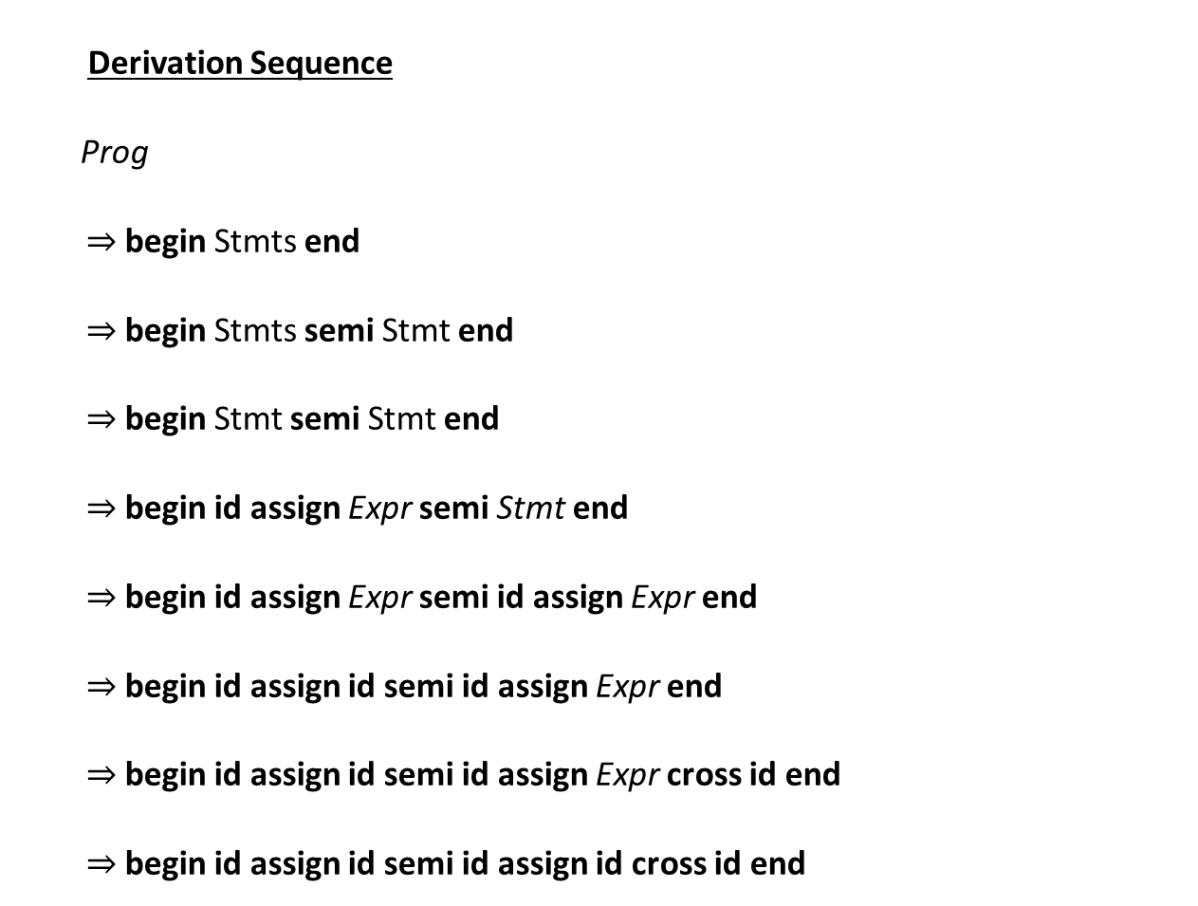
Parse Tree
Prog
Derivation Sequence
Prog
begin Stmts end
begin Stmts semi Stmt end
begin Stmt semi Stmt end
begin id assign Expr semi Stmt end
begin id assign Expr semi id assign Expr end
begin id assign id semi id assign Expr end
begin id assign id semi id assign Expr cross id end
begin id assign id semi id assign id cross id end
begin
Stmts
end
Prod. 1
Stmts
semi
Stmt
Prod. 2
Stmt
id
assign
Expr
Prod. 3
id
assign
Expr
Expr
cross
id
Prod. 4
id
id
Prod. 4
Productions
Prog ::= begin Stmts end
Stmts ::= Stmts semi Stmt
| Stmt
Stmt ::= id assign Expr
Expr ::= id
| Expr cross id
Prod. 5
Prod. 6
Prod. 5

Slide 46
End of Lecture
Syntactic Definition
Next Time
Parsing - Beyond specification for CFGs
Extracting the correct tree from a token stream
Time Permitting
Proof sketch: why RegExs can’t match PL constructs

