Slide 1
Check-In
Review: Compiler Overview
What is an example of an input to a C compiler that would cause a lexical analysis error?
What is an example of an input to a C compiler that would cause a syntactic analysis error?

Slide 2
Administriva
Housekeeping
Project 1
Out tonight
Add Flex rules for our language
Might want to find a project partner!

Slide 3
Administriva
Housekeeping
What should we call our language?

Slide 4
Survey Results
Housekeeping
Flipped Wednesdays?

Slide 5

2 – Implementing Scanners
KU | EECS 665 | Drew Davidson

Slide 6


Compiler Construction
Progress Pics
Currently working on lexical analysis concepts
Convert the character stream from the user into the token stream (the “words” of the programming language)
Scanner
Lexical analysis
Parser
Syntactic analysis
Semantic analysis
Intermediate code generation
IR optimization
Final Code generation
Final code optimization

Slide 7
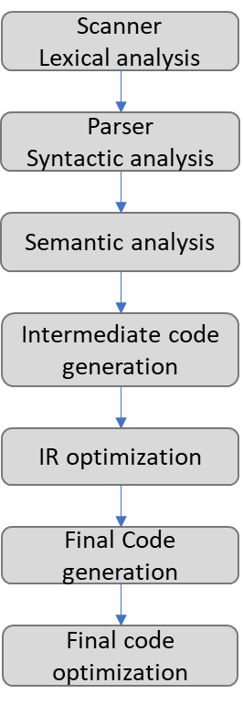
Last Time
Review: Compiler Overview
Introduced a definition of a compiler and its workflow
Used RegExs to specify languages of tokens
You Should Know
The phases of the compiler and what each step does
What errors the various phases catch
How to specify a token’s lexemes with a regex
Token
Integer Literal
RegEx
0|(1|2|…|9)(0|1|…|9)*

Slide 8
This Time
Lecture Outline – Implementing Scanners
From lexical definition to lexical recognition

Slide 9

Why the Regex Makes a Good Lexical Specification
Lecture Outline – Implementing Scanners
  Closed under…
    Concatenation
    Union
    Repetition
    Complementation
    …and more!
  Equivalent to DFAs
By Construction!

Slide 10


RegEx $≡$ DFA… So What?
RegEx Properties
This matters for implementation!

Slide 11
DFAs: Easy to Implement
RegEx Properties
DFA (Graph Depiction)
S
x
A
x,y
D
D
DFA (Successor Notation)
DFA (Array Implementation)
<Current state>,<Transition symbol> = <next state>
Row: current state
Column: transition symbol
Cell: next state
S,x = A
A,x = D
A,y = D
 | x | y
S | A
A | D | D
D

Slide 12
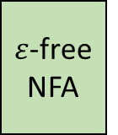
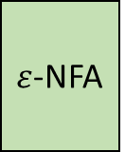

Lecture Overview
Lecture 2 – Implementing Scanners
Walk through the translation process formally
RegEx
$ε$-NFA
$ε$-free NFA
DFA
Thompson’s
Construction
Algorithm
$ε$-elimination
Rabin-Scott
Powerset
Construction

Slide 13


Key Concept
Thompson’s Construction Algorithm
Use an expression tree:
  Leaf: atomic operand
  Branch: operations joining subtrees
Expression Tree Examples
Arithmetic Expression
RegEx
1 $+2$ $×$ 3 $+$ 4
a|b*
Arithmetic Expression Tree
Expression Tree
+
low precedence
operators shallow
in the tree
|
1
+
a
*
$$×$$
4
NOTE:
high precedence
operators deep
in the tree
b
2
3

Slide 14
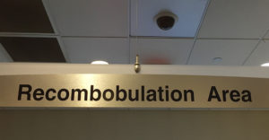
Thompson’s Construction Intuition
Thompson’s Construction Algorithm
Two-Step Process:
Break the RegEx down to the simplest units with “obvious” FSMs (i.e. expression tree leaves)
Combine the sub-FSMs according to operator rules (i.e. expression tree branch rules)
Recombobulate the Regex into an FSM piecewise

Slide 15


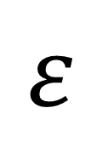
Thompson’s Construction Alg.
Build the RegEx Tree | Replace nodes bottom-up
Op | Precedence
* | High
concat | Medium
| | Low
(a|$ε$)(c|d|b)*
concat
|
*
(c|d|b)*
a | $ε$
a
$$ε$$
|
c|d|b
c
d|b
|
Apply rules bottom up:
- convert leaf nodes (RegEx operands) to DFAs
- combine branch nodes (RegEx operators) per operator
b
d

Slide 16

Thompson’s Construction Alg.
Build the RegEx Tree | Replace nodes bottom-up
Op | Precedence
* | High
concat | Medium
| | Low
(a|$ε$)(c|d|b)*
concat
|
*
(c|d|b)*
a | $ε$
a
$$ε$$
|
c|d|b
a
$$ε$$
S_{A}
A
S_{E}
A
A
E
c
d|b
|
c
S_{C}
A
C
Apply rules bottom up:
- convert leaf nodes (RegEx operands) to DFAs
- combine branch nodes (RegEx operators) per operator
b
d
d
b
S_{D}
A
S_{B}
A
D
B

Slide 17




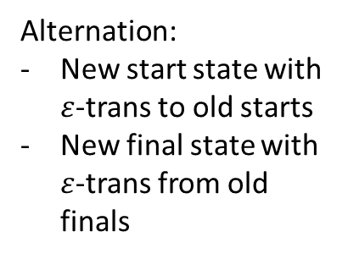

Thompson’s Construction Alg.
Build the RegEx Tree | Replace nodes bottom-up
Alternation:
New start state with $ε$-trans to old starts
New final state with $ε$-trans from old finals
(a|$ε$)(c|d|b)*
concat
|
*
(c|d|b)*
a | $ε$
|
c|d|b
a
$$ε$$
S_{A}
A
S_{E}
A
A
E
d|b
|
a
c
S_{A}
A
S_{C}
A
$$ε$$
$$ε$$
C
S
L
$$ε$$
$$ε$$
d
S_{E}
E
$$ε$$
b
S_{D}
A
S_{B}
A
D
B

Slide 18





Thompson’s Construction Alg.
Build the RegEx Tree | Replace nodes bottom-up
Alternation:
New start state with $ε$-trans to old starts
New final state with $ε$-trans from old finals
(a|$ε$)(c|d|b)*
concat
a
*
(c|d|b)*
a | $ε$
S_{A}
A
$$ε$$
$$ε$$
S
L
$$ε$$
$$ε$$
|
c|d|b
S_{E}
E
$$ε$$
d|b
|
c
S_{C}
A
C
d
b
S_{D}
A
S_{B}
A
D
B

Slide 19




Thompson’s Construction Alg.
Build the RegEx Tree | Replace nodes bottom-up
Alternation:
New start state with $ε$-trans to old starts
New final state with $ε$-trans from old finals
(a|$ε$)(c|d|b)*
concat
a
*
(c|d|b)*
a | $ε$
S_{A}
A
$$ε$$
$$ε$$
S
L
$$ε$$
$$ε$$
|
c|d|b
S_{E}
E
$$ε$$
d|b
c
S_{C}
A
d
C
S_{D}
D
$$ε$$
$$ε$$
S
A
M
$$ε$$
b
S_{B}
B
$$ε$$

Slide 20







Thompson’s Construction Alg.
Build the RegEx Tree | Replace nodes bottom-up
Alternation:
New start state with $ε$-trans to old starts
New final state with $ε$-trans from old finals
(a|$ε$)(c|d|b)*
concat
a
*
(c|d|b)*
a | $ε$
S_{A}
A
$$ε$$
$$ε$$
S
L
$$ε$$
$$ε$$
|
c|d|b
S_{E}
E
$$ε$$
c
S_{C}
C
$$ε$$
d|b
$$ε$$
c
d
A
S_{C}
A
d
N
C
D
S
S_{A}
A
$$ε$$
S_{D}
$$ε$$
$$ε$$
$$ε$$
$$ε$$
S_{M}
M
S
A
M
$$ε$$
b
$$ε$$
b
S_{E}
E
$$ε$$
S_{B}
B
$$ε$$

Slide 21







Thompson’s Construction Alg.
Build the RegEx Tree | Replace nodes bottom-up
Alternation:
New start state with $ε$-trans to old starts
New final state with $ε$-trans from old finals
(a|$ε$)(c|d|b)*
concat
a
*
(c|d|b)*
a | $ε$
S_{A}
A
$$ε$$
$$ε$$
S
L
$$ε$$
$$ε$$
S_{E}
E
$$ε$$
c
S_{C}
C
$$ε$$
$$ε$$
d
A
N
S
S_{A}
A
$$ε$$
$$ε$$
$$ε$$
S_{M}
M
$$ε$$
b
S_{E}
E
$$ε$$

Slide 22
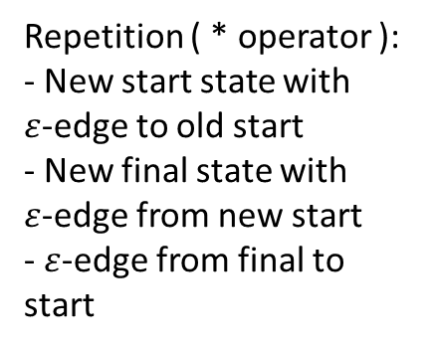
Thompson’s Construction Alg.
Build the RegEx Tree | Replace nodes bottom-up
Repetition ( * operator ):
- New start state with $ε$-edge to old start
- New final state with $ε$-edge from new start
- $ε$-edge from final to start
(a|$ε$)(c|d|b)*
concat
a
*
(c|d|b)*
a | $ε$
S_{A}
A
$$ε$$
$$ε$$
S
L
$$ε$$
$$ε$$
S_{E}
E
$$ε$$
c
S_{C}
C
$$ε$$
$$ε$$
d
A
N
S
S_{A}
A
$$ε$$
$$ε$$
$$ε$$
S_{M}
M
$$ε$$
b
S_{E}
E
$$ε$$

Slide 23























Thompson’s Construction Alg.
Build the RegEx Tree | Replace nodes bottom-up
Repetition ( * operator ):
- New start state with $ε$-edge to old start
- New final state with $ε$-edge from new start
- $ε$-edge from final to start
(a|$ε$)(c|d|b)*
concat
(c|d|b)*
a | $ε$
S_{A}
a
A
*
$$ε$$
$$ε$$
S
A
L
$$ε$$
$$ε$$
c|d|b
S_{E}
E
$$ε$$
$$ε$$
c
$$ε$$
S_{C}
C
A
N
c
$$ε$$
$$ε$$
S_{C}
C
N
d
S
S_{D}
D
$$ε$$
d
$$ε$$
$$ε$$
S
$$ε$$
S_{N}
S_{A}
A
$$ε$$
S_{M}
M
$$ε$$
$$ε$$
A
O
$$ε$$
b
S_{M}
M
S_{B}
B
$$ε$$
$$ε$$
b
S_{E}
E
$$ε$$
$$ε$$

Slide 24









Thompson’s Construction Alg.
Build the RegEx Tree | Replace nodes bottom-up
Repetition ( * operator ):
- New start state with $ε$-edge to old start
- New final state with $ε$-edge from new start
- $ε$-edge from final to start
(a|$ε$)(c|d|b)*
concat
(c|d|b)*
a | $ε$
a
A
c
$$ε$$
S_{A}
$$ε$$
$$ε$$
S_{C}
C
N
$$ε$$
S
A
d
$$ε$$
L
$$ε$$
S_{D}
D
$$ε$$
S
S_{C}
$$ε$$
$$ε$$
$$ε$$
A
S_{E}
E
$$ε$$
O
S_{M}
M
$$ε$$
b
S_{B}
B
$$ε$$
$$ε$$

Slide 25



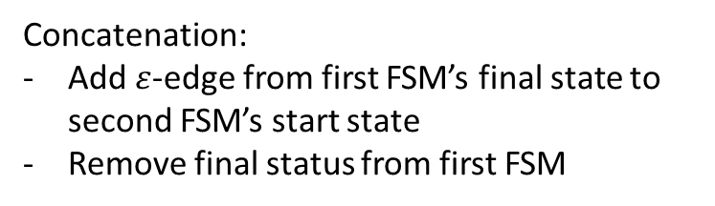
Thompson’s Construction Alg.
Build the RegEx Tree | Replace nodes bottom-up
Concatenation:
Add $ε$-edge from first FSM’s final state to second FSM’s start state
Remove final status from first FSM
(a|$ε$)(c|d|b)*
concat
(c|d|b)*
a | $ε$
a
A
c
$$ε$$
S_{A}
$$ε$$
$$ε$$
S_{C}
C
N
$$ε$$
S
A
d
$$ε$$
L
$$ε$$
S_{D}
D
$$ε$$
S
S_{C}
$$ε$$
$$ε$$
$$ε$$
A
S_{E}
E
$$ε$$
O
S_{M}
M
$$ε$$
b
S_{B}
B
$$ε$$
$$ε$$

Slide 26

Thompson’s Construction Alg.
Build the RegEx Tree | Replace nodes bottom-up
Concatenation:
Add $ε$-edge from first FSM’s final state to second FSM’s start state
Remove final status from first FSM
(a|$ε$)(c|d|b)*
concat
(c|d|b)*
a | $ε$
a
A
c
$$ε$$
S_{A}
$$ε$$
$$ε$$
S_{C}
C
N
$$ε$$
$$ε$$
S
L
d
$$ε$$
S_{O}
$$ε$$
S_{C}
S_{D}
D
$$ε$$
$$ε$$
$$ε$$
A
$$ε$$
S_{E}
E
$$ε$$
O
S_{M}
M
$$ε$$
b
S_{B}
B
$$ε$$
$$ε$$

Slide 27







Thompson’s Construction Alg.
Build the RegEx Tree | Replace nodes bottom-up
(a|$ε$)(c|d|b)*
c
$$ε$$
a
$$ε$$
S_{C}
C
N
S_{A}
A
$$ε$$
$$ε$$
$$ε$$
d
$$ε$$
S
L
S_{O}
$$ε$$
S_{C}
S_{D}
D
$$ε$$
$$ε$$
A
$$ε$$
O
$$ε$$
S_{E}
E
$$ε$$
S_{M}
M
$$ε$$
b
S_{B}
B
$$ε$$
$$ε$$

Slide 28

Thompson’s Construction: Side-Note
Build the RegEx Tree | Replace nodes bottom-up
The FSMs produced by Thompsons Construction are a little bit messy!
Clearly less efficient than what we would do by hand
Designed for ease of proofs
In practice, it’s easy to minimize FSMs later

Slide 29


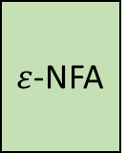

From RegEx to DFA
Lecture 2 – Implementing Scanners
RegEx
$ε$-NFA
$ε$-free NFA
DFA
Thompson’s
Construction
Algorithm
$ε$-elimination
Rabin-Scott
Powerset
Construction

Slide 30





Eliminating $ε$-transitions
Lecture 2 – Implementing Scanners
Observation: You never see an epsilon in the input
  Consuming a character means taking a “chain” of zero-or-more 𝜀-edges then a real character edge
Algorithm Intuition: cut out the middleman
  Replace all “chains” with a direct real-character edge
Input: a
S
S
$$ε$$
$$ε$$
1
2
a
$$ε$$
$$ε$$
2
3
b
a
b
a
a
S
S
3
4

Slide 31

Eliminating $ε$-transitions
Lecture 2 – Implementing Scanners
Compute $ε$-close(s), the set of states reachable via 0 or more $ε$-edges from s
Copy all states from N to an $ε$-free version, N’
Put s in F’ if $ε$-close(s) contains a state in F
Put s,c $→$ t in $δ$’ if there is a c-edge to t in $ε$-close(s)

Slide 32
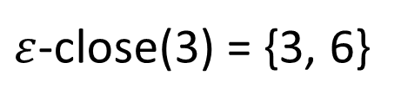
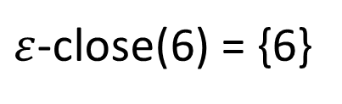

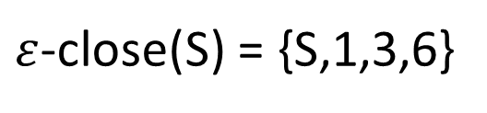
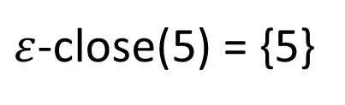

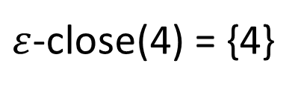

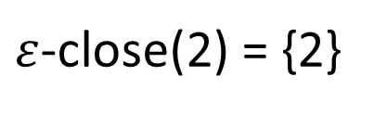

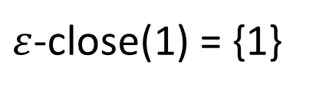
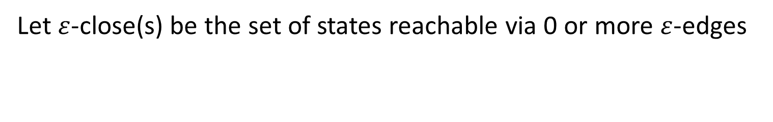
Example, Step I
Eliminating $ε$-Transitions
Let $ε$-close(s) be the set of states reachable via 0 or more $ε$-edges
6
$ε$-close(S) = {S,1,3,6}
$ε$-close(3) = {3, 6}
S
$$ε$$
$$ε$$
$ε$-close(1) = {1}
C
3
$ε$-close(2) = {2}
$$ε$$
x
$ε$-close(4) = {4}
1
4
x
$ε$-close(5) = {5}
x
x
$ε$-close(6) = {6}
2
x
5

Slide 33

Example, Step II
Eliminating $ε$-Transitions
  Copy all states from N to N’
6
6
$ε$-close(S) = {S,1,3,6}
$ε$-close(3) = {3, 6}
S
S
$$ε$$
$$ε$$
$ε$-close(1) = {1}
C
3
C
3
$ε$-close(2) = {2}
$$ε$$
x
$ε$-close(4) = {4}
1
4
1
4
x
$ε$-close(5) = {5}
x
x
5
$ε$-close(6) = {6}
2
2
x
5

Slide 34


Example, Step III
Eliminating $ε$-Transitions
  Put s in F’ if $ε$-close(s) contains a state in F
6
6
$ε$-close(S) = {S,1,3,6}
$ε$-close(3) = {3, 6}
S
S
S
$$ε$$
$$ε$$
$ε$-close(1) = {1}
C
3
C
3
$ε$-close(2) = {2}
$$ε$$
x
$ε$-close(4) = {4}
1
4
1
4
x
$ε$-close(5) = {5}
x
x
5
$ε$-close(6) = {6}
2
2
x
5

Slide 35


Example, Step IV
Eliminating $ε$-Transitions
  Put s,c $→$ t in $δ$’ if there is a c-edge to t in $ε$-close(s)
6
6
$ε$-close(S) = {S,1,3,6}
$ε$-close(3) = {3, 6}
S
S
S
$$ε$$
$$ε$$
$ε$-close(1) = {1}
C
3
C
3
$ε$-close(2) = {2}
$$ε$$
$$ε$$
x
$ε$-close(4) = {4}
x
1
4
1
4
x
$ε$-close(5) = {5}
x
x
x
5
$ε$-close(6) = {6}
2
2
x
5

Slide 36

Example, Step IV
Eliminating $ε$-Transitions
  Put s,c $→$ t in $δ$’ if there is a c-edge to t in $ε$-close(s)
6
6
$ε$-close(S) = {S,1,3,6}
$ε$-close(3) = {3, 6}
S
S
S
$$ε$$
$$ε$$
$$ε$$
C
$ε$-close(1) = {1}
3
C
x
3
$ε$-close(2) = {2}
$$ε$$
x
x
$ε$-close(4) = {4}
x
1
4
1
4
x
$ε$-close(5) = {5}
x
x
5
$ε$-close(6) = {6}
2
2
x
5

Slide 37
Example, Step IV
Eliminating $ε$-Transitions
  Put s,c $→$ t in $δ$’ if there is a c-edge to t in $ε$-close(s)
6
6
No edges out of 6!
$ε$-close(S) = {S,1,3,6}
$ε$-close(3) = {3, 6}
S
S
S
$$ε$$
$$ε$$
$ε$-close(1) = {1}
C
3
C
x
3
$ε$-close(2) = {2}
$$ε$$
x
$ε$-close(4) = {4}
x
1
4
1
4
x
$ε$-close(5) = {5}
x
x
5
$ε$-close(6) = {6}
2
2
x
5

Slide 38
Example, Step IV
Eliminating $ε$-Transitions
  Put s,c $→$ t in $δ$’ if there is a c-edge to t in $ε$-close(s)
Note: this definition necessarily preserves all original non-$ε$ edges
6
6
$ε$-close(S) = {S,1,3,6}
$ε$-close(3) = {3, 6}
S
S
S
$$ε$$
$$ε$$
$ε$-close(1) = {1}
C
3
C
x
3
$ε$-close(2) = {2}
$$ε$$
x
x
$ε$-close(4) = {4}
x
1
4
1
4
x
x
$ε$-close(5) = {5}
x
x
x
x
x
5
$ε$-close(6) = {6}
2
2
x
5

Slide 39

Example, Done!
Eliminating $ε$-Transitions
Can also remove unreachable “useless” state
6
6
=
S
S
S
$$ε$$
$$ε$$
C
3
C
x
3
$$ε$$
x
x
x
1
4
1
4
x
x
x
x
x
x
x
5
2
2
x
5

Slide 40




Example, Step IV
Eliminating $ε$-Transitions
  Put s,c $→$ t in $δ$’ if there is a c-edge to t in $ε$-close(s)
6
$ε$-close(S) = {S,1,3,6}
6
S
S
$$ε$$
$$ε$$
S
C
C
x
3
3
$$ε$$
x
x
1
4
x
1
4
x
x
x
x
x
x
x
5
2
x
5
2

Slide 41
From RegEx to DFA
Lecture 2 – Implementing Scanners
RegEx
$ε$-NFA
$ε$-free NFA
DFA
Thompson’s
Construction
Algorithm
$ε$-elimination
Rabin-Scott
Powerset
Construction

Slide 42
Recall: NFA Matching Procedure
Rabin-Scott Powerset construction
Successor
set of
states
NFA can “choose” which transition to take
  Always moves to states that leads to acceptance (if possible)
Simulate set of states the NFA could be in
  If any state in the ending set is final, string accepted
S,x = {S,A}
R,x = {D}
S,y = {S}
R,y = {D}
A,x = {R}
D,x = {}
A,y = {R}
D,y = {}
NFA
S
x
A
x,y
R
x,y
D
D
x,y
Input String
x
x
y
x
position
0
1
2
3
4
possible
states
S
S
S
S
S
A
A
A
R
D
R
D

Slide 43
From Successors to Powerset DFA
Rabin-Scott Powerset Construction
S,x = {S,A}
A,x = {R}
R,x = {D}
D,x = {}
S,y = {S}
A,y = {R}
R,y = {D}
D,y = {}
y
{S}
x
{S,A}
{S,A, R}
D
{S,D}
{S,A,R,D}
{A,R,D}
{S,D}
{S,R}
{S,A,D}
D
{A,R}
{S,D}
{S,A,D}
{S,R,D}
{S,D}
{A}
x,y
{R}
x,y
{S,D}
{A,D}
{D}
{R,D}

Slide 44
From Successors to Powerset DFA
Rabin-Scott Powerset Construction
S,x = {S,A}
A,x = {R}
R,x = {D}
D,x = {}
S,y = {S}
A,y = {R}
R,y = {D}
D,y = {}
{S,A}, x
= S,x U A,x
= {S,A} U {R}
y
= {S,A,R}
{S}
x
{S,A}
x
{S,A, R}
D
{S,D}
{S,A,R,D}
{A,R,D}
{S,D}
{S,R}
{S,A,D}
D
{A,R}
{S,D}
{S,A,D}
{S,R,D}
{S,D}
{A}
x,y
{R}
x,y
{S,D}
{A,D}
{D}
{R,D}

Slide 45
From Successors to Powerset DFA
Rabin-Scott Powerset Construction
S,x = {S,A}
A,x = {R}
R,x = {D}
D,x = {}
S,y = {S}
A,y = {R}
R,y = {D}
D,y = {}
{S,A}, y
= S,y U A,y
= {S} U {R}
y
= {S,R}
{S}
x
{S,A}
x
{S,A, R}
x
D
{S,D}
{S,A,R,D}
{A,R,D}
y
{S,D}
{S,R}
{S,A,D}
D
{A,R}
{S,D}
{S,A,D}
{S,R,D}
{S,D}
{A}
x,y
{R}
x,y
{S,D}
{A,D}
{D}
{R,D}

Slide 46
From Successors to Powerset DFA
Rabin-Scott Powerset Construction
S,x = {S,A}
A,x = {R}
R,x = {D}
D,x = {}
S,y = {S}
A,y = {R}
R,y = {D}
D,y = {}
y
x
{S}
x
{S,A}
x
{S,A, R}
x
D
{S,D}
{S,A,R,D}
{A,R,D}
x
y
y
y
x
x
{S,D}
{S,R}
{S,A,D}
x
D
{A,R}
{S,D}
{S,A,D}
{S,R,D}
y
y
{S,D}
{A}
x,y
{R}
x,y
{S,D}
{A,D}
{D}
{R,D}

Slide 47
Exponential State Count
Rabin-Scott Powerset Construction
How may states might the DFA have?
  2^{|Q|}
Why 2^{|Q|}?
S
A
D
S
x
A
x,y
D
0
0
0
{}
D
0
0
1
{D}
0
1
0
{A}
1
0
0
{S}
x,y
0
1
1
{A,D}
1
1
0
{S,A}
1
0
1
{S,D}
1
1
1
{S,A,D}

Slide 48
From RegEx to DFA
Lecture 2 – Implementing Scanners
RegEx
$ε$-NFA
$ε$-free NFA
DFA
Thompson’s
Construction
Algorithm
$ε$-elimination
Rabin-Scott
Powerset
Construction
DONE!
… or are we?

Slide 49
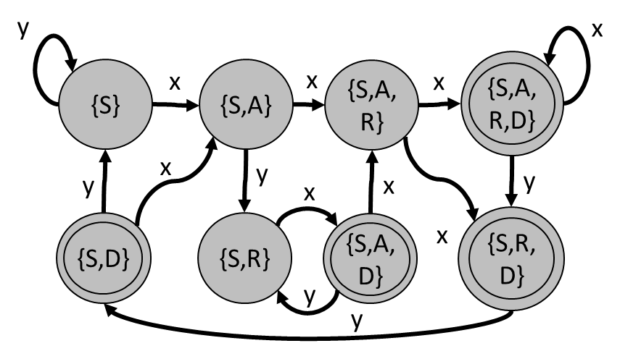




DFA $≠$ Tokenizer
Limitations
Finite automata only check for language membership of a string (recognition)
The Scanner needs to
  Break the input into many different tokens
  Know what characters comprise the token
input string
int a; b = 3 + 2;
DFA
recognition
or

Slide 50

DFA $≠$ Tokenizer
Limitations
Finite automata only check for language membership of a string (recognition)
The Scanner needs to
  Break the input into many different tokens
  Know what characters comprise the token
We need to go… beyond recognition
input string
int a; b = 3 + 2;
DFA
recognition
or

Slide 51
Next Time
Lecture 3 Preview
Source code in S (sequence of chars)
Lexical Definition
Lexical Recognition
Tokenization
Scanner
Lexical analysis
Next
Time
Syntactic Definition
Syntactic Recognition
Parsing
Parser
Syntactic analysis
Next
Time
(Soon)
(Soon)
Semantic analysis
Intermediate code generation
IR optimization
Final Code generation
Final code optimization
Output code in T

